Slide 1




Relative Carbapenem Use for a Burn ICU at an Academic Medical Center
Jacob Pierce PGY-3
Contributing authors:
Jacob Pierce, MD; Andrew Kirk; Emily Godbout, DO, MPH; John D. Markley, DO, MPH; Amy Pakyz PharmD, PhD; Kimberly Lee, PharmD; Andrew Noda PharmD; Michelle Doll, MD, MPH; Gonzalo Bearman, MD, MPH; and Michael P. Stevens, MD, MPH

Slide 2


Why focus on Carbapenems?
Above image from CDC Antibiotic threat report 2013

Slide 3
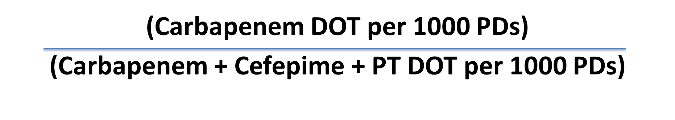
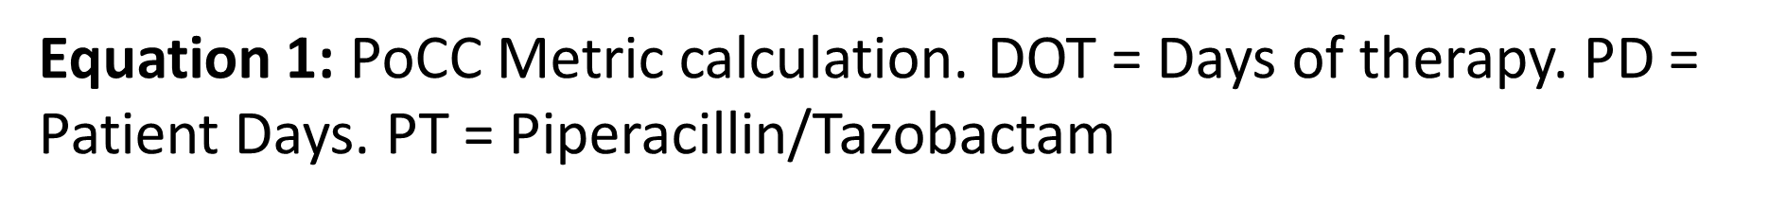
What is Proportional Consumption of Carbapenems (PoCC)?

Slide 4
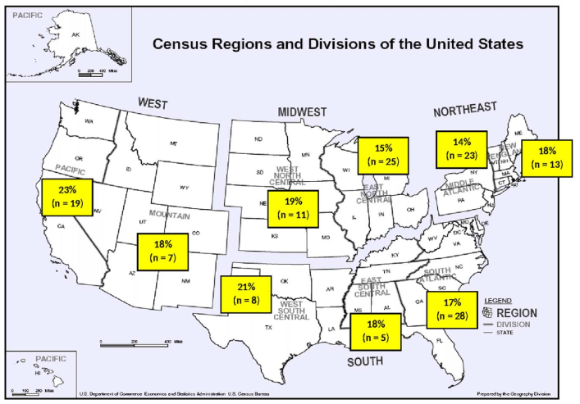
Background
Figure 1: Regional averages for PoCC in 2015.
Markley JD, Pakyz AL, Sabo RT, Bearman G, Hohmann SF, Stevens MP. Performance of a Novel Antipseudomonal Antibiotic Consumption Metric Among Academic Medical Centers in the United States. 2015;39(2).

Slide 5

Methods
We examined the PoCC for the burn unit at an academic medical center from August 2012-June 2018. Data were generated on a monthly basis.
Interrupted time series (ITS) analysis, which consists of an ordinary least squares regression modeling PoCC as a function of time trend (# of months since the beginning of the analysis period) and a binary ITS variable indicating the date meropenem orders became subject to FRPA at our institution, was utilized.

Slide 6
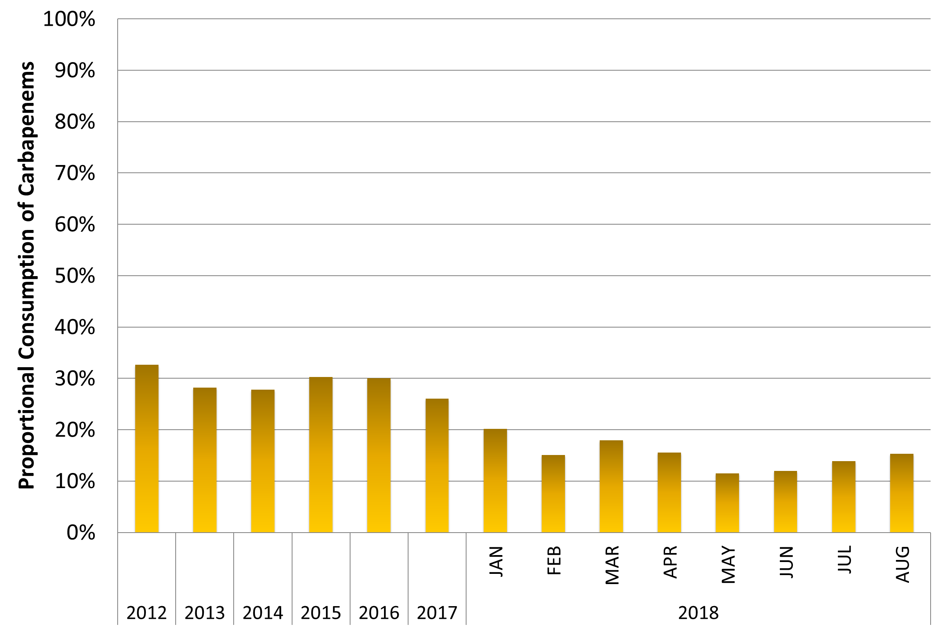
Results
Figure 2: Facility-wide mean PoCC from August 2012-August 2018.

Slide 7
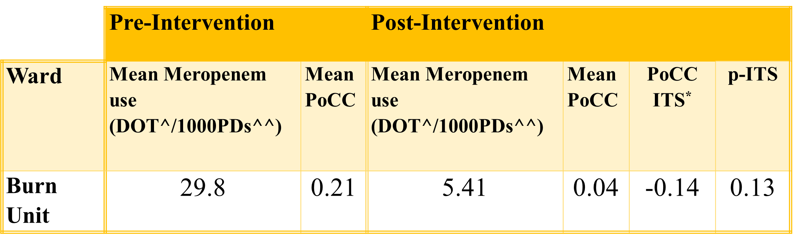
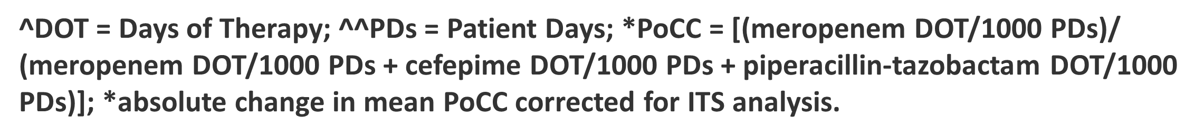
Results

Slide 8
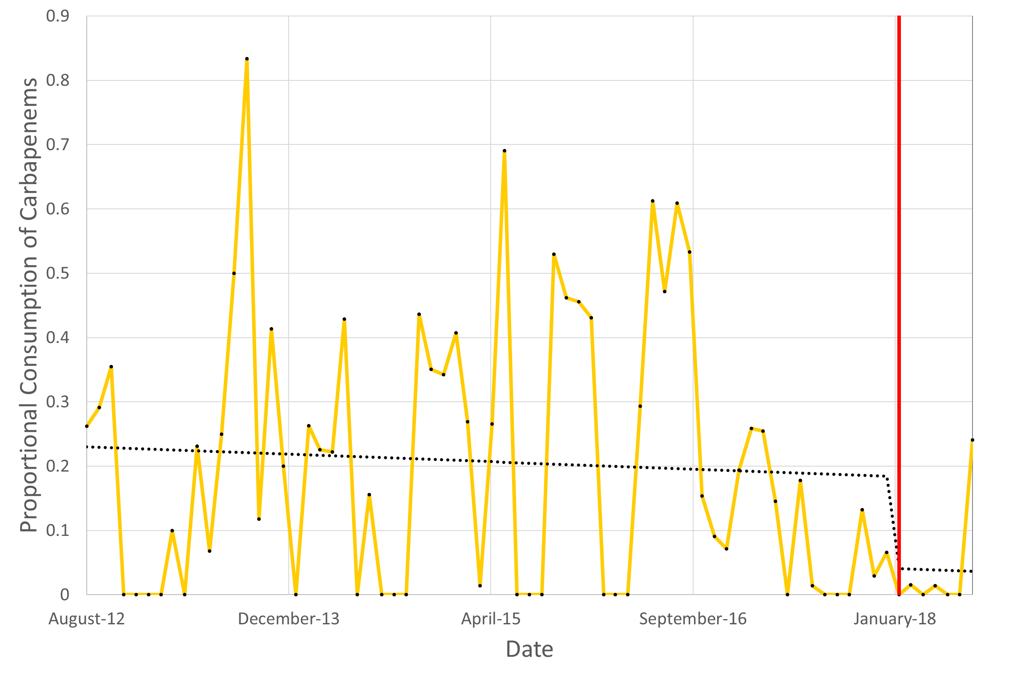
Results
Figure 1: Mean PoCC from Aug. 2012-Aug. 2018 with superimposed ITS trend (dotted line).
Red line indicates implementation of Formulary Restriction with prior authorization in February 2018.

Slide 9

Discussion
This is the first description of the PoCC metric for a dedicated Burn unit. We detected a decrease in PoCC after FRPA, but this did not achieve statistical significance.
The PoCC can contextualize relative carbapenem use and may be a useful antibiotic consumption metric. However, it does not provide data on absolute consumption.
Further studies are needed to determine the best use of the PoCC metric by Antimicrobial Stewardship Programs for Burn units.

Slide 10

Thank You!
Please forward questions/comments to Jacob.Pierce@vcuhealth.org.

