Slide 1
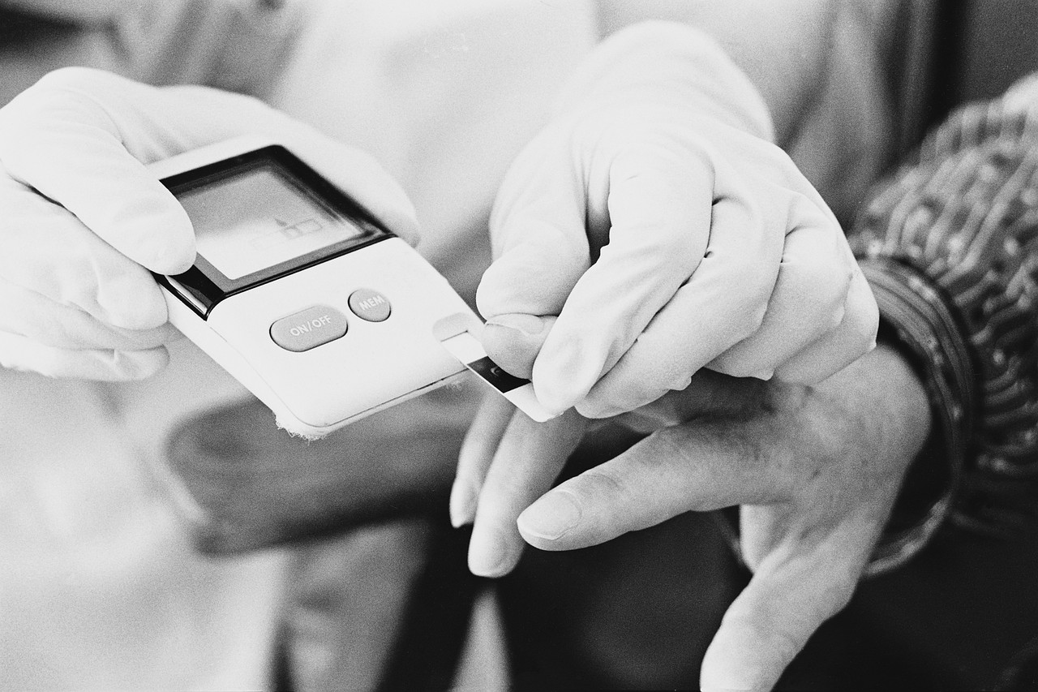
Safe Injection Practices and Safe Blood Glucose Monitoring Practices

Slide 2
Objectives
Define safe injection practices and explain what can happen if they are not followed
Discuss recent outbreaks of hepatitis in healthcare settings associated with unsafe injection practices
Discuss proper uses of single-dose and multi-dose vials
Highlight best practices when performing blood glucose monitoring (BGM) to reduce the risk of transmitting bloodborne pathogens
Discuss proper use and storage of fingerstick devices and blood glucose meters as well as appropriate insulin administration techniques

Slide 3
What Are Safe Injection Practices?
Safe injection practices are a set of measures to perform injections in an optimally safe manner for patients, healthcare providers, and others.
Part of the “standard precautions” that should be used on all patients/residents, in all settings, all the time.
Minimum infection prevention practices that apply to all patient care, regardless of the suspected or confirmed infection status of the patient, in any setting where healthcare is delivered.
2007 Guideline for Isolation Precautions: Preventing Transmission of Infectious Agents in Healthcare Settings: http://www.cdc.gov/hicpac/pdf/isolation/Isolation2007.pdf

Slide 4
What Can Happen When You Do Not Follow Safe Injection Practices?
Transmission of disease to patients
Patients at risk for bacterial, fungal, viral, and parasitic infections
>50 outbreaks in the U.S. since 2001
56% bacterial infections
44% viral hepatitis (hepatitis B, hepatitis C)
Notification of thousands of patients who have been exposed; recommendations to test
Referral of providers to licensing boards for disciplinary action
Malpractice suits filed by patients
COSTLY TO PATIENTS, PROVIDERS, and HEALTH DEPARTMENTS
Notes:
Unsafe injection practices put patients at risk for bacterial, fungal, viral, and parasitic infections.
Since 2001, at least 50 outbreaks involving unsafe injection practices were reported to CDC
90% (n=45) occurred in outpatient settings
56% bacterial, 44% viral hepatitis
Many hundreds of infected patients
Over 150,000 patients notified and tested
In the last decade, more than 150,000 patients in the United States were advised to get tested for hepatitis B virus (HBV), hepatitis C virus (HCV), and HIV due to the reuse of syringes and misuse of medication vials.

Slide 5
Bloodborne Pathogens
Unsafe injection practices can expose healthcare workers and/or patients/residents to viruses in the blood that can cause illness.
Hepatitis B virus (HBV)
Risk of transmission from needlestick: 6-31%
Hepatitis C virus (HCV)
Risk of transmission from needlestick: 1.8%
Human immunodeficiency virus (HIV)
Risk of transmission from needlestick: 0.3%
Notes:
These pathogens differ in the risk of infection following exposure.
If exposed to the blood of an infected person such as through a needlestick, the risk of transmission of hep B is 6-31%, hep C is 1.8% and HIV is ~0.3%.
Note – these pathogens also differ in how long they are viable on surfaces. Hepatitis B can be viable for at least 7 days on surfaces, while hep C is viable for at least 16 hrs, not longer than 4 days, and HIV is the least hearty – there have been no cases of transmission of HIV from environmental surfaces.

Slide 6
Hepatitis Outbreaks in Healthcare Settings: US, 2008-2012
Type of Hepatitis and Setting | Number of Outbreaks – US | Number of Outbreaks – VA | Notes
Hepatitis B – long-term care settings | 15 | 5 | All VA outbreaks were in assisted living settings
Hepatitis B – hospital | 1 | 1
Hepatitis B – other settings (dental clinic, oncology clinic) | 2 | * | Dental clinic outbreak occurred in another state, but VA residents were involved
Hepatitis B and C – pain clinic | 1 | 0
Hepatitis C (2 hospitals, 6 dialysis facilities, 7 outpatient clinics) | 16 | 0
TOTAL | 35 | 6
Notes:
Despite education, FDA alerts on the use of multiuse fingerstick devices (or penlets), and increased attention from licensing agencies around the nation, outbreaks have still occurred in recent years. Of the 29 hepatitis outbreaks in non-hospital settings in the US in the past four years, 4 occurred in Virginia ALFs and all involved transmission of hep B. An additional outbreak was in a West Virginia dental clinic but did have some VA residents who were among the ill.
Before this time period, there were other outbreaks in Virginia non-hospital settings including a hepatitis C outbreak in a dialysis facility – one specific cause for this outbreak wasn’t identified but environmental contamination likely played a role in transmitting hepatitis from chronically infected patients to other patients
The hospital case involved a HBV-infected orthopedic surgeon with high viral load performing exposure-prone procedures on patients

Slide 7
Virginia’s Hepatitis B Outbreaks in Assisted Living Facilities (2009-2012)
First 4 outbreaks (2009-2011) summarized in May 2013 MMWR article
All involved unsafe blood glucose monitoring practices:
Use of fingerstick devices for >1 resident
Use of blood glucose meter for >1 resident without proper cleaning and disinfection
Failure to use gloves and perform hand hygiene between fingerstick procedures
Two outbreaks were related:
Resident from facility A transferred to facility B, where there were improper infection control practices, leading to the spread of disease in facility B
35 total infections identified
Many other potentially exposed persons notified & tested
2012: additional HBV outbreak in an assisted living facility (3 cases)
http://www.cdc.gov/mmwr/preview/mmwrhtml/mm6119a3.htm
Notes:
>200 people vaccinated. Note that hep B vaccine uptake can be low in the elderly (30-50%) so although vaccination is a good prevention strategy, it is just one of many measures that should be in place to prevent disease.
2012 outbreak: Gaps in infection control identified. Poor overall cleanliness. Shared bathroom items. Shared reusable fingerstick device used on >1 resident during BGM

Slide 8
what do I need to know to follow safe injection practices?

Slide 9

Know Your Medication: Dates
Expiration date: Set by the manufacturer
Date after which an unopened vial (single-dose or multi-dose) should not be used. If the vial passes this date, throw it out.
Single-dose vials that have been opened/accessed should be discarded according to the manufacturer’s specified time or at the end of the procedure for which it is used, whichever comes first.
Beyond-use date: Applies only to multi-dose vials
Date after which an opened multi-dose vial should not be used.
If a multi-dose vial has been opened or accessed, a healthcare worker should date the vial and discard within 28 days after opening (unless the manufacturer specifies a different date for that opened vial).
Notes:
• If a multi-dose has been opened or accessed (e.g., needle-punctured) the vial should be dated and
discarded within 28 days unless the manufacturer specifies a different (shorter or longer) date for
that opened vial.
• If a multi-dose vial has not been opened or accessed (e.g., needle-punctured), it should be
discarded according to the manufacturer’s expiration date.
The manufacturer’s expiration date refers to the date after which an unopened multi-dose vial should not
be used. The beyond-use-date refers to the date after which an opened multi-dose vial should not be used.
The beyond-use-date should never exceed the manufacturer’s original expiration date.
• If a single-dose or single-use vial has been opened or accessed (e.g., needle-punctured) the vial
should be discarded according to the time the manufacturer specifies for the opened vial or at the
end of the case/procedure for which it is being used, whichever comes first. It should not be stored
for future use.
• If a single-dose or single-use vial has not been opened or accessed (e.g., needle-punctured),
it should be discarded according to the manufacturer’s expiration date.

Slide 10
Know Your Medication: Single-Dose Vials (SDV)
Approved for use on a SINGLE person for a SINGLE procedure or injection.
Typically lack an antimicrobial preservative.
Do NOT save or combine (“pool”) leftover medication from these vials – harmful bacteria can grow and infect a patient/resident.
Discard after EVERY use!
Notes:
Approved for use on a SINGLE patient for a SINGLE procedure or injection.
SDVs typically lack an antimicrobial preservative. Do not save left over medication from these vials. Harmful bacteria can grow and infect a patient.
DISCARD after every use! If expiration date has been reached but the vial has not been used, it should be discarded as well.

Slide 11
Know Your Medication: Multi-Dose Vials (MDV)
Recognized by its FDA-approved label.
Can be used for more than one person when aseptic technique is followed, but ideally used for only one person.
Typically contain an antimicrobial preservative to help limit growth of bacteria.
No impact on growth of bloodborne viruses.
Discard when the beyond-use date or expiration date has been reached or any time the sterility of the vial is in question!
If a multi-dose vial enters the immediate patient treatment area (e.g., patient’s room), it should be dedicated for use by that person only and discarded immediately after use.
Notes:
A MULTIPLE-DOSE VIAL (MDV) is recognized by its FDA-approved label.
Although MDVs can be used for more than one patient when aseptic technique is followed, ideally even MDVs are used for only one patient.
MDVs typically contain an antimicrobial preservative to help limit the growth of bacteria. Preservatives have no effect on bloodborne viruses (i.e. hepatitis B, hepatitis C, HIV).
Discard MDVs when the beyond-use date has been reached, doses are drawn in a patient treatment area, or any time the sterility of the vial is in question!

Slide 12
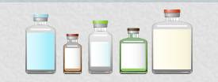
Size Does Not Matter!
Single-dose vials and multiple-dose vials can come in any shape and size.
Do not assume that a vial is a SDV or MDV based on size or volume of medication.
Always read the label.
Notes:
SDVs and MDVs can come in any shape and size. Do not assume that a vial is an SDV or MDV based on size or volume of medication.

Slide 13
Knowledge Check
True or False: Single-dose vials with large volumes that appear to contain multiple doses can be used for more than one person.
FALSE!
Single-dose vials should not be used for more than one person regardless of the vial size.

Slide 14
What are safe injection practices?

Slide 15
Safe Injection Practices
Use aseptic technique to avoid contamination of sterile injection equipment.
This term refers to a set of practices that are performed under carefully controlled conditions to minimize contamination by pathogens.
Injections should be prepared in a clean area free from contamination or contact with blood, body fluids, or contaminated equipment.
Aseptic technique includes:
Hand hygiene
Use of gloves and other personal protective equipment
Creation of a sterile field
Opening and introducing packages and fluids in a way that avoids contamination
Constant avoidance of contact with nonsterile items
Notes:
IV.H. Safe Injection Practices The following recommendations apply to the use of needles, cannulas that replace needles, and, where applicable, intravenous delivery systems: IV.H.1. Use aseptic technique to avoid contamination of sterile injection equipment. Category IA
- Injections should be prepared using aseptic technique in a clean area free from contamination or contact with blood, body fluids or contaminated equipment.
Aseptic technique is a set of specific practices and procedures performed under carefully controlled conditions with the goal of minimizing contamination by pathogens. The application of aseptic technique will vary by setting (for example, the practices will be more stringent in a surgical setting than in other settings).

Slide 16
Safe Injection Practices (cont’d)
Never administer medications from the same syringe to more than one person, even if the needle is changed.
After a syringe or needle has been used to enter or connect to a person’s IV, it is contaminated and should not be used on another person or to enter a medication vial.
Use fluid infusion and administration sets (i.e., IV bags, tubing, and connectors) for one person only and dispose appropriately after use.
Notes:
IV.H.2. Do not administer medications from a syringe to multiple patients, even if the needle or cannula on the syringe is changed. Needles, cannulae, and syringes are sterile, single-use items; they should not be reused for another patient nor to access a medication or solution that might be used for a subsequent patient. Category IA IV.H.3. Use fluid infusion and administration sets (i.e., intravenous bags, tubing, and connectors) for one patient only and dispose appropriately after use. Consider a syringe or needle/cannula contaminated once it has been used to enter or connect to a patient's intravenous infusion bag or administration set. Category IB

Slide 17
Knowledge Check
True or False: If you don't see blood in the IV tubing or syringe, it means that those supplies are safe for reuse.
FALSE!
Pathogens including hepatitis C virus, hepatitis B virus,
and HIV can be present in sufficient quantities to produce
infection without any visible blood. Syringes and fluid infusion and administration sets are for one person only.

Slide 18
Safe Injection Practices: Multiple-Dose Vials
Use single dose vials whenever possible.
If multiple-dose (“multi-dose”) vials must be used:
Designate to a single person whenever possible.
Both the needle and syringe used to access the vial must be sterile.
Do not keep multi-dose vials in the immediate patient/resident treatment area (e.g., patient’s room).
Store them in accordance with the manufacturer’s recommendations.
Discard vial if sterility is compromised or questionable.
Notes:
IV.H.4. Use single-dose vials for parenteral medications whenever possible. Category IA
IV.H.6. If multidose vials must be used, both the needle or cannula and syringe used to access the multidose vial must be sterile. Category IA IV.H.7. Do not keep multidose vials in the immediate patient treatment area and store in accordance with the manufacturer's recommendations; discard if sterility is compromised or questionable. Category IA
- Multi-dose vials to be used for more than one patient should be kept in a centralized medication area and should not enter the immediate patient treatment area (e.g,. operating room, patient room/cubicle).

Slide 19
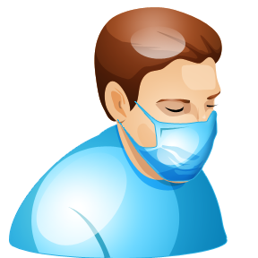
Safe Injection Practices (cont’d)
Do not give medications from single-dose vials to multiple people or combine leftover contents for later use.
Do not use bags or bottles of intravenous solution as a common source of supply for multiple people.
Wear a surgical mask when placing a catheter or injecting material into the spinal canal or subdural space.
Follow proper infection prevention practices during the preparation and administration of injected medications.
Notes:
IV.H.5. Do not administer medications from single-dose vials or ampules to multiple patients or combine leftover contents for later use. Category IA IV.H.8. Do not use bags or bottles of intravenous solution as a common source of supply for multiple patients. Category IB

Slide 20
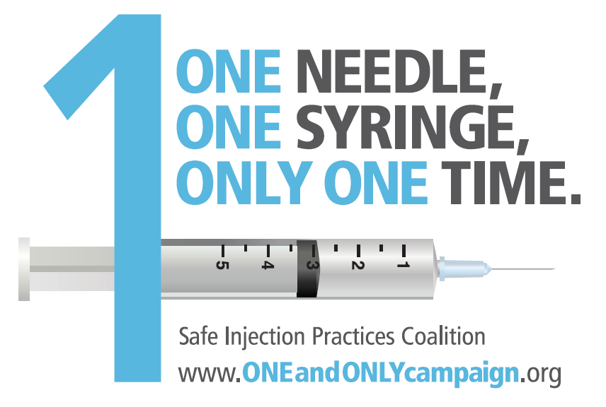
Notes:
The One and Only Campaign is a public health campaign aimed at raising awareness among the general public and healthcare
providers about safe injection practices.
Needles and syringes are used for only one patient (this includes manufactured prefilled syringes and cartridge devices such as insulin pens).

Slide 21
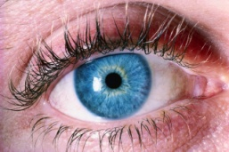
Before the Procedure
Carefully read the label of the medication vial.
Visually inspect the vial to ensure there is no visible contamination.
Is it single-dose?
If it has already been accessed (e.g., punctured by a needle), throw it away.
Is it multi-dose?
If so, double-check the expiration date and the beyond-use date if it was previously opened.
Discard if either of those dates has passed.
When in doubt, throw it out.

Slide 22
During the Procedure
Use aseptic technique.
Use a NEW needle and syringe for every injection.
Use a new needle and syringe even when obtaining additional doses for the same person.
Do not leave the needle in the medication vial septum if using the vial for multiple uses.
Clean your hands immediately before handling any medication.
Disinfect the medication vial by wiping the rubber septum with alcohol.
Notes:
Medication vials should be entered with a new needle and a new syringe, even when obtaining additional doses for the same patient.
A needle or other device should never be left inserted into a medication vial septum for multiple uses.

Slide 23
Where Should I Draw Up the Medication?
Draw up medications in a designated clean medication area that is not next to areas where potentially contaminated items are placed (like used needles, blood collection tubes, or other soiled equipment or materials).
Any item that could have come in contact with blood or body fluids should not be in the medication prep area.
If a multi-dose vial is used, it should not be kept or accessed in the immediate patient/resident treatment area.
This prevents accidental contamination of the vial.
If a multi-dose vial enters the immediate patient/resident area, it should be dedicated to that person only and discarded immediately after use.
Notes:
Where should I draw up medications?
Medications should be drawn up in a designated clean medication area that is not adjacent to areas where
potentially contaminated items are placed. Examples of contaminated items that should not be placed in or
near the medication preparation area include: used equipment such as syringes, needles, IV tubing, blood
collection tubes, needle holders (e.g., Vacutainer® holder), or other soiled equipment or materials that have
been used in a procedure. In general, any item that could have come in contact with blood or body fluids
should not be in the medication preparation area.
Can multi-dose vials be used for more than one patient? How?
Multi-dose vials should be dedicated to a single patient whenever possible. If multi-dose vials must be used for more than one patient, they should not be kept or accessed in the immediate patient treatment area. This is to prevent inadvertent contamination of the vial through direct or indirect contact with potentially contaminated surfaces or equipment that could then lead to infections in subsequent patients. If a multi-dose vial enters the immediate patient treatment area, it should be dedicated to that patient only and discarded after use.

Slide 24
After the Procedure
Appropriately discard all used needles, syringes, and SDVs after the procedure is over.
Store used MDVs appropriately.
Discard MDVs when:
The beyond-use date has been reached
Doses are drawn in a patient treatment area
Any time vial sterility is in question

Slide 25
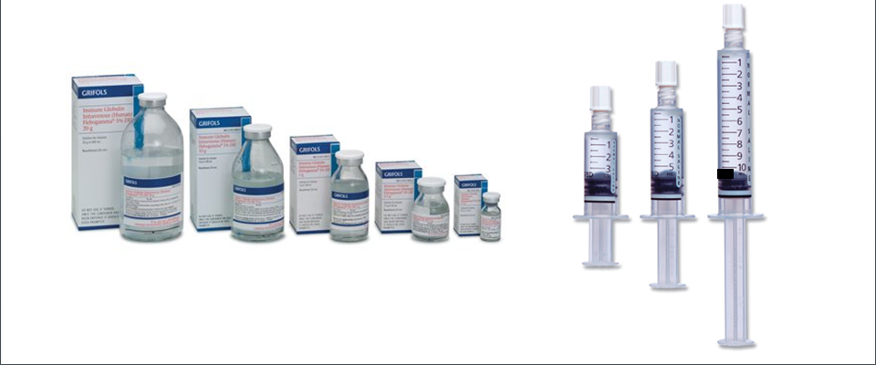
Take-Home Messages
Needles and syringes are single-use devices.
Do not administer medications from a single-dose vial or bag to multiple people.
Use right-sized vials and prefilled syringes.
Selecting the smallest vial necessary for the needs prevents waste and the temptation to use contents from SDVs on more than one patient.
Notes:
To prevent unnecessary waste or the temptation to use contents from single-dose or single-use vials for more than one patient, clinicians and purchasing personnel should select the smallest vial necessary for their needs when making treatment and purchasing decisions.

Slide 26
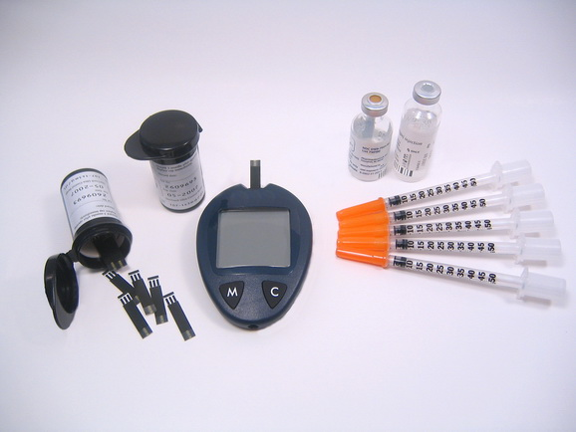
Safe Injection Practices: Spotlight on Safe Blood Glucose Monitoring and Insulin Administration

Slide 27
Person-to-Person Transmission of Bloodborne Viruses During Blood Glucose Monitoring
Susceptible Persons
Infected with Agent (ex. Hep B)
We want to prevent the contamination of equipment/supplies to prevent the spread of disease
Contaminated Equipment/Supplies
Notes:
Exposure to bloodborne pathogens can occur during blood glucose monitoring if unsafe practices are used
Possibility for exposure to staff member performing the procedure as well as patient or resident receiving blood glucose monitoring.

Slide 28
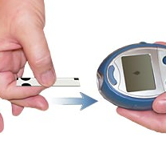
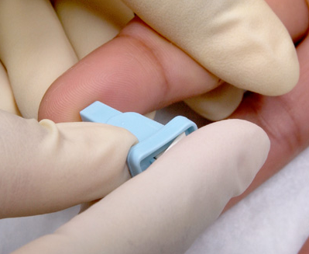
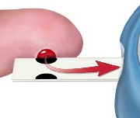
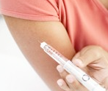
Blood Glucose Monitoring (BGM)
Blood glucose monitoring is the regular testing of the level of sugar (glucose) in the blood. It is part of the ongoing care for people with diabetes.
BGM involves:
Inserting a test strip into a blood glucose monitor
Drawing blood with a fingerstick device
Applying blood to a test strip and placing it in the blood glucose monitor
Obtaining a reading (glucose level) from the blood glucose monitor
Administering insulin as needed

Slide 29
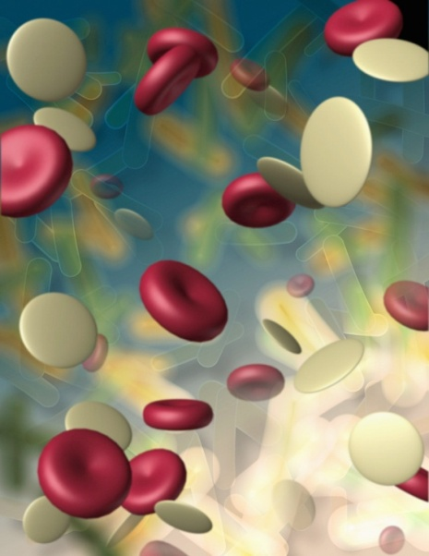
Fingerstick Devices
Use a lancet to prick the skin to get drops of blood for testing
Two types of devices
Single-use devices
Reusable devices

Slide 30
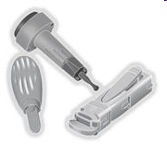
Fingerstick Devices: Single-Use
Disposable
Go into sharps container
Prevent reuse through auto-retracting feature
Appropriate for situations and settings where assisted monitoring of blood glucose is performed
“Assisted monitoring” means that a patient or resident needs help performing BGM and cannot do it independently (by themselves)
Single-Use Fingerstick Device
Source: CDC
Select single-use devices that permanently retract upon puncture
Notes:
Main item to highlight is that auto-retracting lancets prevent reuse.

Slide 31
Fingerstick Devices: Reusable
Often resemble a pen (“penlet”)
In general, use not recommended:
Failure to change disposable pieces
New lancet is required every time the device is used
Failure to clean and disinfect properly
Linked to multiple HBV outbreaks (including in Virginia)
Risk for occupational needlesticks
Only appropriate for people who are able to perform BGM independently and do not require assistance
Reusable Fingerstick Device. Source: CDC
Notes:
Cleaning is important because hepatitis viruses can remain viable for days on surfaces (hepatitis B is up to 7 days).
Often find that we open penlet devices and they still have lancets loaded in them. This is a never event
Dried blood is often visible on the penlet
Linked with outbreak b/c of lack of understanding of the infection control processes for using penlets between residents. Also allows for “lazy” employee syndrome—it is just easier to stick everyone with the same penlet. But, this practice greatly increases chance of a large outbreak. Also find that if residents have different penlet styles which require different lancet styles. If the facility runs out of lancets, they will use another’s penlet for BGM.
The design of the penlet itself can lead to a risk for occupational needlestick…the staff member needs to remove the lancet after sticking the resident and some of them can be really dangerous..like a flip top version, you can easily cut your thumb on the lancet when you flip it open to remove the lancet…
And not only change the lancet, but perform cleaning step.
Because of the potential for misuse and the ease with which HBV can be transmitted by sticks, penlets should NOT be used with assisted BGM practices.

Slide 32
Fingerstick Devices: Recommended Practices for Reusable Devices
Restrict use to individual persons who do not require assistance with monitoring their blood glucose
Never share reusable devices between persons
Clearly label any fingerstick device designed for reuse on a single person
Label with individual patient/resident’s name
Store in a secure area such as a locked cabinet or medication cart
Dispose of used lancets at the point of use in an approved sharps container
Do not overfill sharps container!
Notes:
It is imperative to be vigilant and not use a fingerstick device on the wrong resident or to share devices.
In facilities, residents usually have different penlet styles which require different lancet styles. If the facility runs out of lancets, they often use another’s penlet for BGM and this should not happen.

Slide 33
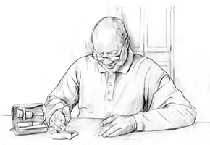
Blood Glucose Monitors
Also known as glucometers
Instant feedback on the individual’s blood glucose level
When possible, assign blood glucose monitors to an individual person; do not share
Clean and disinfect monitor, even if not shared
Label device with patient/resident’s name and store in a secure place such as a locked cabinet
Source: NIDDK/NIH
Notes:
All supplies and equipment and medications should be stored in clean areas separate from used supplies and equipment. All individual equipment (glucose meters) should labeled with the resident’s name and stored in a secure place (medication cart, locked cabinet).
Similar issue with glucometers and penlets with regards to availability or running out of supplies. There are different styles of glucometers and some require different meter strip sizes. If the facility runs out of strips or if a device malfunctions, they will use another resident’s supposedly “dedicated” glucometer to check the blood sugar level.

Slide 34
Sharing Blood Glucose Monitors Effectively
If sharing is necessary, clean and disinfect the monitor after every use, per manufacturer’s instructions
If the manufacturer does not specify how the monitor should be cleaned and disinfected, then it should not be shared.
Manufacturer’s cleaning instructions are included in the glucometer’s packaging.
Example of how to effectively share two glucometers
Alternate use of monitors between patients/residents so that sufficient “kill time” elapses between cleaning/disinfecting.
Notes:
Shared items tend to be larger, commercial style glucometers like you would see in medical settings as opposed to the smaller, personal style glucometers.

Slide 35
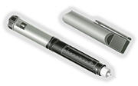
Insulin Pens
Pen-shaped injector devices for insulin
Contains an insulin reservoir or cartridge; an individual usually self-injects several doses of insulin before the reservoir is empty
The needle is changed in the insulin pen before each injection
Assign to individuals and label appropriately
Never share insulin pens between people
Should be used only by individuals who are able to administer insulin and change the pen needle independently.
CDC clinical reminder regarding use of insulin pens – January 2012
“Use of insulin pens for more than one person, like other forms of syringe reuse, imposes unacceptable risks and should be considered a ‘never event’.”
Insulin Pen, Source: CDC

Slide 36
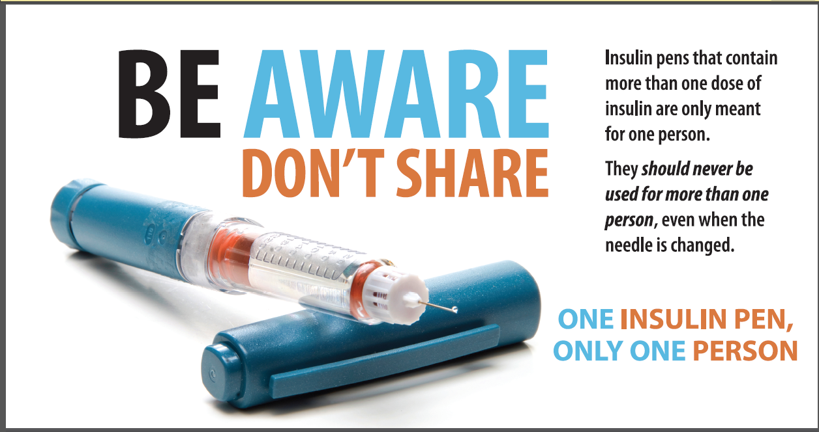

Slide 37
Multi-Dose Vials: Insulin Administration
Dedicate to a single person
Do NOT borrow insulin from another person’s vial
Always puncture the vial with a new needle and new syringe for each dose
Never reuse needles or syringes
Do not recap needles
Do not carry insulin or other supplies in your pocket
Make sure an approved sharps container is available
Place used sharps in sharps container immediately
Notes:
Have witnessed recapping of needles during outbreak investigations. This puts the staff member at great risk.
Practice that has been observed: Staff member wandering down the hall with a used needle – should have disposed of this immediately!

Slide 38

Blood Glucose Monitoring:
UNSAFE Practices
Using fingerstick devices for more than one person
Using a blood glucose meter for more than one person without cleaning and disinfecting it between uses per manufacturer’s instructions
Using insulin pens or multi-dose insulin vials for more than one person
Failing to change gloves and perform hand hygiene between fingerstick procedures
Notes:
Insulin pens, multidose insulin vials, or ANY injection equipment
As well as other breaches in hand hygiene – we’ll talk about those more later…

Slide 39
Blood Glucose Monitoring: SAFE Practices
Consider fingerstick devices and glucometers contaminated equipment
Do not put supplies down on bedside table, soft bedding, etc.
Use a “clean field”, such as a paper towel on a medication cart, to contain the equipment.
Change the clean field between residents even if there is not visible blood.
Have all supplies easily accessible (sharps container, Band-Aids to contain blood, etc.)
Apply pressure and/or Band-Aids/gauze to stop any bleeding
Notes:
The facility should think through the process of where to perform BGM and administer insulin. Make sure that a culture of safety for protection of healthcare workers is established to prevent spills, sticks, etc. before instituting this procedure. A lot depends on where they do this procedure.
The “clean field” needs to be changed between residents even if there is not visible blood. Outbreak observation where the facility used the same paper towel for each resident's BGM equipment before and after use and each resident placed his/her hand on this paper towel.)
Staff should observe the site of finger puncture for bleeding before letting the resident walk away. Band-Aids are hard to place over fingers, and light pressure with a gauze pad may be necessary. Lots of these residents may be on aspirin therapy or other blood thinner products so they may “bleed” easily thus drips of blood could occur. It is easy to want to push through and get a line of residents done and plans need to include observation time for this step.

Slide 40
Hand Hygiene, Glove Use, & Disease Transmission
Hands can become contaminated with blood while performing BGM
Pricking patient/resident’s finger
Handling test strip
Blood can be transferred back to the glucometer when handled to obtain reading
If glucometer not cleaned and disinfected after use, blood and virus particles remaining can be transferred to next person via care provider’s hands

Slide 41
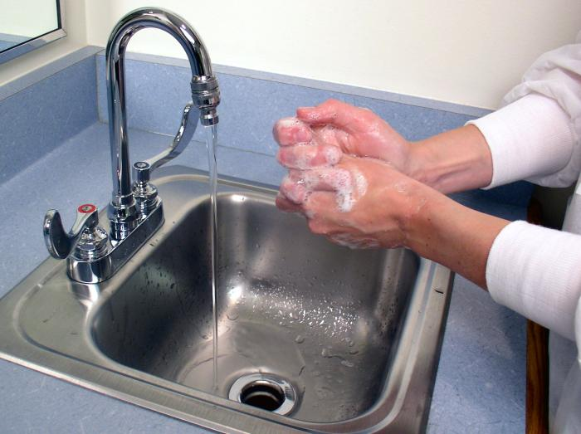
Hand Hygiene and BGM
Perform hand hygiene:
Before putting on gloves prior to procedure
Immediately after glove removal
Between residents receiving assisted BGM
Use soap and water or an alcohol-based hand rub (ABHR)
Use ABHR according to manufacturer’s recommendations; do not over-use
- May need to wash hands after 5-10 uses of ABHR
Notes:
Remember, there are many other times when hand hygiene should be performed as well!
Use hand sanitizer according to manufacturer’s instructions; many require a thorough hand washing after ever 5-10 uses of gel.

Slide 42
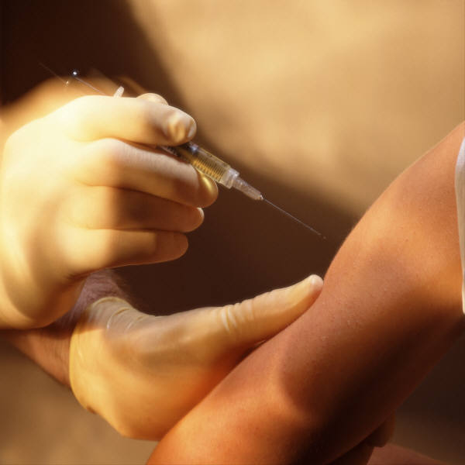
Hand Hygiene and Gloves
Wear gloves during:
Blood glucose monitoring
Insulin administration
Any procedures where contact with blood or body fluids might occur
Change gloves:
Between patient/resident contacts
After touching fingerstick wounds or potentially contaminated objects/equipment
Before touching clean surfaces
Discard gloves in appropriate receptacles – do not keep in pocket!
Notes:
Ex. grabbing for med cart supplies after a fingerstick…still wearing old gloves
** failure to change gloves before touching clean surfaces is a practice that has been observed many times by VDH staff during investigations

Slide 43
Align Policies and Practices
Assure that existing policies reflect latest recommendations and guidance
Monitor what practices are occurring in the facility
Consistent with policy?
Use of reusable fingerstick devices introduces potential for misuse even if policy follows best practices
Train new staff based on policy, not what other staff have been doing
Notes:
Accidents can always happen with single-use devices too (acc. needlestick), but much less of a possibility than with a reusable device/penlet.
Role of the administrator/nursing administration to make sure that staff are monitored and appropriate practices are followed.

Slide 44
Recap: BGM Best Practices
Fingerstick devices should never be used for more than one person
Select single-use devices that permanently retract upon puncture
Dedicate blood glucose meters to a single patient/resident if possible
If shared, the device should be cleaned and disinfected after every use, per manufacturer’s instructions
Insulin pens and other medication cartridges and syringes are for single-use only and should never be used for more than one person
Use available resources from the Virginia Department of Health, CDC, and the Safe Injection Practices Coalition to educate staff on blood glucose monitoring and safe injection practices

Slide 45
Notes:
This slide has two posters from the Successful Strategies for Infection Prevention in Assisted Living Facilities and Nursing Homes toolkit emphasizing the safe practices and the differences between single-use and reusable fingerstick devices.

Slide 46
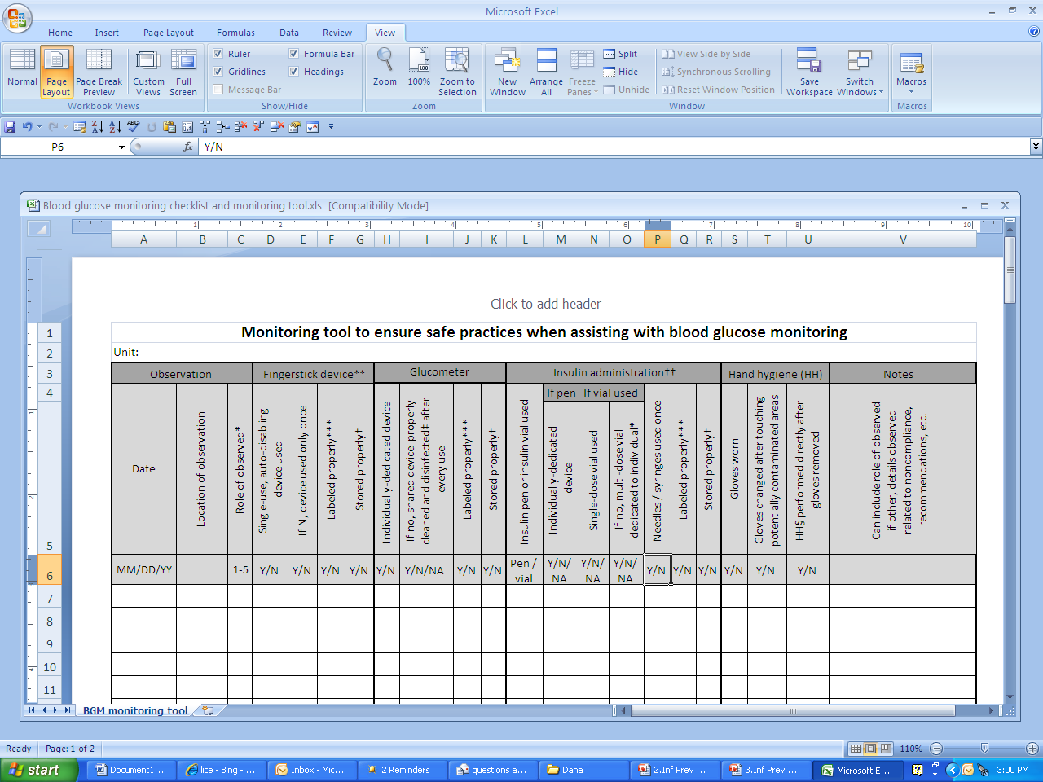
VDH-Developed Tool for Assessing Compliance with BGM Practices
Notes:
This slide has a screenshot of the blood glucose monitoring tool developed by the HAI program. One staff member would observe the person conducting the blood glucose monitoring and make sure that all of the appropriate steps are followed – correct fingerstick device, glucometer, and insulin administration procedures? Appropriate hand hygiene?

Slide 47
Resources
Virginia Department of Health
Safe Injection Practices and Bloodborne Pathogen Prevention webpage
www.vdh.virginia.gov/surveillance/epidemiology/hai/SafeInjection.htm
Infection Prevention Toolkit for Assisted Living Facilities and Nursing Homes
http://www.vdh.virginia.gov/epidemiology/surveillance/hai/longterm.htm#Assisted
Centers for Disease Control and Prevention
HICPAC Guidelines: 2007 Guideline for Isolation Precautions: Preventing Transmission of Infectious Agents in Healthcare Settings
http://www.cdc.gov/hicpac/pdf/isolation/Isolation2007.pdf
Healthcare-Associated Hepatitis B and C Outbreaks Reported to CDC in 2008-2012 http://www.cdc.gov/hepatitis/Outbreaks/HealthcareHepOutbreakTable.htm
Infection Prevention during BGM and Insulin Administration webpage
http://www.cdc.gov/injectionsafety/blood-glucose-monitoring.html
Safe Injection Practices Coalition
One and Only Campaign
http://oneandonlycampaign.org/
Safe Injection Practices FAQs
http://www.oneandonlycampaign.org/sites/default/files/upload/pdf/Injection%20Safety%20FAQs%20%282%29%20FINAL_0.pdf

Slide 48
Post-Test: True or False
Standard precautions are a set of infection prevention measures that are used only on patients who are known to have an infectious disease.
It is acceptable to use the same syringe to give an injection to more than one patient if you change the needle between patients.
It is acceptable to leave a needle inserted in the septum of a medication vial if you are using the vial for multiple medication draws.
Notes:
1. FALSE. Standard precautions should be used on all patients/residents, in all settings, all the time, regardless of the suspected or confirmed infection status of the patient.
2. FALSE. Once they are used, the syringe and needle are both contaminated and must be discarded. Use a new
sterile syringe and needle for each patient.
3. FALSE. A needle or other device should never be left inserted into a medication vial septum for multiple uses. This provides a direct route for microorganisms to enter the vial and contaminate the fluid.

Slide 49
Post-Test: True or False
4. Fingerstick devices should never be used on more than one person.
It is appropriate for a person who requires assistance with blood glucose monitoring to use a reusable fingerstick device or an insulin pen.
Blood glucose monitors only need to be cleaned when they are visibly dirty.
Unsafe injections put patients at risk for the transmission of bacteria, viruses, fungi, or parasites.
Notes:
4. TRUE. Even reusable fingerstick devices are meant to be used on one person only.
5. FALSE. Both of these devices are appropriate only for patients/residents who do NOT require assistance by another person.
FALSE. Blood glucose monitors should be cleaned and disinfected after each use, especially if shared.
TRUE. Any of these types of organisms can be transmitted as a result of unsafe injection practices.

Slide 50
Post-Test: True or False
If a single-dose vial has been accessed, it is okay to re-use as long as there is no visible contamination.
A used syringe can be kept in a healthcare worker’s pocket until he/she has time to dispose of it in a sharps container.
Unsafe injection practices can occur in any healthcare setting.
Notes:
8. FALSE. A single-dose vial is for one use only and should be discarded after it has been accessed.
9. FALSE. Used injection equipment should be disposed of immediately afterward.
10. TRUE. Any setting that delivers injections can have unsafe injection practices, if the staff do not follow appropriate procedures.

