Slide 1

Vizient Database as a Surrogate Marker for Appropriate Use
Barry Rittmann MD, MPH PGY-VI
Hospital Epidemiology and Infection Control Fellow

Slide 2
Antibiotic Misuse
Antibiotic misuse is a growing concern both in the US and globally.
In one 2016 JAMA study, 30.2% of prescriptions were found to be inappropriate.
Increase rates of broad spectrum administration have also been noted.
Monitoring of antibiotic consumption is imperative to identifying potential inappropriate use.

Slide 3
Monitoring Antibiotic Consumption
Tracking antibiotic use (AU) has been identified in one of the 7 core elements of a successful Antibiotic Stewardship Program
Typically, these metrics are measured in either days of therapy (DOT), or defined daily dose (DDD)
  DOT: aggregate sum of days a specific antimicrobial agent is administered
    Can be standardized by dividing by patient*days (PD)
  DDD: The assumed average maintenance dose per day for a drug used for its main indication in adults
The CDC has worked to develop metrics to help institutions monitor antibiotic utilization, compared to national averages

Slide 4
Standardized Antimicrobial Administration Ratio
NHSN calculated ratio assessing aggregated AU data
Observed to Predicted Ratio (O/E)
  Observed: DOT reported by a healthcare facility for a category of antimicrobial agent
  Predicted: DOT predicted based on nationally aggregated AU data
5 Categories of Antibiotic Agent Categories
  Broad spectrum agents used for MDR/HA infections
  Broad spectrum agents for community-acquired infections
  Anti-MRSA agents
  Agents used for surgical site prophylaxis
  All antibiotic agents
Indirect standardization method for comparing O/E DOT

Slide 5
Standardized Antimicrobial Administration Ratio
Locations of SAAR use
  Adult Medical, Medical/Surgical, and Surgical ICUs
  Adult Medical, Medical/Surgical, and Surgical Wards
  Pediatric Medical, Medical/Surgical, and Surgical ICUs
  Pediatric Medical, Medical/Surgical, and Surgical Wards
A SAAR <1 represents less than predicted antibiotic use
A SAAR >1 represents greater than predicted antibiotic use
The SAAR is not a definitive test of appropriateness

Slide 6
Limitations of the SAAR
Cannot calculate SAAR for oncology wards, step down units, and emergency departments
A small percentage of US hospitals currently submit AU to NHSN
  Limits generalizability of SAAR
  AU contributions are increasing, and should improve over time
Must be able to submit AU to NHSN
Calculated by NHSN
Not able to to target specific antimicrobial agents

Slide 7
What is the Vizient Network Database?
A peer-to-peer networking database
>95% of academic medical centers, and >50% of acute care systems, and >20% of the nations ambulatory markets
Allows for the comparison of multiple metrics of like organizations, from resource utilization to hospital length of stay to morbidity and mortality parameters
  Days of Therapy Per Patient*Days
This can act as a surrogate marker for a standardized ratio of use
  Would look at hospitals of similar geography and patient complexity
  Would better account for acuity of care than the general population

Slide 8
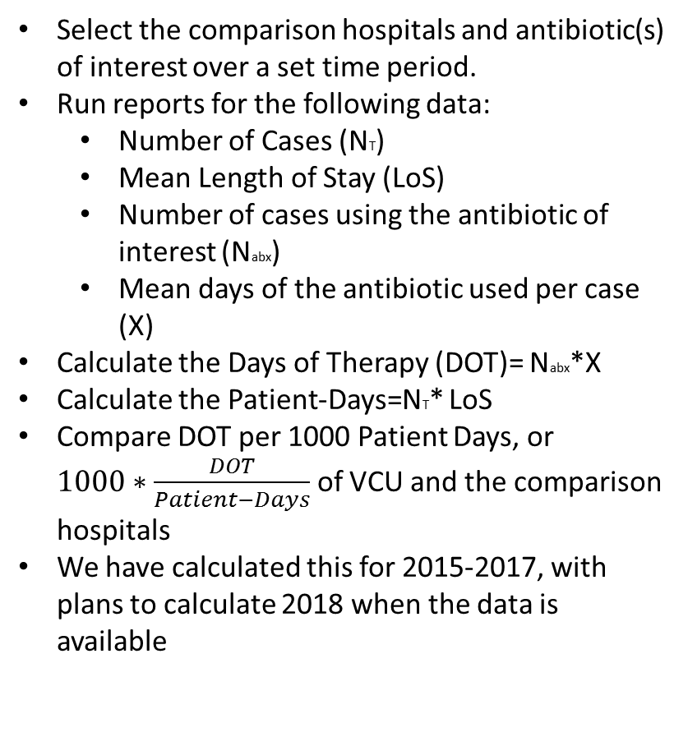
Methods
Selected Report Options
Report: Resource Utilization By Hospital / Hospital System/Discharge Quarter (CY)/Route of Administration
Risk Adjustment Model: 2017 Risk Model (AMC)
AHRQ Version: 6.0.2 (Pediatric) / 6.0.2 (Quality) / 6.0.2 (Safety)
Report Patient Type: Inpatient
Time Period: Quarters: 2018 Quarter 3,2018 Quarter 2,2018 Quarter 1
Focus Hospital(s): VCUMC 490032
Comparison Hospitals: Custom: NEBRASKA 280013,NEVADA 290007,UCHEALTH_COLORADO 060024,UTAH 460009,WESTVIRGINIA 510001,WFBH_DAVIE_MED_CTR 340187 Show Ungrouped
Focus Hospital Systems / Hospital Custom Lists:
Standard Restrictions: Default Settings With the following exception(s): Normal Newborn: Exclude All Pediatrics Age: Exclude All
Advanced Restrictions: Pharmacy Clinical Resource In Custom List(Vancomycin(648785 vancomycin), Ceftaroline (924847 ceftaroline))
Select the comparison hospitals and antibiotic(s) of interest over a set time period.
Run reports for the following data:
  Number of Cases (NT)
  Mean Length of Stay (LoS)
  Number of cases using the antibiotic of interest (Nabx)
  Mean days of the antibiotic used per case (X)
Calculate the Days of Therapy (DOT)= Nabx*X
Calculate the Patient-Days=NT* LoS
Compare DOT per 1000 Patient Days, or $1000∗\frac{DOT}{Patient−Days}$ of VCU and the comparison hospitals
We have calculated this for 2015-2017, with plans to calculate 2018 when the data is available

Slide 9
DOT/PD*1000

Slide 10
Standardized Antibiotic Use Ratio
Like the SAAR, this is a ratio assessing AU data
The SAUR is calculated by dividing the DOT per 1000 PD of the target hospital by the mean of the comparison hospitals
>1 represents increased use vs comparator hospitals
<1 represents decreased use vs comparator hospitals
Can be used to track trends over time, as well as potential areas of intervention from a stewardship perspective

Slide 11
Antimicrobial | 2015 | 2016 | 2017
Aztreonam | 0.33 | 0.34 | 0.37
Ceftriaxone | 0.83 | 0.80 | 0.80
Gentamicin | 0.79 | 0.80 | 0.68
Levofloxacin | 2.38 | 2.16 | 2.01
Ciprofloxacin | 1.14 | 0.99 | 1.03
Piperacillin/Tazobactam | 2.09 | 1.33 | 1.39
Cefepime + Ceftazidime | 0.57 | 0.75 | 0.66
Meropenem | 2.02 | 1.86 | 1.71
Ceftazidime/Avibactam | 0.00 | 0.11 | 0.61
Ceftolozane/Tazobactam | 0.02 | 0.15 | 0.25
Fosfomycin | 1.18 | 0.93 | 0.73
Amikacin | 0.48 | 1.05 | 0.44
Colistin (Colistimethate) | 2.41 | 2.22 | 2.10
Tigecycline | 0.65 | 1.01 | 0.79

Slide 12
Results
The SAUR indicates increased use of levofloxacin, meropenem, piperacillin/tazobactam, and colistin in 2015, 2016, and 2017
The SAUR indicates deceased use of aminoglycosides, aztreonam, and cefepime + ceftazadime in 2015, 2016 and 2017
This does not indicate appropriateness of use
Results may be trended to assess effectiveness of an intervention

Slide 13
Discussion
The SAUR represents a quick, accurate representation of the utilization rates of specific antibiotics.
This can be done easily by a hospital within the Vizient network
The report is customization to fit a hospitals specific needs
Trending the SAUR around interventions can assess effectiveness of the intervention

Slide 14
References
Fleming-Dutra KE, Hersh AL, Shapiro DJ, et al. Prevalence of Inappropriate Antibiotic Prescriptions Among US Ambulatory Care Visits, 2010-2011. JAMA. 2016; 315(17):1864–1873. doi:10.1001/jama.2016.4151
Barlam TF, Cosgrove SE, Abbo LM, et al. Implementing an Antibiotic Stewardship Program: Guidelines by the Infectious Diseases Society of America and the Society for headrest Epidemiology of America. Clin Infect Dis. 2016; 62(10):e51–e77. doi:10.1093/cid/ciw118
Centers for Disease Control and Prevention (CDC). Core elements of hospital antibiotic stewardship programs, 2014. Available at: http://www.cdc.gov/getsmart/headrest/pdfs/core-elements.pdf Accessed 8 May 2014.
van Santen KL, Edwards JR, Webb AK, Pollack LA, O'Leary E, Neuhauser MM, Srinivasan A, Pollock DA.The Standardized Antimicrobial. Administration Ratio: A New Metric for Measuring and Comparing Antibiotic Use. Clin Infect Dis. 2018 Jul 2; 67(2):179-185. Doi: 10.1093/cid/ciy075.
O’Leary EN, van Santen KL, Edwards EM, Braun D, Buus-Frank ME, Edwards JR, Guzman-Cottrill JA, Horbar JD, Lee GM, Neuhauser MM, Roberts J, Schulman J, Septimus E, Soll RF, Srinivasan A, Webb AK, Pollock DA. Using NHSN’s Antimicrobial Use Option to Monitor and Improve Antibiotic Stewardship in Neonates. Hospital Pediatrics May 2019, VOLUME 9 / ISSUE 5

