Slide 1
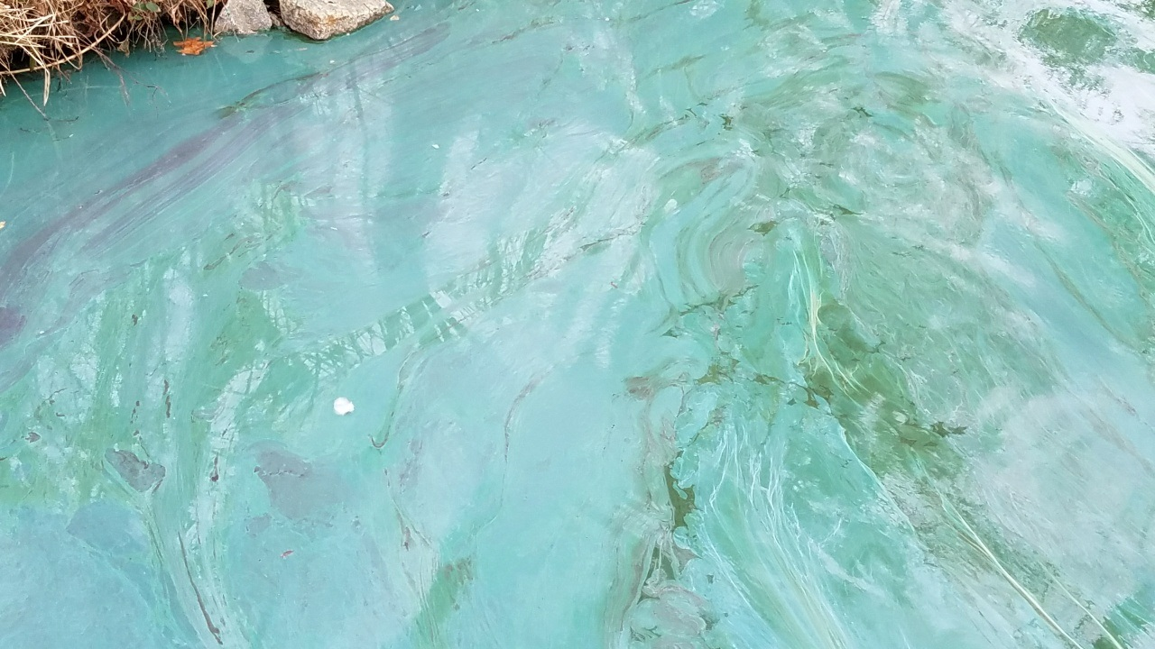

IS THAT BLUE-GREEN PAINT ON THE LAKE?
IT MAY BE A HARMFUL ALGAE BLOOM.
WHEN IN DOUBT, STAY OUT!
Learn more and report algae blooms at www.SwimHealthyVA.com

Slide 2
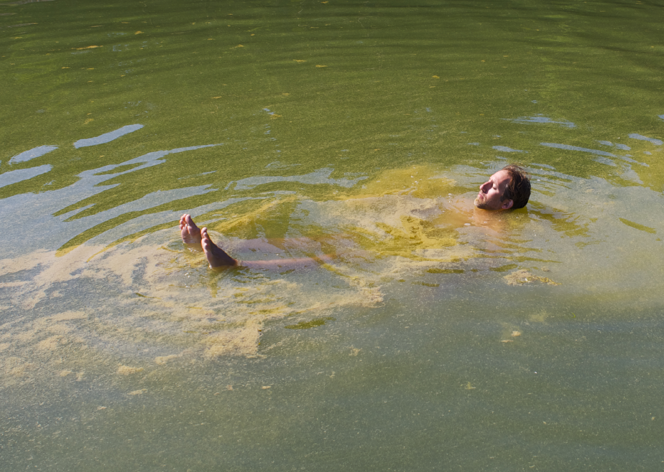
SWIMMING IN WATER THAT LOOKS LIKE THIS ISN’T COOL.
WHEN IN DOUBT, STAY OUT!
Learn how to swim healthy to stay healthy at
www.SwimHealthyVA.com
Add VDH Logo banner here please!

