Slide 1
Effects of low-level exposure to HAB toxins
(PTX2, YTXs, and AZA) on the larval life stage of the eastern oyster Crassostrea virginica
Nour Ayache
Assistant Research Scientist, Smith lab
VA HAB Task Force Meeting
February 2023
Contact: nayache@vims.edu
804.684.7812

Slide 2
Context
Unexplained hatchery failures and oyster larval mortalities
1- Seasonal abundance peaks of multiple toxigenic HAB taxa
(Dinophysis, Azadinium, Protoceratium) (King et al. 2021)
2- Detection of HABs toxins (PTX2, YTXs and AZAs) in post treated water in several hatcheries (Sanderson et al. 2023, King et al. 2021)
Little to nothing is known about the toxicity of these emerging toxins to
early life stages of oyster species
Gaillard et al. 2020: Purified PTX2 at low concentrations of 5 nM caused 25% decrease in fertilization success of both exposed oyster gametes of the Pacific oyster Crassostrea gigas after 2-h
Pease et al. 2022: Exposure to purified PTX2 at concentrations of 223 nM, Eq. to 10,000 cells mL⁻¹ of D. acuminata caused rapid larval mortality 50% of the eastern oyster, Crassostrea virginica as well as full immobilization of the larval oysters after 48-h

Slide 3
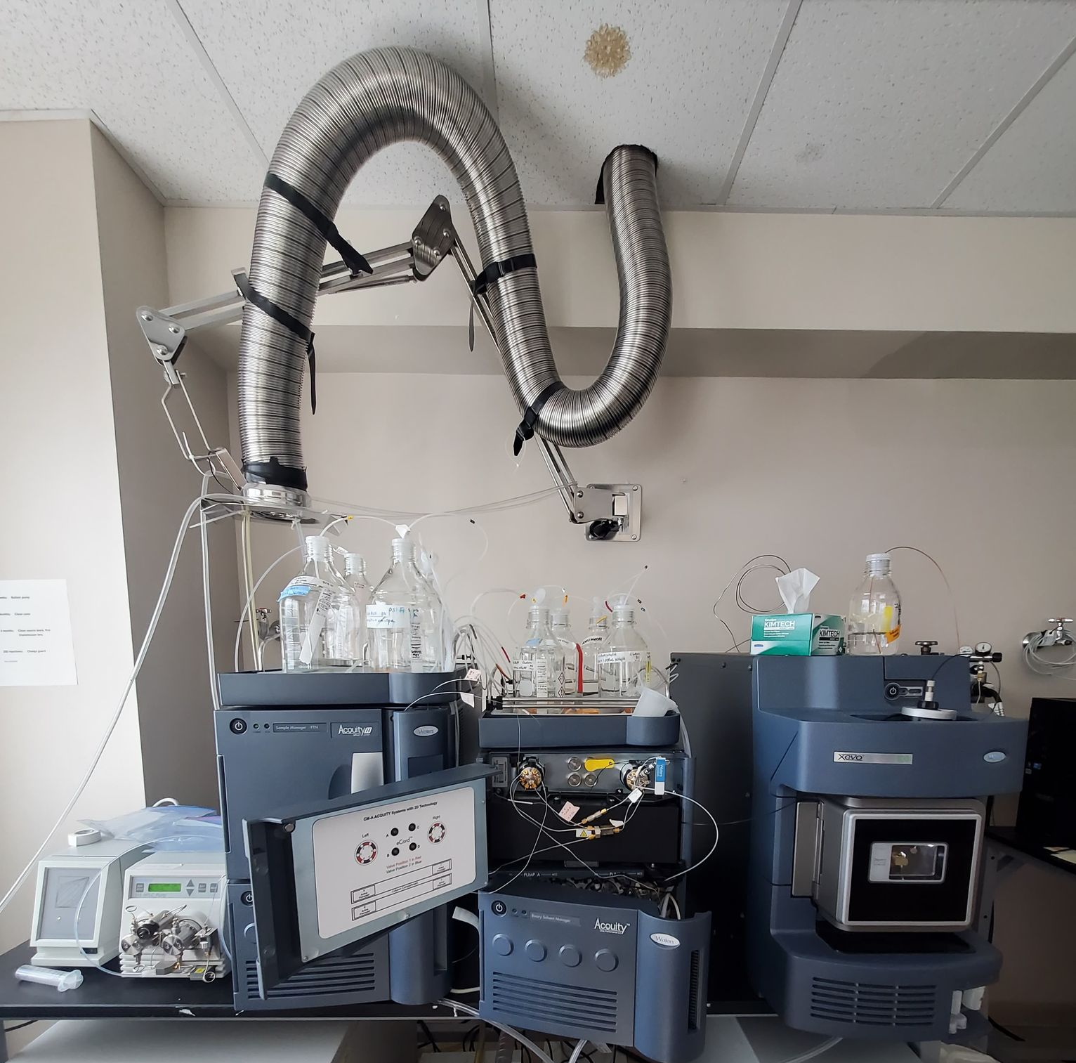
Experimental set-up
Low toxin concentrations: ecologically relevant bloom concentration, SPATTs extracts, collected water samples
(King et. al. 2021, Sanderson et al. 2023, Onofrio et. al 2021)
Diploid Crassostrea virginica 7-days post-fertilization veliger larvae (VIMS-ABC Hatchery)
PTX2
(2.5 ng mL⁻¹; Eq. 2.9 nM)
YTXs
(2 ng mL⁻¹; Eq. 1.8 nM)
AZA1
(0.45 pg mL⁻¹; Eq. 0.5 × 10⁻³ nM)
+ 2 controls (fed larvae and fed larvae + Methanol 0.2%)
After 48-h of exposure
Monitored:
Larvae mortality (microscopic observations)
Toxin accumulation in larvae (LC-MS/MS)

Slide 4
Next steps
Collaborate with several hatcheries
Identify the link between the presence of these toxins and their impacts on oyster’s early life stages
Range-finding experiment using toxin concentrations in water samples collected from the hatcheries
Determine the lethal doses (LD₅₀), and a lower toxicity threshold at which no mortality is detected
Determine the potential additive effects of the mixture of these toxins on oyster larvae
Provides options for shellfish growers to mitigate their effects through early harvest, movement of shellstock to upland facilities, or enhanced filtration

Slide 5
Thank you for your attention
References:
Sanderson, M.P. et al., (2022) Detection of toxins and harmful algal bloom cells in shellfish hatcheries and efforts toward removal. Aquaculture 562; 738714.
King, T.L. et al., (2021) Hiding in plain sight: Shellfish-killing phytoplankton in Washington State. Harmful Algae, 105, p.102032.
Gaillard, S. et al., (2020) Cultures of Dinophysis sacculus, D. acuminata and pectenotoxin 2 affect gametes and fertilization success of the Pacific oyster, Crassostrea gigas. Environmental Pollution, 265, p.114840.
Pease, S.K.D. et al., (2022) Effects of two toxin-producing harmful algae, Alexandrium catenella and Dinophysis acuminata (Dinophyceae), on activity and mortality of larval shellfish. Toxins 14(5), 335.
Onofrio, M.D. et al., (2021) Spatiotemporal distribution of phycotoxins and their co-occurrence within nearshore waters. Harmful Algae, 103, p.101993.
VA HAB Task Force Meeting 2023
Contact: nayache@vims.edu
804.684.7812

