Slide 1
January 2022
5 Things Parents Need to Know About the COVID-19 Vaccines
Real Talk With Your Pediatrician

Slide 2
DISCLAIMER
January 2022
These materials have been developed to support providers in conducting conversations with their patients to support and encourage COVID-19 vaccinations. These materials should not be used for any other purpose.
For questions related to these materials, please email: covidtele-townhall@vdh.virginia.gov

Slide 3
CONTENTS
Impact of COVID-19 on Children
How COVID-19 is Impacting Children
5 Things Parents Need to Know
Debunking 5 Common COVID-19 Vaccine Myths
The Differences Between Myocarditis, Pericarditis, MIS-C
The COVID-19 Vaccine for the 5-11 Age Group
Frequently Asked Questions
Your Questions Answered

Slide 4
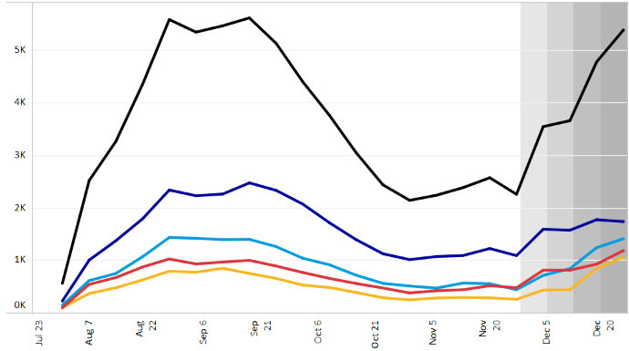
Impact of COVID-19 on Children
Count of Cases by Pediatric Age Group
Number of cases by the day closest to when symptoms began for pediatric age groups in Virginia. Dark area indicates illness may not have been reported yet due to delay in reporting.
PROVIDER MATERIALS - VIRGINIA
0-17 AGE GROUP
5-11 AGE GROUP
12-15 AGE GROUP
0-4 AGE GROUP
16-17 AGE GROUP
SOURCE: https://www.vdh.virginia.gov/coronavirus/see-the-numbers/covid-19-data-insights/cases-among-children/

Slide 5
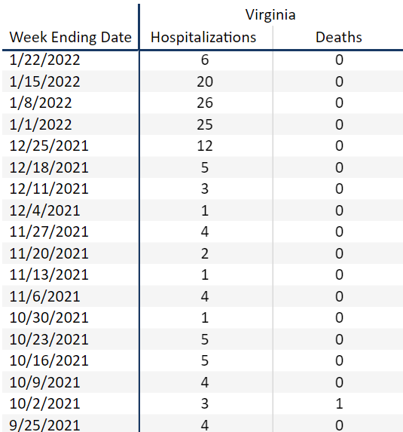
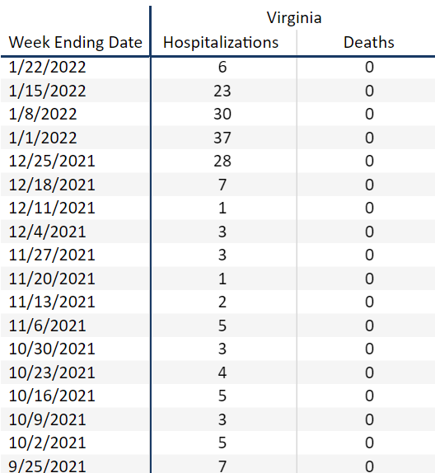
Impact of COVID-19 on Children
Count of Hospitalizations by Pediatric Age Group
5-11 AGE GROUP
12-17 AGE GROUP
Weekly number of hospitalizations and deaths in Virginia for the specified age groups in Virginia since 9/25. Note that the weeks 1/24 through 1/29 haven’t been reported on yet.
PROVIDER MATERIALS - VIRGINIA
SOURCE: https://www.vdh.virginia.gov/coronavirus/see-the-numbers/covid-19-data-insights/cases-among-children/

Slide 6
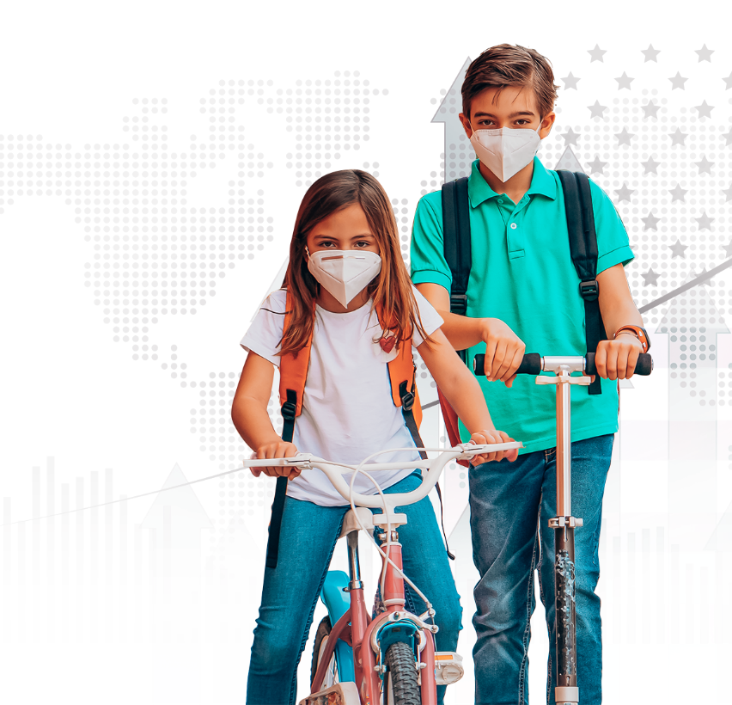
Impact of COVID-19 on Children
Children currently make up 17.8% of all COVID-19 Cases reported nationally. This includes a total of 7.6 million COVID-19 child Cases. The overall rate for child COVID-19 Cases is 12,559 cases per 100,000 children.
These child COVID-19 cases are not slowing down, as they are currently on the rise in the months of October and November. Children made up 21.4% of the Cases reported the week of ending 1/13/22. In addition, over a two-week period, there was a 20% increase in children COVID-19 cases from 12/30/21-1/13/22
PROVIDER MATERIALS - VIRGINIA
SOURCE: https://www.aap.org/en/pages/2019-novel-coronavirus-covid-19-infections/children-and-covid-19-state-level-data-report/

Slide 7
How COVID-19 is Impacting Children
Children that contract COVID-19 will have their everyday educational, social, and physical activities impacted. In addition, children have been found to have respiratory, cardiac, and neurodevelopmental issues along with cognitive and physical fatigue. It is also important to note how COVID-19 affects the child’s mental health and adds stress and adjustment difficulties
to their lives.
The best way to combat these issues in children is to prevent a COVID-19 infection in every way possible – most importantly the vaccine. The COVID-19 vaccine can help children stay focused on what is most important in their education and social lives.
PROVIDER MATERIALS - VIRGINIA
SOURCE: https://www.aap.org/en/pages/2019-novel-coronavirus-covid-19-infections/clinical-guidance/post-covid-19-conditions-in-children-and-adolescents/

Slide 8
5 Things Parents Need to Know
The benefits of the vaccines far outweigh any potential risks – the CDC continues to recommend COVID-19 vaccination for everyone 5 years of age and older, given the greater risk of COVID-19 illness and possibly severe complications.
1
2
3
4
5
PROVIDER MATERIALS - VIRGINIA
You Cannot Get COVID-19 From The Vaccine
Vaccines Were Made Following FDA Standards
COVID-19 Vaccines Protect Your Health
The Vaccines Are Zero Cost Out Of Pocket
Vaccinated Kids May Have Fewer Restrictions

Slide 9
Debunking 5 Common COVID-19 Vaccine Myths
COVID-19 CAN MAKE CHILDREN SICK…
NO ONE WILL…
PROVIDER MATERIALS - VIRGINIA
become more vulnerable to or contract COVID-19 due to the vaccine
and they should get the vaccine to protect themselves
THE VACCINES WILL NOT…
THE VACCINES WILL NOT…
NOT VACCINATING MY CHILD…
hurt the fertility or the ability to become a parent for anyone
affect the DNA or alter the DNA of anyone
will affect other children, not only my child’s health

Slide 10
Concerns About Myocarditis and Pericarditis
Pericarditis is the inflammation of the outer lining of the heart.
Myocarditis is the inflammation of the heart muscle.
In rare cases, myocarditis has occurred, primarily one week after the second dose of mRNA vaccination. The risk of myocarditis from the infection is much greater than the risk of myocarditis from the vaccine.
Myocarditis and pericarditis have rarely been reported.
These diseases are a potential side eﬀect of the COVID-19 vaccine.
They have occurred predominantly in adolescent males within several days after COVID-19 vaccination.
Risks of not getting The COVID-19 vaccine:
Becoming infected with COVID-19.
Developing myocarditis or pericarditis from a COVID infection.
Long COVID aﬀects
Multi-System inflammatory Syndrome
Hospitalization
Death
cdc.gov/coronavirus/2019-ncov/vaccines/safety/myocarditis.html?s_cid=11374:myocarditis%20children%20covid%20vaccine:sem.ga:p:RG:GM:gen:PTN:FY21 https://www.health.harvard.edu/blog/new-information-for-parents-on-myocarditis-and-covid-19-vaccines-202107012523

Slide 11
The COVID-19 Vaccine for the 5-11 Age Group
The Pfizer-BioNTech COVID-19 vaccine is approved for emergency use authorization (EUA) by the U.S. Food and Drug Administration (FDA) for the 5-11 year old age group. See below for the key details on the differences between Pfizer-BioNTech’s 5-11 year old COVID-19 vaccine and the 12+ year old COVID-19 vaccine. It is important to note that the 12+ year old Pfizer-BioNTech vaccine can NOT be administered to 5-11 year olds and 5-11 year olds can only receive the vaccine approved specifically for their age group*.
Description | Adult/Adolescent Formulation | Pediatric Formulation
Age Group | >12 years | 5 to <12 years
Vial Cap Color | Grey | Orange
Dose | 30 mcg | 10mcg
Injection Volume | 0.3 mL | 0.2 mL
PROVIDER MATERIALS - VIRGINIA
*Dose formulation is determined strictly by child’s age at date of vaccine administration.

Slide 12
Frequently Asked Questions
Does my child need a vaccine if they aren’t going to get very ill from COVID-19?
Will my child have to get a booster shot?
Will my child get sick after getting the vaccine?
Can you get other shots with the Covid-19 vaccine? i.e., flu shot
What are the different variants?
PROVIDER MATERIALS - VIRGINIA
Should my child get the vaccine if they are immunocompromised or have a pre-existing condition?
How soon after testing positive can my child get vaccinated?

Slide 13
Your Questions Answered
PROVIDER MATERIALS - VIRGINIA

Slide 14
Get Vaccinated!
SCHEDULE YOUR APPOINTMENT ONLINE:
vaccinate.virginia.gov
SCHEDULE YOUR APPOINTMENT OVER THE PHONE:
877-VAX-IN-VA
(877-829-4682)
For all other COVID-19 related concerns:
https://www.vdh.virginia.gov/

