Slide 1
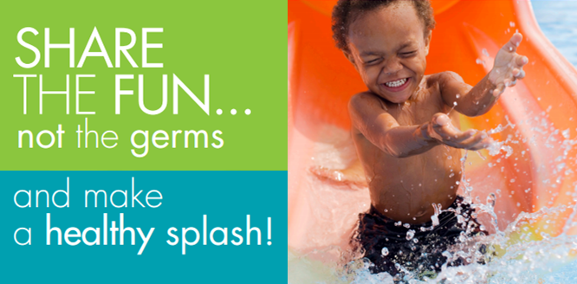
Healthy & Safe Swimming Week May 23-29, 2022

Slide 2
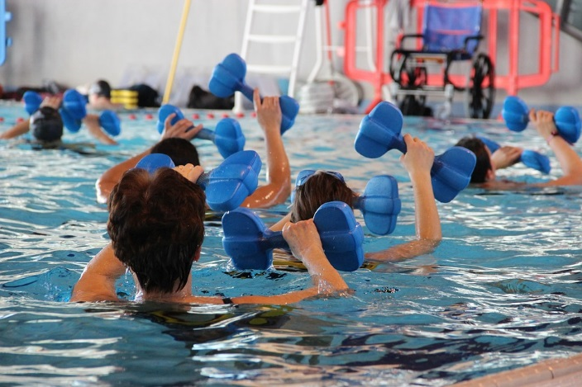
Don’t swallow the pool water you swim in—
Just one mouthful of pool water that has diarrhea germs can make you sick.
Learn more at www.SwimHealthyVA.com

Slide 3
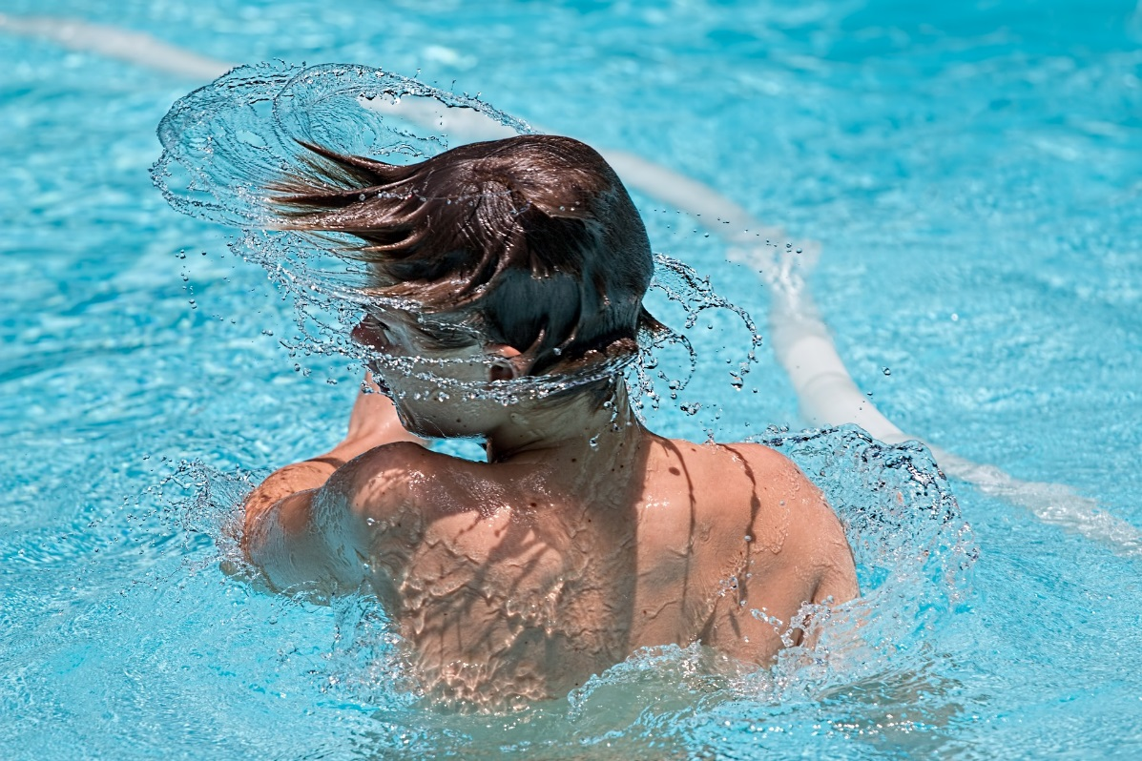
Properly maintain your pool and spa to control the growth
of bacteria like
Legionella, which
can cause severe respiratory infections.
Learn more at www.SwimHealthyVA.com

Slide 4
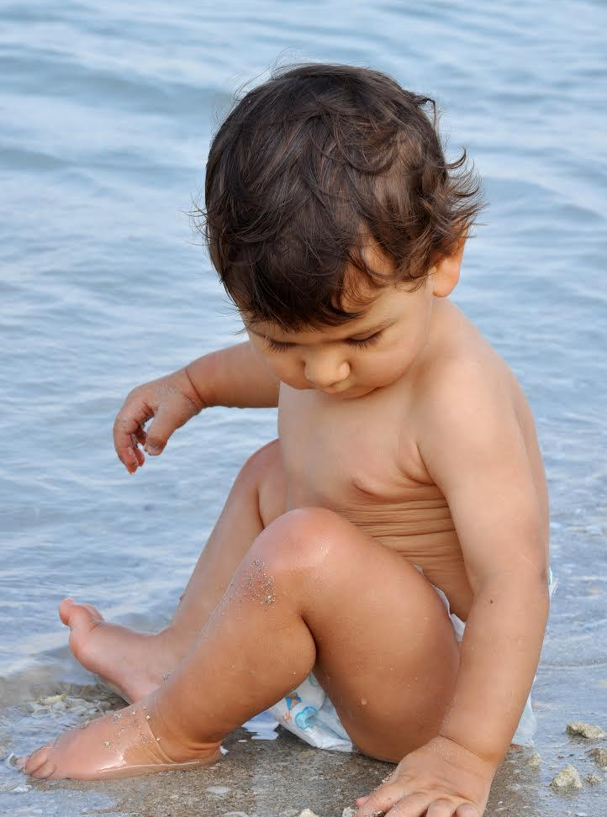
Help prevent germs from getting in the water you swim in.
Take children take on bathroom breaks and check swim diapers at least once an hour.
Learn more at www.SwimHealthyVA.com

