Slide 1
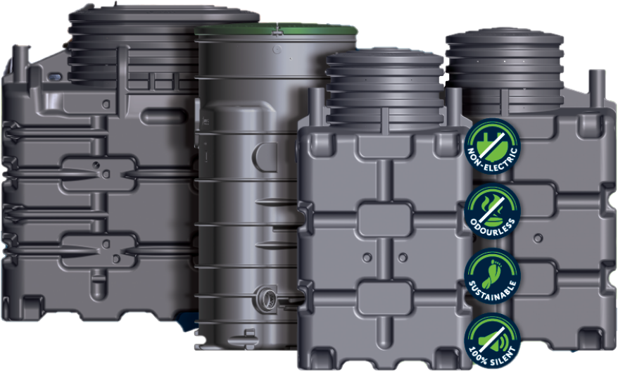
ECOROCK
Installation Manual

Slide 2
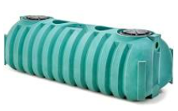
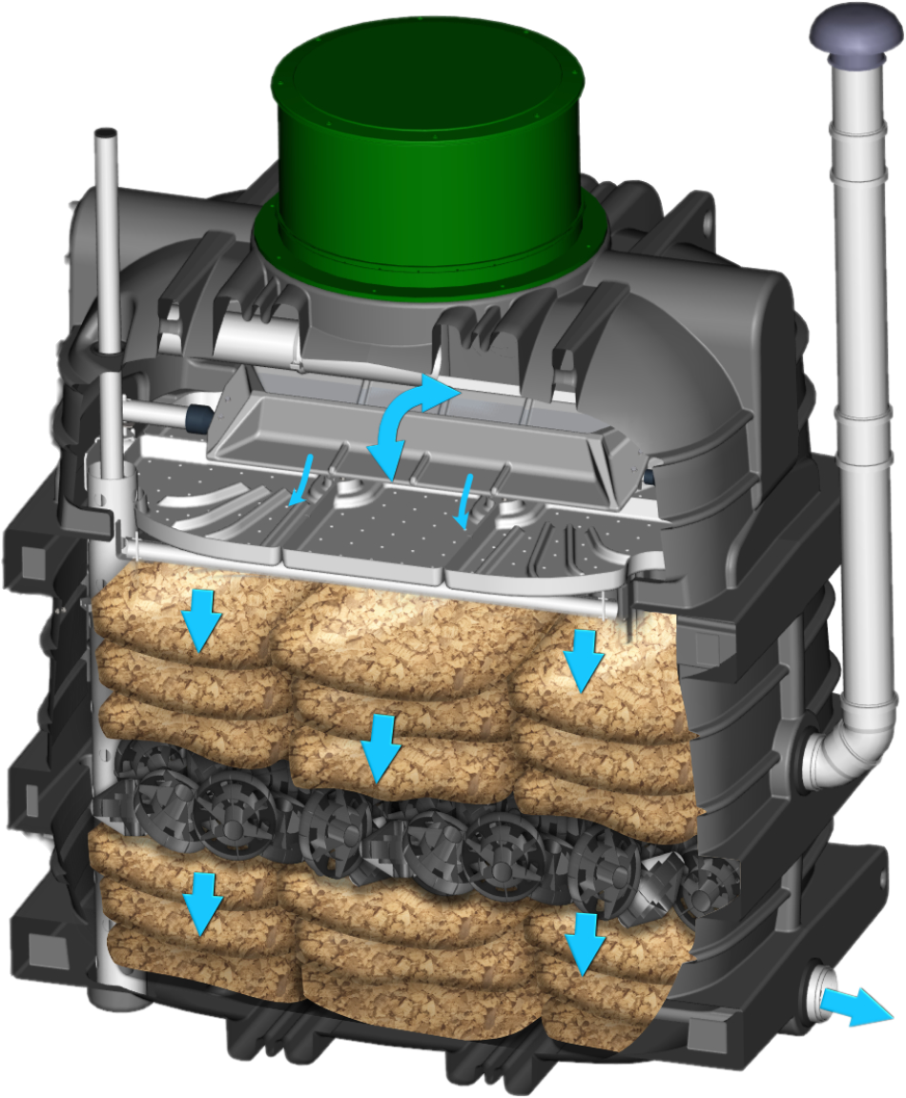
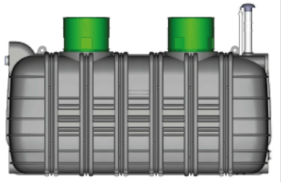
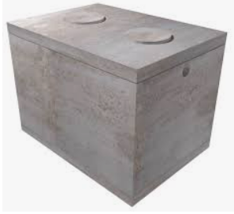
Understanding ECOROCK System
ECOROCK units are compatible with any “APPROVED” and properly vented primary tank.

Slide 3
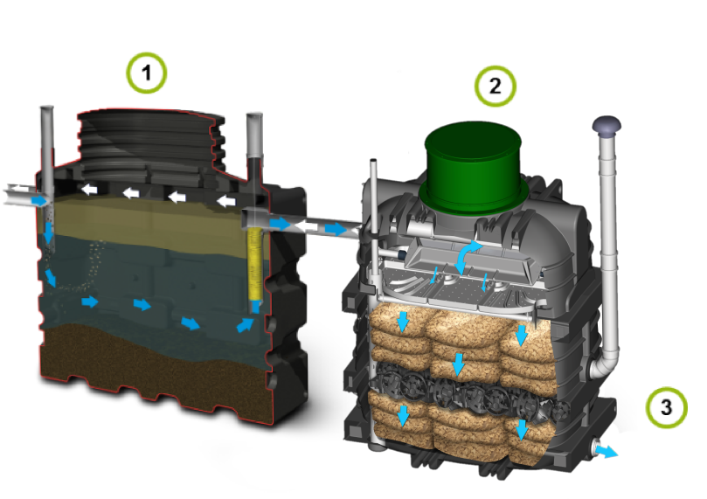
The ECOROCK system
The ECOROCK system is a compact wastewater treatment system . Domestic wastewater is treated using the “fixed media” filter bed principle.
1
The Primary Tank
Wastewater is initially collected in a settling tank where separation takes place (larger solids and other floating particles)
The pre-treatment stage takes place in the Primary Tank
2
The ECOROCK unit
This is the fixed film biofilter system used for the secondary treatment stage
The ECOROCK unit contains the unique BIOROCK filter media with live bacteria colonies - actively cleaning wastewater
3
The discharge system
Either by gravity where terrain permits or via a simple pump which lifts the final effluent to a discharge point to an appropriate disposal system.
The treatment principle of the ECOROCK system is a combination of two biological phenomena :
Anaerobic digestion in the Primary Tank (primary treatment)
Aerobic digestion by a fixed film of bacteria on the BIOROCK media within the ECOROCK unit. (secondary treatment)

Slide 4
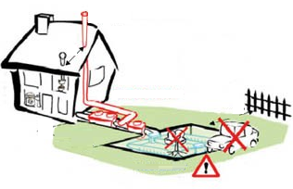
Installation of the ECOROCK System

Slide 5

The stages of installation

Slide 6

The stages of installation
The work of the EcOROCK installer must be conducted according to the criteria set out by ECOROCK.
1
Site preparation
Prepare for the installation with the ACUANTIA local agent.
Prepare and check all materials required
Check the installation area thoroughly
2
Installing the discharge system if necessary
Install a pump shaft according to discharge method for site. If site grade permits gravity discharge, install sampling pipe .
3
Excavating the site
Dig the hole in accordance with the instructions set out by ACUNATIA and the client.
Carry out proper and safe excavation work enabling the installation of all system components.
4
Installing the system – Ventilation control
Make sure that the water flows correctly by gravity
Check that the ventilation is correct and functioning
Follow the recommendations set out by ACUANTIA when installing on a difficult site
5
Filling the units with water and backfilling around the tanks
Filling the tanks with water must take place as you backfill the tanks
Position the wastewater discharge system
Put in place and screw down the lids
6
Finish the job
Leave a finished, clean and neat site.
Get the job signed off by the client
On the site:
Never smoke in the vicinity of construction during operations described in this manual
Never enter the tanks if you have not taken all the necessary measures regarding ventilation and air monitoring in accordance with the current statutory provisions.
Quality commitment

Slide 7



Site Preparation
Preparation is the key to an efficient installation
1
Prepare the site with the ACUANTIA local agent
Ensure that you are well briefed on the details of the project
15 days before the work begins
Aim
Discuss with the ACUANTIA local agent the specifics of the project : type of soil, existing system if applicable, site access etc…
Confirm the project dates and arrival times
Confirm the delivery dates for the tanks
The local agent provides you with :
The customer installation folder
The customer’s contact information
2
Customer contact
Confirm the day and time of arrival
Establish a good contact with the client
Ensure that the client understands the project timelines
7 days before the work begins
Aim
“ Hello, I am …, in charge of the installation of your ECOROCK STP system”
“I will start work as planned on ….day at ……time. will someone be on site ? Will I have clear access to the site?”
3
Materials - preparation
Be totally prepared on the day of installation
checklist
2 days before the work begins
Aim
If you are unable to attend site or need to change times, please inform the customer and the ACUANTIA local agent
Make sure that you have all the necessary equipment on site.
Check details - access to a water for backfilling / where you are going to place excavated soil, etc
Quality commitment

Slide 8
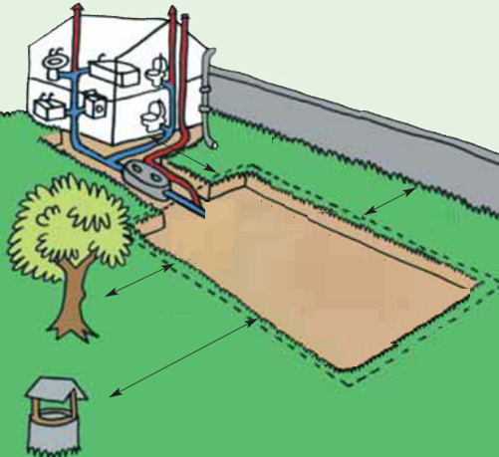
Site Planning
The installation of the ECOROCK system will be affected by various things:
The available space on site,
The gradient of the site,
The size of the project,
The type of discharge at the end of the system
The type of soil / ground conditions
The available area
The basic installation rules:
Ensure a minimum distance of about 10 ft from the house and 10 ft from any neighboring fences and trees or plants that develop extensive root systems.
The units must be located away from traffic and parking areas, not in agricultural fields, landscaping or storage areas. Installation in a wet area (high water table) is possible (consult your local agent).
System lids must not be buried and must be accessible for maintenance.
The minimum distance between the Primary Tank and the BIOROCK must be 1 ft.
The distance between the walls of the installation and the tanks must be a minimum of 1 ft.
>10ft
>10ft
>10ft
>50ft

Slide 9
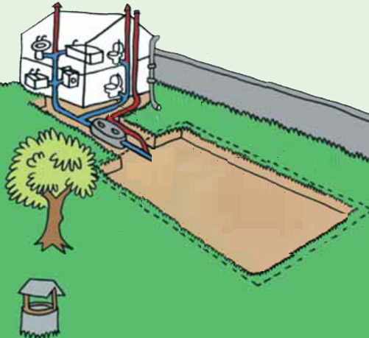
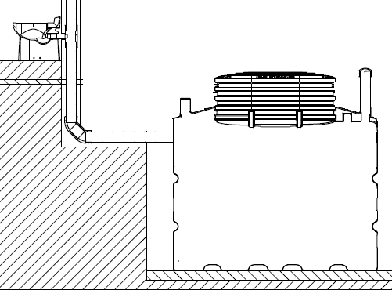
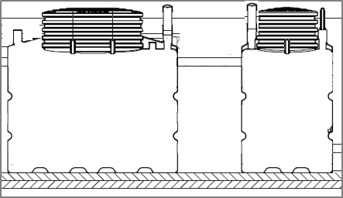
Setting up: general points prior to excavating
Installing the Primary Tank
The Primary Tank must be installed as close as possible (less than 30 feet) to the wastewater discharge point at the property, this avoids fats clogging in the inlet pipe. With a longer pipe from the property to the primary tank the installation of a grease trap may be necessary. The 4” diameter inlet pipe should have a minimum gradient of 2 % and a maximum of 4%.
> 10 ft
< 30 ft
> 2%
< 4%
The Primary Tank must be installed 50 feet from any potable water point such as a borehole.
Positioning the ECOROCK unit
The ECOROCK unit must be installed after downstream from the Primary Tank. The effluent should flow by gravity into the ECOROCK unit. The gradient of the pipe carrying the settled effluent from the primary tank to the ECOROCK unit should have a minimum gradient of 1% .
The minimum distance between the PT and the BIOROCK unit should be 1 foot
> 1 ft
> 1%

Slide 10
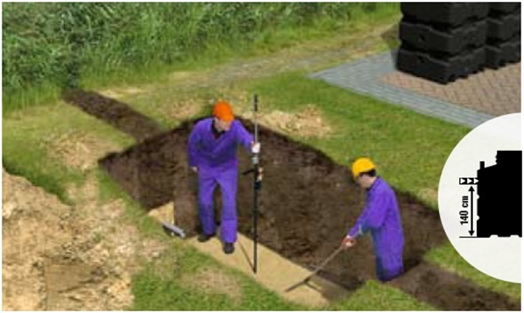
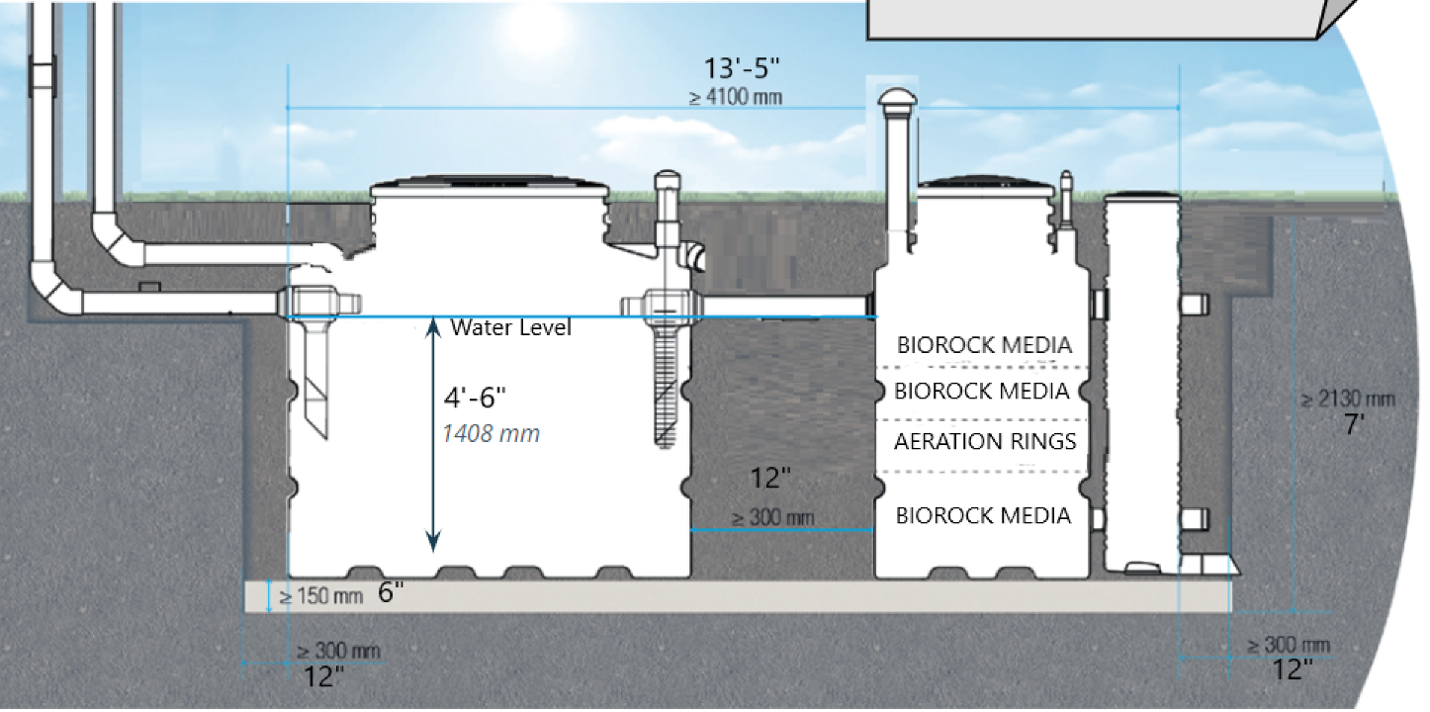
Excavating the Site
This section explains the stages involved in the construction work and our recommendations for installing a ECOROCK system in dry ground conditions. For installations where a high water table exists or where there are other concerns such as nearby traffic please see the next section:
Taking the environment into account / Setting up layout: specific cases
Excavation dimensions
Total length: L of the tanks + 12” between the PT and BIOROCK unit + 12” of backfill on each side.
Width: 4.5” + 12” of backfill on each side
Total height: will depend on the level of the water inlet.
The difference between the wastewater inlet and the base of the tank is 55”.
Thickness of the concrete or pea gravel bed under the system: 6”.
Place the excavated soil on a tarp to minimise the mess on site.
Try to limit the area where machinery is used.
Take extra care when working in a wet area.
Quality commitment
Setting up layout: specific cases

Slide 11
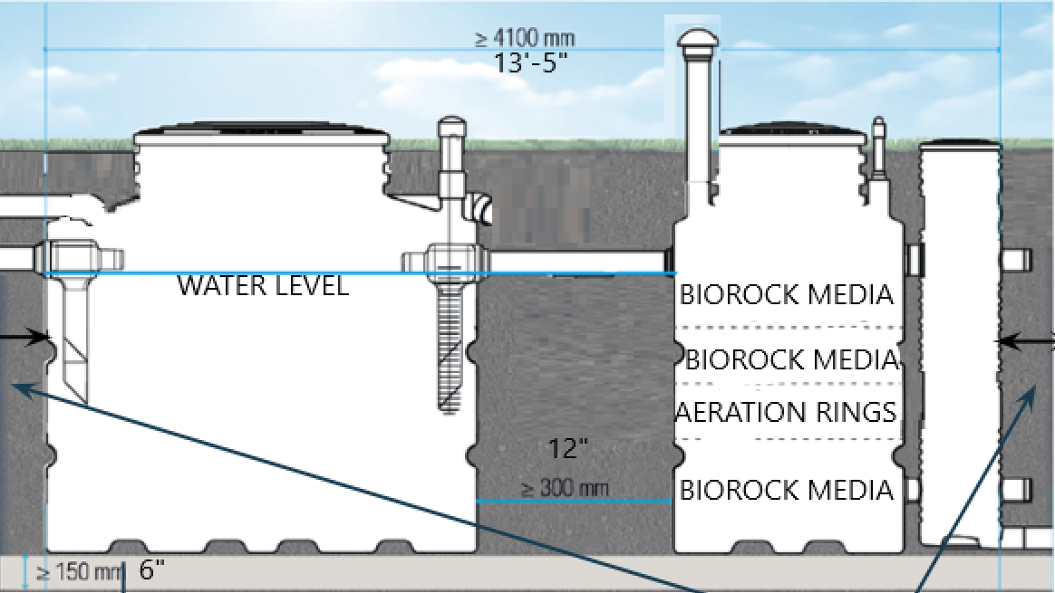
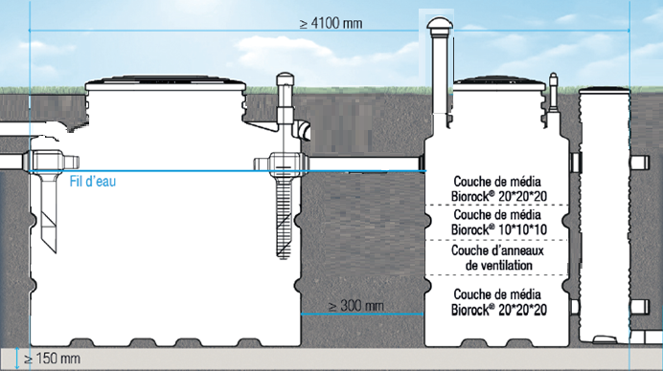
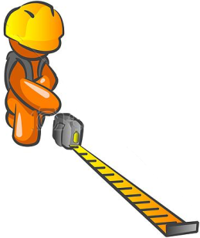
Excavating the Site
The units must stand on a clean and stable base such as concrete or in very dry ground conditions pea gravel can be used. Mud and other soft materials must be removed from the bottom of the excavation prior to installation.
A stable base must be created at the bottom of the excavation. In dry conditions pea gravel with a size of between 3 to 6mm can be used (always use concrete in wet conditions). The base should have a minimum thickness of 6 inches.
The base of the excavation should be perfectly level and compacted to avoid the tanks settling.
There must be a distance of at least 12” between the excavation walls and the units.
The depth to the base of the excavation must be enough for the wastewater pipe from the property to the primary tank to be fitted with gradient of between 2% and 4% .
Ensure that topsoil is put to one side enabling it to be used when the top of the tanks are made to finish grade.
Quality commitment

Slide 12
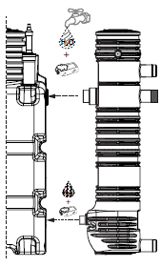
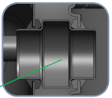
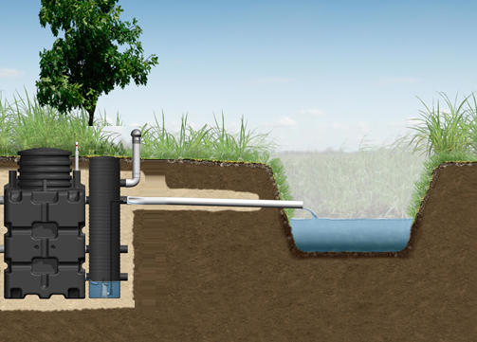
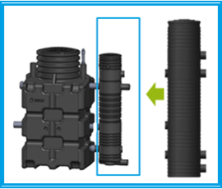

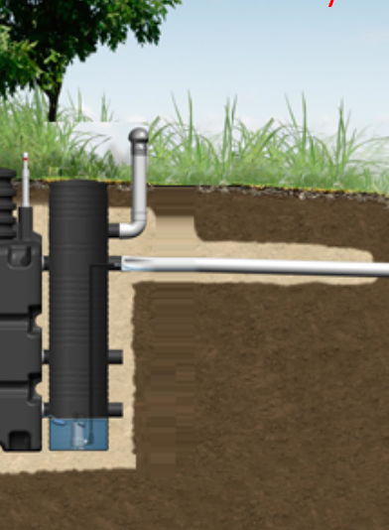

Installing the Pump Shaft Assembly
The system has rubber seals and is leak-proof. These seals are pre-installed on the tanks.
For ease of installation it is recommended that you fix and strap up the pumping well to the treatment unit before lowering the tank into the excavation.
1+2
Connect the pump shaft assembly to the tank
The pump shaft is connected to the ECOROCK unit with a fitting that acts as connector between the two tanks.
This part is pre-assembled.
Discharge to approved disposal field
Discharge to
Opening up the water outlets you require:
Non -gravity discharge: Connection of the pump shaft, at 16”

Slide 13
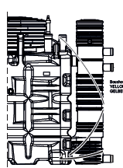
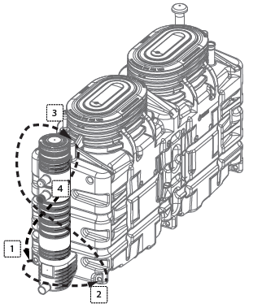
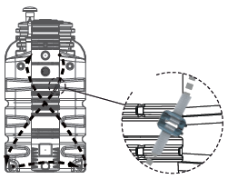
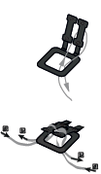
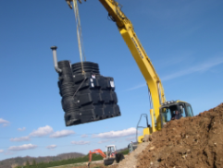
Installing the Pump Shaft System
3
Secure the pump shaft to the ECOROCK unit
It is recommended that the pump shaft is assembled and strapped securely to the ECOROCK unit prior to lowering the tank into the excavation.
The strap is included with the system.
The method of strapping the pump shaft to the unit is described within the manual provided with the tanks.
4
Lower the completed ECOROCK system into the excavation and position it carefully.
Ensure that the slings are correctly positioned on the tanks using the purpose built rings .These are positioned on the 4 corners on the upper part (ECOROCK 450/600/750). Follow instructions for lowering of the Primary Tank (Septic Tank) provided by manufacturer.

Slide 14
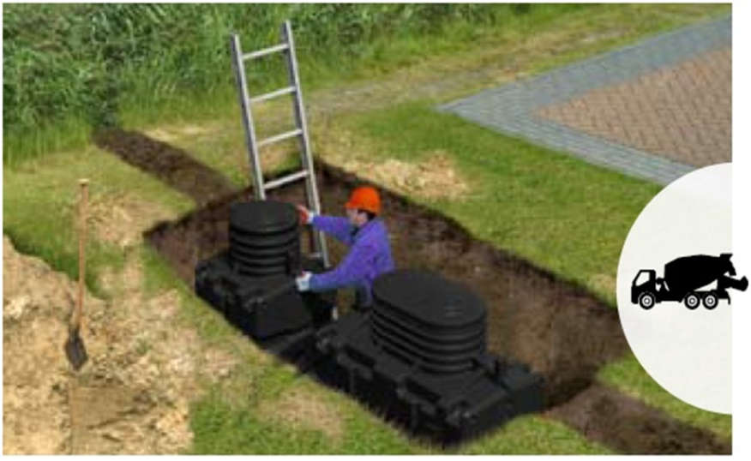
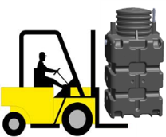
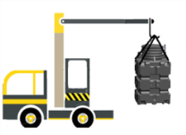
Installing the ECOROCK System
Positioning information
Weight of the tanks: 450:400 lbs;600:700 lbs; 750: 810 lbs.
Four lifting eyes are integrated in the upper corner of each tank, enabling the lifting by a crane.
Secure movement of the tanks to the installation area is possible with a fork lift vehicle using the purpose built grooves under the tanks.
Once the base of the excavation is stable the installation can begin.
Install the ventilation ducts and water pipes. Use standard PVC-pipes, Ø 4”.
Check that all connections are correctly positioned . Pay special attention to the seals (interlocking). The seals ensure that the system is watertight.
Ventilation
Ventilation of the Primary Tank:
The Primary Tank must have a ventilation system consisting of an air intake and air outlet with a minimum diameter of 4”. The outlet vent must be located above the building.
The air must be able to circulate freely in the upper level of the unit, the pre-filter and the Primary Tank through the water pipe.
Ventilation of the ECOROCK unit:
The ECOROCK unit has one single ventilation duct. When installed after a Primary Tank, the ECOROCK Treatment Unit is ventilated together with the Primary Tank.
Product Manual/ Composition of the PT: ventilation
Product Manual / The BIOROCK system/ Other components/ ventilation
Before connecting any piping or ventilation pipes ensure the units are perfectly installed and stable on the excavation base. Ensuring that all levels are correct is crucial to allow the wastewater to flow efficiently through the system.
Make sure that the lids, alarm and the Primary Tank filter are at ground level for easy access.
Quality commitment

Slide 15
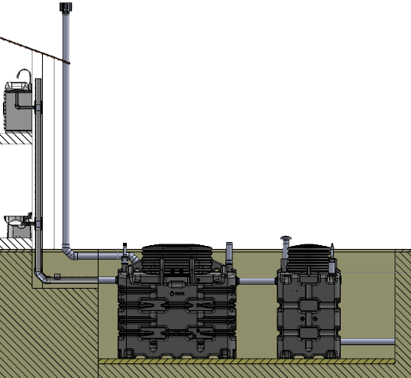
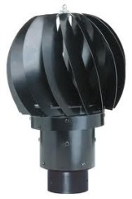
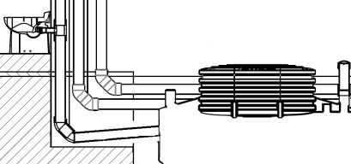

Installing the Ventilation System
The wind driven ventilator
The ventilation system, with a minimum diameter of 4”, is fitted with a static or wind driven ventilator which feeds air into the system naturally.
This ventilator must be :
located at least 16” above roof level,
clear of all potential obstacles
located at least 3 ft away from any windows or skylights.
The ventilation ducts can be installed anywhere but should not be more than 30 feet from the system.
The difference in height between the air intake and air outlet must be at least 12 ft to create effective air circulation in the system.
Fit the wind driven ventilators at the end of the ducts.
Check that the ventilation pipework is level.
Min. 12 ft
Check list :
Ensure it works…. Perform a smoke test once the ducts are installed and prior to backfilling
Light a small smoke bomb and place it in front of the air intake; The smoke should be drawn into the intake and out of the air outlet.
Make sure that the ventilation works properly.
Check that the ventilation system for the Primary Tank follows the diagram and that piping is not obstructed or disconnected at any stage.
In case of installation after Primary Tank without air inlet and outlet fittings, the ventilation for the ECOROCK unit must be separate from the Primary Tank ventilation.
Ensure that the cowls are fitted to the air vents / outlets
Quality commitment

Slide 16
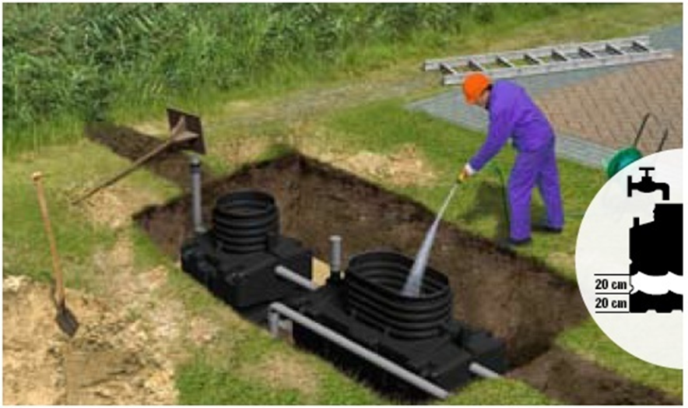
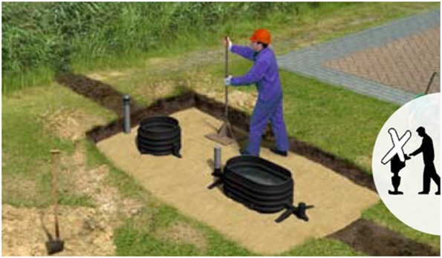
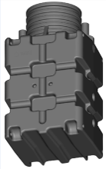
Backfilling and Balancing the Tanks with Water
Volume of the tanks:
ECOROCK 450: 400 gallons
ECOROCK 600: 530 gallons
ECOROCK 750: 660 gallons
Filling up the tanks:
At the same time as backfilling around the Primary Tank and ECOROCK unit, both tanks should be gradually filled with clear water (increments of 12”)
Serial numbers are marked on the tank to provide traceability .
Copy the serial number onto the documents that are handed customer.
With the logo facing you on the ECOROCK unit: The serial number is located on the right side, also inside the extension neck on the label
Backfilling the tanks:
Backfilling material for a dry site should be composed of pea gravel (size from 3 to 6 mm). This should be 12” thick and compacted.
Do not use the soil removed for the excavation for backfilling: roots and stones can result in damage to the tank wall.
Do not compact the backfill material mechanically: compact manually.
These instructions apply to dry sites only: Not wet sites Installation Layout: specific cases
Check during the installation that the top of the tanks have not deformed around the cover openings.
Use quality backfill.
Write the serial number of the tank on the documents handed to the customer
Once the backfilling is finished and compacted, check the levels of the tanks again
Quality commitment

Slide 17
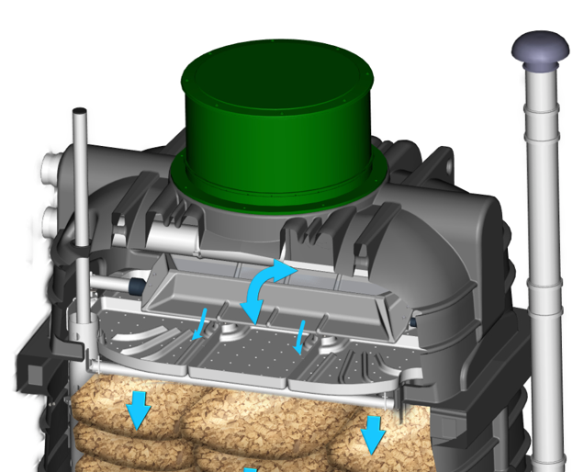
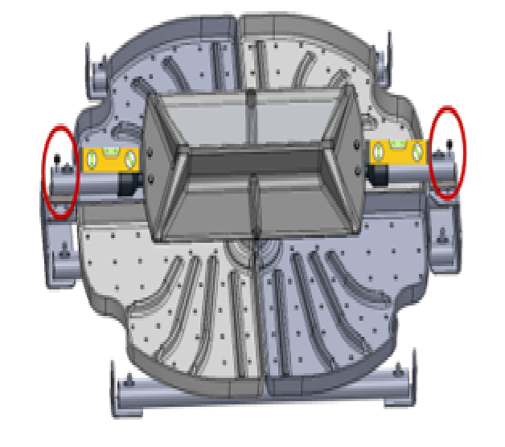
Adjusting the Water Distribution System
ECOROCK 450/600/750
Wastewater is evenly distributed over the filter media using a Tipping Tray and Distribution Plate..
Check that the tipping tray is working correctly. Make sure that it’s tipping several times. The pretreated water flushed by the tipping tray should be evenly distributed on all the holes of the distribution plate. No overflow out of the distribution plate should be observed.
Check that the tipping tray is level. If this is not the case, adjust the 2 rods located at the ends of the tipping tray.
The filter media bags must cover 100 % of the surface of the unit.
The water must be distributed to the Tipping Tray from the effluent inlet pipe before flowing onto the Distribution Plate.
Flush the toilets several times to check proper that the water distributes properly,
Check that the treated wastewater flows out of the ECOROCK unit into base of pump shaft.
Quality commitment

Slide 18


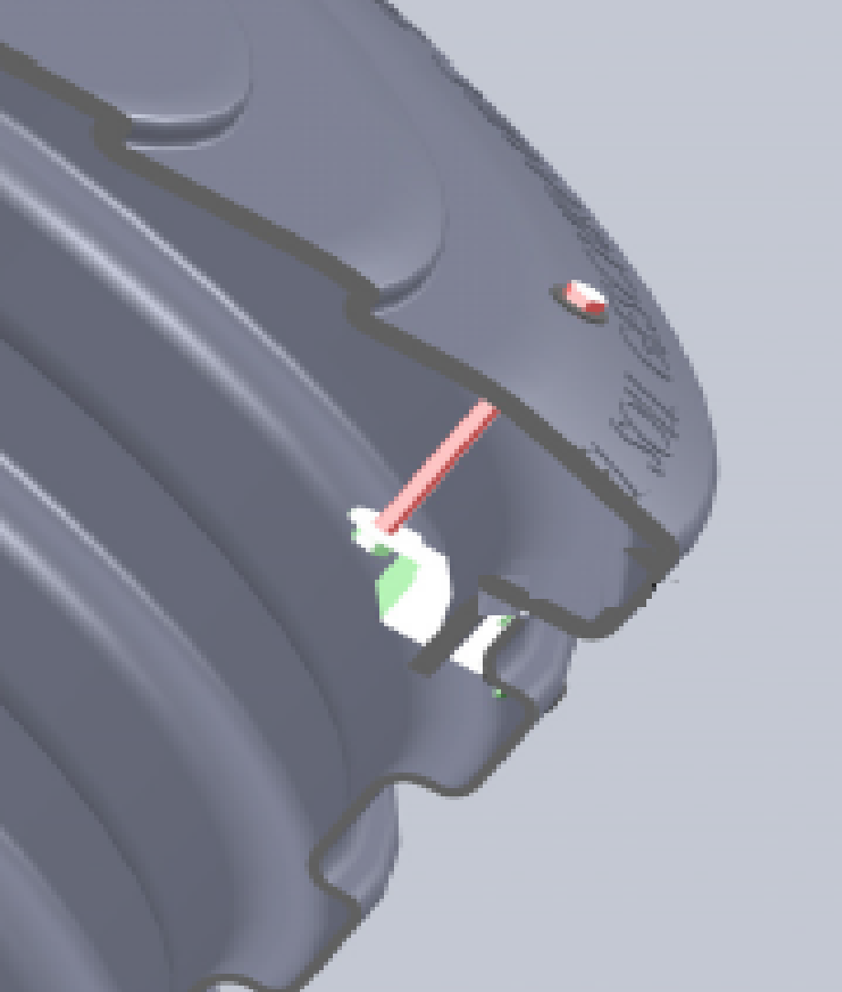

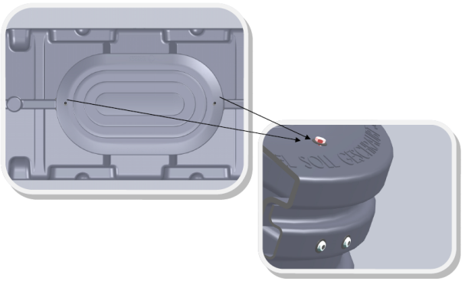
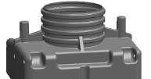
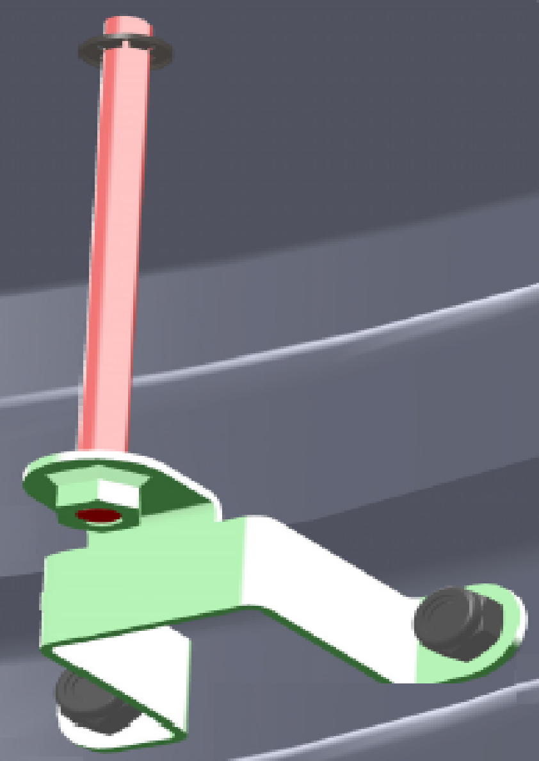


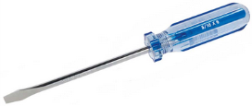

Finishing the Installation
Fitting the covers
The various lids or access covers for the system are installed just above ground level to provide easy access for maintenance.
Position the hatches and secure them with the screws positioned on the sides:
A screwdriver is all that is required
Final backfilling to ground level
Backfilling to the surface is completed once all pipework has been connected. With a maximum depth of 0.75” the backfill should consist of top soil without any stones or sharp objects.
When building up the final level of backfill around the covers keep in mind
any future settlement of the soil.
Ensure that the lids are accessible and secured with the screws.
Ensure that the final backfill reaches the cover level resulting in a tidy finish.
Seed, sod or replace turf removed.
Quality commitment

Slide 19
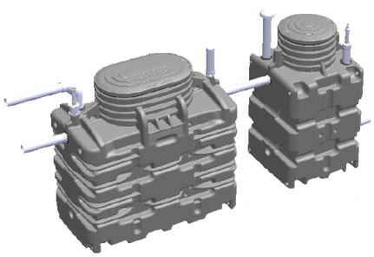
Finishing the Project
1
Clear the site
Remove all spare materials
Remove the extracted soil on the tarp
Sow seed, place sod or removed turf grass on the backfilled areas and water the area.
Present the final installation to the customer
2
Handing over the finished project to the client
Review how the project went with the client
Give the user guide to the client
Explain what regular checks the client needs to carry out
Explain any potential issues that may require contact with ACUANTIA.
Ask the customer to sign off the work on the final documents.
3
Debrief the ACUANTIA local agent
Confirm the completion of the project with ACUANTIA
Supply ACUANTIA with the “completion of construction work” document
Supply ACUANTIA with photographs taken during the installation
Complete the installation control sheet (section 5 in the user guide) and return it.
The importance of photographs
During the work on site the installer must take pictures (during all stages of installation)
In the future, these photographs may enable ACUANTIA to establish the cause of a problem and avoid potentially expensive work to rectify a situation.
The site must be returned to its original condition, grass must be sowed on excavated areas.
Do not leave site without informing the client and ensure that all questions are answered.
Take pictures of all phases of the installation: site before works, excavation, positioning of the tanks, connections, water filling and backfilling, before and after site photos etc.
Quality commitment

Slide 20
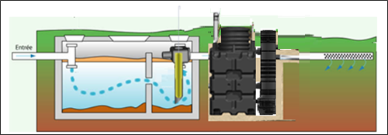
Site conditions
Installing an ECOROCK
to renovate an existing
Primary Tank

Slide 21
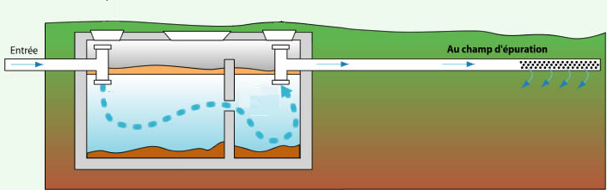
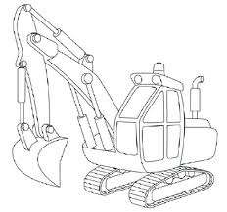

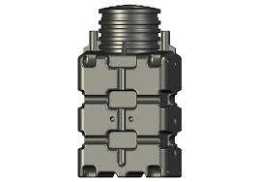

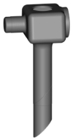

Connecting to an Existing Primary Tank
ECOROCK treatment plants can be installed following an existing septic tank. The existing septic tank then acts as a Primary Tank. The existing septic tank must be suitable and approved by ACUANTIA.
Existing septic tank
Requirements
Volume of the existing septic tank must be correct
Condition of the septic tank (no leaks etc)
Ability to install the ECOROCK primary tank pre-filter
Ability to ventilate the existing tank
Suitability of the site (access for construction and available space for the installation)
Consent from the relevant authorities
When an existing septic tank can be used as a Primary Tank the client benefits from a more economical installation.

Slide 22
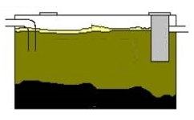


Stages of Retrofit to an Existing Tank
The method of installing a ECOROCK to an existing septic tank is identical to a normal installation. However the suitability of the existing tank must be confirmed from the outset.
Is the tank suitable?
The condition of the tank:
The tank must not leak - no holes, cracks or exposed rebar
The volume of the tank
Must be between 940 gallons or larger.
The shape of the tank:
The tank must be rectangular in shape: It is not possible to use a spherical tank.
Must be able to accept the ECOROCK pre-filter :
This must fit on the outlet side within the tank.
Stages of installation
Once these various points have been confirmed, the installation stages are similar to a standard system installation, except for the adaptation of the existing Septic Tank into a Primary Tank, this is the initial stage of the installation.
Before work begins to update the existing tank it must be properly emptied
by a specialist contractor
Adapting the existing Primary Tank
Upgrading an existing Septic Tank into a Primary Tank upstream from a ECOROCK Unit is a two stage process:
Fit ventilation
Install the prefilter
The installation of PVC connections (diameter 4”) is required for proper ventilation of the existing tank and for the efficient operation of the ECOROCK system in general.
- The construction stages: The installation and control of the ventilation
The primary tank should be fitted with a pre-filter that resembles a “stiff plastic brush”
This traps remaining suspended solids and fats, etc. resulting in a better quality of pre-treatment .

Slide 23



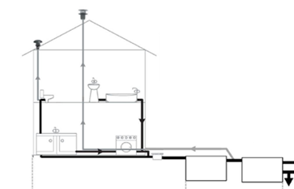




Stages of Adapting an Existing Tank
Ventilation
Efficient air extraction must be installed to remove the gas produced in the Primary Tank. Ventilation should be created using :
Connect the ECOROCK ventilation outlet to an available “knock-out” on the PT. The PT connection to structure vent stack serves as system air outlet, or
Install a ”tee” at the PT wastewater inlet and install a 4” pipe from ECOROCK air outlet. Airflow to vent stack is air outlet.
The gas extraction vent must not be located less than 16” above the roof level and at least 3 ft away from any ventilation of windows .
Installing the pre-filter
The filter is installed in the T-pipe. This is a rotationally moulded component and is positioned inside the Primary Tank at the effluent outlet.
Shows the position the filter, allowing the air to flow above it.
Detailed stages
1
2
3
4
The T-pipe can be PVC ø4”

Slide 24


Venting the Retrofitted ECOROCK Treatment Unit
Ventilation of the ECOROCK Treatment Unit: principle (example ECOROCK 450)
The venting of the Primary Tank and Treatment Unit are separated.
The primary tank has its dedicated air in and air out pipes.
The ECOROCK unit has its dedicated air in and air out pipe. A 4” PVC pipe is added on top of the ECOROCK unit.
The pipes between the PT ant treatment unit should be air tight to avoid air flow disruption in the ECOROCK unit (air tight « T pipe » - cap on effluent filter - or siphon in the pipe)
Side views
Max. 2x 90°
90° = 2x45°
Top view

Slide 25



Venting the ECOROCK Treatment Unit: Distances
Ventilation of the ECOROCK Treatment Unit: Distances
ECOROCK 450:
Max distance air-in / air-out is 50 feet.
Max 2x 90° elbows (90°= 2x45°)
50’
ECOROCK 600:
Max distance air-in / air-out is 50 feet.
Max 2x 90° elbows (90°= 2x45°)
50’
ECOROCK 750:
Max distance air-in / air-out is 35 feet.
Max 2x 90° elbows (90°= 2x45°)
30’

Slide 26

Site Conditions

Slide 27







“Traditional” layout
A traditional layout refers to an installation in optimal site conditions:
Dry ground, no high water table
Sufficient gradient on the site
Final effluent able to be discharged into a standard disposal system.
Layout:
Primary Tank
BIOROCK unit
pump shaft
Discharge
Excavation, the base and backfill material
The standard precautions specified in the installation manual are usually sufficient for a traditional layout.
Excavation base: The tanks should be placed on a pea gravel base with a grain size between 3 and 6 mm.
The backfill should be composed of the same type of material
The discharge system
The treated water will be discharged by pump into an approved disposal system
All effluent connections must be watertight when assembled. Use a watertight seal provided with the ECOROCK (to be installed at the final effluent discharge point if necessary
Discharge to an approved drainage method

Slide 28

Site conditions
Complex installations

Slide 29

Specific Situations
Type of ground
Gradient of the site
Other issues
Wet ground
High water table
Typical gradient
Steep gradient
road
Deep installation
Stage involved
Excavation
Excavation
Location
Discharge
Excavation
Finishing
Excavation
Risk
Excavation filling with ground water
Leaching of backfill
Upwards movement tanks - water pressure
Discharge by pump to disposal field
Backfill break down
Impact on the tanks
Limited access to covers
Solutions
De-watering the bottom of the excavation
Use sheet piling to support excavation & de-watering
Anchoring the tanks to the base
Unfavorable soil requires drip/dosing
supporting excavation walls
Creating load stability
Using neck extensions

Slide 30




Difficult Ground Conditions
Wet soil : Draining the bottom of the excavation
In wet ground conditions, digging a large hole is often made difficult by the progressive flow of water into the bottom of the excavation.
The bottom of the excavation has to be drained or ‘de-watered’ using a pump prior to laying the base and should be continuously drained throughout the installation, if required. Solutions such as sheet piling should be used to secure the sides of the excavation in wet conditions.
High ground water table : installation of a support structure
“High” ground water table
A “high” groundwater table will lead to water in the excavation.
The level of water table must never exceed the level of liquid inside the Primary Tank. Extremely high water tables signify a flood risk which could cause water ingress or collapsed tanks.
A support structure such as sheet piling might be necessary around the tanks to limit the risk of water ingress and collapse of the installation. A qualified civil engineer should be consulted.
If not installed properly a tank in wet ground conditions can be subject to external pressure from the water table. This might lead to the tank being crushed, collapsing or being forced upwards out of the ground.
In all wet ground conditions backfilling should be carried out to a level of 8’ below the tank covers. Lean mix concrete should be used, compacted and applied in layers of 12”.
In all wet ground conditions the base of the excavation should be constructed from lean mix concrete with a minimum depth of 12”.
- High water table: Anchoring of the units to the footing
When making good the top soil level of the installation, avoid using heavy clay soil. If the top soil to be used is predominantly clay then mix it with sand.

Slide 31






Layout: Specific Cases
High water table: Anchoring the tanks to the concrete slab
To avoid the upwards movement of the tank due to ground water pressure the tanks should be anchored to a concrete base. (A high water table level should not exceed the effluent level in the Primary tank)
Strapping tanks to the concrete base:
The tanks should be secured with non-perishable material via the stainless attachment points and anchored to the concrete base.
Careful attention should be paid to the size of the straps, attachments and anchoring points ensuring that the tanks are fully secured .
A concrete base is recommended for all tanks involved in the installation. The base should be a minimum of 12” deep.
The weight of the base should be at least equivalent to the weight of the tanks when filled with water.
Example: for a system ECOROCK 450 + PT, total weight 3600 +8000=11,600 lb, the slab will have a minimum weight of 6 tons.
Anchoring the tanks to the base:
Anchoring the tanks to the base is achieved with a system using the anchoring points, these are positioned on the lower corners of the tanks.
This system uses anchors screwed directly into the concrete slab.
A detailed assessment must be carried out for all installations in difficult ground conditions.
The depth to the bottom of the excavation and the concrete base for the Primary Tank must allow an incline of between 2% minimum and 4% maximum for the wastewater inlet pipe from the property to the Primary Tank.
Quality commitment

Slide 32






Deep Installations: Using Extension Rings
In some cases, ECOROCK systems need to be installed deeper than the standard depth allows. This is usually due to on-site levels. When working with a deep installation extension rings for the Primary Tank and ECOROCK may be required ensuring that access to the tanks is possible for maintenance purposes.
Typical installation with extensions :
Level differential
1
Position the extension in the right direction
2
Position the double-sided tape at the tank/extension connection
The tape is provided with the extension

Slide 33

Deep Installations: Installing an Extension
Do not install more than one 24” extension. Any more and access to the tanks will be an issue.
Ensure that the extensions are tightly screwed and correctly positioned, and that the lid is properly adjusted and screwed on.
Quality commitment

Slide 34

Issues Related to
Site Gradient
Steep Gradient: Installing a sampling pipe
When discharging final effluent to a site with steep gradient, gravity discharge may be an option.
Conditions:
Steep gradient
Depending upon site conditions, direct discharge of final effluent to an approved disposal system is an option.
Primary Tank
ECOROCK unit
Ø 6” sampling pipe
Discharge

Slide 35



Option: Installing the sampling pipe
The system has plastic joints and is leak-proof. These joints are pre-installed on the tanks.
For ease of installation it is recommended that you fix and strap up the sampling pipe to the treatment unit before lowering the tank into the excavation.
1
Position the seal provided with the tank
An extra seal is provided with the ECOROCK unit and must be clipped on during assembly (outlet for treated wastewater)
This seal is bagged up inside the tank.
2
Connect the sampling pipe to the tank
Discharge to approved method
Opening up the water outlets you require:
Gravity discharge with sampling pipe: Connection of the sampling pipe, ø160

Slide 36



Other Potential Requirements
Incline too steep : Creation of a of a retaining wall
A retaining wall may be necessary to ensure that the backfill does not move in a difficult installation. The thickness and structure of any retaining wall should be specified by a qualified engineer along with the method of construction and backfilling procedure.
Generally the backfill material must be compacted pea gravel or lean mix concrete applied in layers of 12”. (depending on ground conditions)
Backfill
Cast concrete
Drain
The foundations and thickness and weight of the slab, the creation of an access hatch to the Primary Tank, ECOROCK unit, sampling pipe (Ø 160 shaft) along with the design of a retaining wall and associated backfilling should all be specified by a qualified civil engineer.
Quality commitment
Roads, courtyards or storage areas: Installing a weight distribution slab
For an installation under roads, courtyards or storage areas, a distribution slab of reinforced concrete should be constructed and placed above the tanks.
This slab must be constructed in such a way that it does not rest on the tanks. The edges of the slab must rest on the surrounding ground, the ground must be stable. The slab must extend to a minimum distance of 2 ft beyond the edge of the excavation on all sides..
The air inlet vent (ECOROCK) should preferably be installed outside the concrete slab area, if this is impossible then be anchored in the slab.
The slab must be anchored into the ground surrounding the tanks. These anchors or foundations must rest on stable ground.

