Slide 1
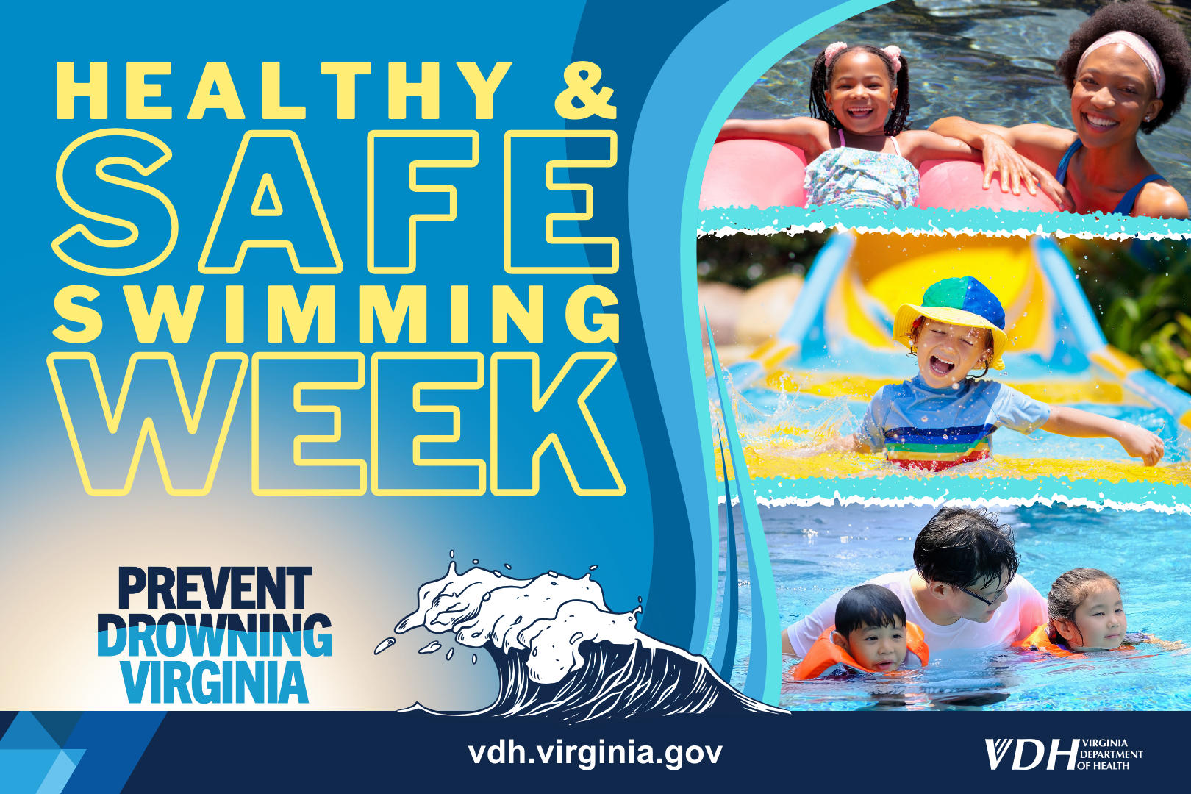
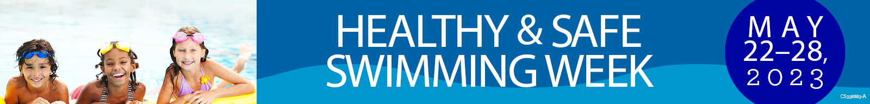

Prevent Drowning:
Swim Lessons Save Lives

Slide 2
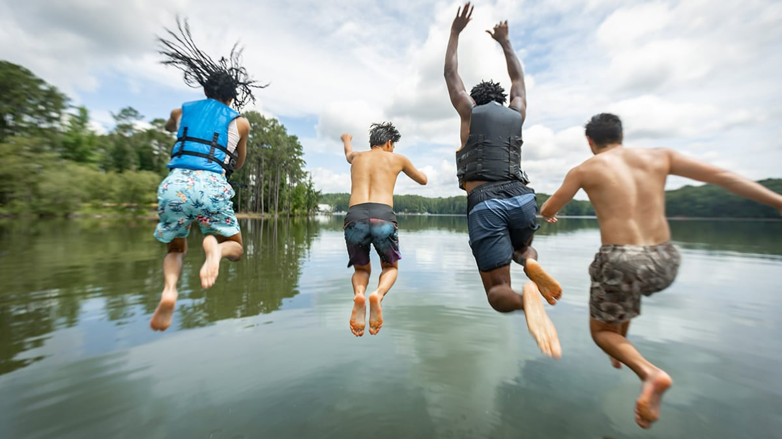
Swimming lessons can reduce the risk of drowning, but over half of U.S. adults have never taken a swimming lesson.
Learn more at www.SwimHealthyVA.com

Slide 3
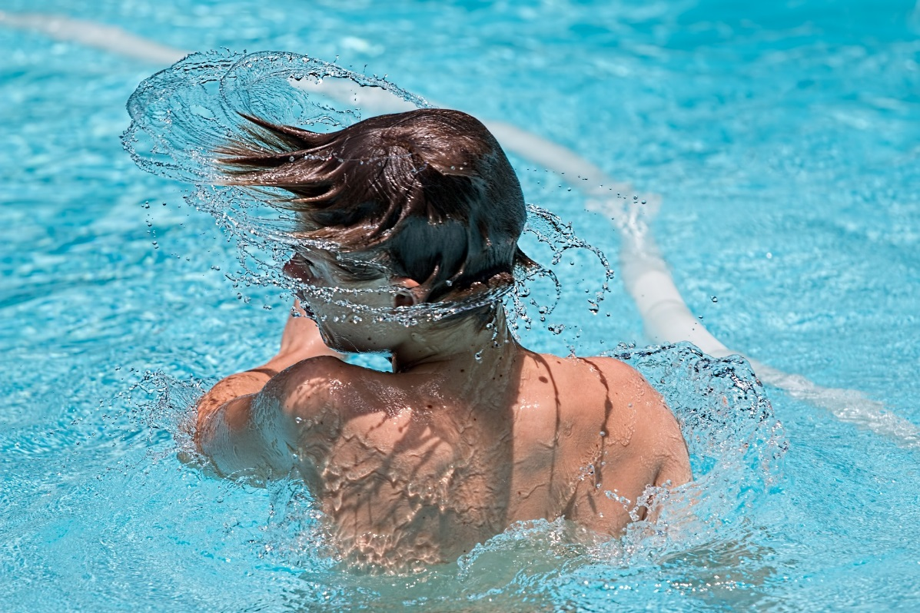
"Floaties," arm bands, or water wings do not prevent children from drowning and can easily slip off, especially when kids jump into the water.
Learn more at www.SwimHealthyVA.com

Slide 4
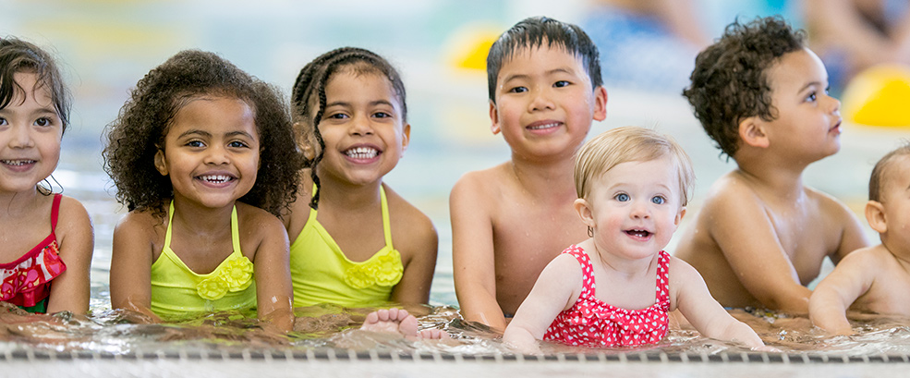
Consider enrolling children in swimming lessons. And consider swim lessons for yourself to improve your swimming skills and comfort in the water.
It's never too late to learn to swim and the benefits increase as we age.
Keep in mind that children who have had swimming lessons still need close and constant supervision when in or around water, even when a lifeguard is present.
Learn more at www.SwimHealthyVA.com

