Slide 1
VASE+ Job Aid – Create Clinic Sites
Version 1.2
Summary:
In this job aid, users will learn how to create a clinic site in VASE+. This job aid applies to Administrators, Locality Admins, and Clinic Schedulers. The clinic site is created within the context of a jurisdiction (also referred to as Locality) and corresponds to the entity that is responsible for these clinics. The clinic site corresponds to the physical location where clinics will be hosted. The address included for the clinic site will be displayed to the vaccine recipients when they create appointments at clinics conducted at the corresponding site. The VIIS Org Code is also captured at the Clinic Site level and is critical for data reporting to VIIS.
Register a new site
To register a new clinic site, navigate to Clinic Sites from the navigation bar on the left. Then click the button in the top right corner of the page titled “Create New Site”.
Figure 1 – Create a new site
This triggers a pop-up screen and prompts to user to choose the Local Health Department (i.e. jurisdiction or locality) that the site will be associated with. The user is also required to enter the address associated with the site. The address will begin to auto-fill when started in the “Address Search” box. Note: The options for the Local Health Department field will be based on the user’s access and their association with the locality (or Local Health Department) defined
The name provided to the clinic site should include a unique qualifier to distinctly identify the clinic site. Note: This should be a unique qualifier tied to the site itself since clinics created under this site will also include a distinct qualifier and the user will be prompted to enter a name for the clinic when creating the clinic schedule
A clinic will register as a VASE+ clinic by leaving the default option “Use VASE+ Registration” toggled to "Yes". If the VASE+ Registration button is changed to "No", then the clinic is registered as a VASE clinic . After clinic site information is entered, click the “Save” button.
If the clinic is registered as a VASE+ clinic, the user will be required to enter the VIIS Org Code, and the start date associated with VASE+ functionality. Select today's date (i.e. the date the clinic is being entered into the system).

Slide 2
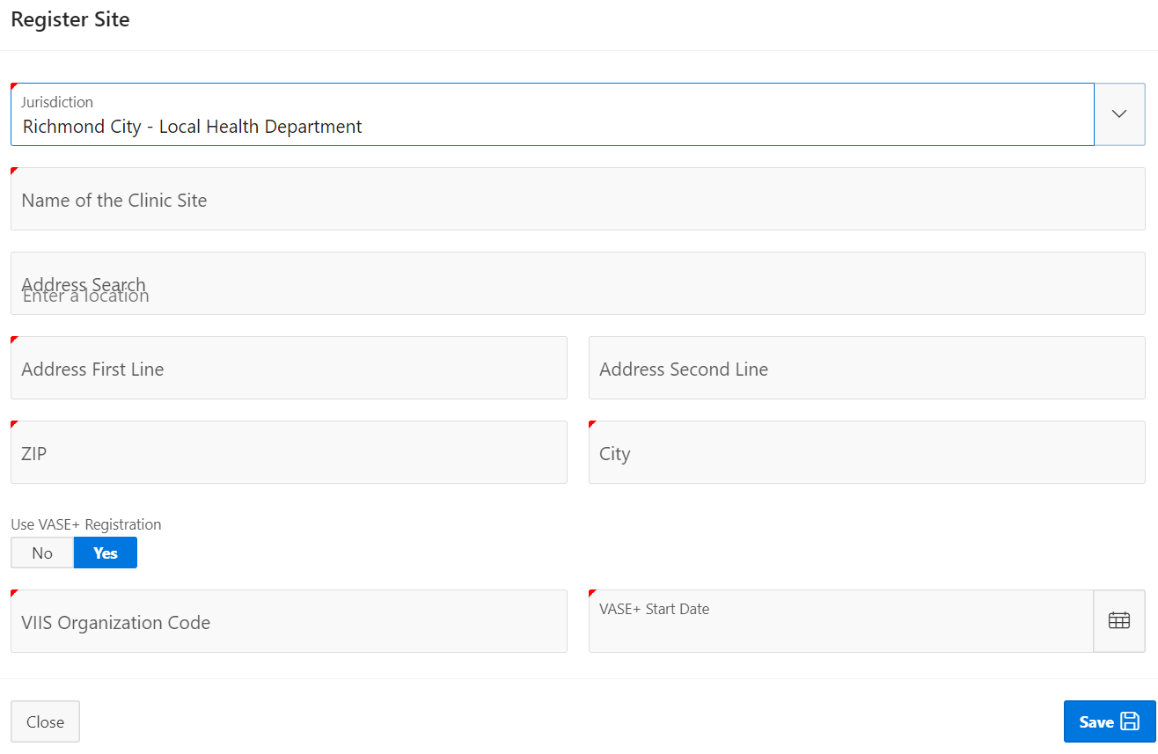
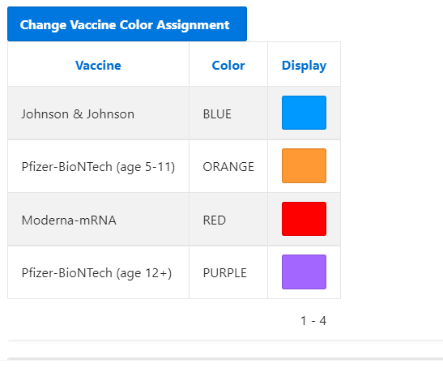
VASE+ Job Aid – Create Clinic Sites
Version 1.2
Figure 2 – Enter all mandatory field and save to create the site
Upon successful creation of a clinic site in VASE+, the user will receive the following message:
Figure 3 – Successful clinic creation notification
After a site has been registered in the system, users are able to view and edit the colors assigned to each vaccine type at the clinic. Users can leave the colors as-is if they prefer the default colors. If users would like to change the color-coding of the vaccine types, they can click the “Change Vaccine Color Assignment” button.
Figure 4 – Changing vaccine color assignments

Slide 3
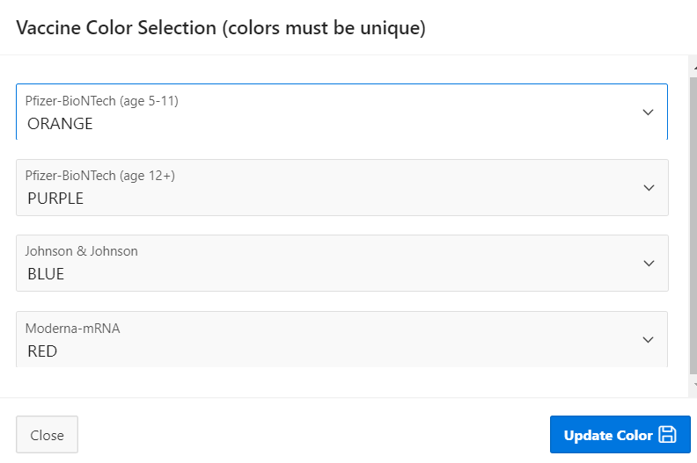
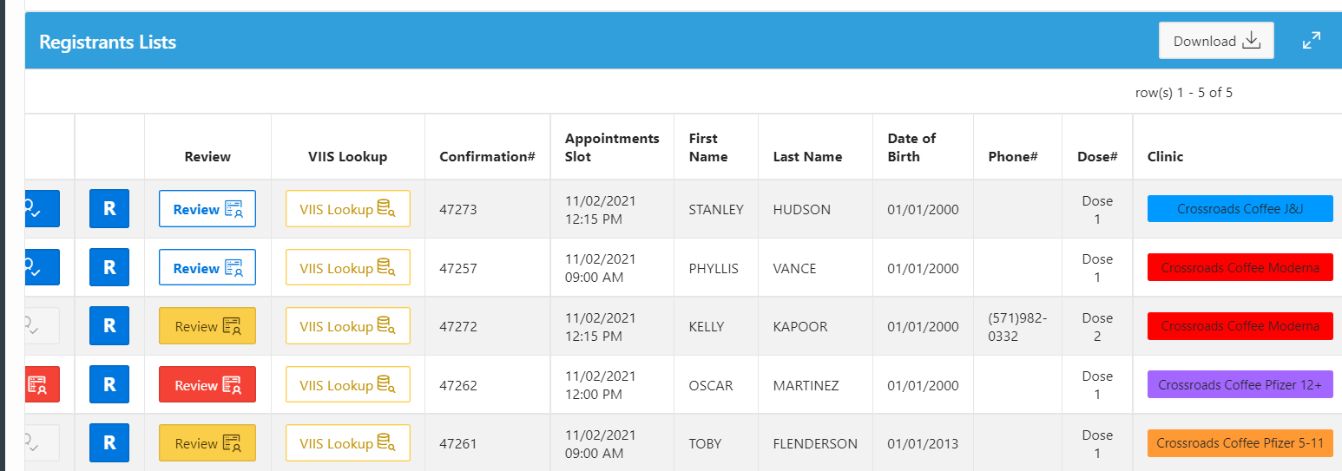
VASE+ Job Aid – Create Clinic Sites
Version 1.2
Users will be able to customize the vaccine color assignments using the dropdown list next to each vaccine type. The available colors for assignment include orange, blue, green, pink, purple, red, and yellow. Please note that each vaccine type must have a unique color assigned.
Figure 5 – Vaccine color assignment dropdown
Assigned colors will display in the clinic column for each registrant during day-to-day clinic operations. Colors are assigned at a site level and will reflect at all clinics occurring at a specific site.
Figure 6 – Color-coded clinics
Once the Site has been successfully created, it shows up in the Inactive Clinic Sites tab. A clinic schedule needs to be added to the clinic site in order to make it Active. Please use the Create Clinic Schedule job aid for a guide to creating a schedule for your clinic Note: If there are no clinic schedules for the current day or in the future, the clinic will revert back to an Inactive Clinic Site.
Figure 7 – Inactive Clinic Site

