Slide 1
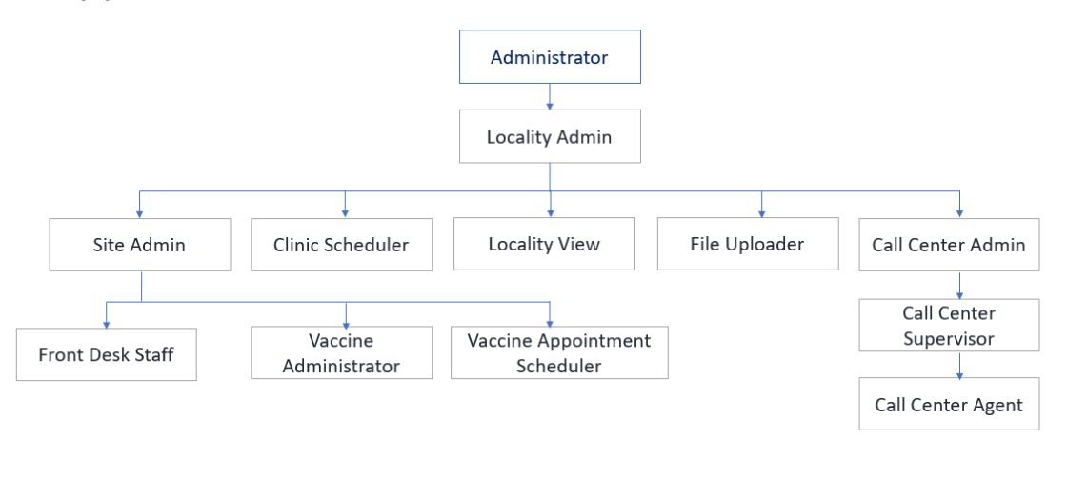
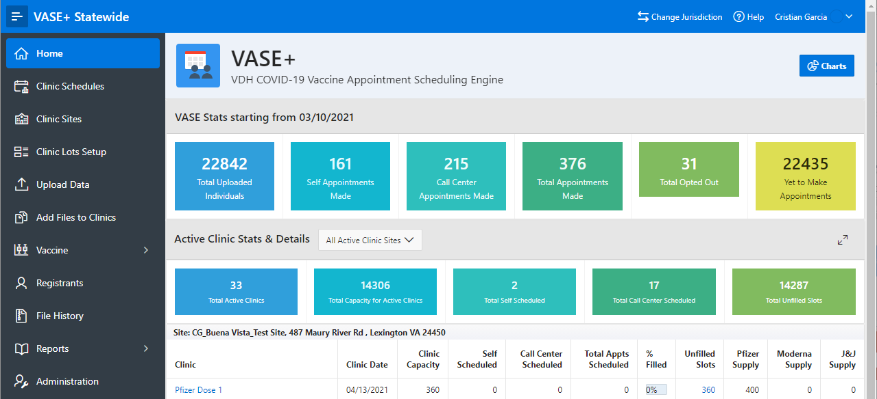
VASE+ Job Aid – Assign User Roles
Version 1.1
In this job aid, users will learn how to assign user roles. User role assignment in VASE+ is based on a hierarchical model. Users can grant permissions to other users in roles that are lower in the hierarchy. This can be accomplished through the Administration module in the system.
VASE+ User Role Hierarchy
The following diagram represents the user role hierarchy in VASE+
Figure 1 – User Role Hierarchy
Assigning User Roles
Click on “Administration” module at the bottom of the navigation menu on the left.
Figure 2 – Administration Module from the Navigation Bar

Slide 2
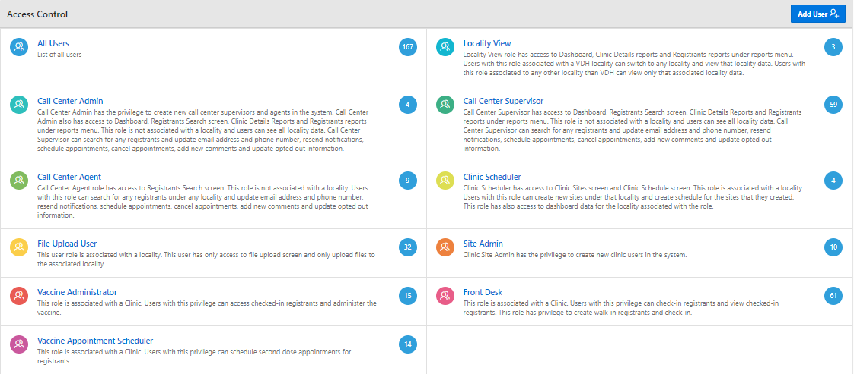
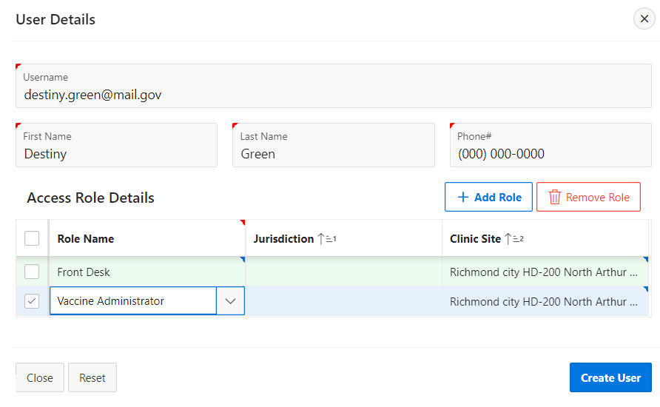
VASE+ Job Aid – Assign User Roles
Version 1.1
Assigning User Roles (Continued…)
The administration page has many options to add user roles which are defined by access control.
From access control you can add a user, upload users, or view current users.
Figure 3 – View users by each role by clicking on the associated tile
Add User and Assign Roles
Click on “Add User.”
Fill out the user details.
Click on the “+ Add Role” button
Click on the rows below role name or clinic site
to access corresponding drop-down menus.
Add access roles by searching and selecting the
role name.
Add a clinic site to each role by searching and
selecting the clinic name.
Add additional roles by pressing the “+ Add Role” button.
Click on “Create User” when finished.
Note: When a new user account is created a notification email will be sent to the user to complete the registration.
Figure 4 – Add a new user account and assign permissions

Slide 3
VASE+ Job Aid – Assign User Roles
Version 1.1
Upload a User File and Assign Role
Site Admins may upload users via file upload.
Click on “Upload Users.” - In the Upload Users window the system allows for the submission of a predefined list of users to be assign to a specific role.
Search and choose a role, a locality (if applicable), and a clinic by clicking on each corresponding sections dropdown menu.
Choose a user file to upload. Only XLSX or delimited (CSV) files are supported.
Figure 5 – Upload Users Button
Figure 6 – Upload Users
Users may be uploaded for multiple roles and/or multiple clinics at the same time.
Use the search button to select the file you wish to upload. Click on the small question mark icon to view the steps to upload the file as well as file format. Once the file has been selected, click the Upload button to add the users to the system.
Figure 7 – Upload Users for Multiple Roles or Clinics

Slide 4
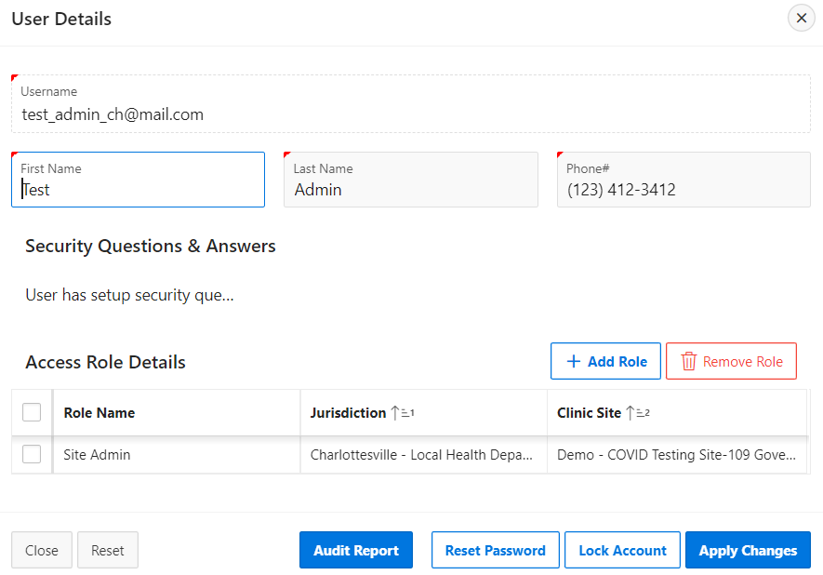
VASE+ Job Aid – Assign User Roles
Version 1.1
Add a User Roles or Edit User Roles by Viewing Current Users
In the Administration – Access Control window user access control groups are visible.
Click on a user control access category to view the users in that access control group.
Figure 8 – View User Control Groups
The user role group will list all current users in that role.
All present users in the system can be searched and edited.
Figure 9 – Edit permissions for an existing user
Editing a particular user allows for the addition or removal of roles for that user’s account.
Editing also gives the option to reset an account password and or block a particular user account depending on administrative level and permissions.
Figure 10 – Update permissions, lock account, and reset password
Click “Apply Changes” when finished.
Figure 11 – User profile update confirmation

Slide 5
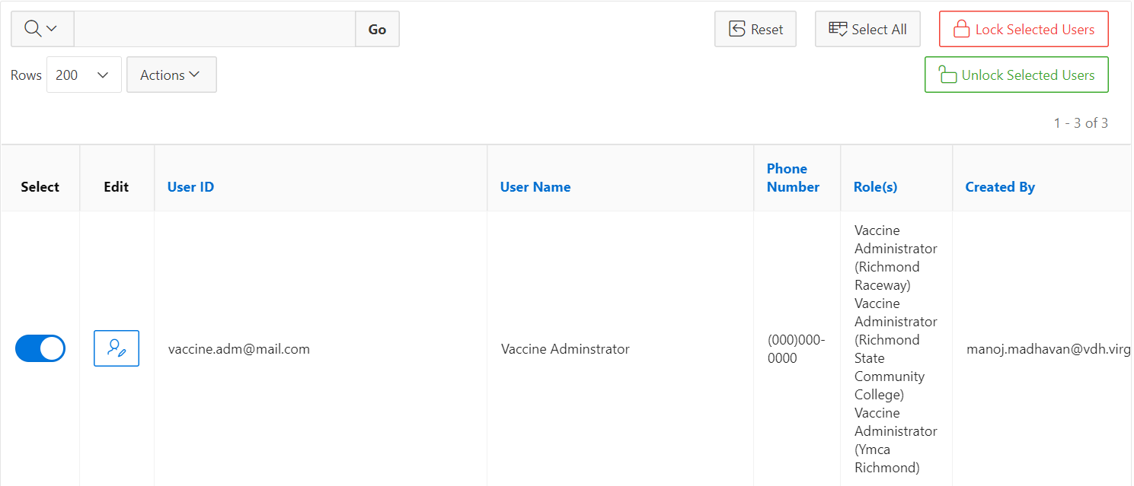
VASE+ Job Aid – Assign User Roles
Version 1.1
Lock and Unlock Users
Click on “All Users” or the user group where you would like to lock or unlock accounts.
Search for the user(s) you wish to select, filter under “User ID” or “User Name” for the user(s) or scroll down the list until you find the user(s).
Select user(s) by clicking the toggle switch. Multiple users can be selected at once. The toggle switch will turn blue if that account is selected, as shown in Figure 10 below.
Click “Lock Selected Users” or “Unlock Selected Users” once all users have been selected. This will lock their account. Once the account has been locked, the row will be shaded red (Figure 11 below). If an account is unlocked, the row will turn from red to white. A user’s account may be unlocked again after it has been locked.
Figure 12 – Lock and Unlock Users
Figure 13 – A Locked User Account

