Slide 1
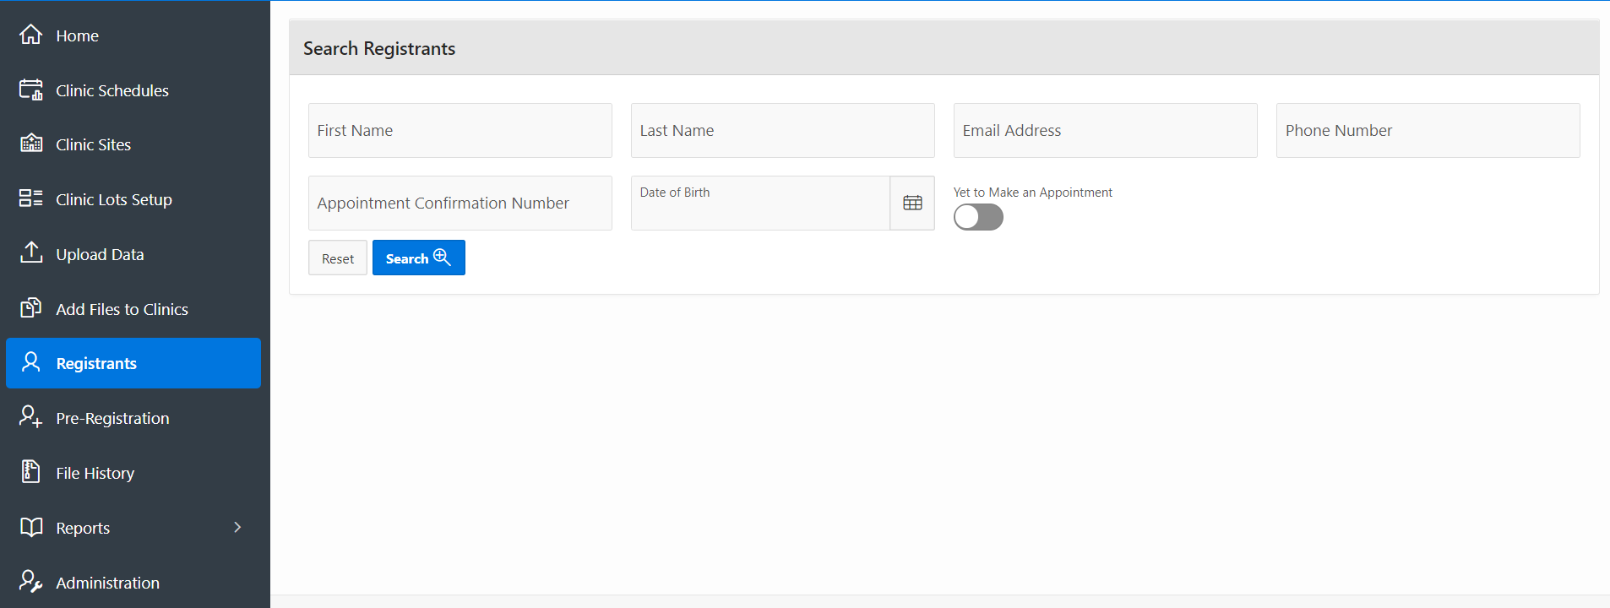
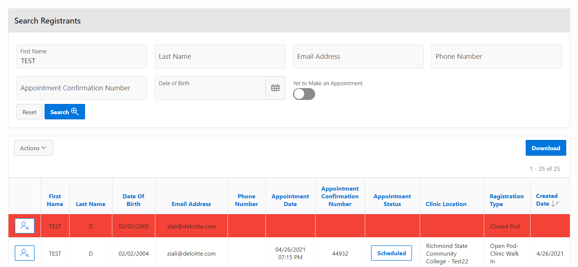
VASE+ Job Aid – Search Registrants
Version 1.1
In this job aid, users will learn how to use the Search Registrants and Pre-Registration features in VASE+. These features are available to call center roles only in addition to Administrator and Locality Admin and will display all registrants within the jurisdiction of the operator. Through registrant searches individuals can be identified for follow-up on 1st and 2nd dose appointment scheduling; as well as provide additional information on the status of an individual's sate in the registration process.
Search Registrants
Click on “Registrants” from the navigation menu on the left. In the Search Registrants search engine, a registrant can be searched by any this categories: Fist Name, Last Name, Email Address, Phone Number, Appointment Confirmation Number, and Date of Birth. (Note: Combining search criteria elements will yield the best results.)
The toggle switch “Yet to Make an Appointment” will look for people in the system that have yet to make an appointment allowing for prioritization scheduling of this individuals during a search.
Figure 1 – Search Registrants Engine
Results of the search will be displayed in a list at the bottom in color codes:
White colored rows are cleared for scheduling and there is a current availability for an appointment.
Red colored rows are not cleared for scheduling and or there is no current availability for an appointment.
The search results can also be downloaded using the “Actions” button.
Click on the “View” icon to review a registrant.
Figure 2 – Administration Module from the Navigation Bar

Slide 2
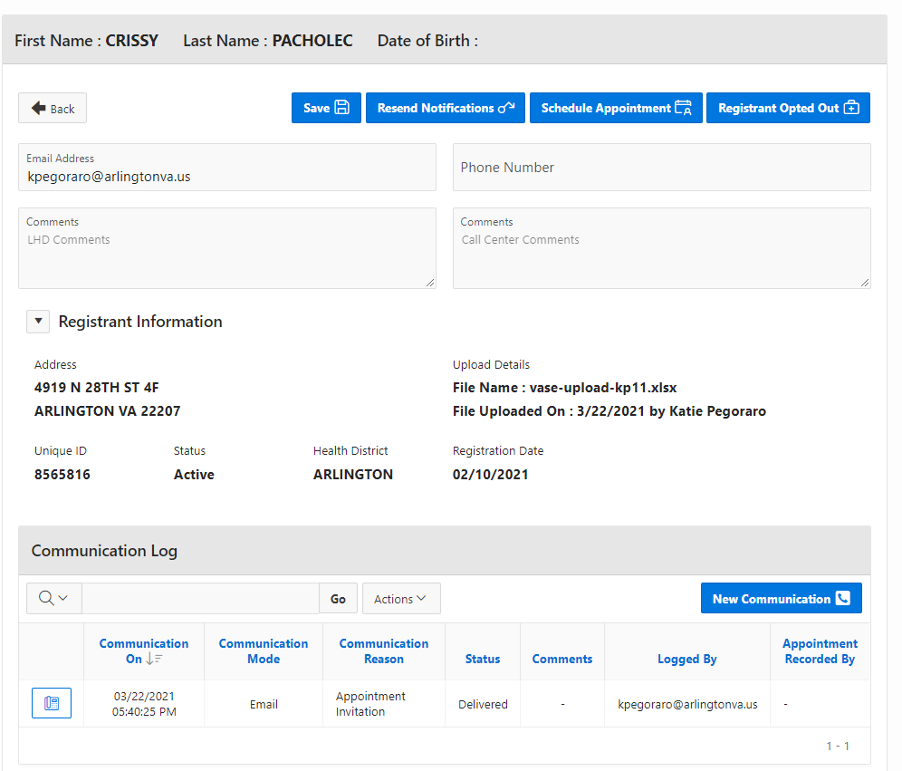
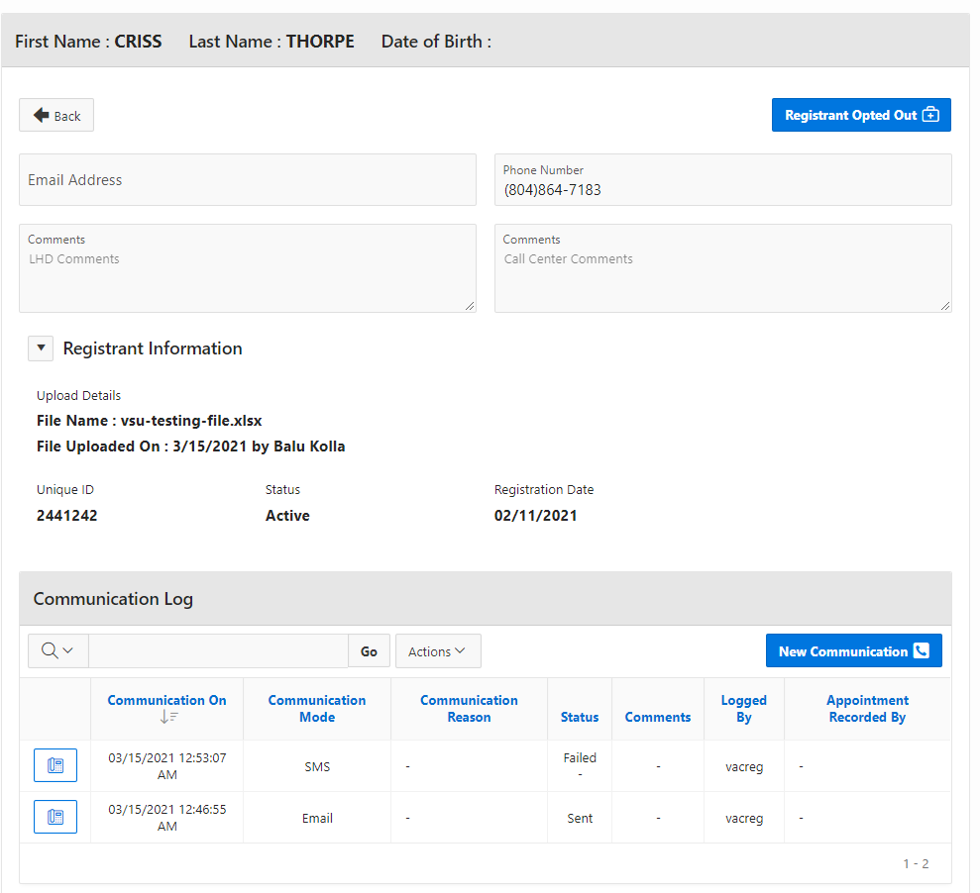
VASE+ Job Aid – Registrant Search
Version 1.1
The two possible outcomes are shown below:
White Color Code Registrants
Cleared for Scheduling
Operator permissions:
Resend Notifications
Contact the Recipient:
Email
SMS
Phone
Schedule Appointment
Optout a Registrant per Recipient Request
Add Comments
Save changes
The available clinics displayed consider the business rules around vaccine type and only display the relevant clinic for 2nd dose appointment scheduling
Figure 3 – White Row: Scheduling and Appointment Available
Red Color Code Registrants
Not Cleared for Scheduling
Operator permissions: None
Note: At this moment registrants color coded red are attached to a list for scheduling that is no longer cleared for scheduling. No further action is necessary due workflow restrictions.
Figure 4 – Red Row: Scheduling and or Appointment Not Available
Note: The two possible outcomes will also show history and status of all prior communications.

