Slide 1
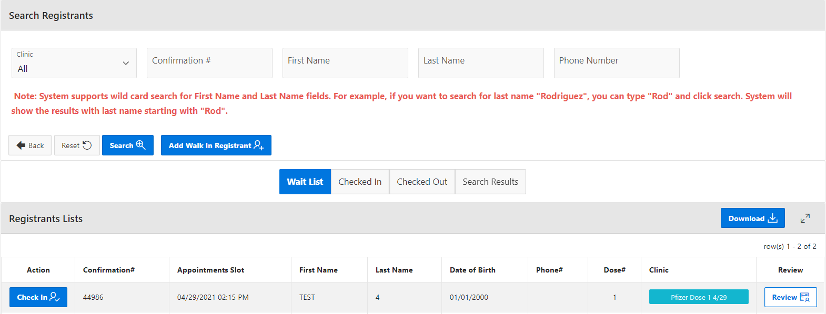
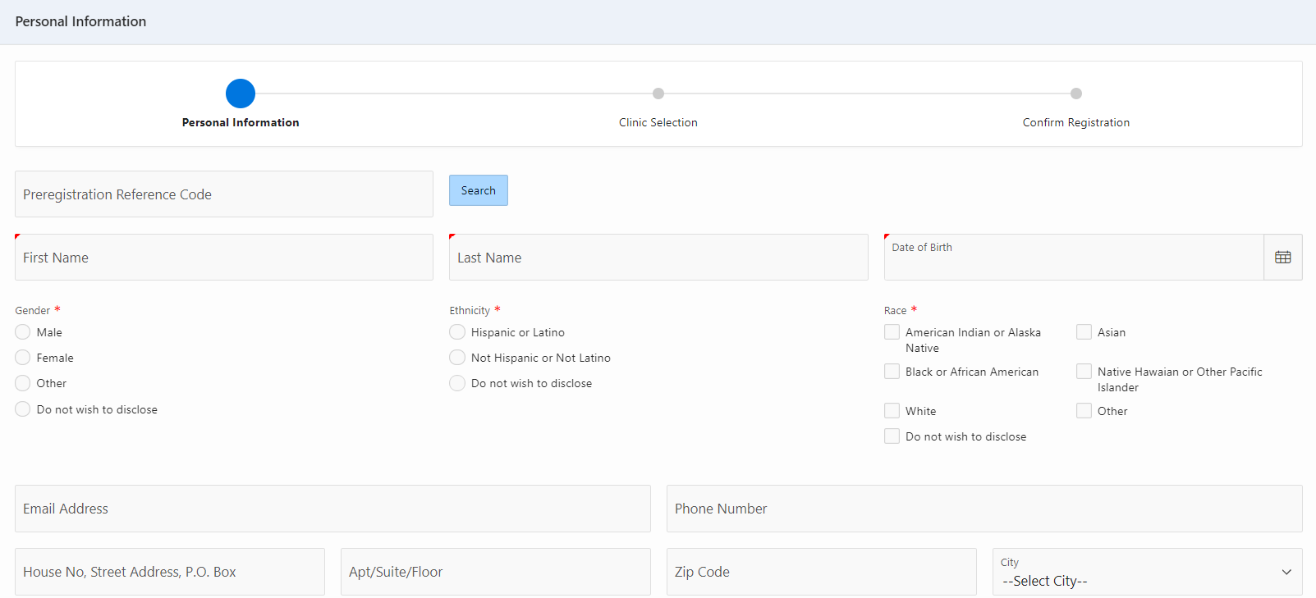

VASE+ Job Aid – On-Site Appointment Scheduling
Version 1.1
Summary:
In this job aid, users will learn how to schedule on-site appointments in VASE+ for registrants that are not currently in the system. Appointments may be scheduled either for a walk-in the same day or for a future day at the clinic. This job aid apples to the Front Desk role and Site Admin.
Creating a Walk-In Registration
To add a walk-in registration, click “Add Walk-In Registrant” on the Registrant List for the clinic.
Figure 1 – Add a Walk-in Registrant
The user will then move onto filling out all patient information, medical screening information, and obtain EUA consent and patient signature
Figure 2 – Fill out walk-in registrant’s information

Slide 2
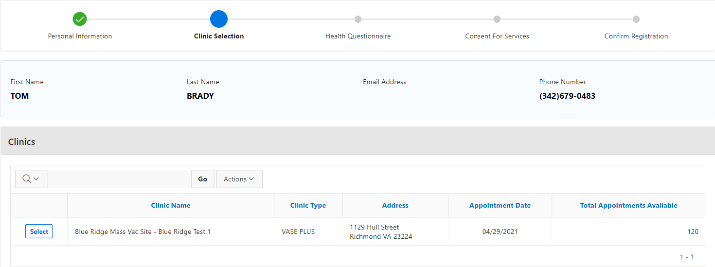
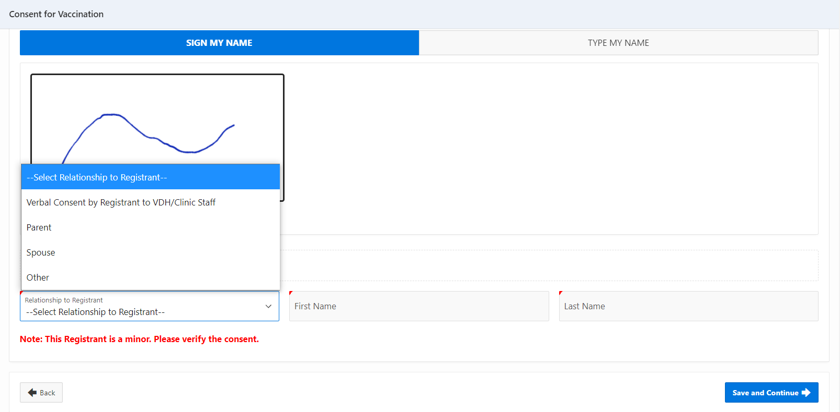
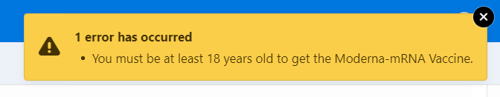
VASE+ Job Aid – On-Site Appointment Scheduling
Version 1.1
Select the correct clinic for the walk-in
Figure 3 – Upon creating a walk-in registrant, they will be added to the Wait List
NOTES FOR WALK-IN REGISTRANTS WHO ARE MINORS:
If the registrant is a minor, in the “Consent for Vaccination” section the consent must be given by an adult accompanying the minor. The “Self” option will not be available for the registrant. The front desk operator must receive consent from an accompanying adult before checking the minor in.
Figure 4 – Signature Options for Minors
Additionally, if a minor is trying to walk-in at a Moderna or Johnson & Johnson clinic, the registrant will be blocked from continuing the process. A yellow pop-up window will appear and the process will be halted.
Figure 5 – Signature Options for Minors

Slide 3
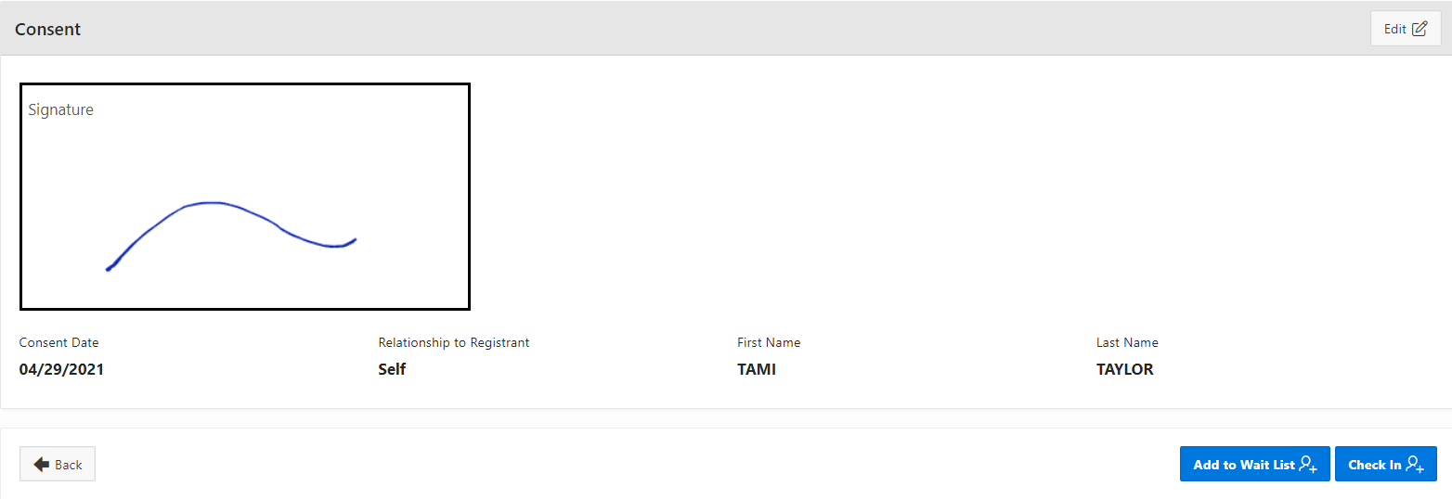
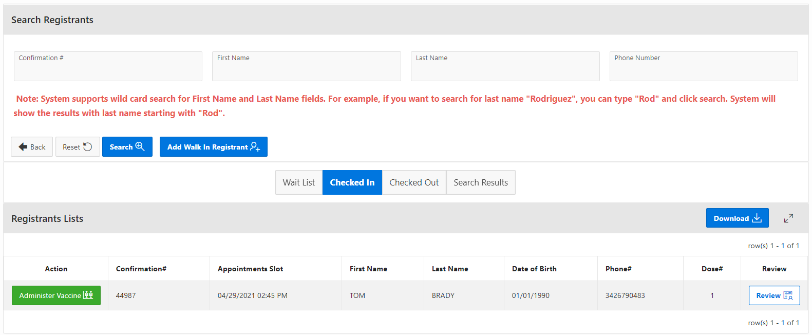
VASE+ Job Aid – On-Site Appointment Scheduling
Version 1.1
After the clinic has been selected, have the walk-in registrant complete the health screening questionnaire. After the questionnaire, the registrant will sign the consent form.
Finally, the user will review the information entered for the walk-in registrant. There are buttons to “Edit” for every section, if needed. The user can then choose to add the registrant to the waitlist or check them in immediately.
Figure 6 – Add a registrant to the waitlist or check-in
The registrant will then appear in the tab that the user clicked. See Figure 5 below for the walk-in registrant that was checked in.
Figure 7 – Walk-in Registrant in Checked in

Slide 4
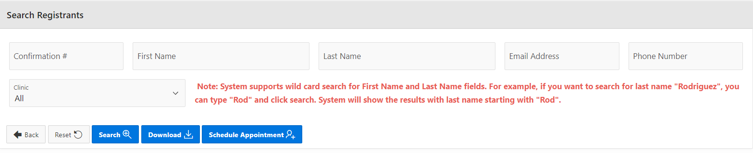
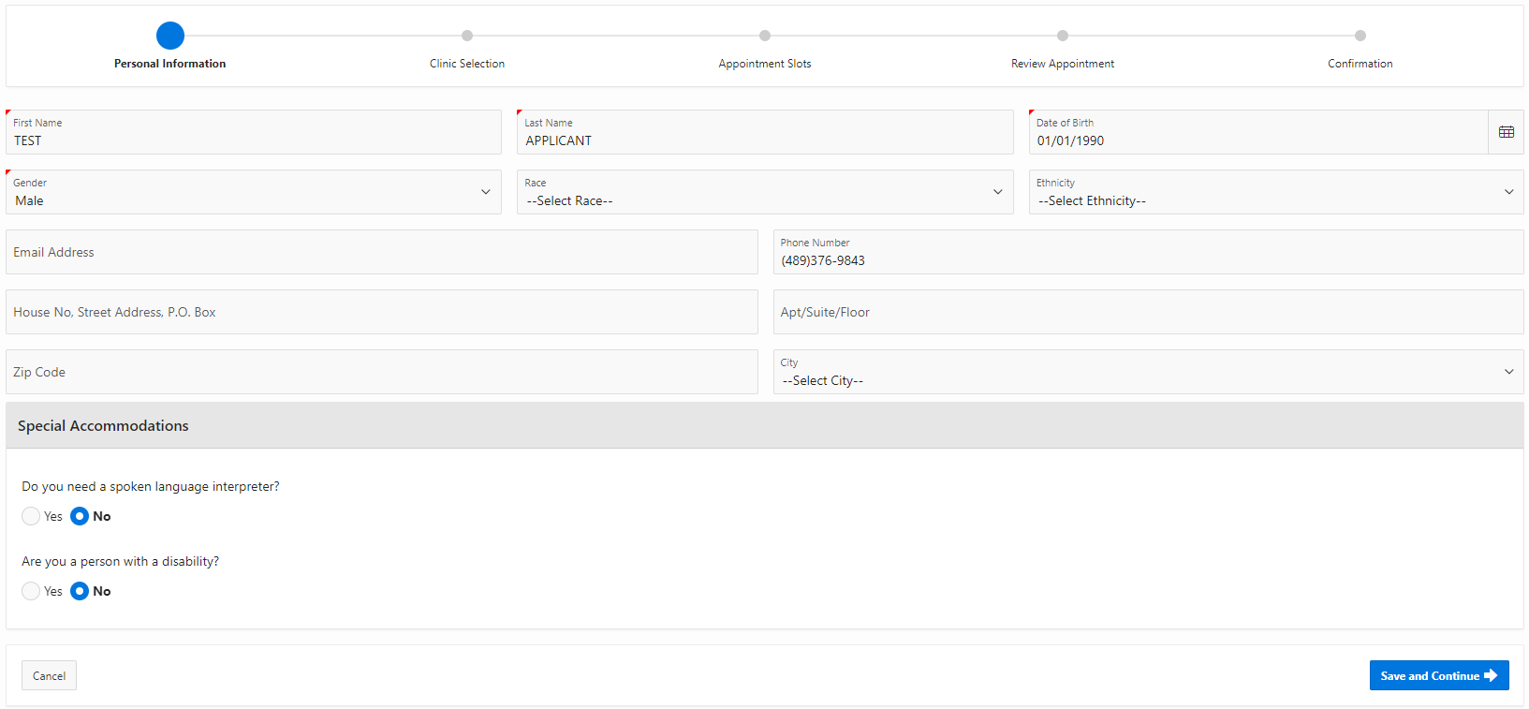
VASE+ Job Aid – On-Site Appointment Scheduling
Version 1.1
Scheduling for a Future Date
Any person who wishes to register for a vaccine may schedule an appointment at the site for a future date. If this occurs, begin by selecting the clinic schedule date that the registrant wishes to be vaccinated on.
Figure 8 – Selecting Clinic for Future Appointment
From there, select the “Schedule Appointment” button to begin scheduling the appointment. After this step, the registration process is very similar to that of a walk-in.
Figure 9 – Scheduling Future Appointment
Fill out the registrant’s personal information in the form below and click “Save and Continue” to move forward.
Figure 10 – Completing Personal Information

Slide 5
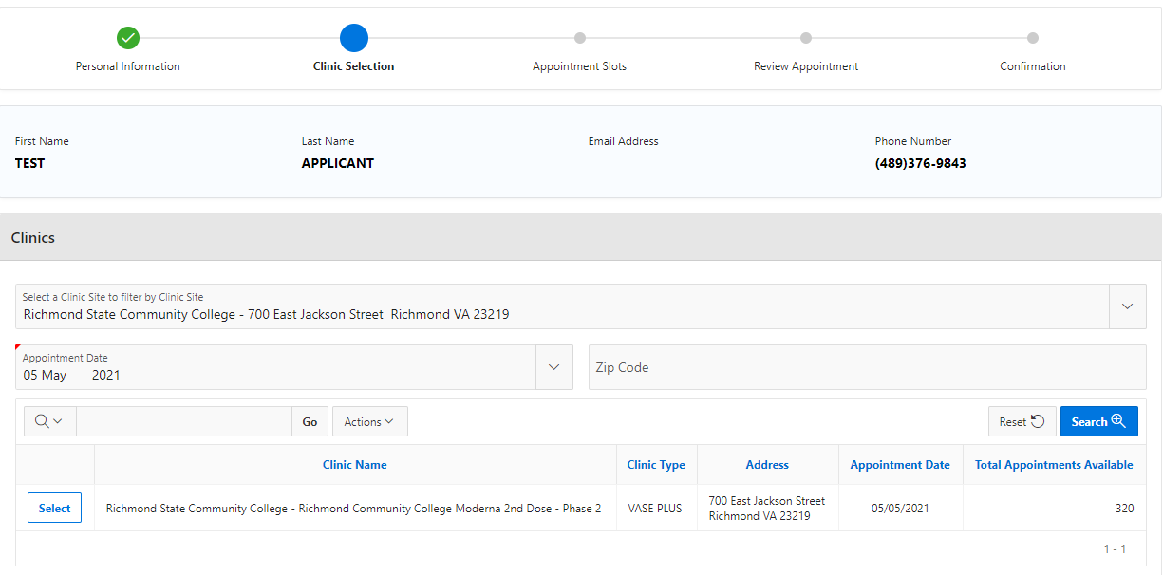
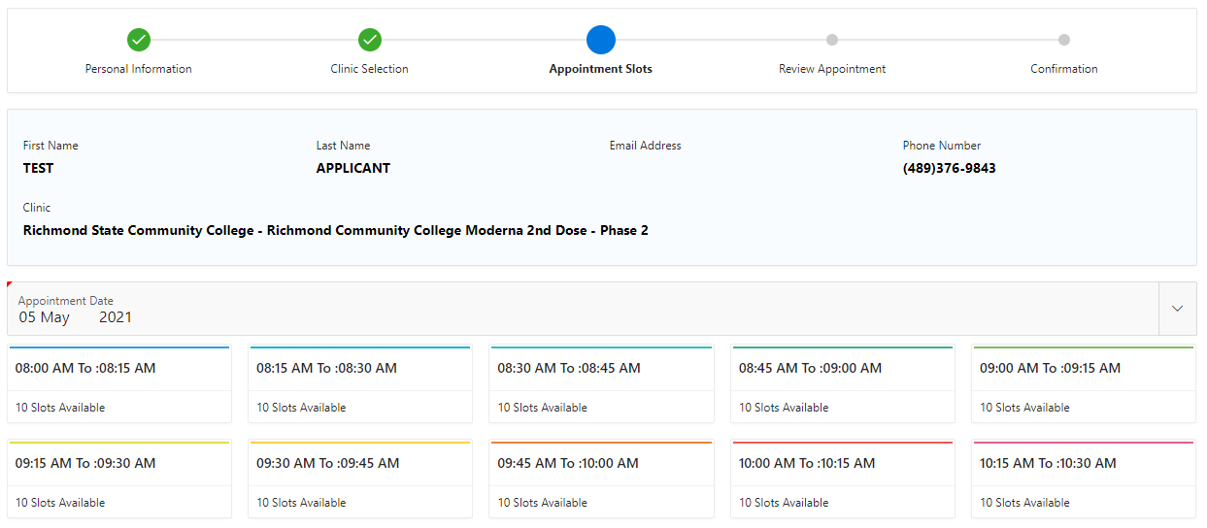
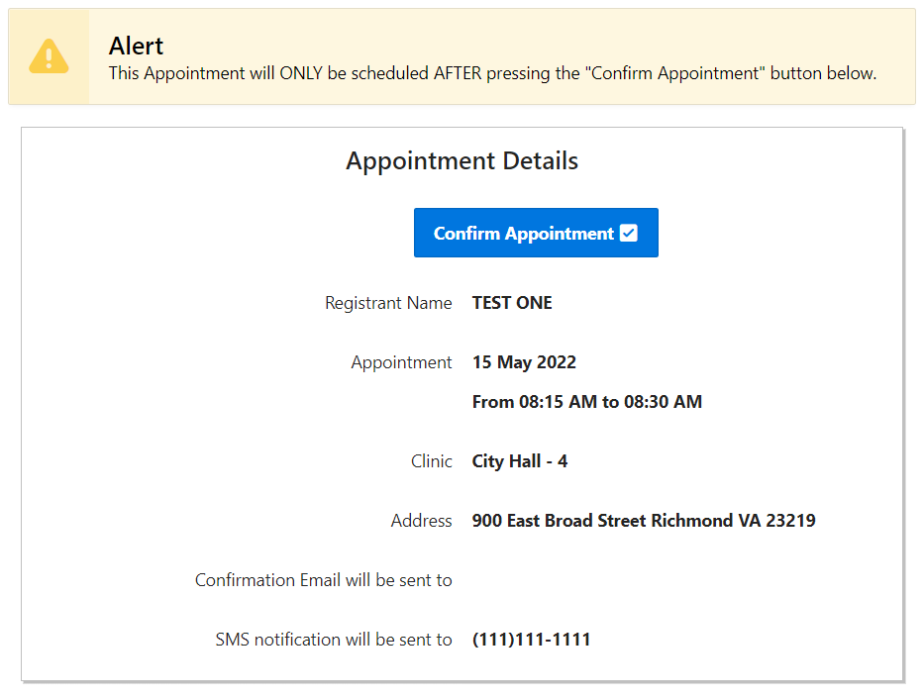
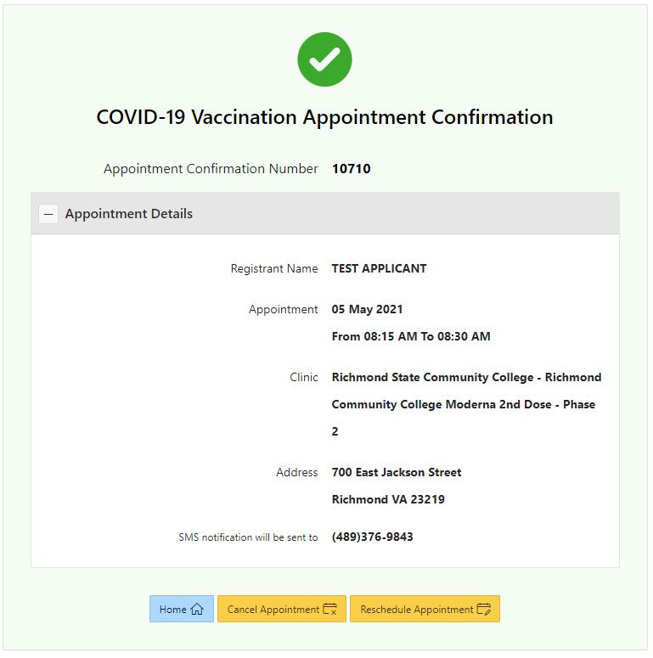
VASE+ Job Aid – On-Site Appointment Scheduling
Version 1.1
Scheduling for a Future Date
Select the Clinic Site and Appointment Date by clicking “Select” next to the Clinic Name.
Figure 11 – Selecting the Clinic Site
Select the appointment timeslot the applicant chooses. You will automatically be taken to the next screen.
Figure 12 – Selecting Timeslot
Finally, click “Confirm Appointment” and you will be shown a confirmation screen.
Figure 13 – Confirming Appointment
Figure 14 – Appointment Confirmation

