Slide 1
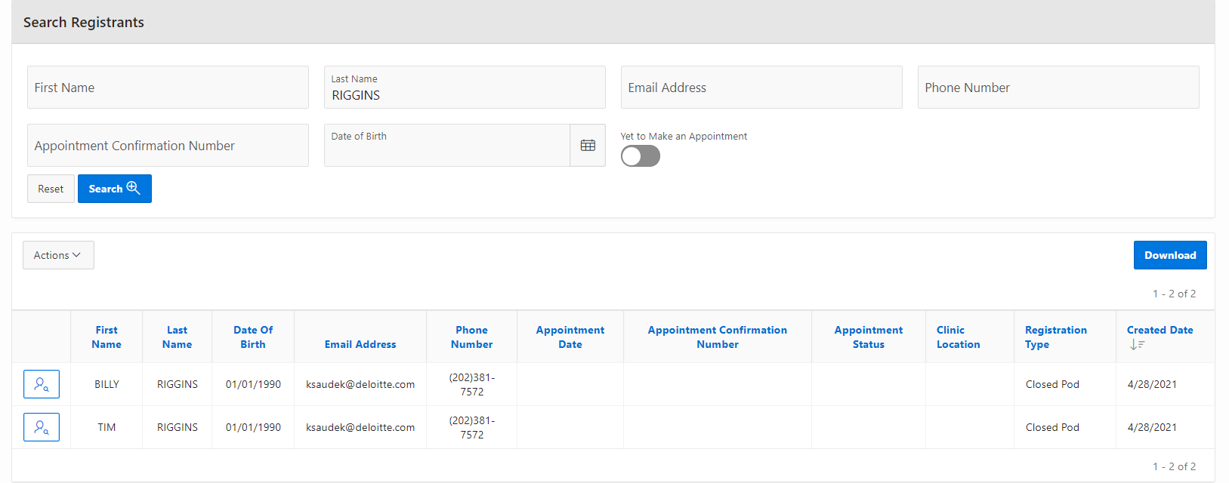
VASE+ Job Aid – Vaccine Recipient Notifications
Version 1.0
In this job aid, users will learn how to initiate registrant communications via VASE+. This user guide applies to the Call Center Admin, Call Center Supervisor, and Call Center Agent.
Registrant Search
In order to locate the recipient of the communication, navigate to the “Registrants” tab from the homepage.
Figure 1 – Select Registrants from the homepage
In the Registrants page, a user can search by the following criteria:
First Name
Last Name
Email Address
Phone Number
Appointment Confirmation Number
Date of Birth
Yet to Make an Appointment
Figure 2 – Registrant Search Results

Slide 2
VASE+ Job Aid – Vaccine Recipient Notifications
Version 1.0
Upon search results generating, the user clicks on the icon in the first column to view the registrant’s details.
Figure 3 – View Registrant Details
At the bottom of the Registrant’s profile, the Communication Log shows the date and time of communications, communication mode, communication reason, communication status, comments, logged by user, and appointment recorded by user.
To create a new communication, select the “New Communication” button.
Figure 4 – Click the “New Communication” button
Upon clicking the “New Communication” button, the user can select the communication mode: email, SMS, or phone. The user can also enter comments about the event. To update the Communication Log, the user must select “Save”.
Figure 5 – Select the communication mode from the drop down and select “Save”

Slide 3
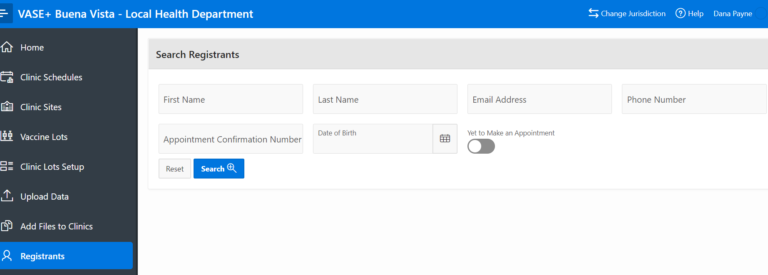
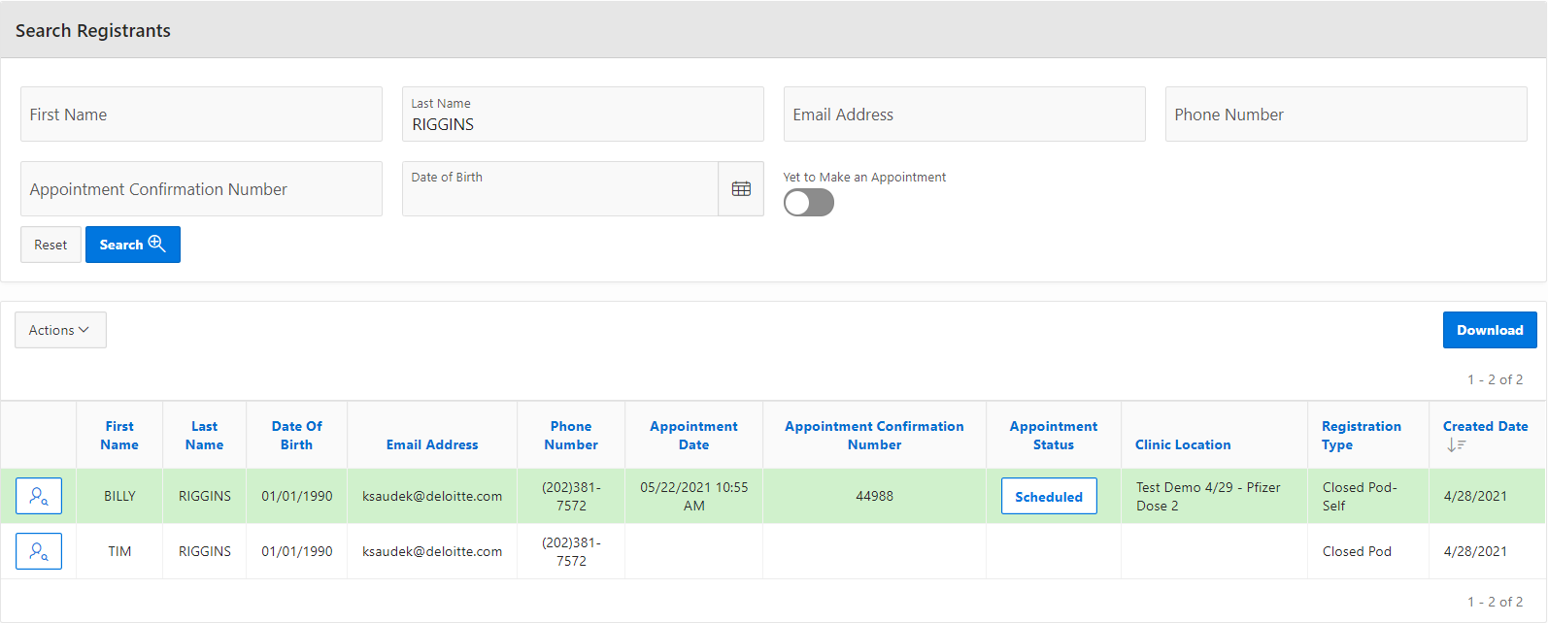
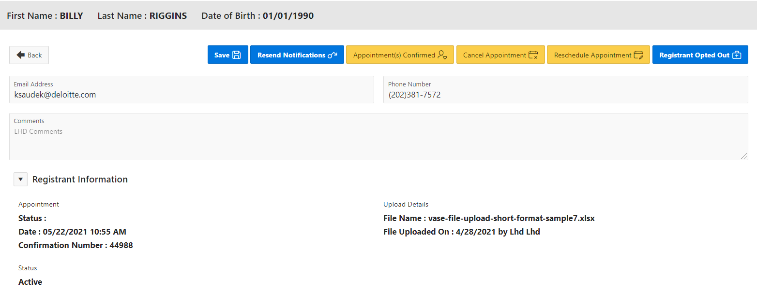
VASE+ Job Aid – Vaccine Recipient Notifications
Version 1.0
Reschedule Appointment
To reschedule a registrant’s appointment, navigate to the Registrants tab from the homepage. The user can then search by First Name, Last Name, Email Address, Phone Number, Appointment Confirmation Number, Date of Birth, and Yet to Make an Appointment
Figure 6 – Navigate to the registrants page
Upon entering search criteria and selecting the “Search” button, related search results will appear in a table below. Select the icon to the left of the patient’s record.
Figure 7 – Search for the registrant and view the profile
In the registrant’s profile, the user can then select the “Reschedule Appointment” button
Figure 8 – Select the “Reschedule Appointment” page

Slide 4
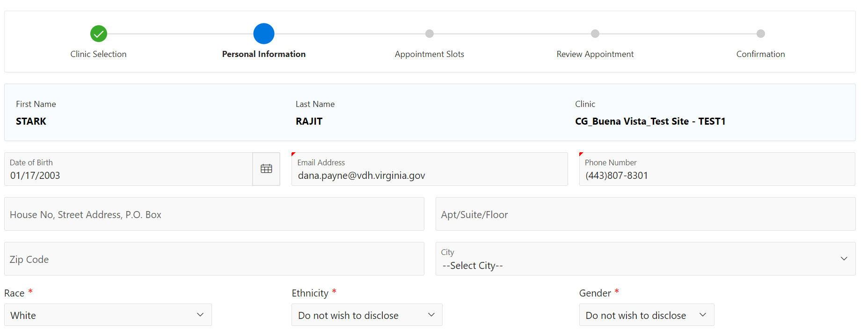
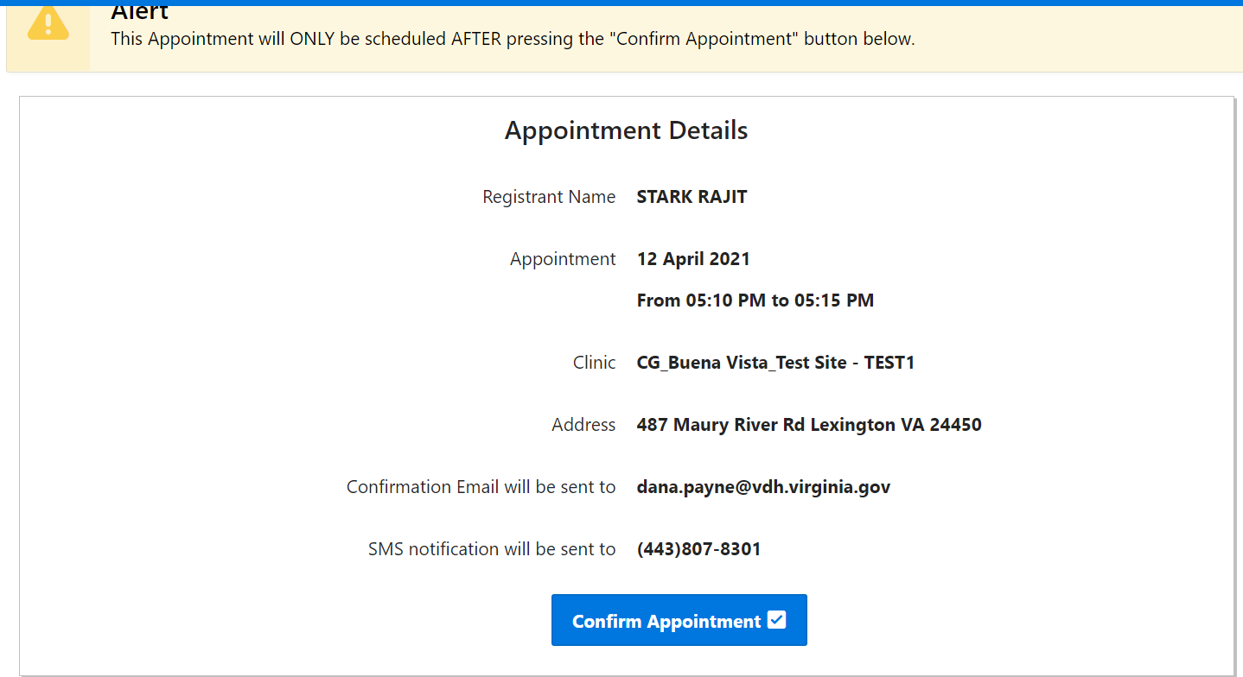
VASE+ Job Aid – Vaccine Recipient Notifications
Version 1.0
The user will be prompted to select the clinic and new time for the registrant’s appointment, then will be sent to the registration process where the registrant’s data must be completed again.
Figure 9 – Complete registrant process and select new appointment time
Upon completing the registration process and selecting a new appointment time, the user will confirm the new appointment by selecting “Confirm Appointment”.
Figure 10 – Confirm Appointment

