Slide 1
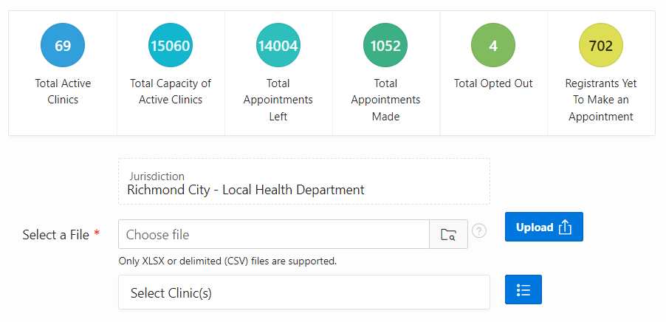
VASE+ Job Aid – File Upload
Version 1.1
In this job aid, users will learn how to upload files to VASE+ which can then be assigned to specific clinics. This guide applies to the file upload user role.
File Upload
In order to navigate to the file upload page, select the “Upload Data” tab,
Figure 1 – Select Upload Data from the homepage
On the Upload Data page, users can see summary metrics related to clinics and appointments. To upload a file, the user will select the jurisdiction the data is assigned to. The user will then click the blue icon next to the “Select Clinic(s)” field.
Figure 2 – Select the jurisdiction data will be assigned
The Select Clinic pop-up will allow for a search of clinic sites the user wishes to assign the file data to. Data can be assigned to one or more clinics.

Slide 2
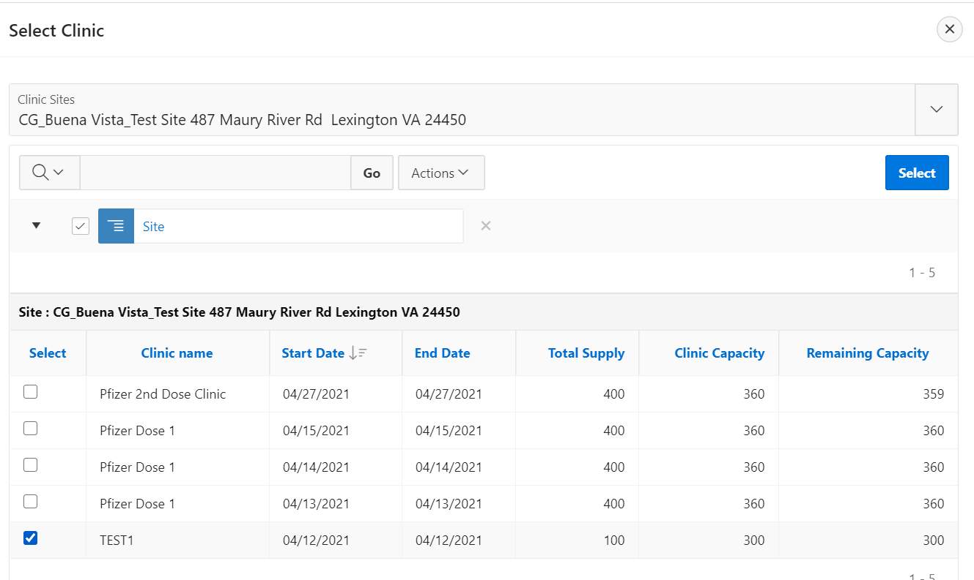
VASE+ Job Aid – File Upload
Version 1.1
After selecting the relevant clinics by clicking the checkboxes , click the “Select” button and then close the “Select Clinic” window.
Figure 3 – Select the clinics for the file upload
To upload a file, select the folder icon and navigate select the file to be uploaded (must be in XLSX or CVS format). The user will then select the “Upload” button.
Figure 4 – Upload a file
Upon uploading the file, a results pop-up will display showing Total Records Processed, Total Records Uploaded, and Total Rejected Records.
Figure 5 – Data File Summary

Slide 3
VASE+ Job Aid – File Upload
Version 1.1
After uploading a file, the relevant information will be shown in the “Notifications Not Yet Scheduled” section prior to sending out communications to registrants in the file. To send out notifications, click the icon below “Send Notifications.”
Figure 6 – View Uploaded Files and click Send Notifications
Upon clicking “Send Notifications”, the user will be directed to the Send Email and SMS Notifications which will show Registrants Uploaded, Registrants with Email ID, Registrants with Phone Number, Registrants Notified via Email, and Registrants Notified via SMS. To send notifications, select the Mode of Communications, then click “Send.” Users can also view “Email Content Preview” to review the contents of the email notifications being sent out.
Figure 7 – Send Notifications
Upon sending out notifications, the data for the relevant file upload will be moved to the “Notifications Scheduled”
Figure 8 – Notifications to be scheduled

Slide 4
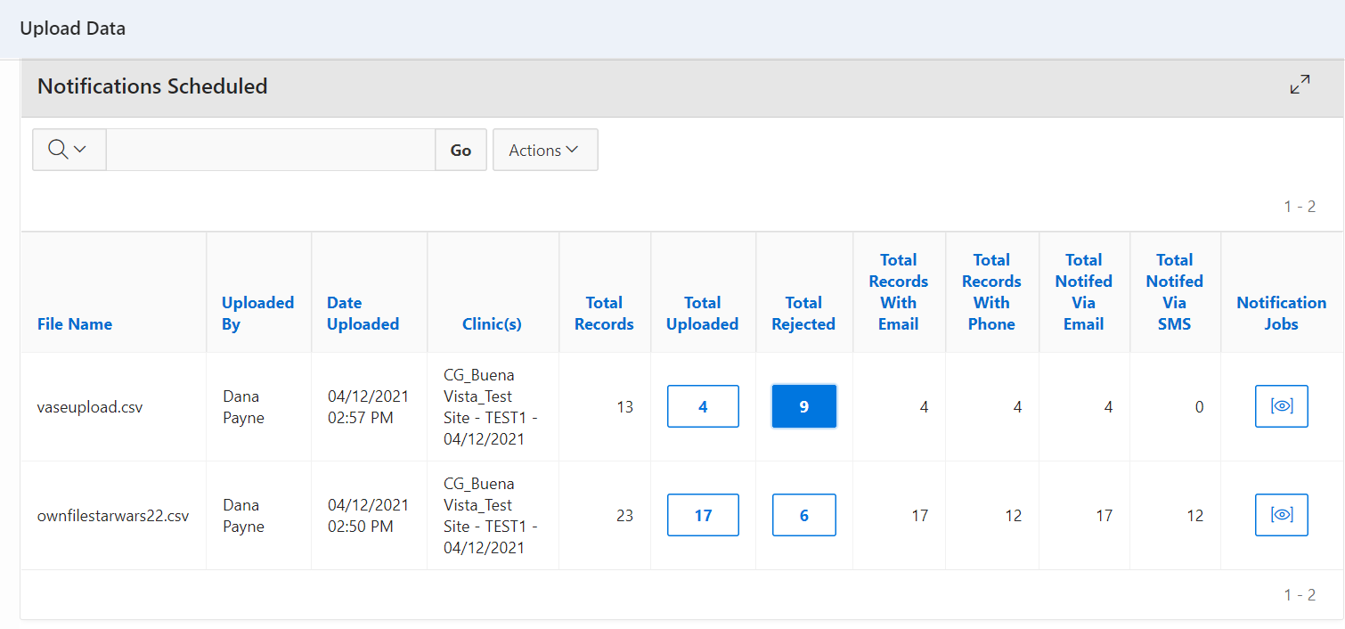
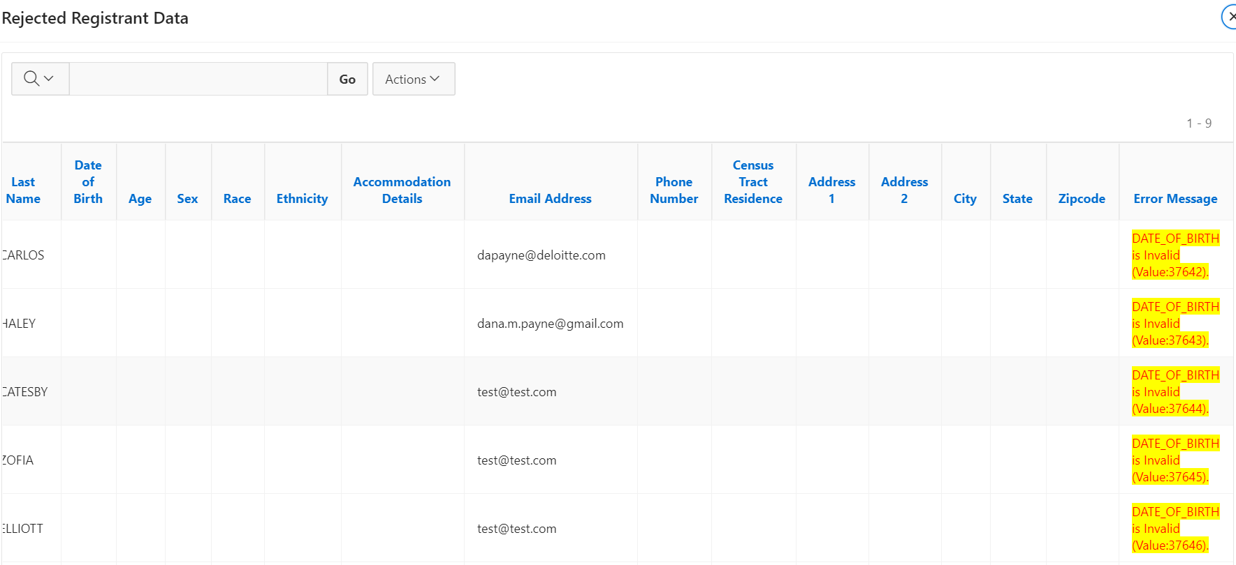
VASE+ Job Aid – File Upload
Version 1.1
File Upload Error
To view upload errors, click the box in the “Total Rejected” column to view record rejection cause.
Figure 9 – View Total Rejected
After scrolling all the way to the right in the Rejected Registrant Data table, the “Error Message” column will show the reason a specific record was rejected.
Figure 10 – View Error Messages

