Slide 1
VASE+ Public Facing Portal for Open Clinic Search
4/19/2021
https://vase.vdh.virginia.gov/vaccinationappointments

Slide 2
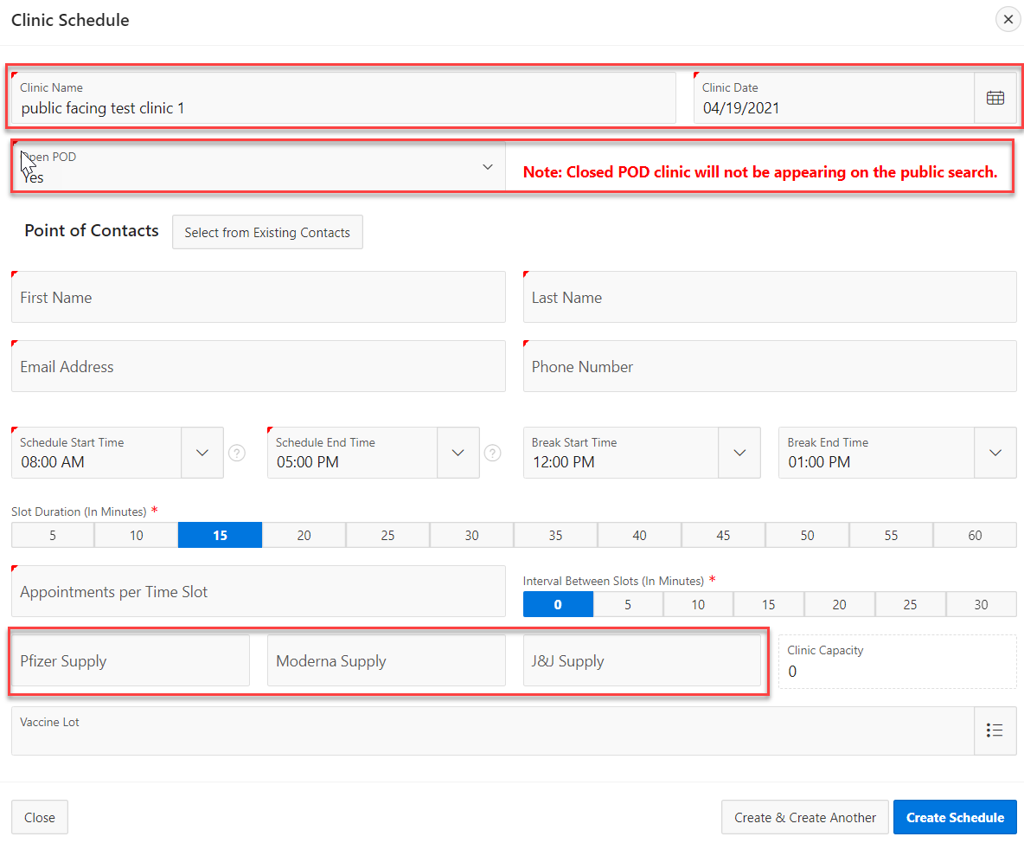
Clinic Setup in VASE+ for open scheduling
Required clinic setup in VASE+ so that the clinics can be displayed and made available for scheduling on the public facing portal.
The clinic name and date are displayed against each clinic grouped within the context of a clinic site
Select ‘Yes’ to the Open POD dropdown to make the clinic public
The vaccine supply entered for a particular clinic is displayed to the public as the Vaccine Type that is offered at that clinic
The VASE+ team recommends that users manage vaccine type offered at their site across different clinics for the same day. The system include seamless user experience for clinic staff to manage the check-in, vaccination and check-out / 2nd dose appointment scheduling process across multiple clinics

Slide 3
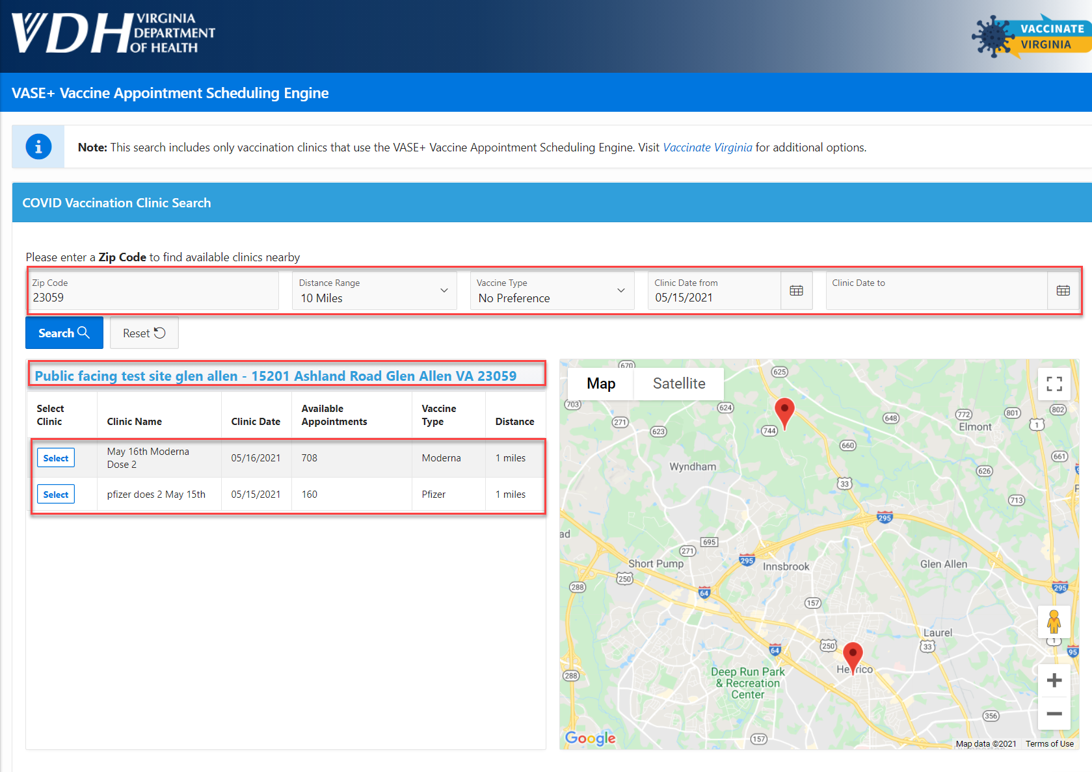
Public Facing Portal
Vaccine recipients can search for clinics based on zip code, distance range as well as vaccine type offered at clinics on the public facing portal. All clinics indicated as “Open POD” will be displayed on the search and allow anyone to schedule an appointment
The search parameters include the zip code, distance range, vaccine type and clinic dates
The site name is displayed based on the address entered for a site
Parameters for each clinic are displayed based on the values entered in Clinic Schedule
After clicking on select for a specific clinic, the user is routed through the regular VASE+ workflow to complete their appointment scheduling

