Slide 1
VASE+ Feature Updates
4/26/2021

Slide 2
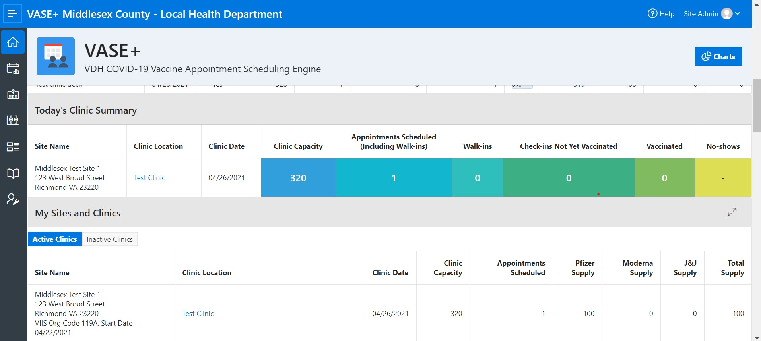
Clinic Summary Dashboard
The clinic summary on the home screen now displays real-time data for Site Admins to monitor their current status for their clinics
Vase+ Dashboard now features a color-coded status report which displays the following information on the left. The No-shows section displays individuals whose appointment times have passed, and they are yet to check in
The dashboard provides an efficient way to track checked in registrants, walk-ins, vaccinated individuals as well as no shows.

Slide 3
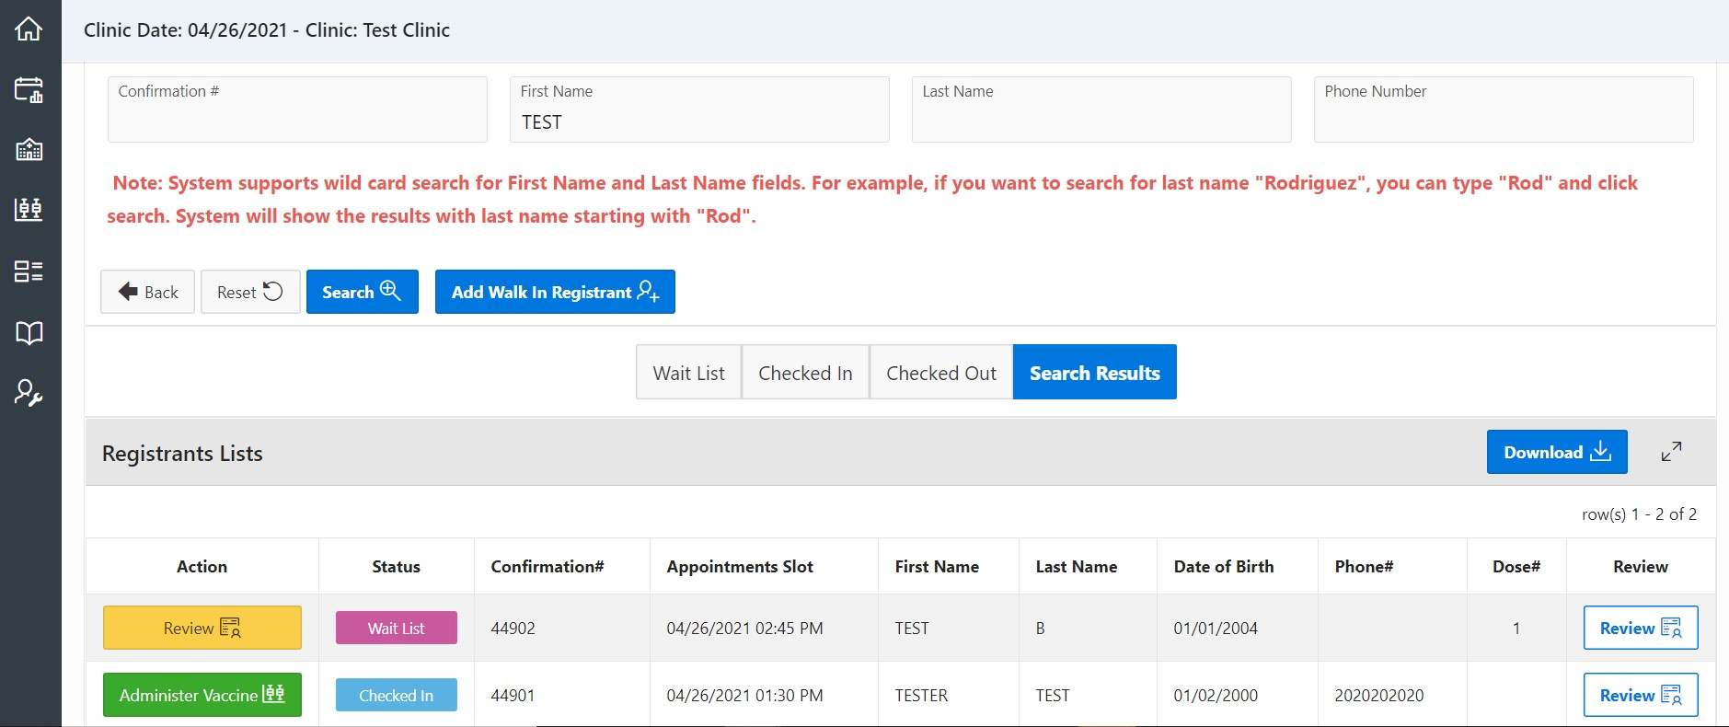
Search Results Function
Ability to search for recipients and update information as needed
VASE+ has a new tab labeled as “Search Results” within each clinic. This bucket will make it easier for users to search of registrants with minimal characters when holding high volume clinics. It also allows users to see where the registrant is in the vaccination process and thus can guide them correctly.
Once a search is run, the Status section will display and color-code where a registrant is in their process. Purple stands for Wait-List, Light blue means Checked-in, and Light green means Checked-out.
The action button functions are only enabled based on user roles. For example, a vaccine administrator can review and enter the vaccine administered. A Front desk staff can check-in individuals and review and update information

Slide 4
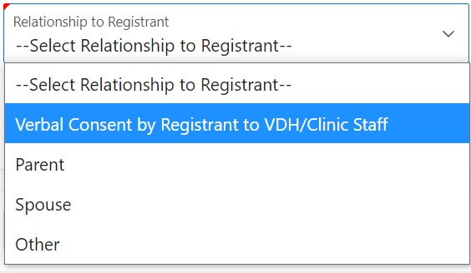
Vaccination Consent for Minors – Sign Up Process
VASE+ is now able to flag individuals between the ages of 16-18 for their consent information to be verified.
When an individual under the age of 16 tries to sign up for a Pfizer vaccine or under the age of 18 for Moderna or Johnson & Johnson vaccine they will be unable to and be prompted with this message
The validation for vaccine type is against the Pfizer, Moderna, Johnson and Johnson supply field in the clinic schedule corresponding to the clinic the recipient is trying to sign up for
When signing up, registrants who are under the age of 18 (for Pfizer) will not be able to self consent as the option is unavailable to them. They will need someone to act on behalf of them

Slide 5
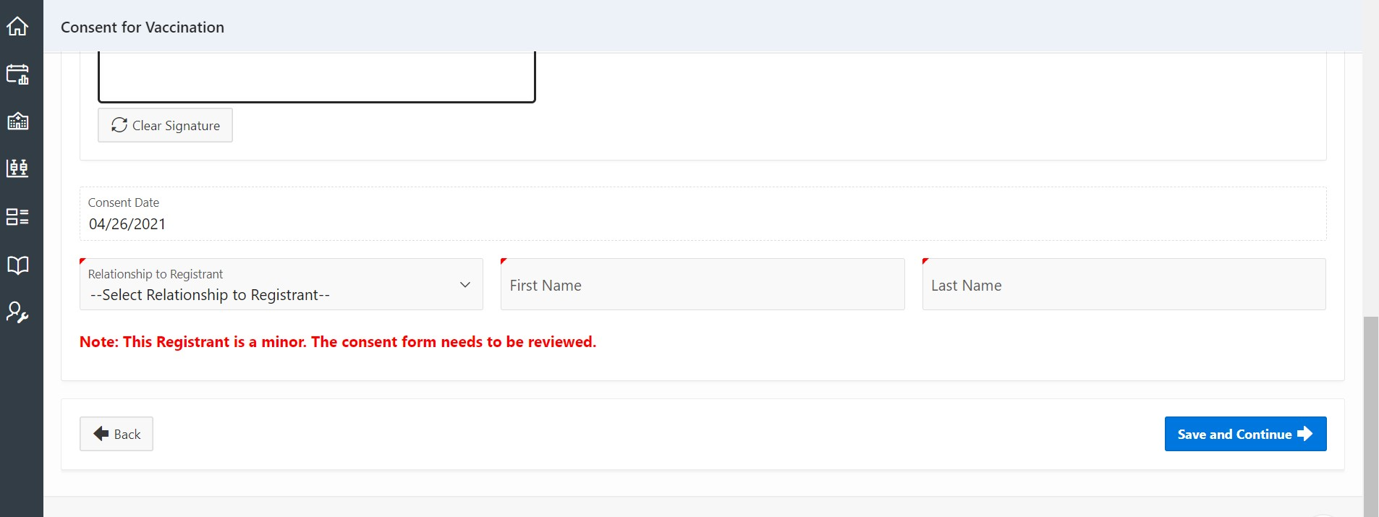
Vaccination Consent for Minors – Check In Process
VASE+ is now able to flag individuals between the ages of 16-18 for their consent information to be verified.
When an individual is under the age of 18, the review action button is highlighted in yellow for the Front-Desk staff and Vaccinators to verify the consent information. Note that this is also available to site admins.
The following note will be displayed on the bottom of the screen once the review button is clicked. Once it is clicked, the user can then verify consent information, update as needed and proceed with checking in a registrant.

Slide 6
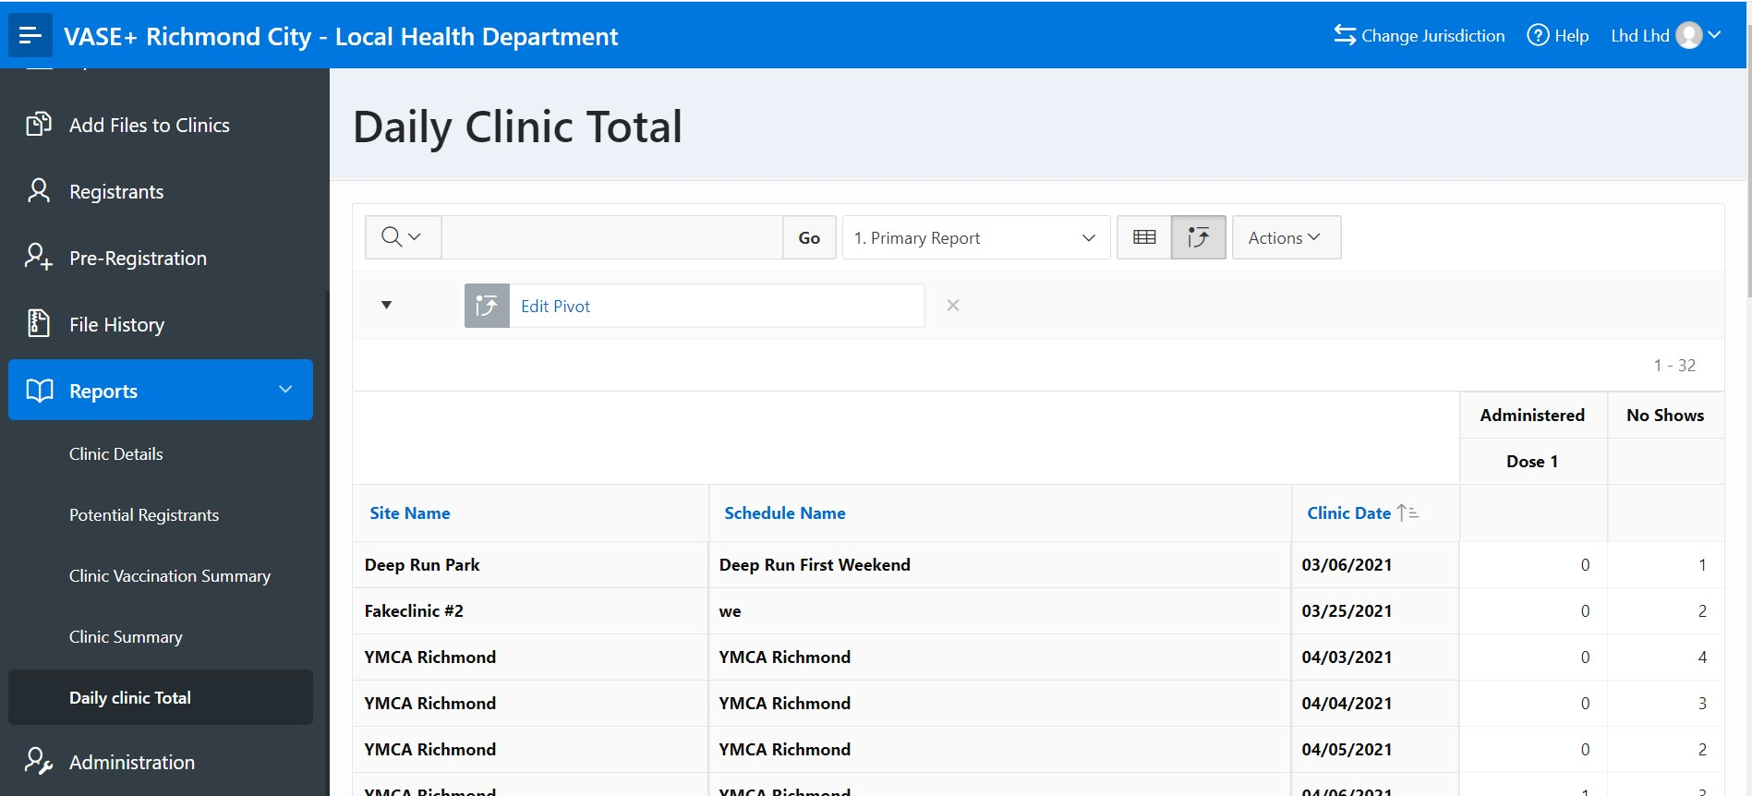
Daily Clinic Total Report
The following report displays End of Clinic data summary that are relevant to site administrators.
VASE+ now features a “Daily Clinic Total” report which highlights the data after the end of each shift with how many vaccines were administered and how many individuals were a no show.

Slide 7
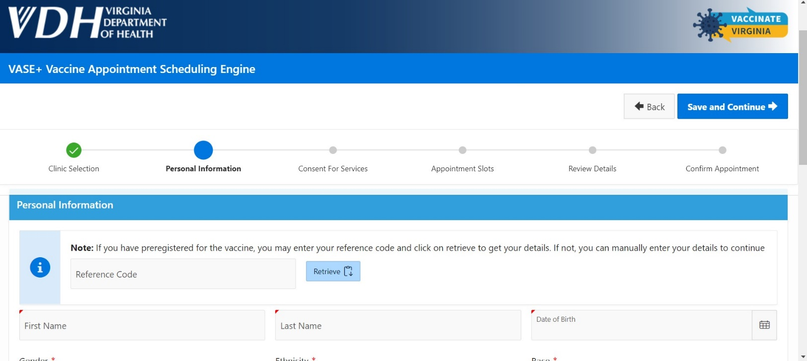
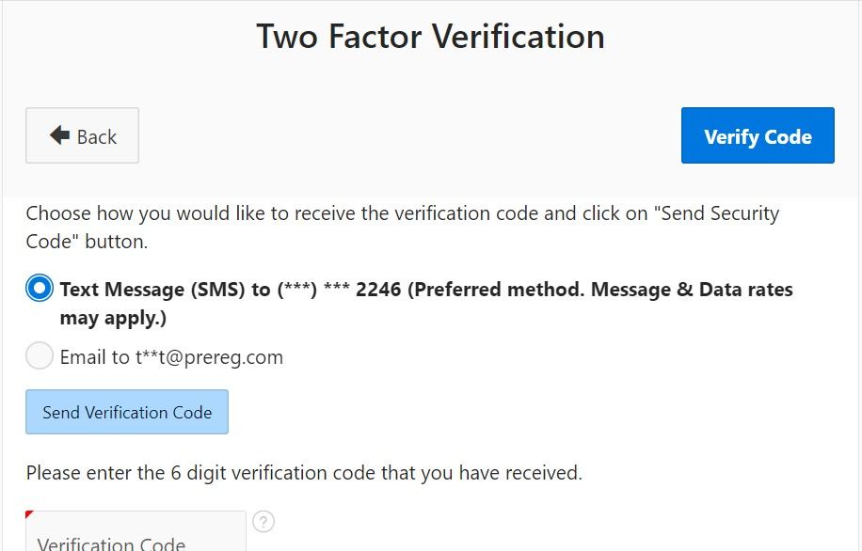
Pre-Registration Reference Code – Public Facing
Pre-registration auto-generated reference codes can be utilized to look up registrants and their demographic data
This is the view where registrants are able to enter in a reference code and sign have their information be auto-populated. This option is available for both closed and open clinics
In order for the registrant to access their information, they will need to go through a two-factor authentication (text or email)

Slide 8
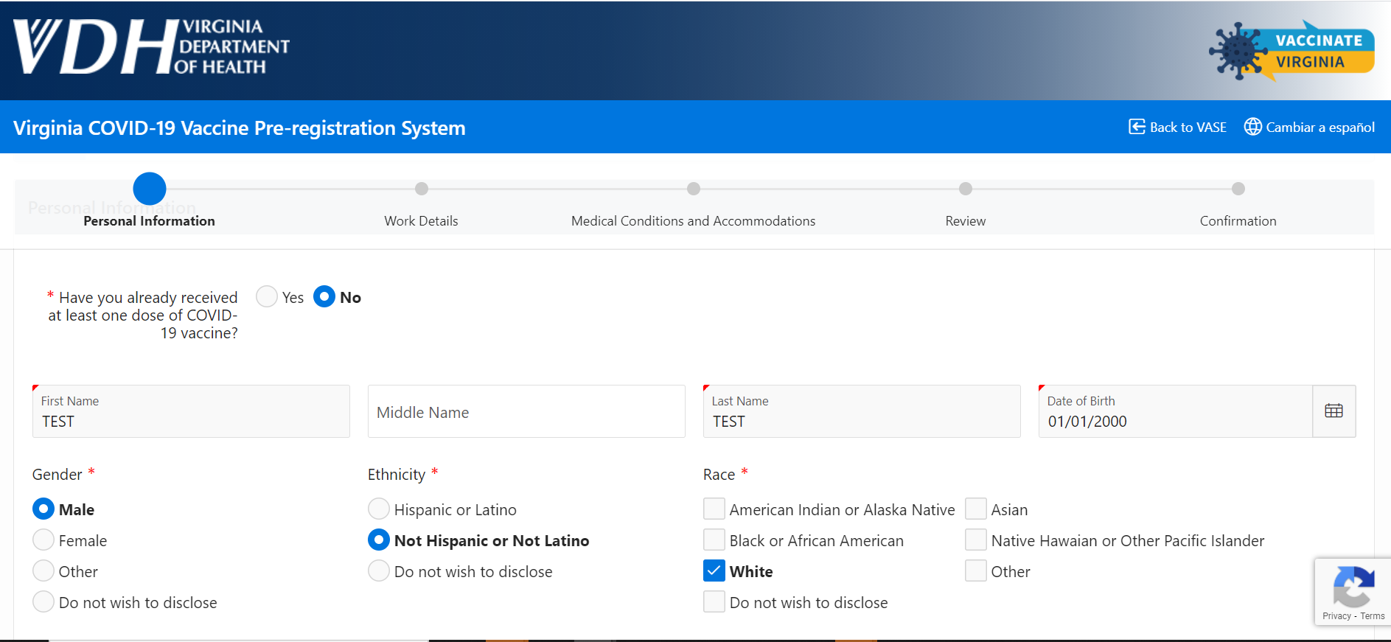
Pre-Registration Reference Code – User Facing
Pre-registration auto-generated reference codes can be utilized to look up registrants and their demographic data
VASE+ Pre-Registration supports functionality to autofill data for patients through their reference code
Shown here is an example of the type of data that is populated once a valid reference code is entered

Slide 9
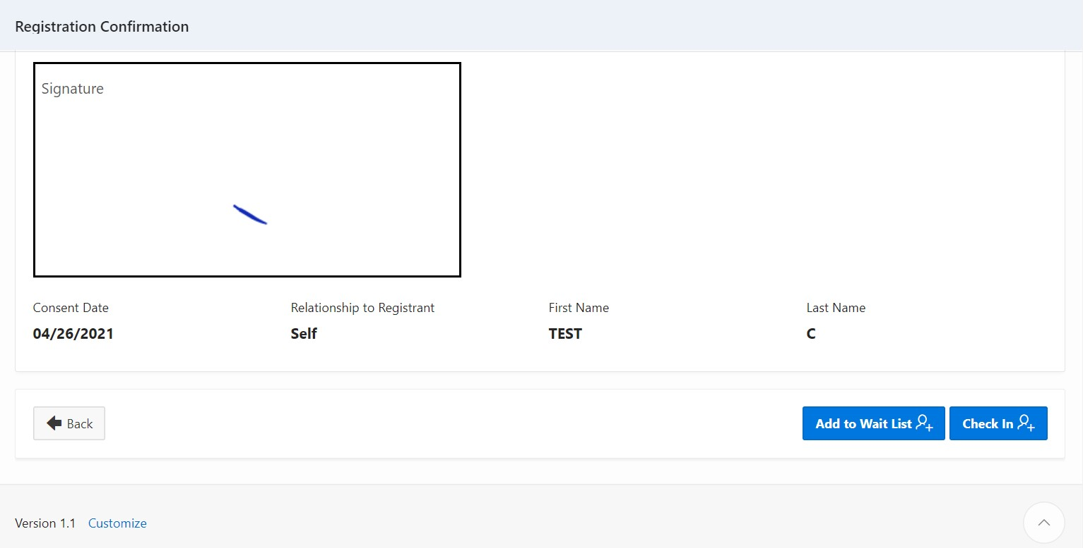
Checking In Walk Ups
Walk-ins can now be checked in directly from their registration screen.
Once a walk-in registrant has gone through the registration process, Site Admin and Front Desk Users are now able check walk up registrants directly from the registration screen

Slide 10
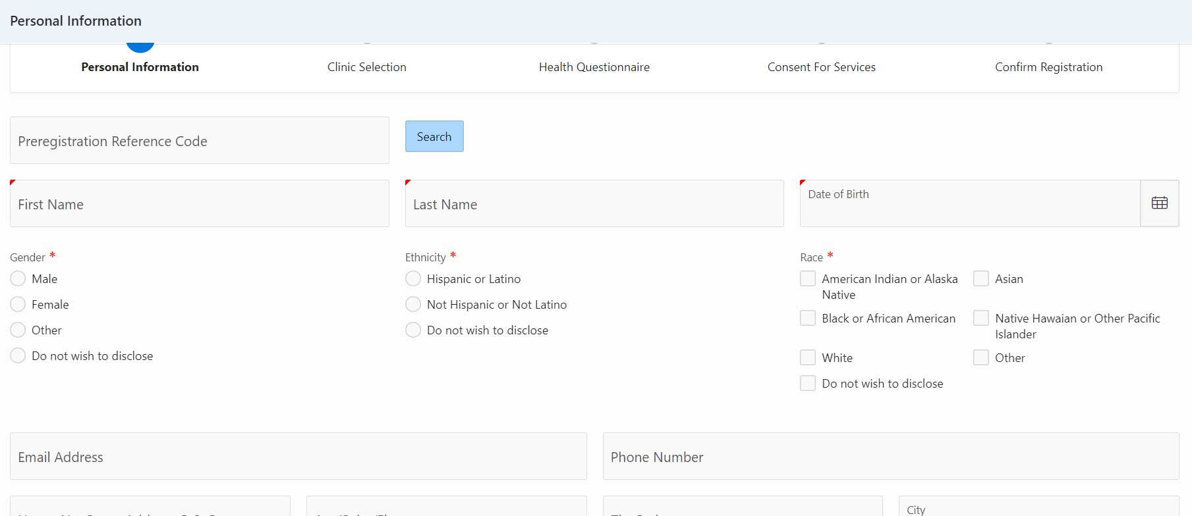
User Registration UI Changes
Some other minor changes have been made to better facilitate registrations
There have been other minor UI changes made. Race selection has changed from a drop down to a multi-select radio button
Ethnicity selection has now become a single select radio button option.

