Slide 1
VASE+ Release Updates
5/14/2021

Slide 2
Patient Registration Search
Registrant search now includes more search fields for easier lookup
VASE+ now supports a search function through email addresses. This helps yield more accurate results when there are multiple individuals with the same name, as well as helps efficiencize the search process

Slide 3
Registrant Review
Registrant review button has shifted to the left for ease of access
Previous versions of VASE+ had the review button to the right of the screen
In the current version of VASE+, the review button has been placed towards the left of the screen. This is an added benefit for mobile and tablet users

Slide 4
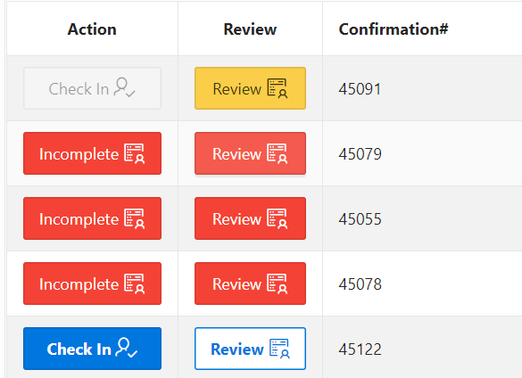
Review Color Coding
Review buttons are now color coded for registrants to be easily distinguishable
Action and review buttons are now color coded
Red: An item is incomplete on an individual's health questionnaire or profile
Yellow: An item needs to be reviewed when a field has been answered with "Yes", "Don't Know", or if a registrant is a minor
Blue/White: Registrant is good to go

Slide 5
Health Questionnaire Review
Questions answered “Yes” prompting a review are now highlighted
Responses marked "Yes" on the health questionnaire are now highlighted in yellow along with "Don’t Know". This enables front desk and vaccine administrators to review health questionnaires accurately prior to checking-in or vaccinating a patient

Slide 6
Updated CDC Guidelines
VASE+ has been updated to follow new CDC Guidelines
The Pfizer vaccine is now authorized for individuals between the ages of 12-15. With the updated vaccine information, registrants under the age of 16 are now able to sign up the Pfizer vaccine with consent from an adult
Updated EUA documentation along with new CDC guidelines have prompted a new health screen question to be added to the health questionnaire

Slide 7
Vaccine Administrator
Vaccine Administrators now have more flexibility and ease of use
If a registrant answers “yes” or “Don’t know” to any question on their health questionnaire, the review button is highlighted yellow for vaccine administrators to review
VASE+ now automatically pre-fills the vaccine administrator section with the name of the user who is logged in

Slide 8
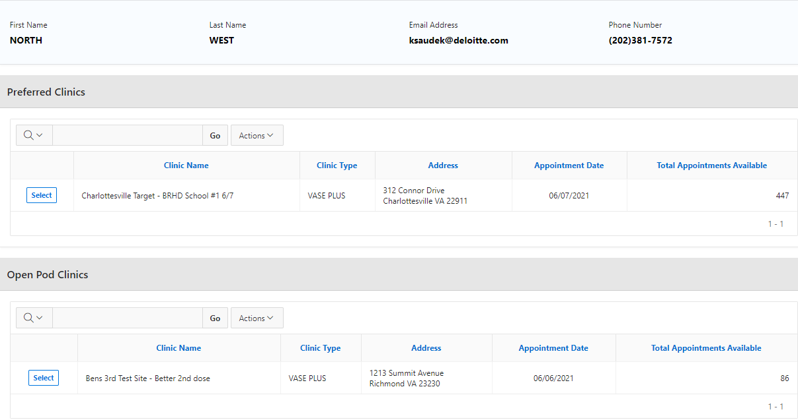
Second Dose Scheduling
Schedulers now can schedule a preferred clinic or any other clinic within a district’s jurisdiction
When a second dose appointment is being scheduled, clinic staffs can now schedule in a preferred clinic or any other Open POD clinics available under the local health department that has been selected

Slide 9
Additional Updates
Here are a list of additional updates made to VASE+
When a walk-in registrant or future appointment is made, and if the site has only one clinic for that day, the clinic selection step is skipped, and the registrant is added directly to the clinic
Vaccine dose numbers for patients are now reflective of their vaccination status throughout VASE+
Additional performance updates have been made to create a smoother VASE+ experience

