Slide 1
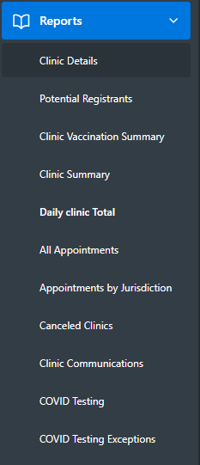
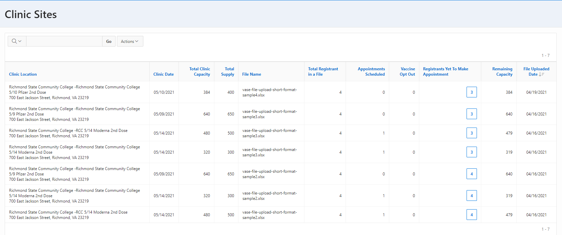
VASE+ Job Aid – Reports Dashboard
Version 1.2
Summary:
In this job aid, users will learn how to use the reports tab in VASE+ to pull data on clinics, registrants, and vaccines. This information may be used to plan for future clinics, analyze efficiency, and design clinic strategy. The reports can be viewed by these roles: Locality Admin, Site Admin, and Call Center. Note that certain roles can only view certain reports.
Reports Tab
On the Reports tab under the side menu for Locality Admins, there are eleven types of reports to choose from. The report type selected depends on the data the user would like to see.
Clinic Details
Data included: Clinic Location, Clinic Date, Clinic Capacity, Vaccine Supply, File Name, Total Registrants in File, Appointments Scheduled, Vaccine Opt Out, Registrants Yet to Make Appointment, Remaining Capacity, File Uploaded Date
Viewed by: Locality Admin, Call Center Admin, Call Center Supervisor
When to use this report: Administrative users can use this report to view the vaccine capacity at a site on a given day. Site administrators also see most of this information on their main dashboard. This information may also be helpful to provide to vaccine administrators and front desk staff to prepare for the day.
Figure 1 – Report Options
Figure 2 – Clinic Sites Sample Report

Slide 2
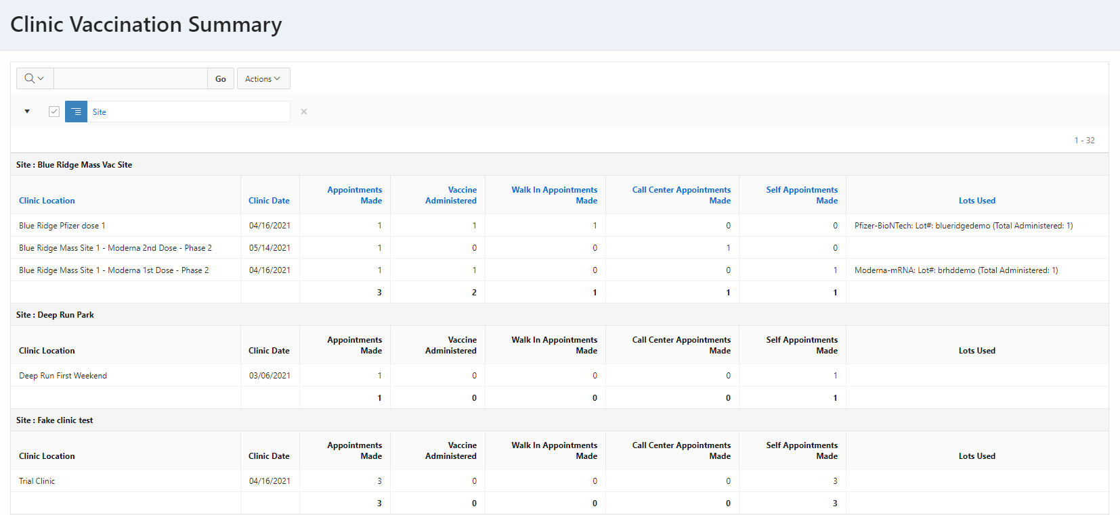
VASE+ Job Aid – Reports Dashboard
Version 1.2
Potential Registrants
Data included: Filtered by Clinic Location and Date; First Name, Last Name, Date of Birth, Email, Email Status, Phone Number, and SMS Status of registrants
Viewed By: Locality Admin, Call Center Admin, Call Center Supervisor
When to use this report: Administrative users can utilize this report to view potential registrants of a clinic that have yet to schedule their appointment. This can be used to plan for potential scheduling or walk-ins or to send out notifications to encourage sign up, especially if the email or SMS was not delivered.
Figure 3 – Potential Registrants Dashboard
Clinic Vaccination Summary
Data included: Separated by Site. Clinic Location, Clinic Date, Appointments Made, Vaccines Administered, Walk-in Appointments, Call Center Appointments, Self Appointments, Vaccine Lots Used
Viewed By: Locality Admin, Site Admin
When to use this report: Administrators may use this report to track inventory by appointments made, vaccines administered, and lots used. This report may also be used to track how appointments are made in the VASE+ system and prepare front desk staff on average number of walk-ins.
Figure 4 – Clinic Vaccine Summary Dashboard

Slide 3
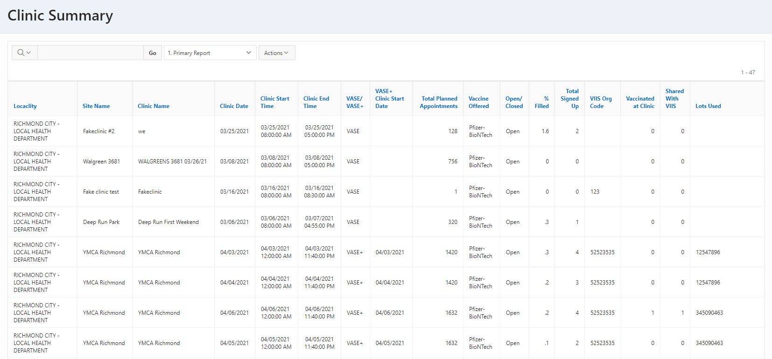
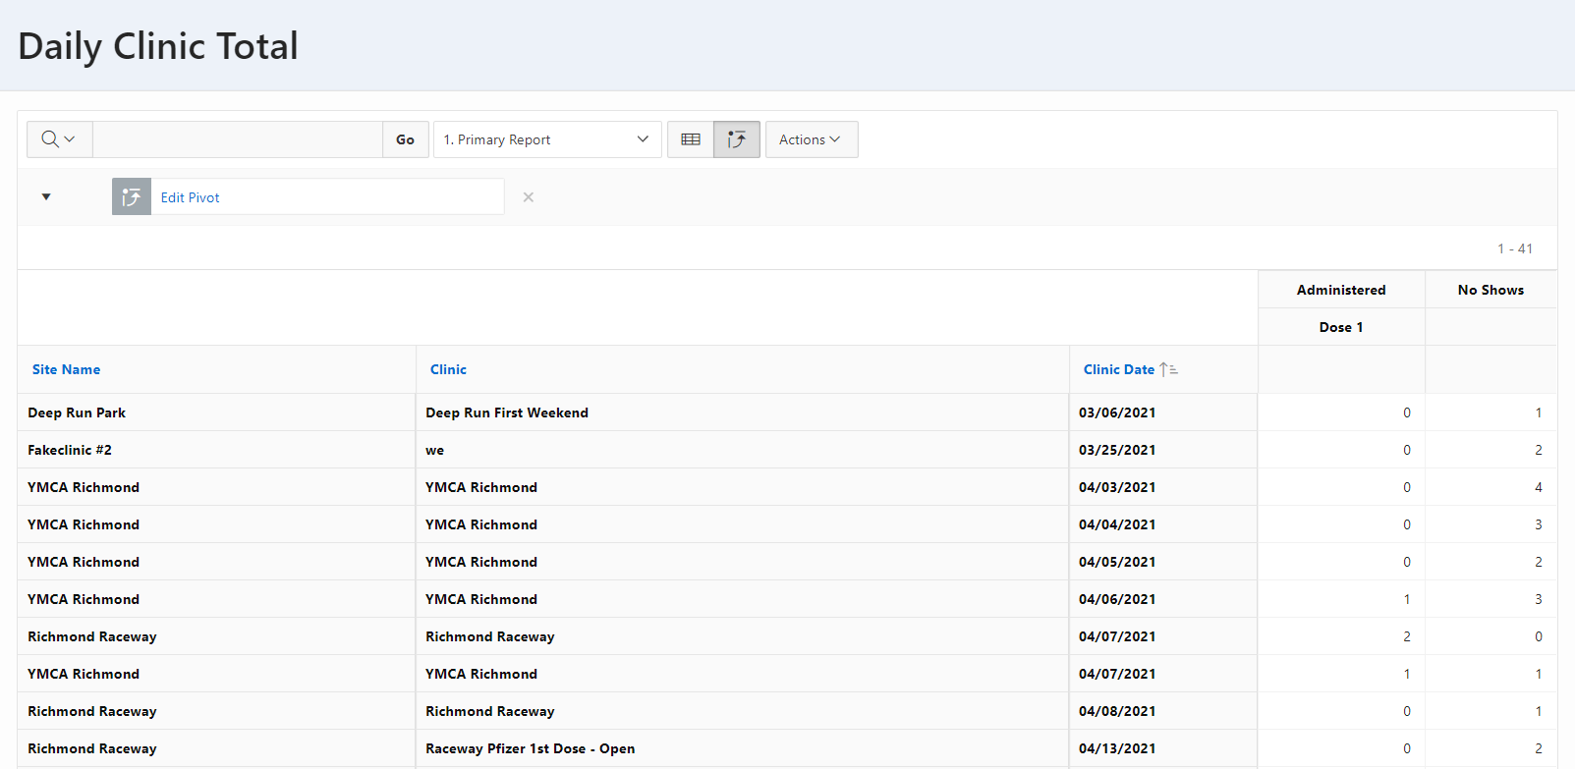
VASE+ Job Aid – Reports Dashboard
Version 1.2
Clinic Summary
Data included: Locality, Site Name, Clinic Name, Clinic Date, Clinic Start Time, Clinic End Time, VASE/VASE+, VASE+ Clinic Start Date, Total Planned Appointments, Vaccine Offered, Lots Used, Open/Closed, % Filled, Total Signed Up, VIIS Org Code, Vaccinated at Clinic, Shared with VIIS
Viewed by: Locality Admin, Site Admin
When to use this report: This report provides a comprehensive view of each clinic. This report is useful when looking at the timing of a clinic, what vaccine was administered, and how full the clinic was on that given day.
Figure 5 – Clinic Summary Dashboard
Daily Clinic Total
Data included: Site Name, Clinic, Clinic Date, # Vaccines Administered, # No Shows
Viewed by: Locality Admin, Site Admin
When to use this report: This report is particularly helpful if the administrator wants to track the sheer number of vaccines administered and no shows at a clinic. Administrators can use report to track trends over time or compare clinics against one another.
Figure 6 – Daily Clinic Total Dashboard

Slide 4
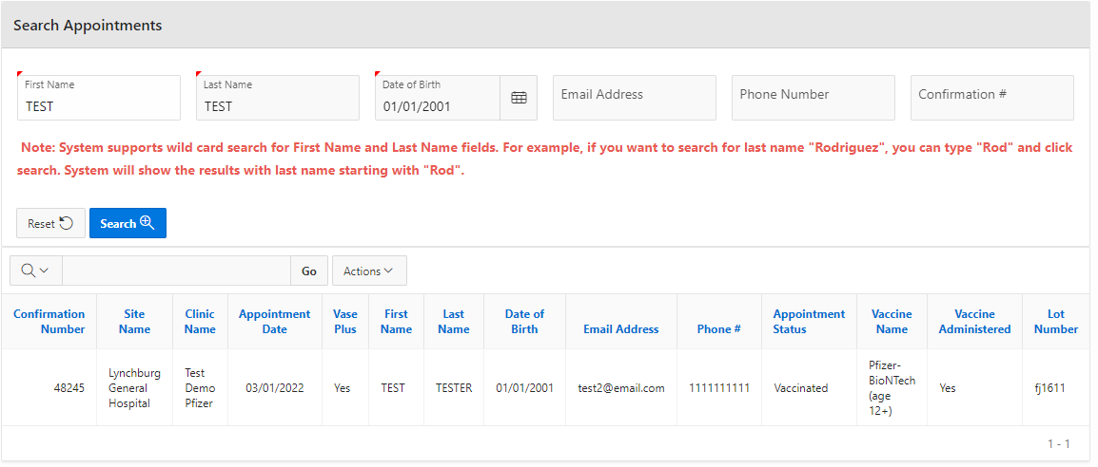
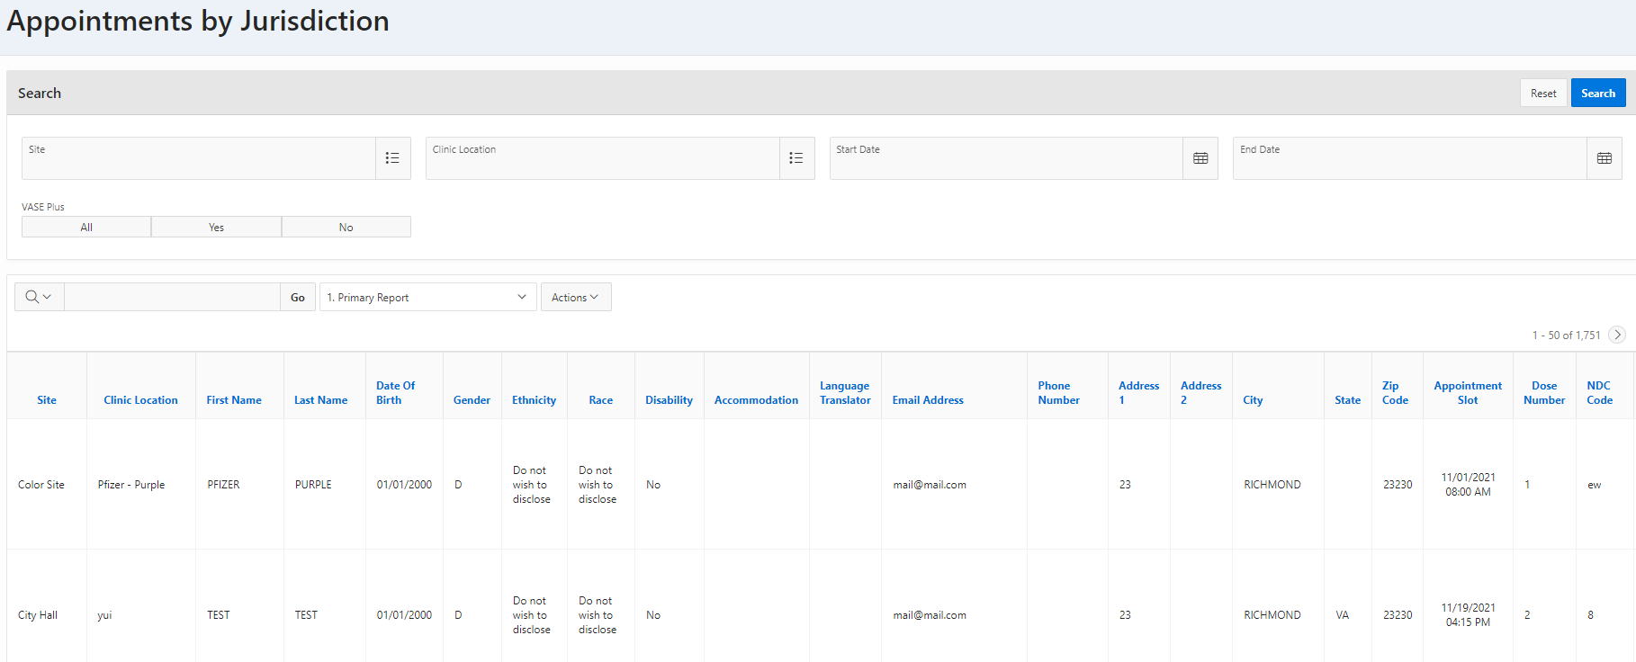
VASE+ Job Aid – Reports Dashboard
Version 1.2
All Appointments
Data included: Confirmation number, site name, clinic name, appointment date, VASE+ clinic, first name, last name, DOB, email address, phone #, appointment status, vaccine name, vaccine administered, lot number, appointment type, check in date/time, dose number, site of injection, vaccine administrator
Viewed by: Locality Admin, Site Admin
When to use this report: This report provides a means to search for registrant’s that have scheduled appointments. It provides details on the registrant and their appointment information.
Figure 7 – All Appointments Dashboard
Appointments by Jurisdiction
Data included: site, clinic location, first name, last name, DOB, gender, ethnicity, race, disability, accommodation, language translator, email address, phone #, address, appointment slot, dose number, NDC code, vaccine administered date, vaccine administrator, vaccine name, vaccine lot #, us registrant vaccinated, vaccine dosage, registrant ID.
Viewed by: Locality Admin
When to use this report: This report provides a comprehensive view of registrants that have scheduled for appointments. It includes demographic information and appointment information.
Figure 8 - Appointments by Jurisdiction Dashboard

Slide 5
VASE+ Job Aid – Reports Dashboard
Version 1.2
Canceled Clinics
Data included: Locality, site name, clinic name, clinic date, schedule start time, schedule end time, point of contact, cancelation reason, canceled by, canceled date,
Appointments canceled, end date, total planned appointments, vaccine name, vaccine supply
Viewed by: Locality Admin, Site Admin
When to use this report: This report provides a list and additional details of clinics that have been canceled.
Figure 9 – Canceled Clinic Dashboard
Clinic Communication
Data included: Locality, site name, clinic name, clinic date, schedule start time, schedule end time, SMS message, email subject, email message, message sent by, message sent on, appointments scheduled, end date, vaccine ID
Viewed by: Locality Admin
When to use this report: This report provides a list of communications that have been sent out to clinics. Users can also click on the clinic name to view a line list of registrants that the messages were sent to, as well as the delivery status.
Figure 10– Clinic Communication Dashboard

Slide 6
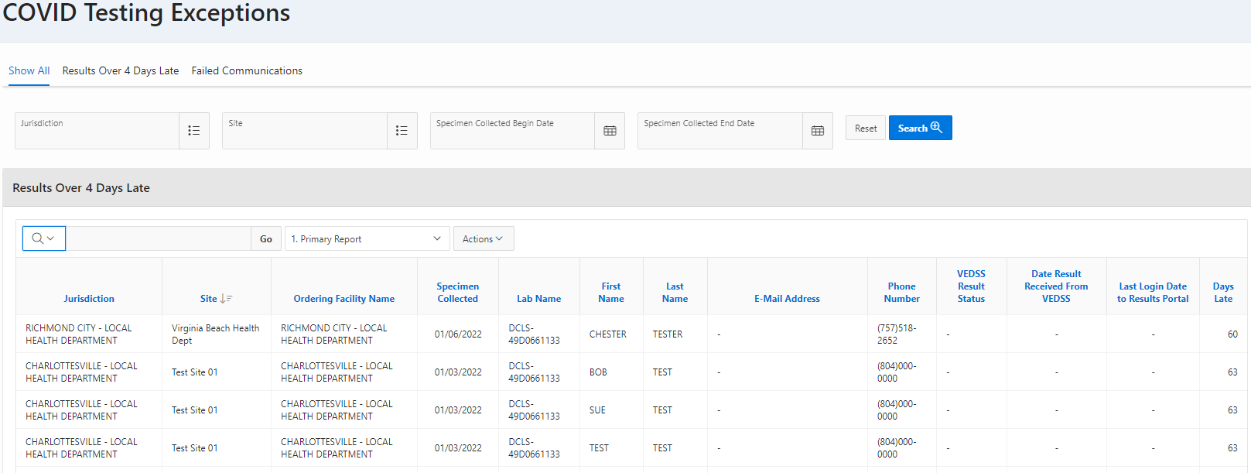
VASE+ Job Aid – Reports Dashboard
Version 1.2
Covid Testing
Data included: jurisdiction, site, ordering facility, performing facility, lab name, specimen collection date/time, first name, last name, DOB, email, phone number, VEDSS result status, date result received from VEDSS, last login date to results portal, SMS sent date, SMS status, email sent date, email status, gender, physician name, results pending, results received, specimen collection date, VASE appt ID
Viewed by: Locality Admin
When to use this report: This report provides a comprehensive view of registrants with appointments for VASE+ testing clinics.
Covid Testing Exceptions
Data included: Patient appointment details and demographics as well as VEDSS result status, date results received from VEDSS, last login to results portal, and days late
Viewed by: Locality Admin
When to use this report: This report provides a view of registrants that have pending test results as well as those who have already received their results.
Figure 12 – Covid Testing Exceptions Dashboard
VEDSS Test Results
Data included: Performing facility, reporting facility name, ordering facility, name, DOB, phone number, accession number, result received date, test result, sample collection date, test result date, date created, refreshed from VEDSS at, updated date
Viewed by: Covid Testing Reports view
*please contract the VASE+ Support team if you need access to this report
When to use this report: This report provides COVID test results reported to VEDSS within the last 15 days, This report will aid user’s in determining if their registrants received their Covid test results

Slide 7
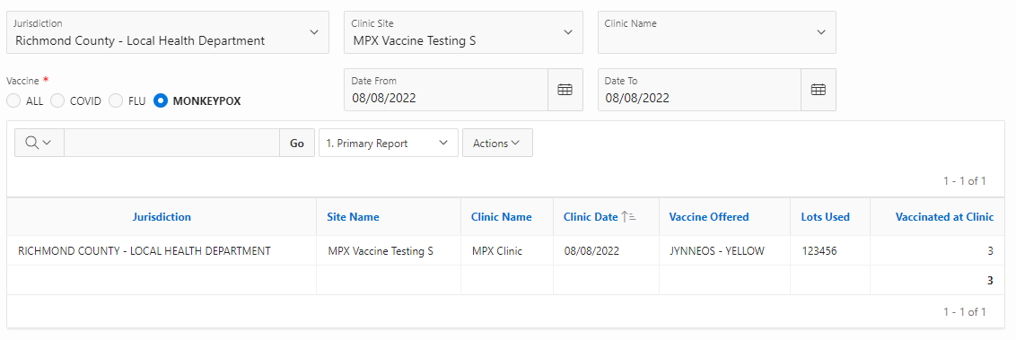
VASE+ Job Aid – Reports Dashboard
Version 1.2
Vaccination Summary By Lots
Data included: Jurisdiction, Site Name, Clinic Name, Clinic Date, Vaccine Offered, Lots Used, Vaccinated at Clinic
Viewed by: Locality Admin, Site Admin
When to use this report: This report provides a means to search for vaccine lots that were used at a particular clinic and how many vaccinations were used from that lot.
Figure 13 – Vaccination Summary By Lots

Slide 8
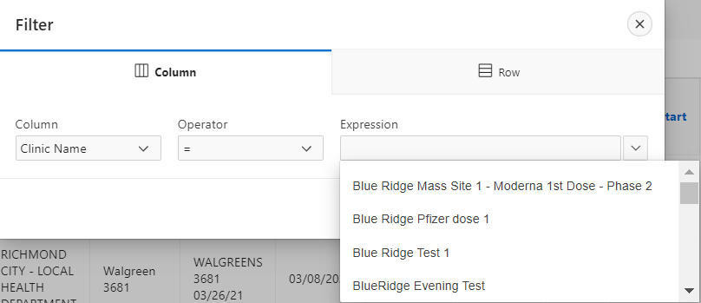
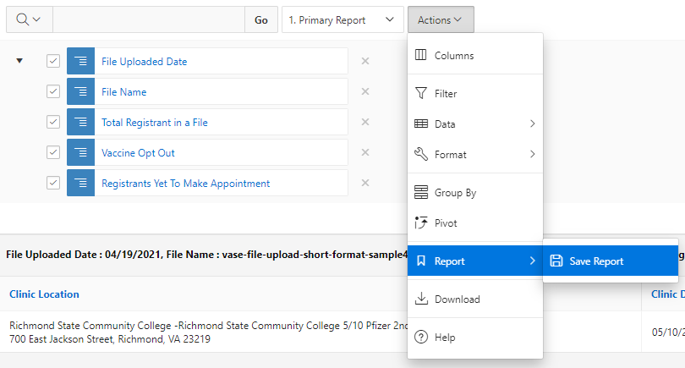
VASE+ Job Aid – Reports Dashboard
Version 1.2
Filtering
Each report may be filtered to narrow down the data shown in the report using the “Actions” button next to the search bar.
Figure 14 – Actions Button
To filter, the user can either filter the columns or the rows. To filter the column, select the column to filter (Clinic Name in Figure 14), the operator (filter to a specific word, date, time etc. or a broader range), and the expression (what the column should show). Clicking on the arrow next to expression will allow you to select an option from all existing entries.
Figure 15 – Filter by Column
Once applied, filters will be shown with a green funnel icon. A filter may be removed by clicking the grey “X” next to that filter.
Figure 16 – Remove a Filter
In addition to filtering the data, the data may be highlighted, grouped, or sorted below the “Actions” button.
To save a report and come back to it later, choose the “Report” and then “Save Report” options below the “Actions” button. Once the report is named, it will be saved and stored under the “Primary Report” button next to the “Actions” button.
Figure 17 – Save a report

Slide 9
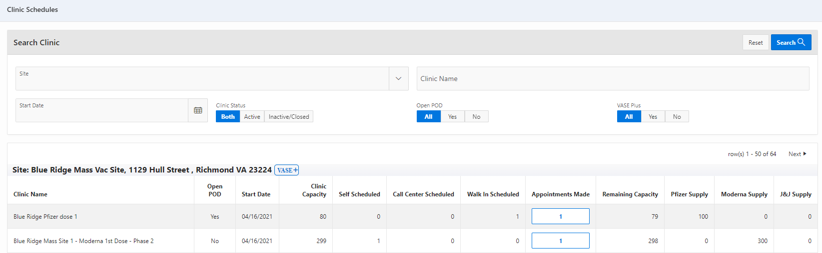
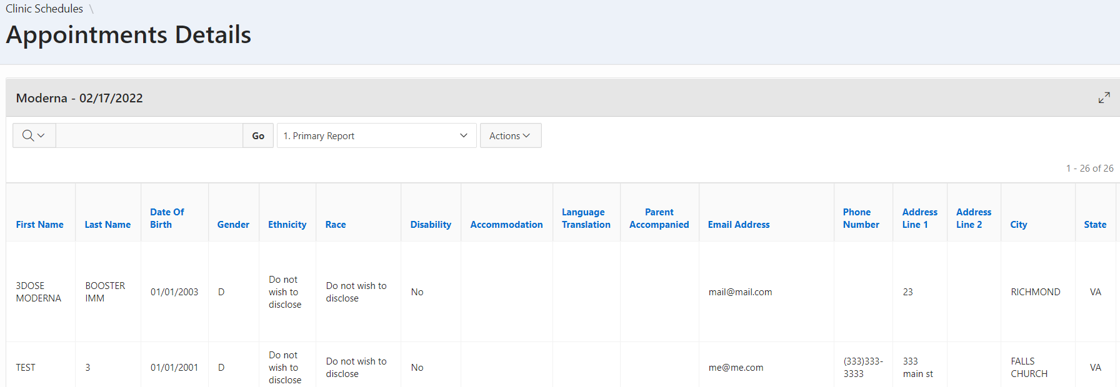
VASE+ Job Aid – Reports Dashboard
Version 1.2
Clinic Schedule Reports
This is another report that is also downloadable from the Clinic Schedule view. The report can be filtered or saved using the same actions as above.
To view this report, click on the blue box under the “Appointments Made” column for the site that you want to view.
Figure 18 – Clinic Schedule View
Figure 19 – Appointments Details View

