Slide 1
VASE+ Feature Updates​
May 27th, 2021

Slide 2
VASE+ and VIIS Integration
VASE+ is now integrated with Virginia Immunization Information System (VIIS)
VASE+ is now linked with the VIIS database to aide in vaccine information lookup regarding a patient’s COVID vaccine. During a clinic, users can click on the VIIS lookup button associated with a registrant which will help pull up COVID vaccine information.
When the VIIS lookup button is clicked, the following fields will pop up and be populated with data if present.
Users should validate the information with the registrant.

Slide 3
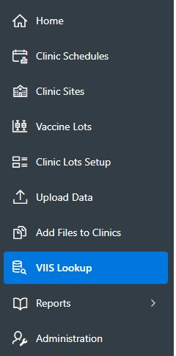
VASE+ and VIIS Integration Cont.
VASE+ is now integrated with Virginia Immunization Information System (VIIS)
A VIIS lookup option is now present in the VASE+ menu bar for Locality and Site admins.
Searching of a registrant under the VIIS lookup will yield results regarding the registrant’s COVID vaccination logs.

Slide 4
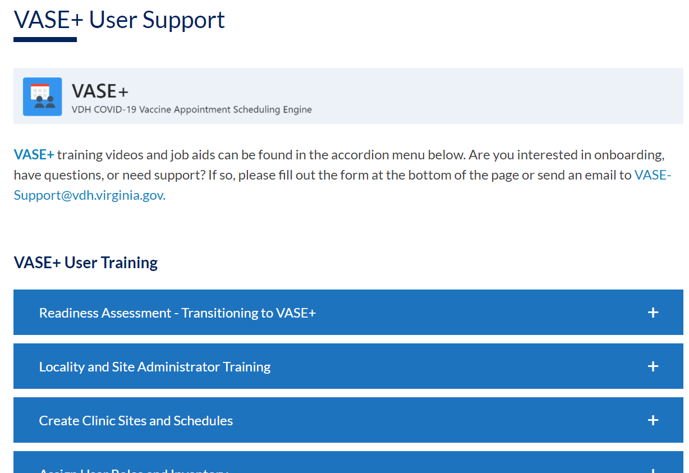
Help and Support
VASE+ now features a Help button to better assist users with questions
A new Help button has been introduced to VASE+ to aide in assisting with common questions and issues. If the issue is not resolved through the “VASE+ User Support” section, users can contact the VASE+ Support team to seek further assistance.

Slide 5
User Profile Enhancement
User profile view has changed for administrators in order to create a more seamless experience
VASE+ now prompts that security questions and answers have been filled out. This suggests that a user has successfully logged in and set up their VASE+ account. Site admins can still lock, unlock and reset a user’s account

Slide 6
Personal Information
Address fields are now mandatory
Addresses are a required field now in VASE+ for when registrants are signing up or being signed up for a vaccine appointment.

Slide 7
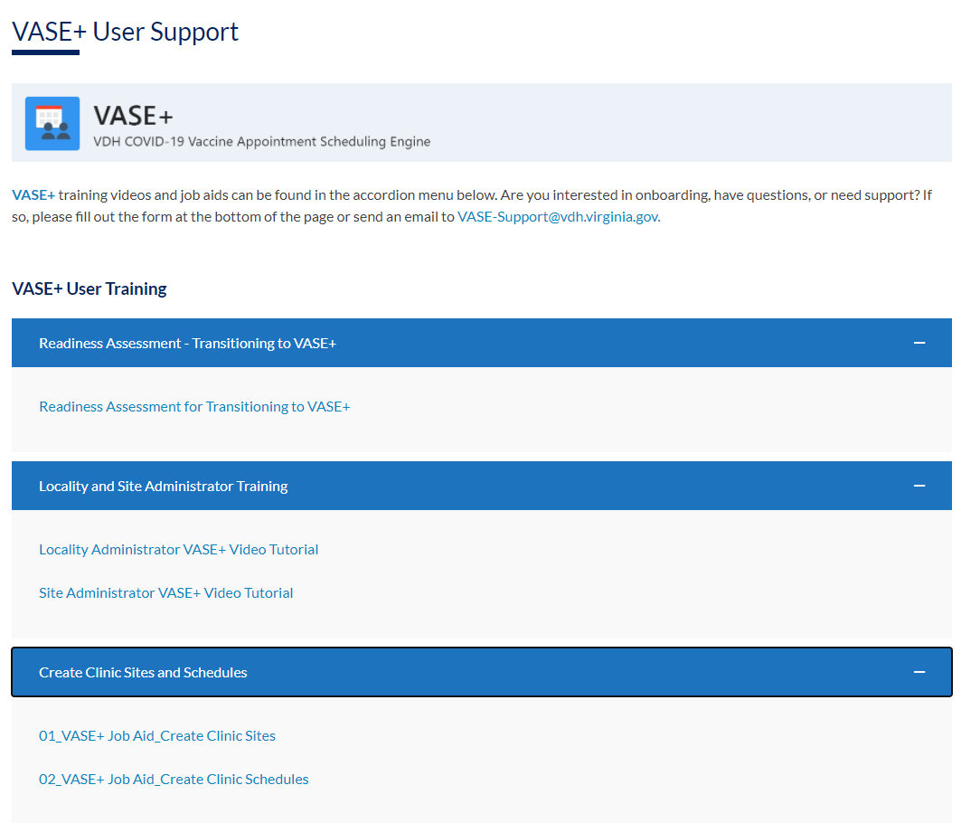
VASE+ Support Portal
VASE+ Support Portal has been updated to reflect VASE+ updates
VASE+ Support Portal has been updated to reflect new tutorial videos, job aides and release notes.
If you have additional questions, you can contact us at vase-support@vdh.virginia.gov

