Slide 1
VASE+ Features Update​
June 25th, 2021

Slide 2
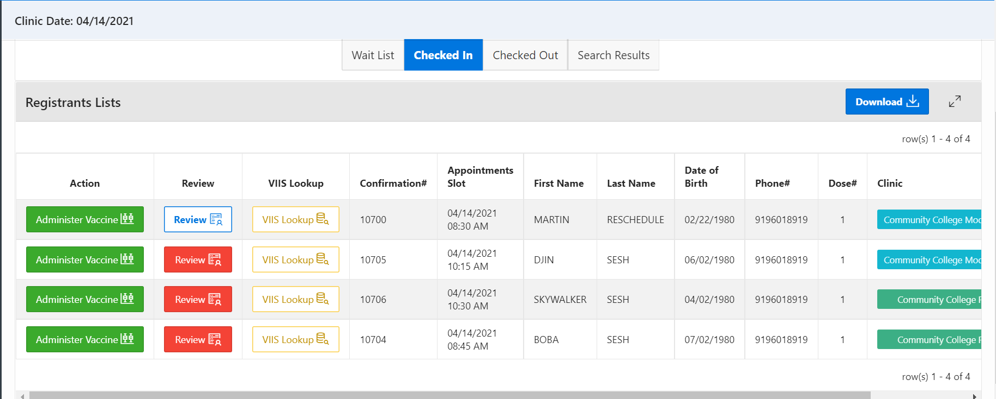
Input Clinic Activities Retroactively
Site Admins can input clinic activities for previous clinics
Site admins have the ability to go back to a previous clinic and input clinic activities such as administering vaccines after the day of the clinic.

Slide 3
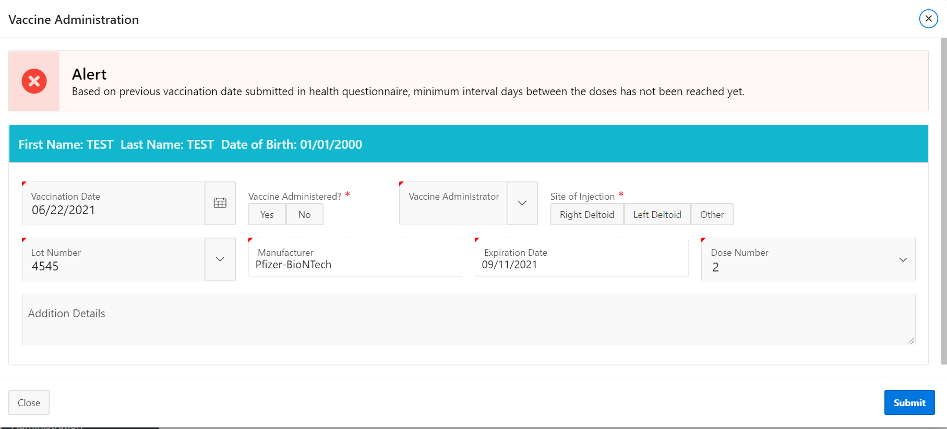
Vaccine Administer Alerts
Alerts are provided to the vaccine administrator on 2nd doses
Vaccine Administrators are provided with an alert if an individual is about to be vaccinated with their 2nd dose prior to meeting the recommend timelines.

Slide 4
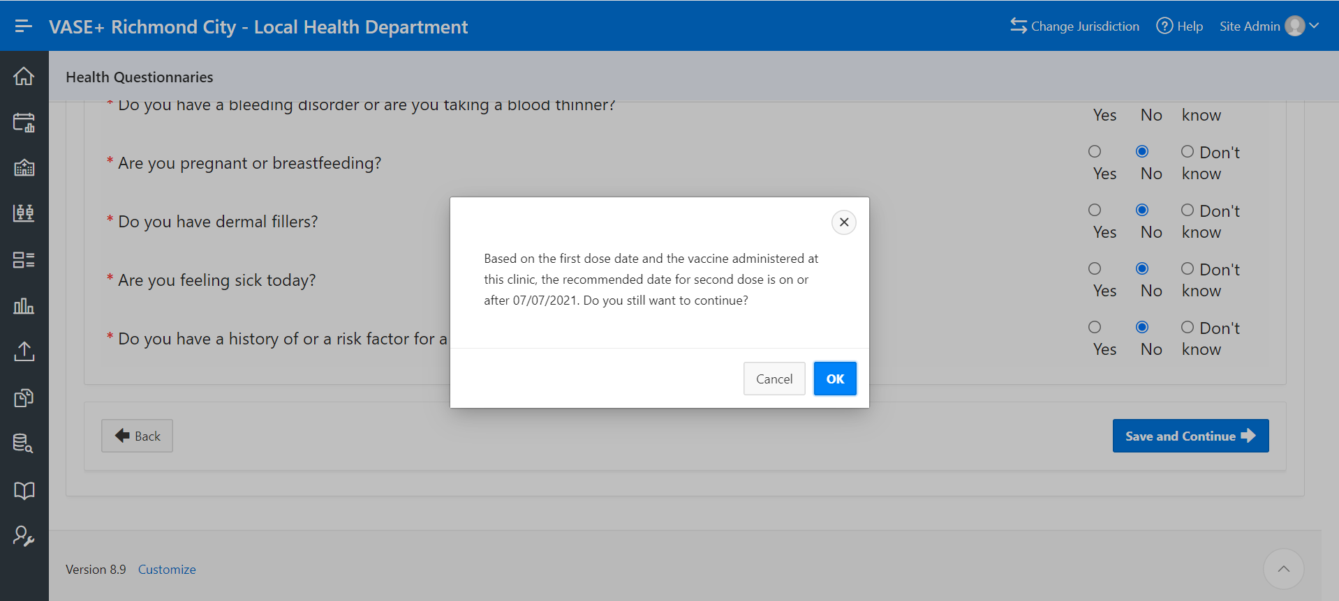
Health questionnaire prompt
A prompt is provided if minimum timeline threshold is not met for the 2nd dose
When a health questionnaire is filled out by a registrant for their 2nd dose appointment, VASE+ will provide this prompt to them if their 2nd dose appointment is below the minimum recommended wait period.

Slide 5
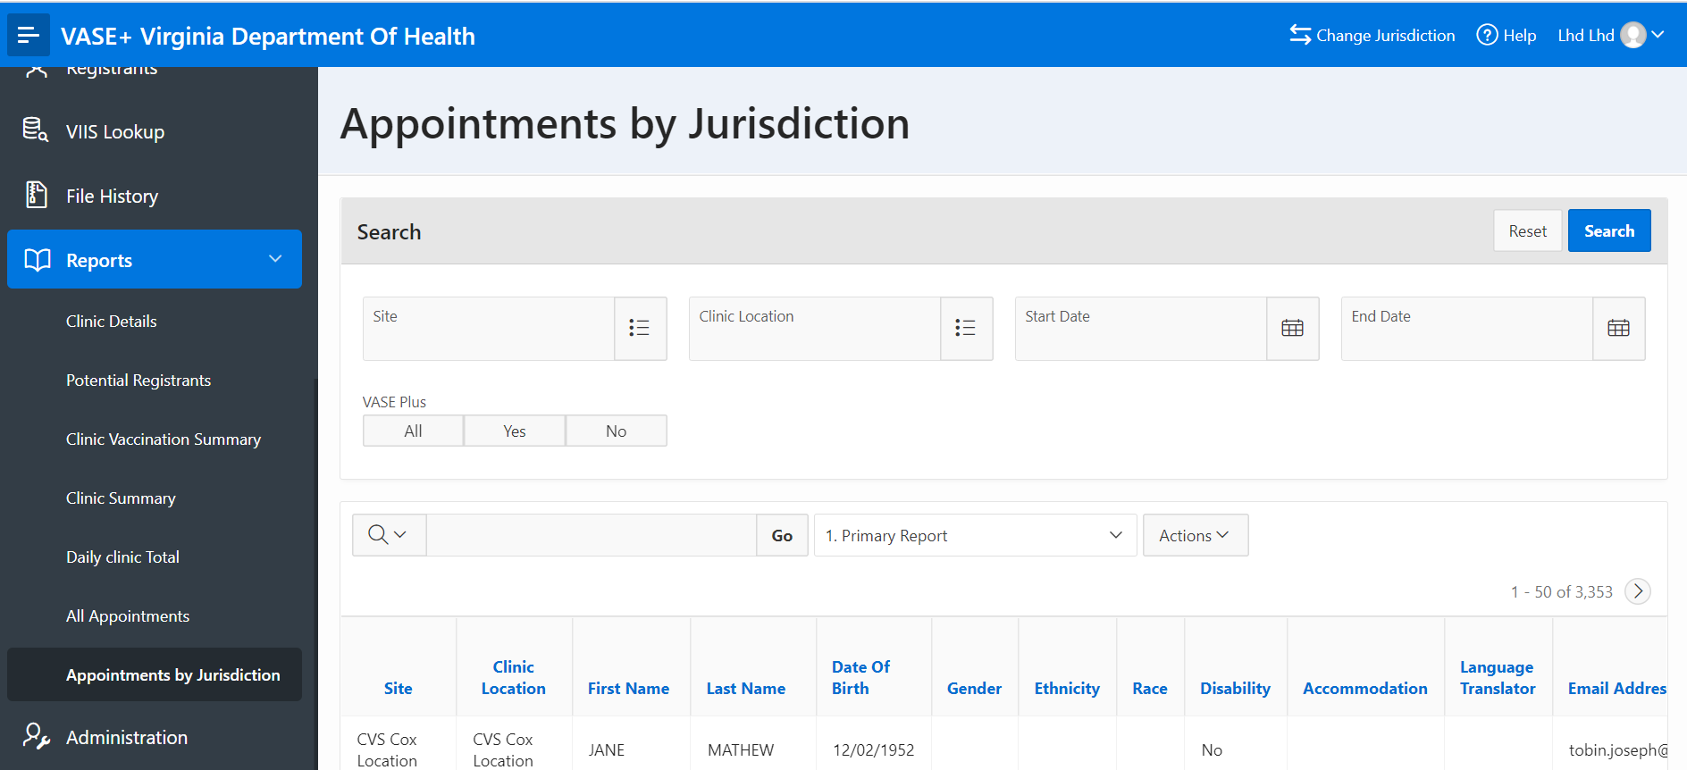
Appointments by Jurisdiction Report
A new report has been introduced for locality admins for the jurisdiction
A new report has been introduced that gives a detailed breakdown of registrants and their appointment details based by jurisdiction.

Slide 6
Multi-clinic View
Multi-clinic view now groups registrants by clinic name
Multi-clinic view has been updated to group together registrants by clinic name to make it easier for users to review their information at a glance.

Slide 7
Additional Updates
New updates made to VASE+
The following question has been removed from the health questionnaire based of the CDC guidelines:
Have you received any vaccine in the last 14 days?
An Arabic version of the health questionnaire and consent form has been introduced. Public facing sign-up pages now futures Arabic and Spanish language options to select from.

