Slide 1
VASE+ Feature Updates​
June 4th , 2021

Slide 2
Dashboard Updates
Dashboards have been updated to reflect check-in status
VASE+ Dashboard now features a “Yet To Check-In” section which shows individuals who have upcoming/active appointments that have not been checked-in. This section will only display data during clinic times. It is different than no-shows, which are expired appointments who have not been checked-in.

Slide 3
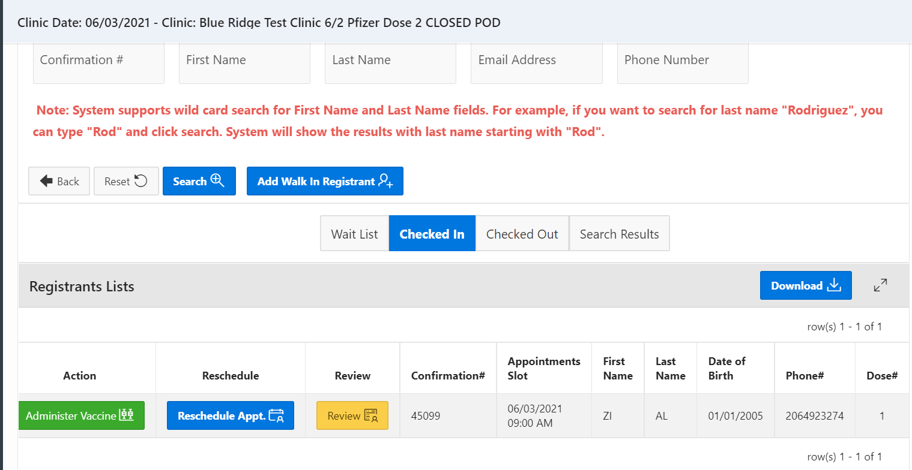
Appointment Rescheduling
Vaccine appointments can be rescheduled for the same or future days
Checked-in registrants can now be rescheduled for an appointment on the same day for either a new vaccination type at the same site (as long as there are multiple clinics at the site for that day), new clinic location, or a clinic at a later date.

Slide 4
Uploading Users
Uploaded users now are able to have multiple roles and clinics associated with them
Now, when multiple users are being uploaded to VASE+, an option is available to assign multiple roles and multiple clinics to said users.

Slide 5
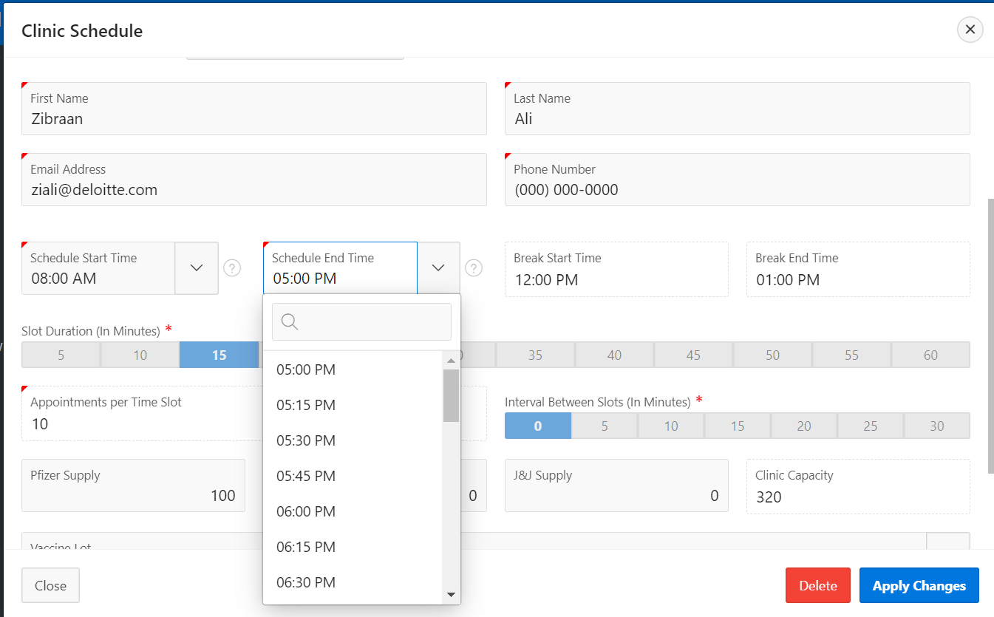
Clinic Schedule Edits
Clinic Schedule start and end times can now be edited
Ability to change clinic start and end times is now available for current and future clinics.

Slide 6
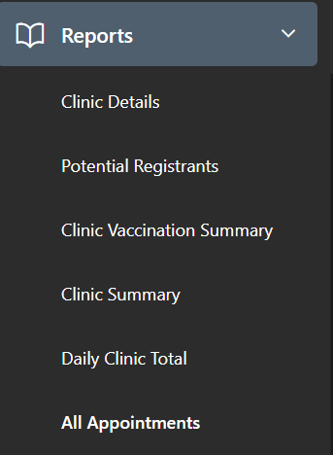
All Appointments Report
A report that displays appointment and vaccination status of a registrant
An all appointments report now will give administrative (locality & site) users the option to search for an individual and look at what appointments they have been scheduled for as well as their vaccination status, name, and dose #.
Notes:
-Believe this is just based off VASE+

Slide 7
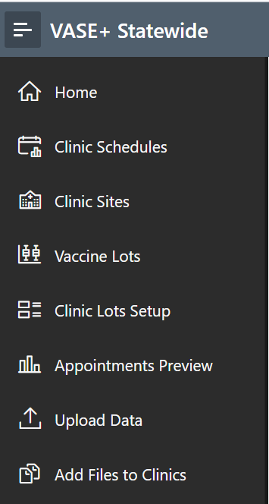
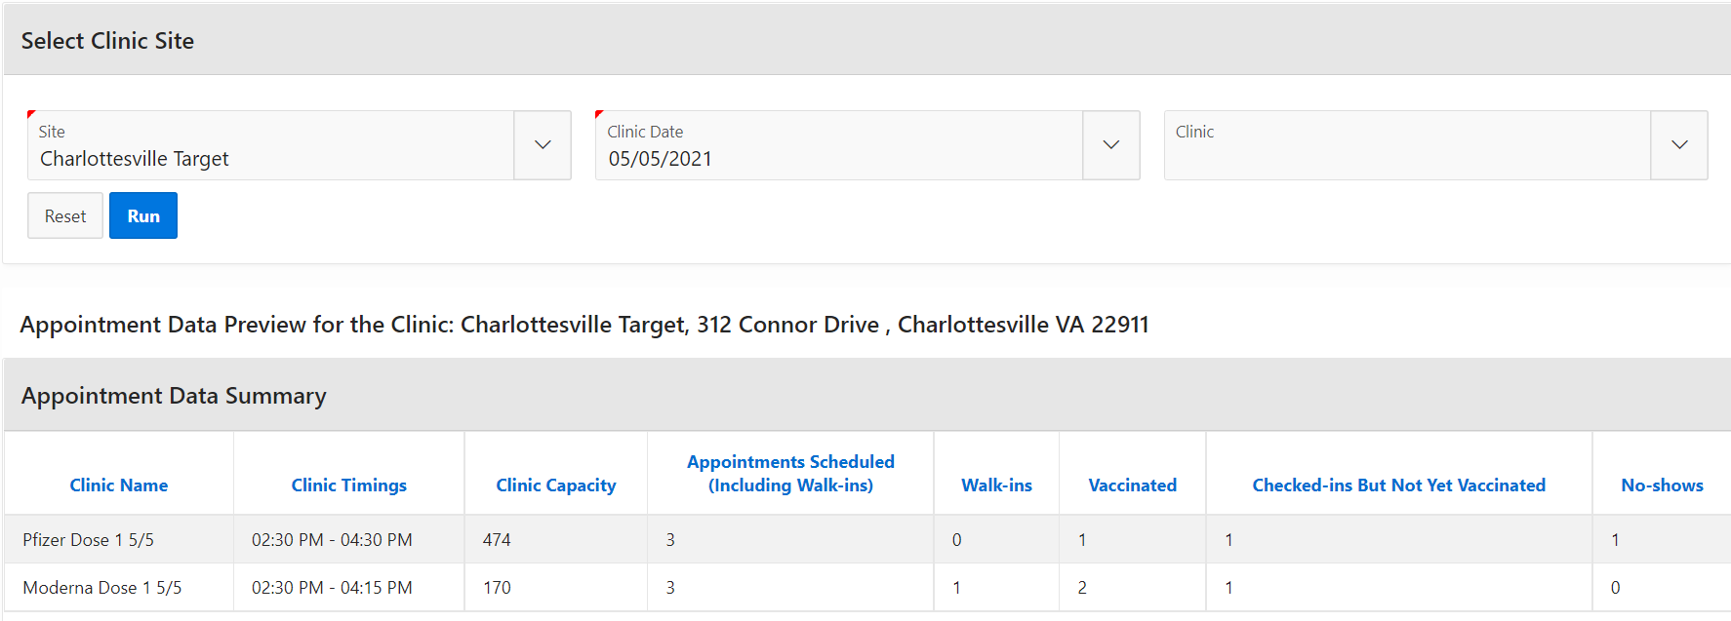
Appointments Preview
Appointments preview gives a breakdown of VASE+ Clinics
The appointments preview section is a new addition to VASE+ that displays information regarding available appointments, scheduled appointments, and vaccinated individuals within a clinic. This view is available to all VASE+ administrators and clinic view users.

Slide 8
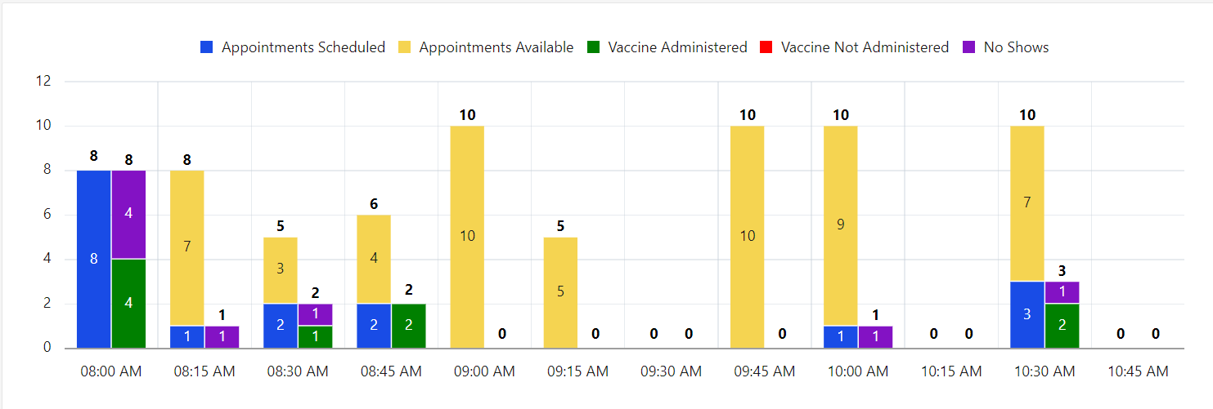
Appointments Preview Cont.
Scheduled appointments can be shown in a graph format
The appointments preview function will also display a chart that will have the information shown above, in a color-coded fashion to make it easier for administrative staff to review. This information is available for past, current and future clinics.

Slide 9
Personal Information
Address fields are now mandatory
The registrant’s address is now a required field for when a registrant is signing up or being checked-in.
Notes:
- Was requested by district

Slide 10
User Profile Enhancement
User profile view has changed for administrators in order to create a more seamless experience
VASE+ now prompts that security questions and answers have been filled out. This suggests that a user has successfully logged in and set up their VASE+ account. Site admins can still lock, unlock and reset a user’s account

Slide 11
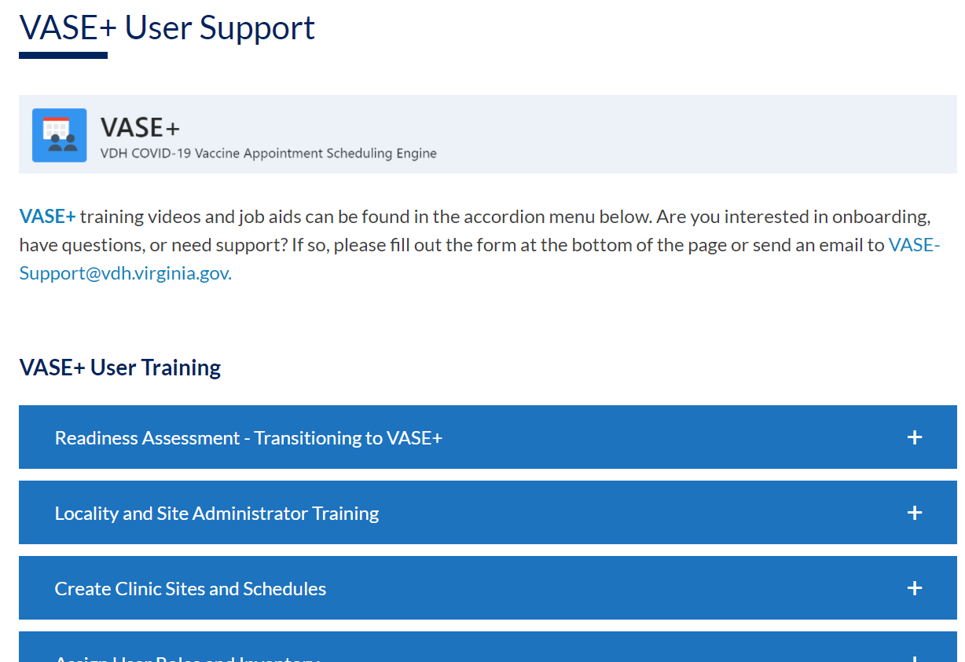
Help and Support
VASE+ now features a Help button with a link to training materials to better assist users with questions
A new link to training materials and guides can be found by clicking the Help to aide in assisting with common questions and issues. If the issue is not resolved through the “VASE+ User Support” section, users can contact the VASE+ Support team to seek further assistance.

