Slide 1
VASE+ Feature Update​
June 10th , 2021

Slide 2
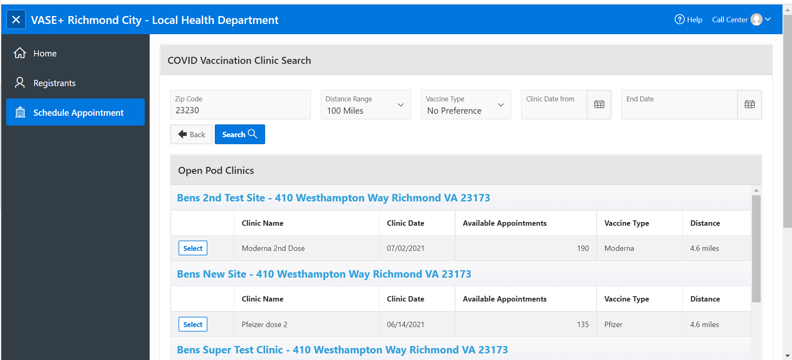
Scheduling Appointments
Scheduling Appointments has been updated to reflect all open pod clinics
When a call center user is scheduling an appointment for a registrant, the schedule appointment section now shows all open pod clinics available within the search radius. Prior, the search only showed the first fifty clinics.

Slide 3
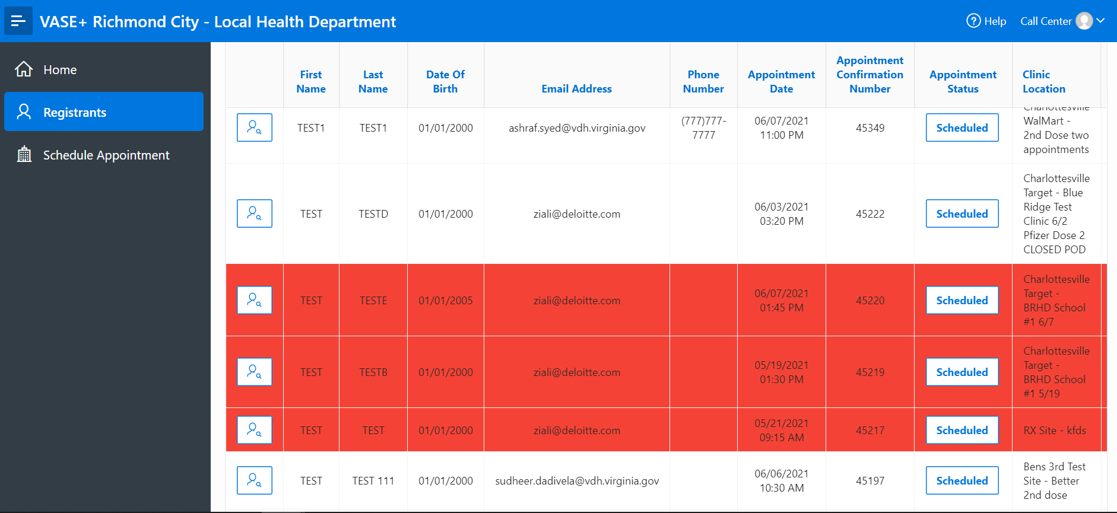
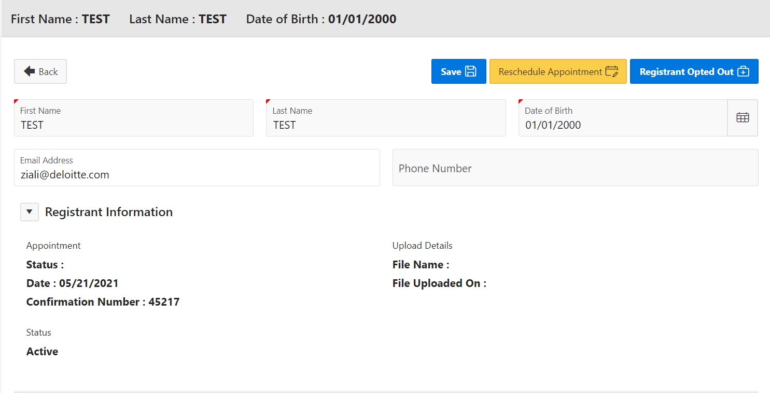
Rescheduling No-Shows
A new feature that makes it easier to reschedule missed appointments
When a call center agent searches for an individual they will be highlighted in red if an appointment was missed.
Clicking on the information icon will direct the agent to a screen to reschedule the registrant's appointment.
Call center agents will then be able to reschedule an appointment for no-shows without having to re-do the entire registration process (name, DOB, address, etc.).

Slide 4
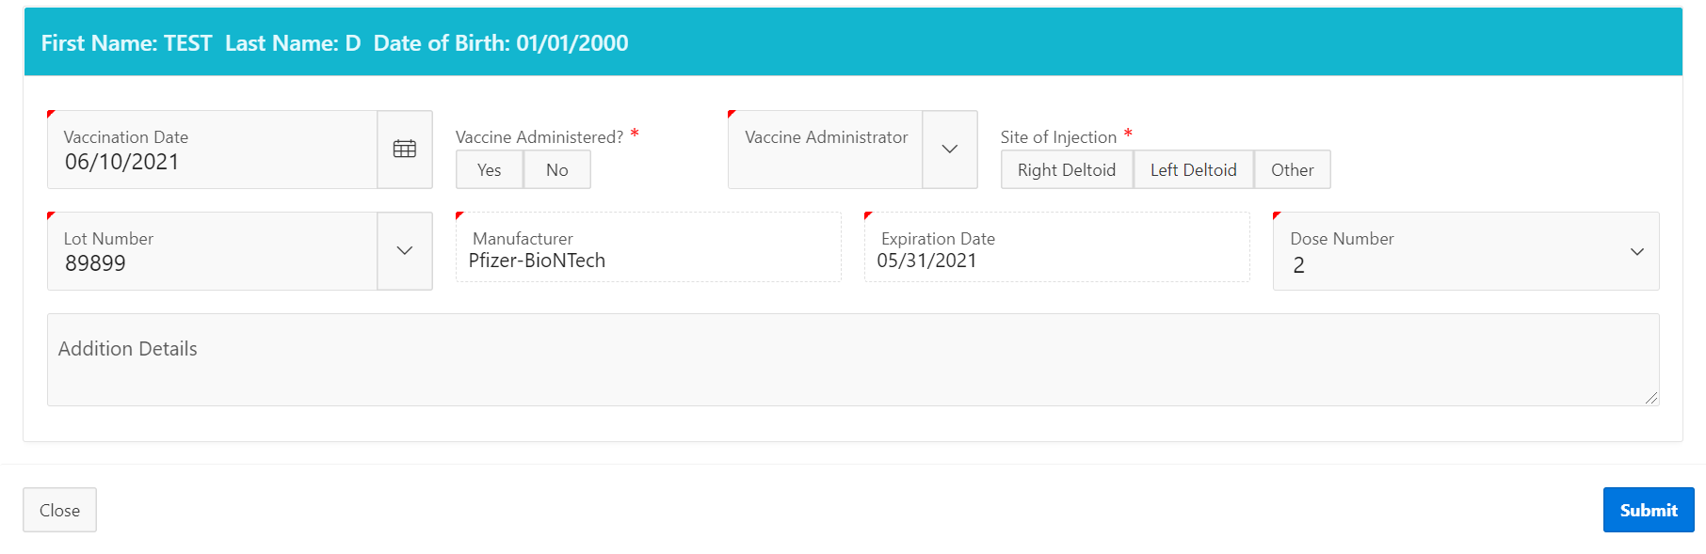
Vaccination Administration
Multi-lot clinic selection has changed to provide a better workflow for vaccine administrators
For clinics with multiple lots, the drop-down menu to select the appropriate lot has changed from “Manufacturer” to “Lot Number”.

Slide 5
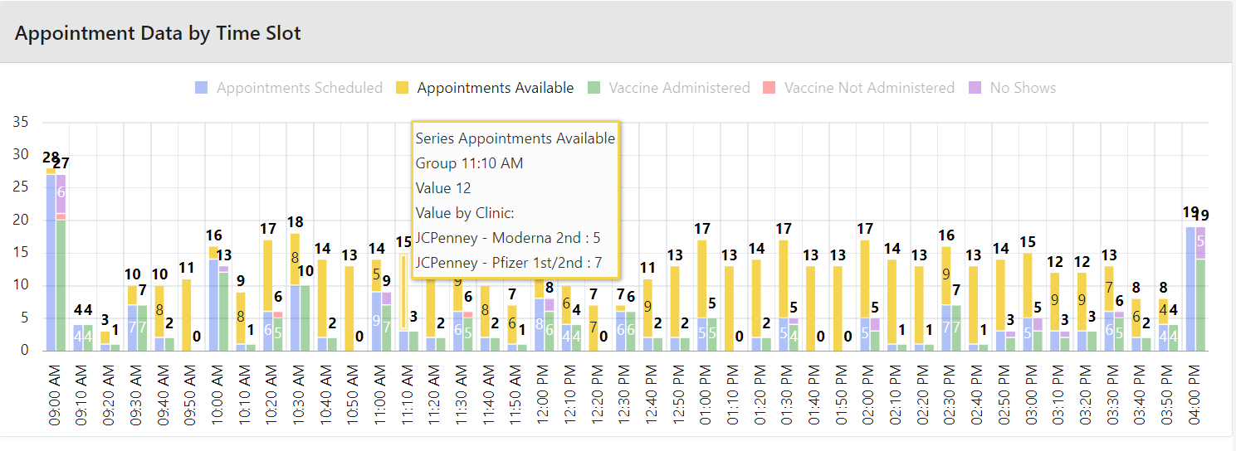
Appointments Preview Graph
The appointment preview graph now providers a further breakdown of available clinic capacity by timeslot and clinic
The tool tips in the appointment preview graph now displays a breakdown of available appointments by timeslot and clinic by hovering over the timeslot.

