Slide 1
VASE+ Features Update​
July 6th, 2021

Slide 2
VASE+ Walk-In Count
A new Walk-In count display has been implemented in the dashboard
A new display section in the dashboard has been added to show how many Walk-In appointments have been made to the clinic.

Slide 3
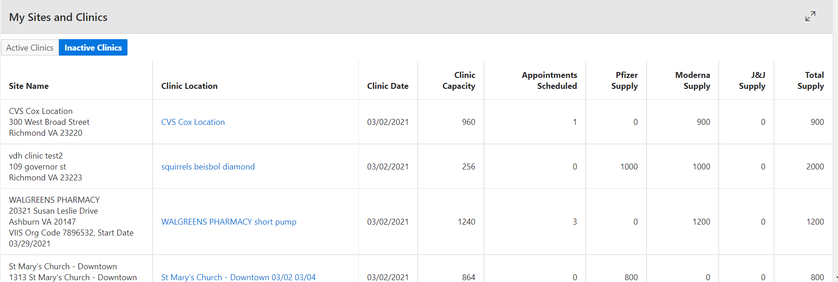
Locality Admin Inactive Clinics
Locality Admins can now view inactive clinics
Locality admins can now view inactive clinics in the inactive clinics tab. This allows for greater functionality. Locality admins can now, for example, navigate to previous clinics and input data.

Slide 4
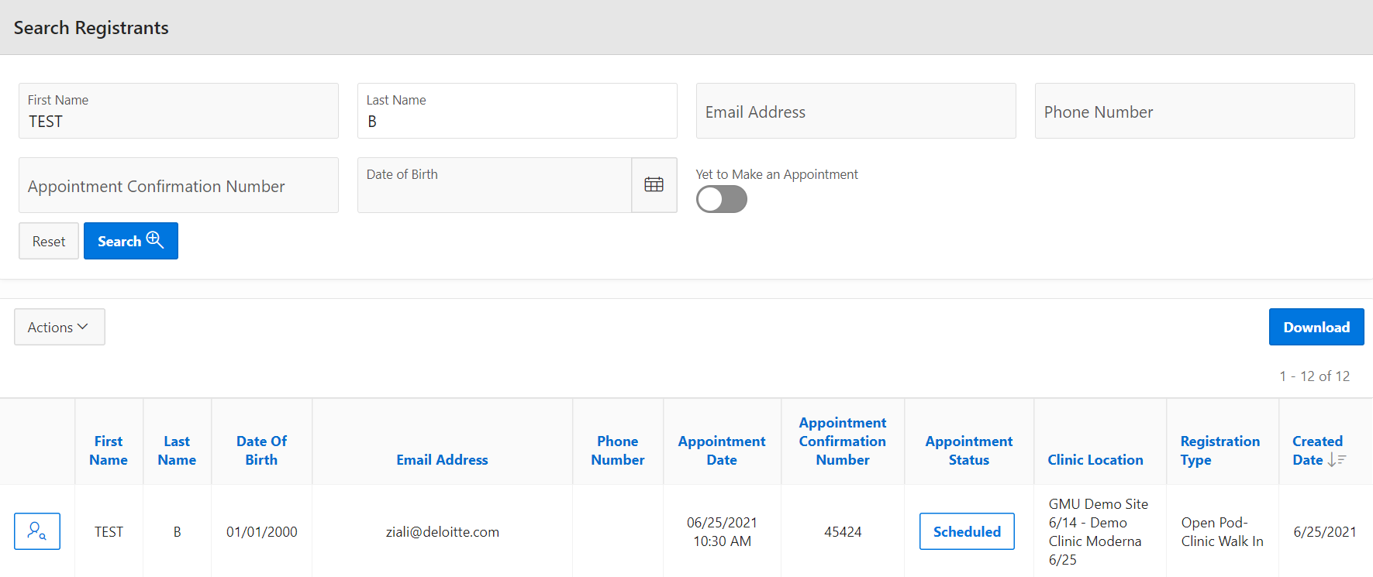
Registrant Search – Call Center Staff
Call Center Staff can now view more information when running a search of registrants
Call Center staffs are now able to view all registrant data under the Search Registrant function.

