Slide 1
VASE+ Features Update​
August 15th, 2021

Slide 2
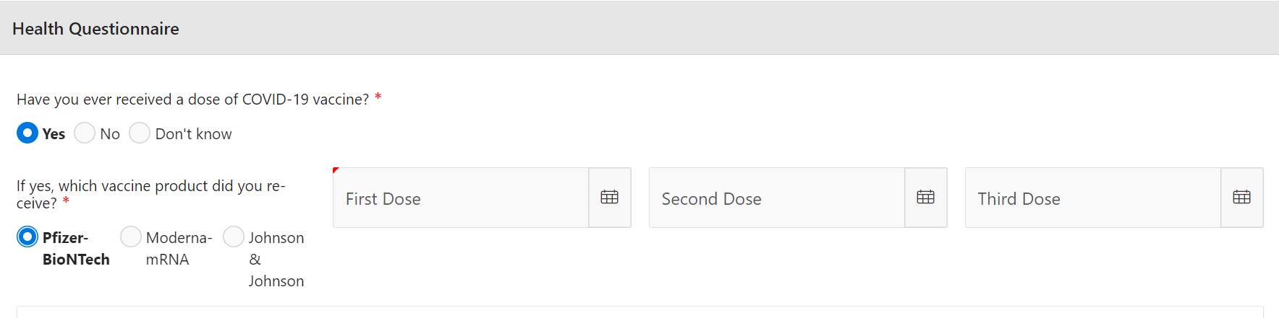
COVID-19 Third Dose
A third dose option has been added for both Pfizer and Moderna vaccine types
Vase+ now allows for a third vaccination dose to be entered for Pfizer and Moderna vaccine types. The health questionnaire now will prompt individuals with selecting the dates of when their doses were received.

Slide 3
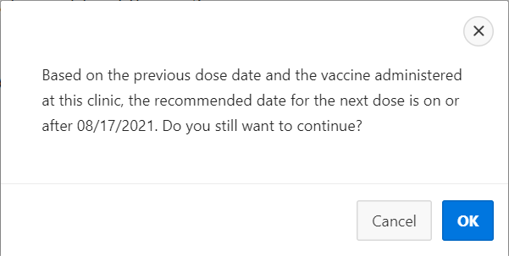
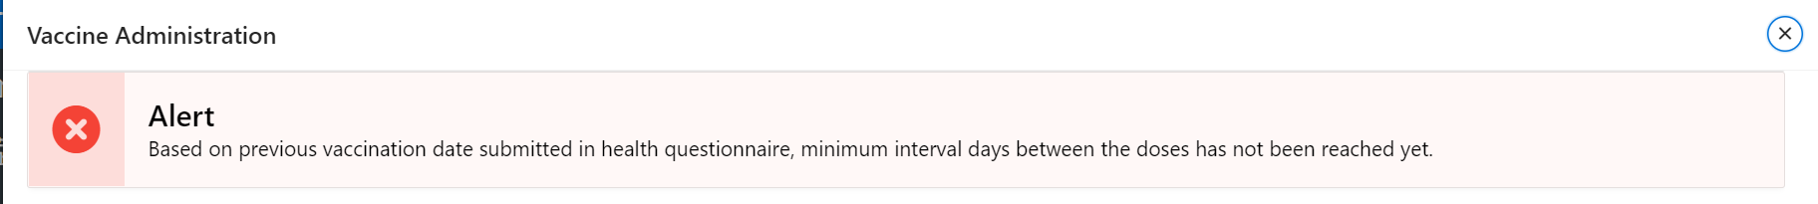
28 Day Interval Warning – 3rd dose
A warning is displayed when scheduling an appointment within 28 days of last vaccination received
If an individual tries to register for a 3rd dose appointment within 28 days of receiving their 2nd dose, the individual will be provided with a warning message such as this when filling out their health questionnaire. Both Moderna and Pfizer have a 28-day waiting period.
The vaccine administrator will also see the following warning if an individual is being administered a 3rd dose prior to 28 days.

Slide 4
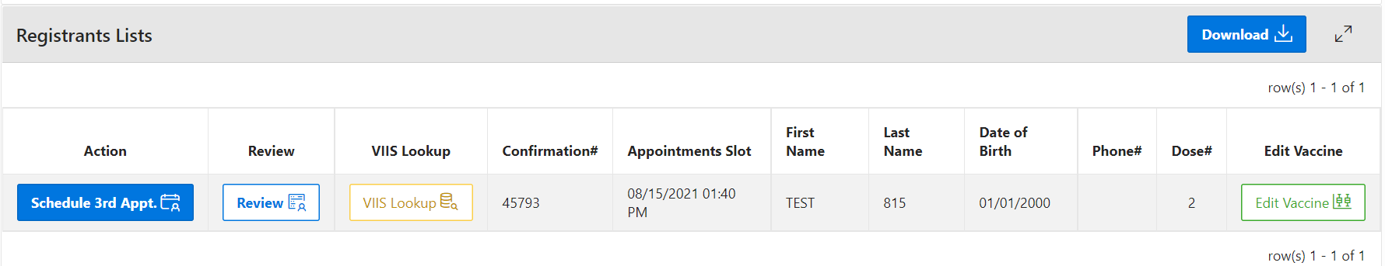
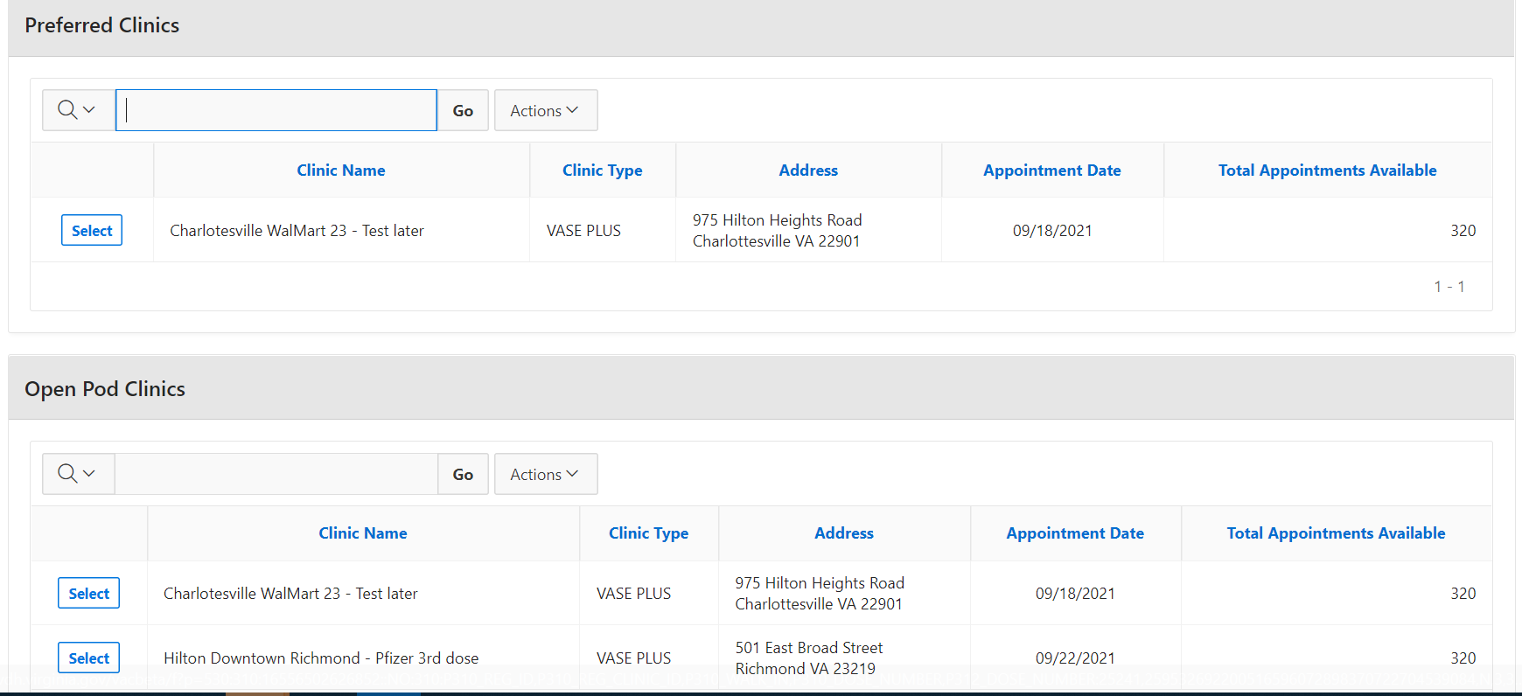
Schedule 3rd Dose Appointment
Ability to schedule a 3rd dose appointment for registrants is now available
Individuals who have received their 2nd dose will now have an action assigned under them to schedule a 3rd appointment.
*VASE+ will not be sending out automated emails to schedule 3rd dose appointments. Only 2nd dose appointment emails will be sent out.
*an individual will show up as fully vaccinated if a 3rd dose date is entered instead of a second dose.
When a clinic staff is trying to schedule a 3rd dose appointment, only clinics that are past the 28-day wait period will be displayed.

Slide 5
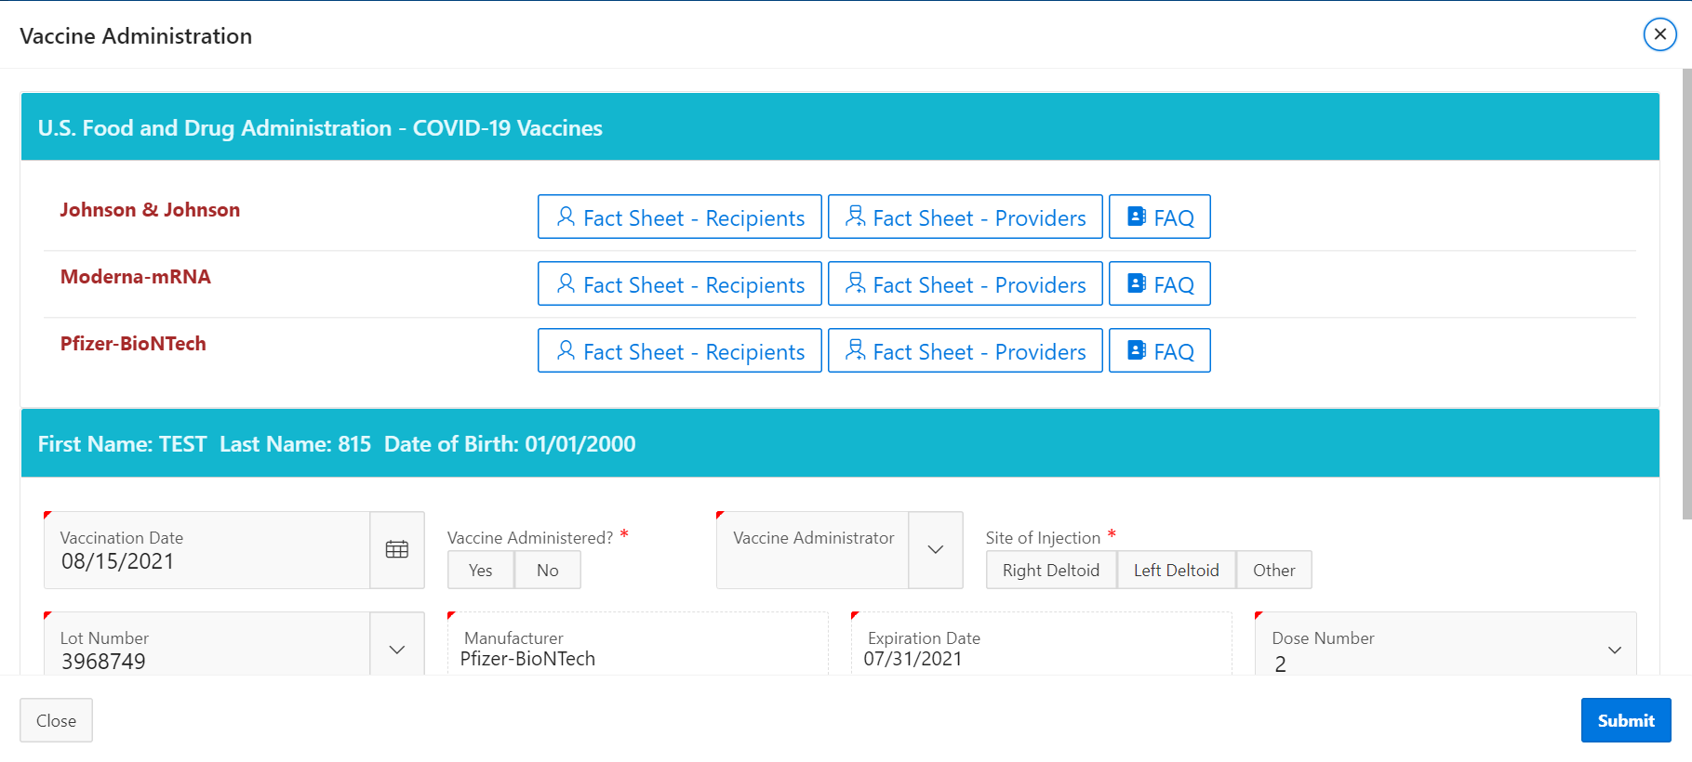
COVID-19 Vaccines Fact Sheets
Fact sheets for COVID vaccine types
Fact sheets are now available to view for all vaccine types, under the vaccine administrators view when vaccinating an individual.

Slide 6
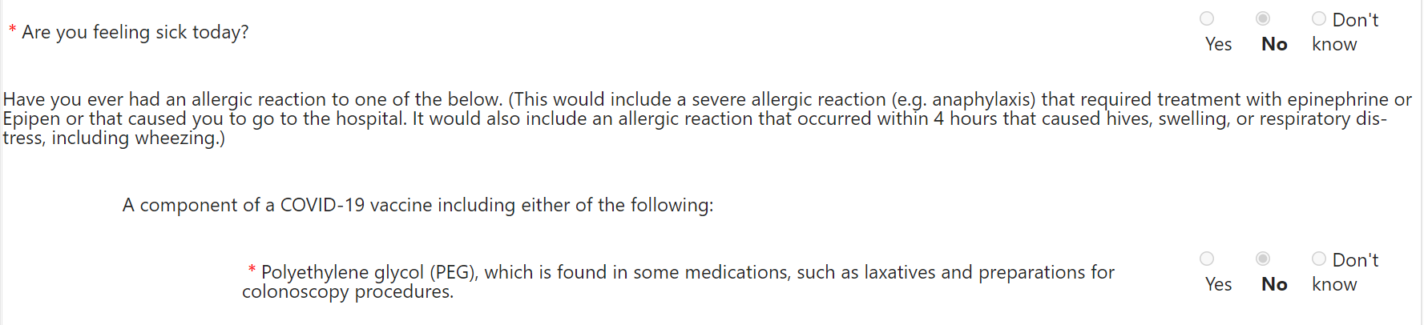
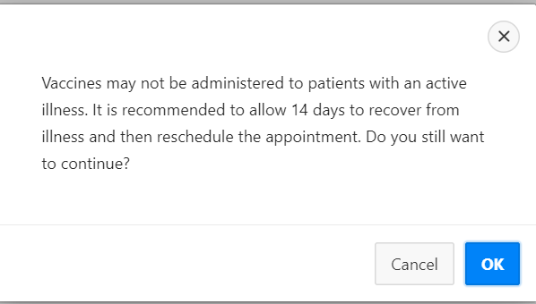
Updated Health Questionnaire Layout
The health questionnaire now prompts a warning message when someone is sick
The question “Are you feeling sick today?” has been placed at the top of the health questionnaire.
If an individual answers yes, the warning on the left will displayed to them.

Slide 7
Further Changes
A list of other functionalities that have been added to VASE+
Call center staff can schedule, reschedule, or cancel a third dose appointment for registrants who have were previously considered to be fully vaccinated with Moderna of Pfizer
Registrants are able to schedule, reschedule, or cancel their third dose appointments through the VASE+ scheduling engine.
The typo in the question “Have a history of herparin-induced thrombocytopenia (HIT)?” is corrected.

