Slide 1
VASE+ Features Update​
August 26th, 2021

Slide 2
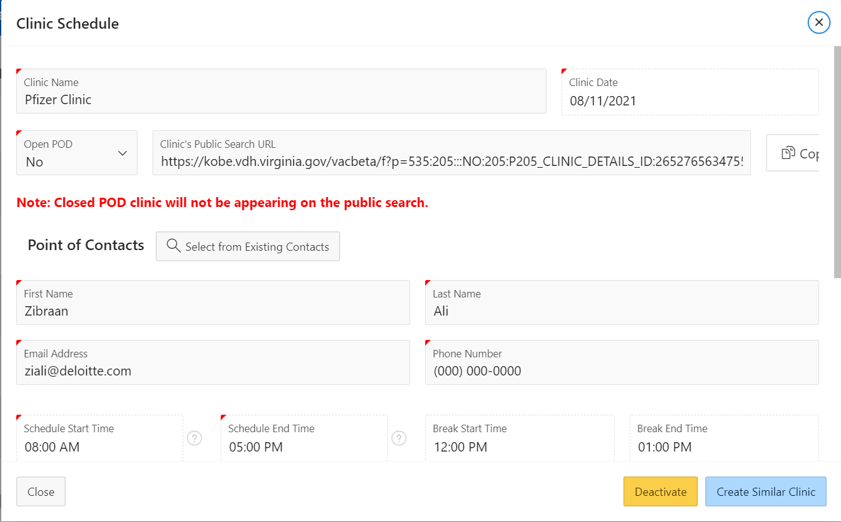
Create Similar Clinic
An option has been introduced to create a similar clinic
VASE+ now supports the ability to create a similar clinic to a clinic that was already built. This could be accessed through the edit clinic button of a clinic you’d like to re-create.
*Note: This feature currently is not available on any inactive clinics.

Slide 3
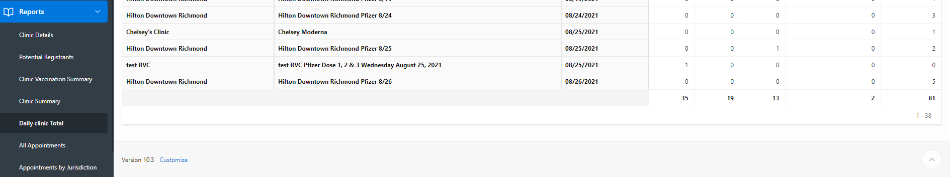
Daily Total Clinic Report
The report has been modified to display a total count
The Daily Clinic Total graph now displays a total clinic count for report run.

Slide 4
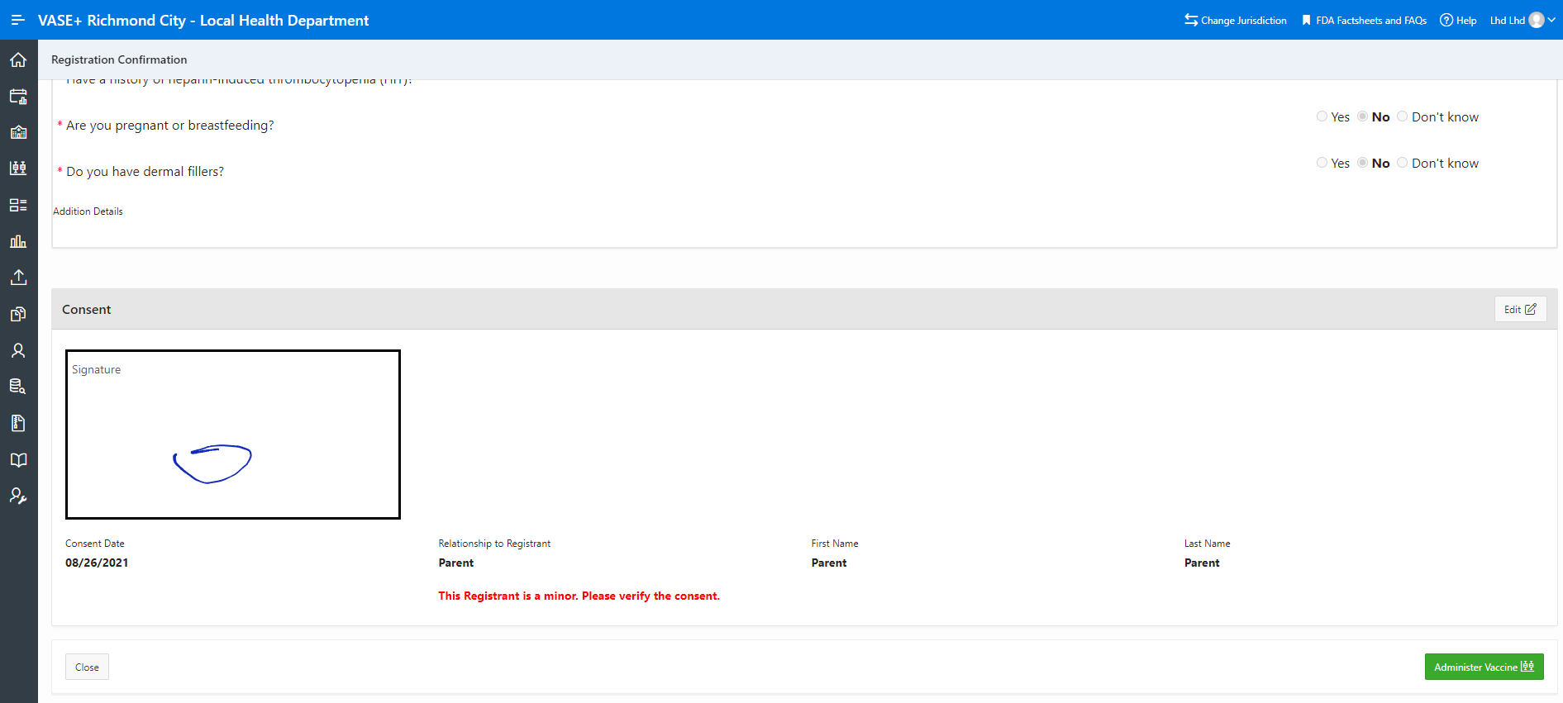
Administer Vaccine
Continued display of administer vaccine button
The Administer Vaccine button will continuously be displayed under the review section of a checked in registrant until the registrant has been vaccinated.

Slide 5
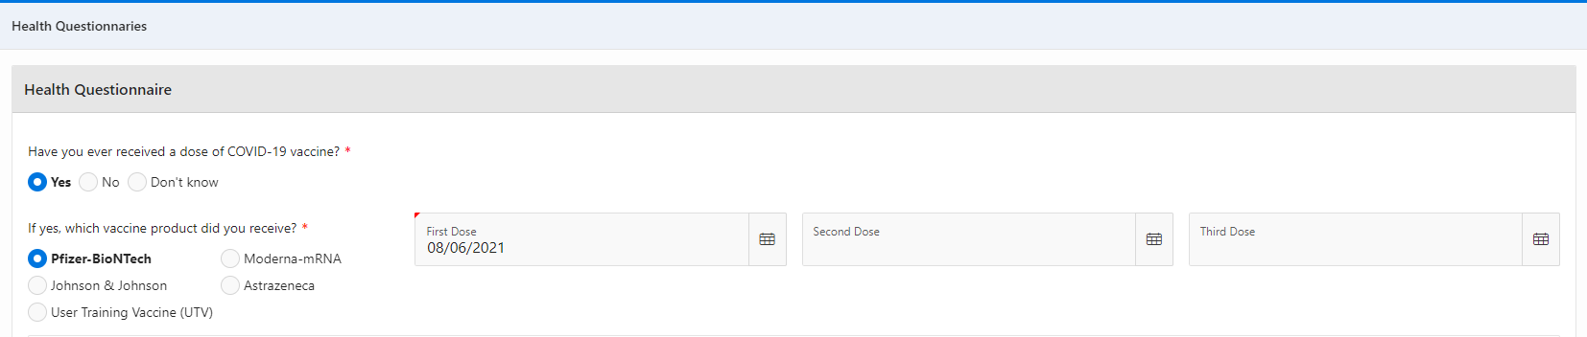
Health Questionnaire Update
Other vaccine types have been introduced in the health questionnaire
New vaccine types, such as AstraZeneca have been added into the Health Questionnaire for registrants to select from.
*Note: the User Training Vaccine (UTV) is only available in Beta for training purposes.

