Slide 1
VASE+ Release Notes
November 3rd, 2021
Release 11.4

Slide 2
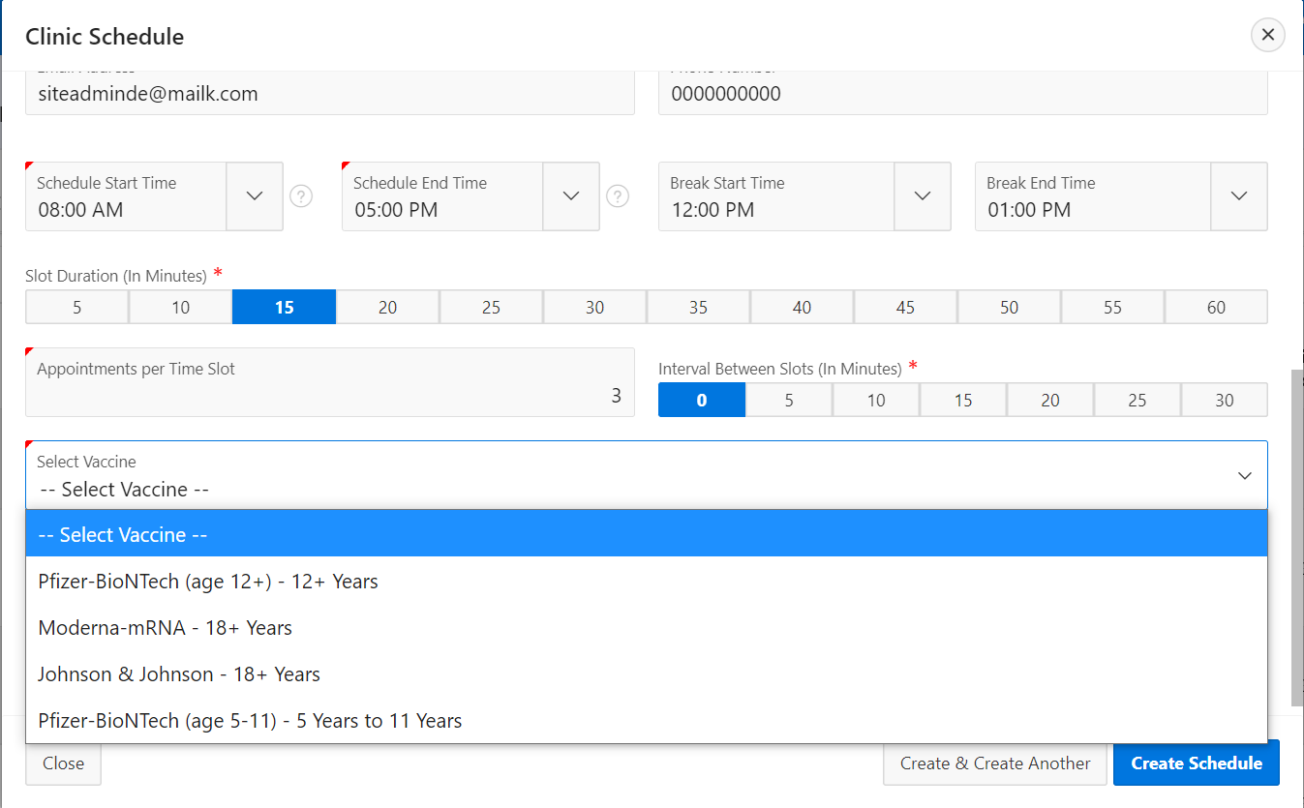
Vaccine Selection
A new vaccine selection field has been introduced
A new vaccine type has been introduced during the clinic schedule creation process. This is to help distinguish between clinic types, especially with the new vaccination approval for 5–11-year-olds.
Users will be prompted to select a vaccine type being offered at their clinics and enter in vaccine supply accordingly.
*Vaccine type will not be editable once there are registrants in the clinic.

Slide 3
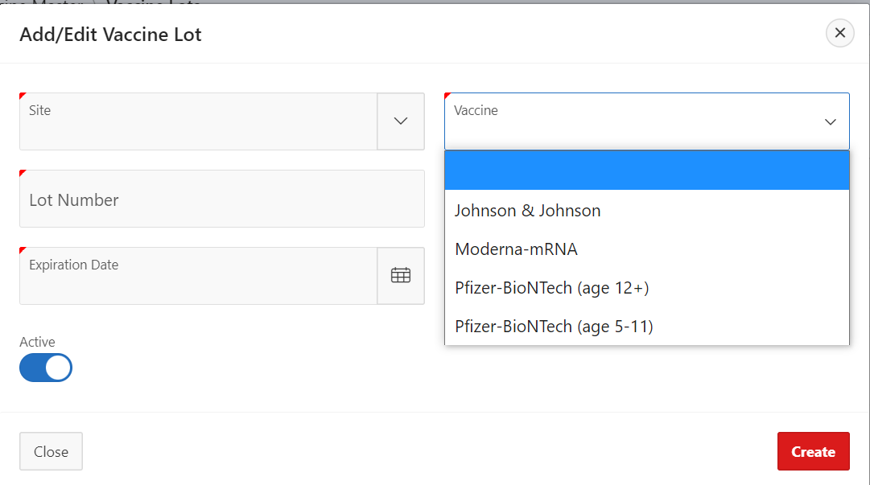
Vaccine Lot Addition – Pfizer 5-11
A new vaccine lot option has been introduced to include Pfizer’s 5–11-year-old vaccine lots
The vaccine lot field now also includes the option to select “Pfizer-BioNTech (age 5-11) to accommodate the new CDC guidelines and approval for 5–11-year-olds to get vaccinated

Slide 4
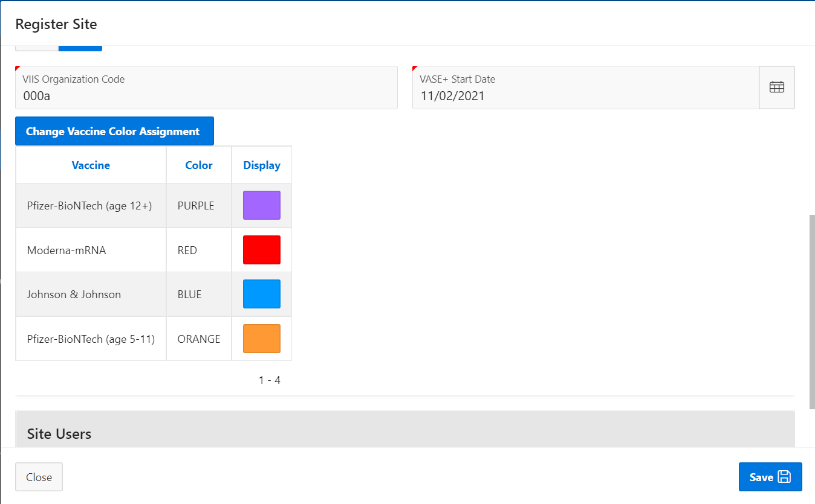
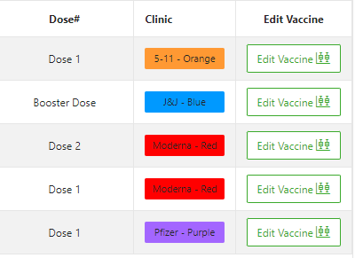
Color Coding Per Vaccine Type
Default colors are applied to vaccine types at a site level
-
VASE+ Now has a standard color coding (shown above) for vaccine types that will carry through out the system.

Slide 5
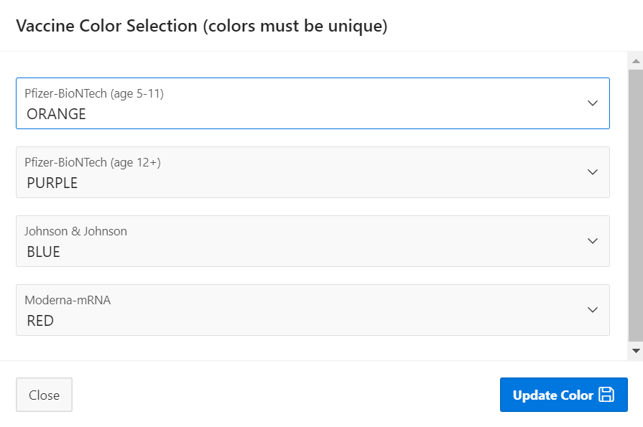
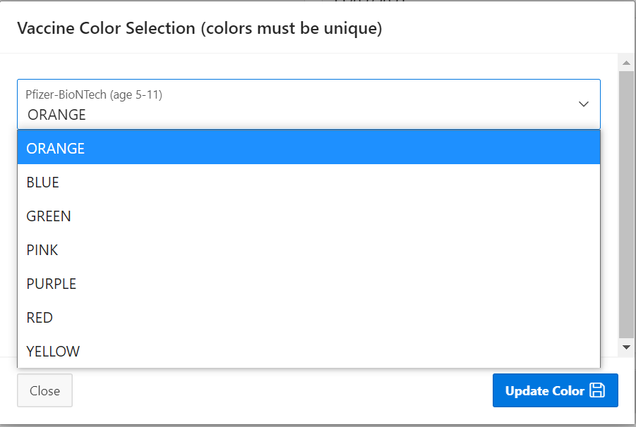
Vaccine Color Coding Customizability
Vaccine color selections can be customized at site levels
Clinic color types are customizable at a site level and can be customized by either a locality or site admin.

Slide 6
Vaccine Name & Vaccine Supply Columns
New columns have been introduced on the Dashboard
A new column showing vaccine name and another showing vaccine supply has been introduced to VASE+. These are visible at the dashboard view level.

Slide 7
Call Center - VIIS Lookup
VIIS lookup has been introduced for call center roles
Call center staff will now be able to perform a VIIS lookup on registrants before scheduling appointments.

Slide 8
VASE+ Release Notes 11.4
Here is a detailed view of all the release items
A new vaccine Pfizer (age 5-11) is added to the vaccine master
Creating clinics for the new vaccine, assigning lots to the clinic in the same page while setting up clinics
If there is an active appointment, system should not allow the updating the vaccine supply and vaccine type at the clinic
Pfizer (5-11) vaccine can be administered as First and Second Doses to the registrants between 5 to 11 years only. No Booster Dose
System should allow the registrant to take first dose of Pfizer(5-11) and second dose of pfizer(12+) (if by the time of second dose, the registrant is 12+ years old)
Call center flow for the new vaccine like scheduling, rescheduling, cancelling appointments with validations to allow registrants of correct age
Clinic staff flow for the new vaccine like adding walk in registrant, administering vaccine, scheduling next appointment, rescheduling, canceling next appointment
Adding lots to new vaccine, assigning vaccine lots to the current clinics
Dashboard page shows a new column Vaccine Type and one column for supply Vaccine Supply
Call center staff can see a new menu link VIIS Look Up and query for the vaccination history
A new column is added to the Vaccine Master table to display the default color code for the vaccine
Locality admins, Site Admins can update the color for the vaccine in their clinics
The background color of the Clinics column in all the walk-in, checked in, checked out buckets will be in the color set by the locality/site admins or will be in its default color.

