Slide 1
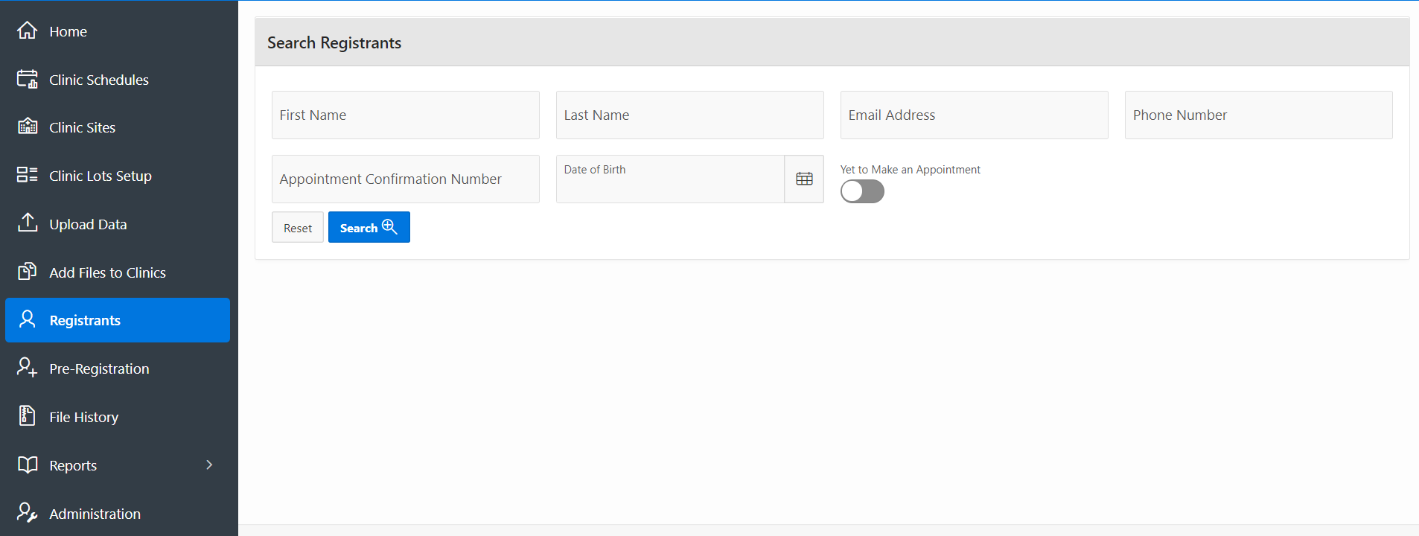
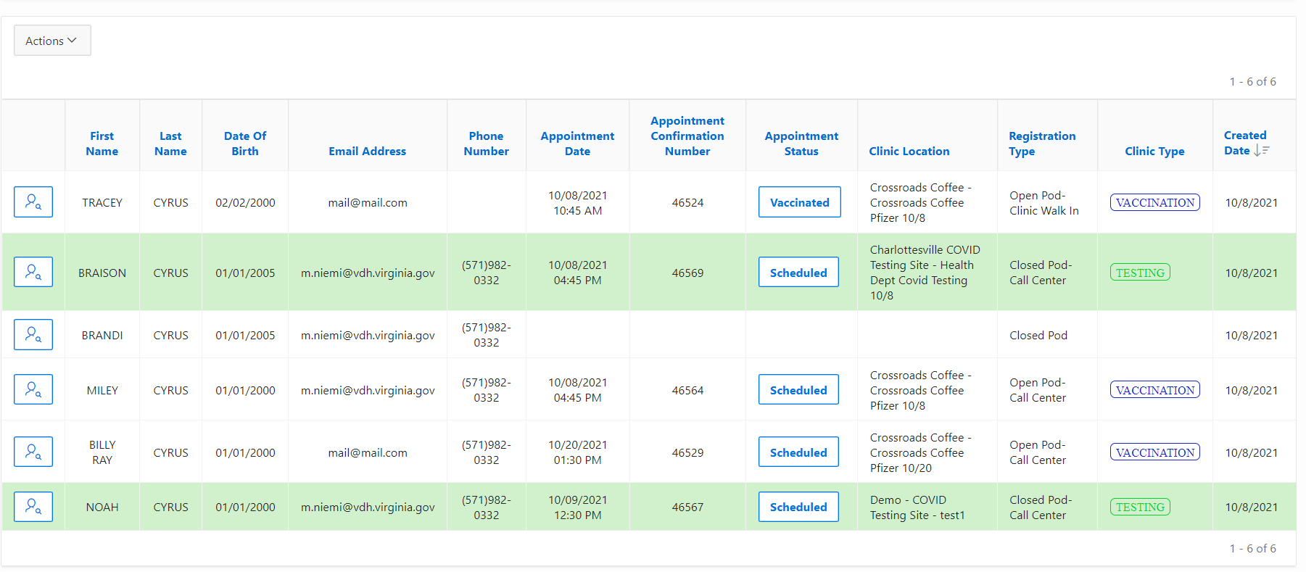
VASE+ Job Aid – Call Center Testing Clinics
Version 1.1
In this job aid, users will learn how to use the Search Registrants and Pre-Registration features in VASE+, specifically for COVID testing sites. These features are available to call center roles in addition to Administrator and Locality Admin and will display all registrants within the jurisdiction of the operator. Through registrant searches, individuals can be identified for testing appointment scheduling; as well as provide additional information on the status of an individual’s state in the registration process.
Search Registrants
Click on “Registrants” from the navigation menu on the left. In the Search Registrants search engine, a registrant can be searched by any of these categories: Fist Name, Last Name, Email Address, Phone Number, Appointment Confirmation Number, and Date of Birth. (Note: Combining search criteria elements will yield the best results.)
The toggle switch “Yet to Make an Appointment” will look for people in the system that have yet to make an appointment allowing for prioritization scheduling of this individuals during a search.
Figure 1 – Search Registrants Engine
Results of the search will be displayed in a list at the bottom
Registrants highlighted in green are scheduled for a COVID testing clinic.
The “Clinic Type” column denotes whether an individual is registered for a vaccination or testing clinic
Click on the “View” icon to review a registrant.
Figure 2 – Color-coded search results menu

Slide 2
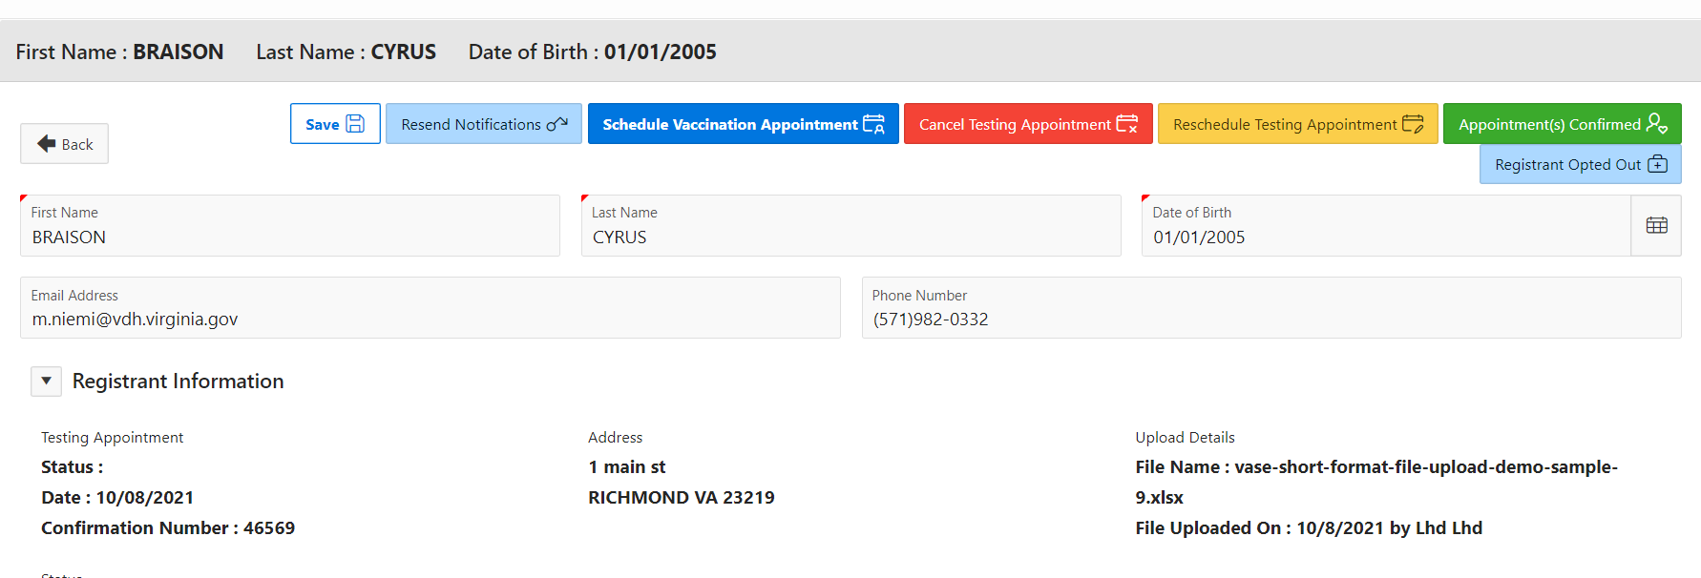
VASE+ Job Aid – Call Center Testing Clinics
Version 1.1
Review Registrants
After clicking the review button, you will have the following actions:
Options to save, resend notification, schedule vaccination appointment, cancel testing appointment, reschedule testing appointment, or registrant opted out.
Edit registrant demographic information
Send new communications
Figure 3 – Reviewing registrants
Schedule Appointments
You can schedule new registrants into the system for COVID testing clinics:
Navigate to the “Schedule Appointment” pane
Toggle the COVID Clinic Search to “COVID Testing.
Enter in search criteria such as zip code, distance range, and/or clinic dates to find testing clinics
Figure 4 – Searching for COVID testing clinics

Slide 3
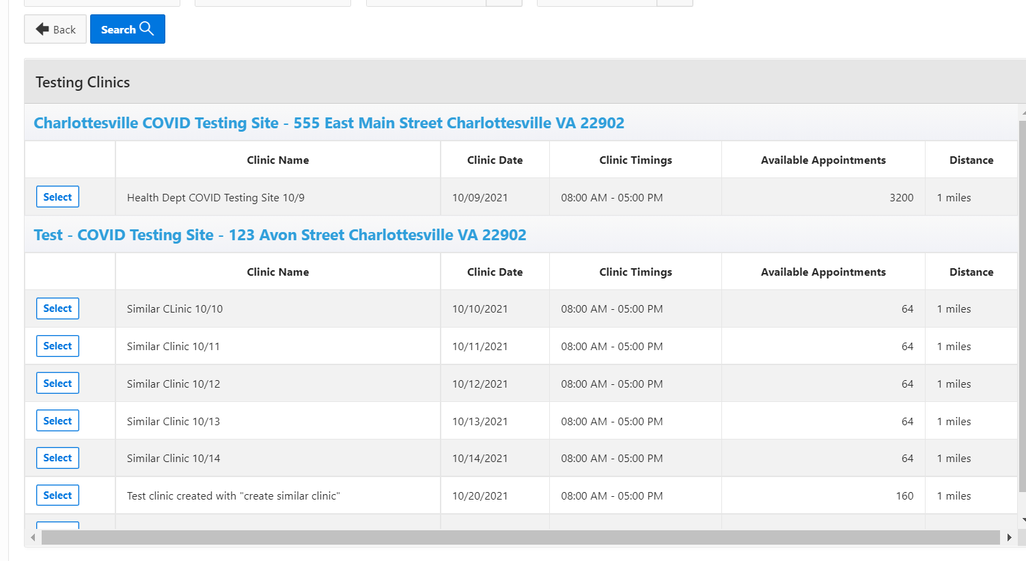
VASE+ Job Aid – Call Center Testing Clinics
Version 1.1
Schedule Appointments (Continued…)
After clicking the search button, you will see a list of open pod COVID testing clinics within your locality that met the search criteria. Select clinic and proceed with registering registrant.
Figure 5 – Selecting clinic for scheduling

