Slide 1
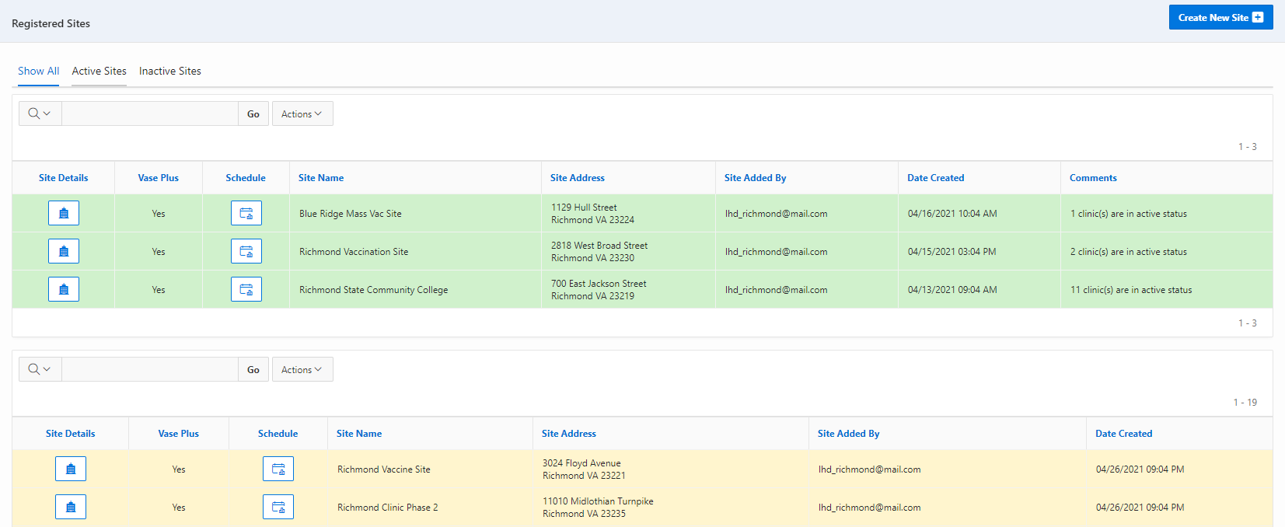
VASE+ Job Aid – Create Covid Testing Clinic Schedules
Version 1.2
Summary:
In this job aid, users will learn how to create Covid testing clinics in VASE+. The following user roles can create clinic sites in the VASE system: Locality Admin, Site Admin, and Clinic Scheduler.
Like a vaccination clinic, a testing clinic schedule is created within the context of a clinic site. The schedule allows the user to set the name of the clinic, date, ordering facility, performing facility, points of contact at the clinic, start and end times, break start and end time, slot durations, appointments per slot, and include intervals that may be needed between slots. The system also allows an easy way to create clinic schedules across multiple days.
*Note that ordering facility and performing facility are new fields specific to testing clinics
Create New Schedule
A clinic schedule can be created by clicking on the ‘Schedule’ button corresponding to each site. This can be done for both Active and Inactive clinic sites. Active sites are shaded in green and inactive sites are shaded in yellow (Figure 1).
Figure 1 – Click on the schedule button to create a new clinic schedule
After clicking on the schedule button corresponding to a particular site, the user can view the Active Clinic Schedules (current and future), Inactive Clinic Schedules (History). In the “Clinic Type” column, testing clinics are denoted in green and vaccination clinics are denoted in purple. Users can create new clinic schedules by clicking on the “Create Clinic Schedule” button on the top right (Figure 2).

Slide 2
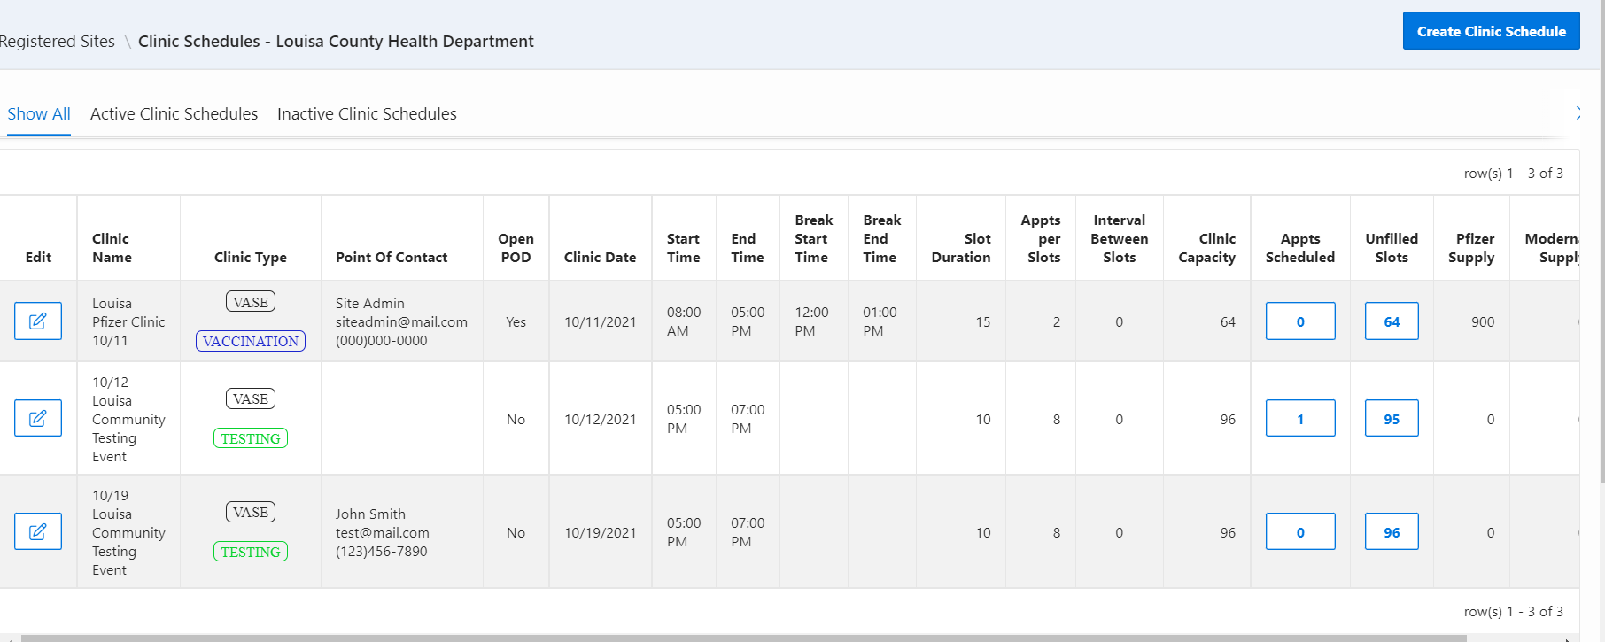
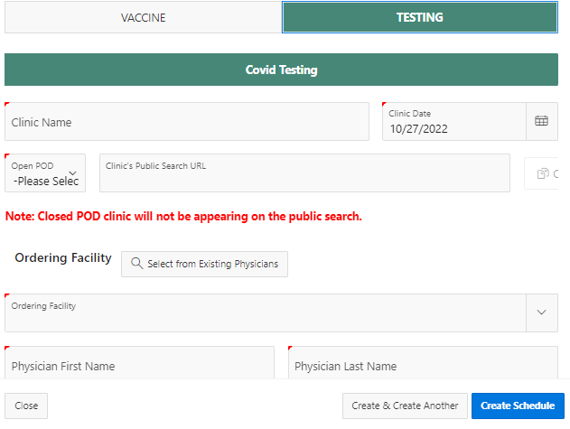
VASE+ Job Aid – Create Covid Testing Clinic Schedules
Version 1.2
Figure 2 – Create Clinic Schedule Button and Color-Coded Clinic Type
This triggers a pop-up screen (Figure 3) to capture:
Clinic Type: Toggle between Covid Vaccination and Covid Testing to indicate which type of clinic you are creating
Clinic Name: This corresponds to the name of the clinic for the corresponding date under the Clinic site
Ordering Facility and Performing Facility: Select the appropriate ordering and performing facility from the dropdown lists that correspond to your clinic's specifications
Points of Contact: This establishes the main point of contact for the clinic. Users can select an existing user users for clinics
Clinic Schedule: The clinic schedule start and end time, the break start and end time, slot durations, appointments per slot, and intervals between slots
The clinic capacity (which sets a cap on the total number of appointment slots created) can be adjusted by increasing or reducing the slot duration or the interval between slots
Figure 3 – Creating a Testing Clinic Schedule

Slide 3
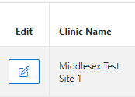
VASE+ Job Aid – Create Covid Testing Clinic Schedules
Version 1.2
After all the information is input, the user can click on Create Schedule to finalize the clinic schedule. Clicking on Create & Create Another will create another clinic schedule with the same data and parameters, except the Clinic Date will automatically fill the next day. This allows users to easily create multiple days with the same schedule. The user can choose to modify other parameters as necessary as well.
Once the clinic schedule has been created in the system, the user can click on the edit button next to the clinic for a link to the clinic, to view the schedule, or make any edits if necessary (Figure 4). The link may be copied and pasted to display on a website or distributed elsewhere for use by registrants (Figure 5).
Figure 4 – Edit Button
Figure 5 – Link for the Clinic
Additionally, on the pop-up screen, several details can be edited. The clinic name may be edited, as well as the point of contact. The clinic date is set and may not be changed.
For the clinic times and capacity, certain adjustments can be made, as well. The start time and end time can be extended, but not shortened. The break start time and end time, the slot duration, the appointments per time slot, and the interval between time slots may not be edited. If these need to be changed, please contact VASE+ support.

