Slide 1
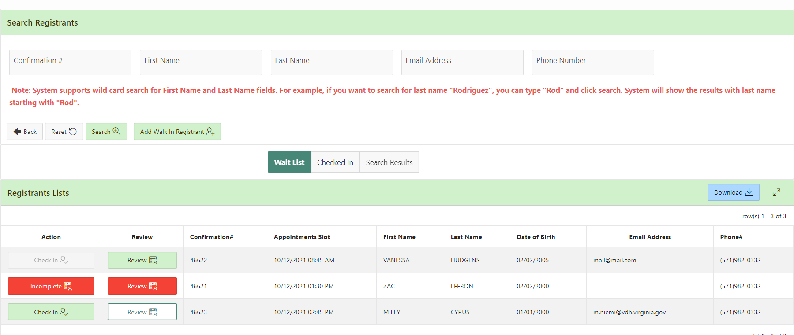
VASE+ Job Aid – Covid Testing Clinic Operations
Version 1.1
In this job aid, users will learn how check-in clinic registrants who have appointments as well as how to create walk-in appointments to allow registrants to receive their Covid test and Covid test results. This guide applies to Locality Admins, Site Admins and the Front Desk role.
Checking in Registrants
To access a clinic, click on the clinic name found in the clinics listing on the home page (Figure 1).
Figure 1 – Clinic listing
Upon clicking the clinic name, the user will be guided to the clinic’s waitlist page, which shows a list of patients awaiting scheduling (Figure 2). Users can search registrants by the following criteria:
Appointment confirmation no.
First Name
Last Name
Email Address
Phone Number
Press the “Download” button if a user needs an Excel copy of the Registrant list
To review or edit a registrant’s personal information, or consent details, click on the “Review” button. A red review button suggests the registrant’s health questionnaire is incomplete. A green review button indicates that the registrant is a minor and consent must be verified.
Figure 2 – Clinic Waitlist

Slide 2
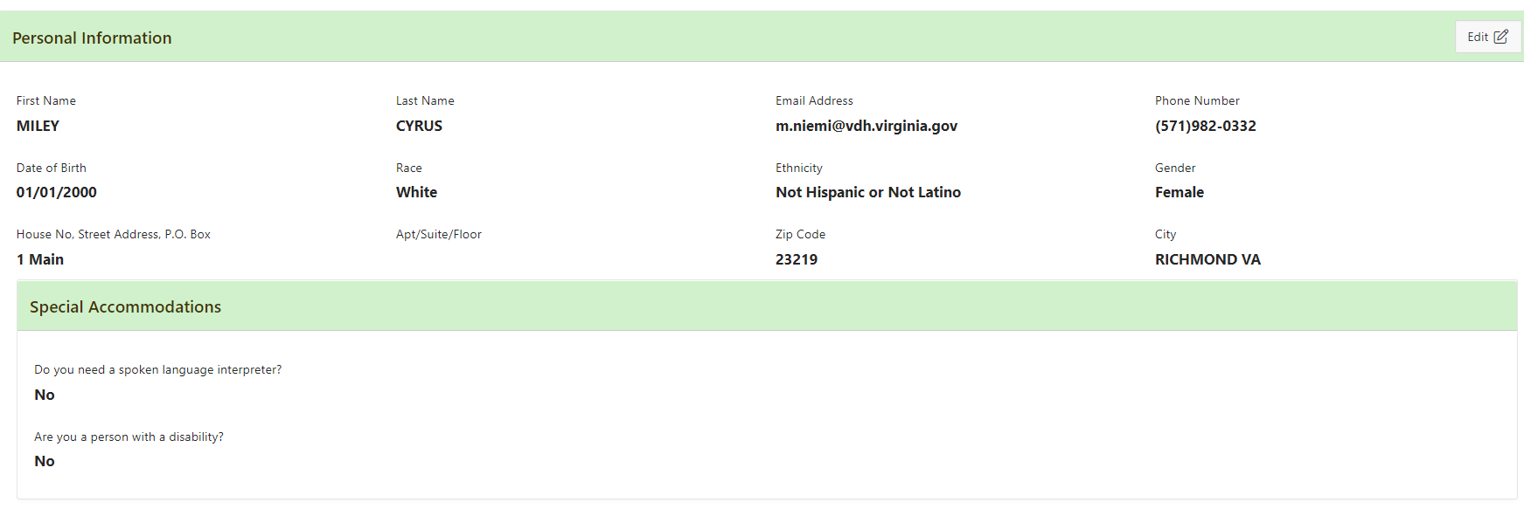
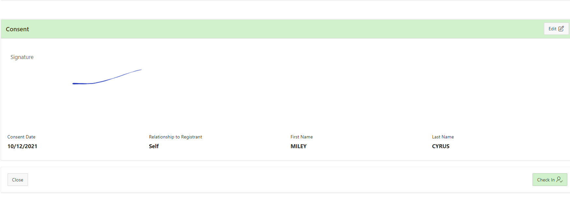
VASE+ Job Aid – Covid Testing Clinic Operations
Version 1.1
Upon clicking the review button, you can review and edit a registrant’s personal information and consent form (Figure 3). If registrant information must be updated, click the “Edit” button, at the top of the section you wish to edit, change the necessary information, and click “Save” to confirm updates.
Figure 3 – Click “Edit” to update registrant information
If registrant information does not need to be updated, they can be checked in at the bottom of the “Review” page (Figure 4).
Figure 4 – Checking in from Review Page
A registrant can be checked in from the Registrant List page by clicking “Check-In” (Figure 5).
A registrant who is under 18 years of age will have a green “Review” button for the Front-Desk staff to verify the consent information. A minor will not be able to be checked-in without verifying consent first. Note that this is also available to site admins.
Figure 5 – Click “Check-In” to check-in a registrant at an active clinic

Slide 3
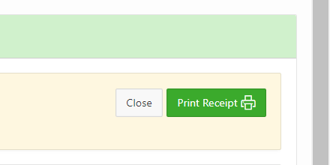
VASE+ Job Aid – Covid Testing Clinic Operations
Version 1.1
After the “Check-In” button is clicked, the registrant’s personal information and consent will be pulled up. From this page, the information can be printed using the “Print Receipt” button (Figure 6). Once the “Close” button is clicked, the patient will be moved to the checked in bucket.
Figure 6 – “Print Receipt” and “Close” buttons
The “Checked In” bucket has a few available action options. Here, you can click “Undo Check In” to move a registrant back to the wait list (Figure 7). Registrant personal information can be viewed and edited using the “Review” button. A list of checked in registrants can be downloaded, and there is a “Print Receipt” option for each registrant.
Figure 7 – “Checked In” bucket
Creating a Walk-In Registration
To add a walk-in registration, click “Add Walk-In Registrant” on the Registrant List for the clinic (Figure 8).
Figure 8 – Add a Walk-in Registrant

Slide 4
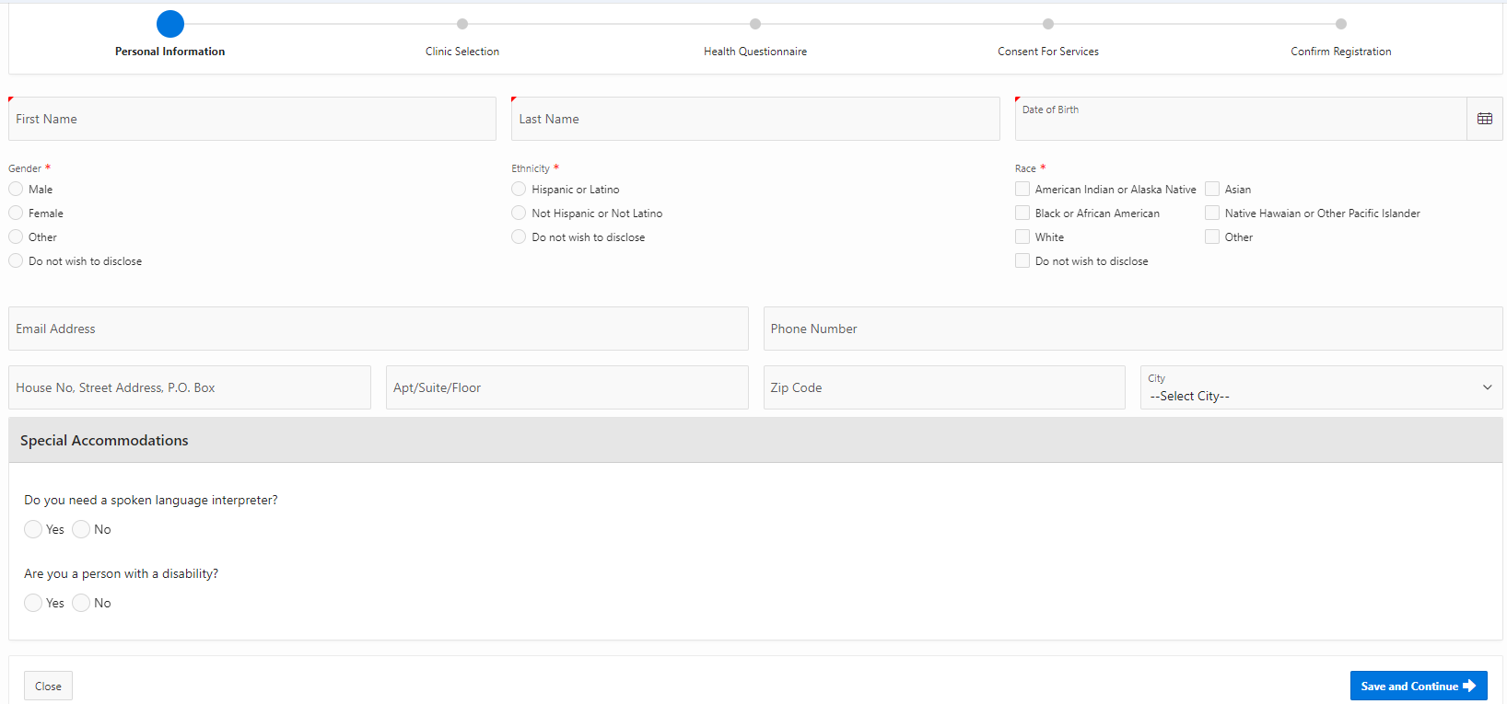
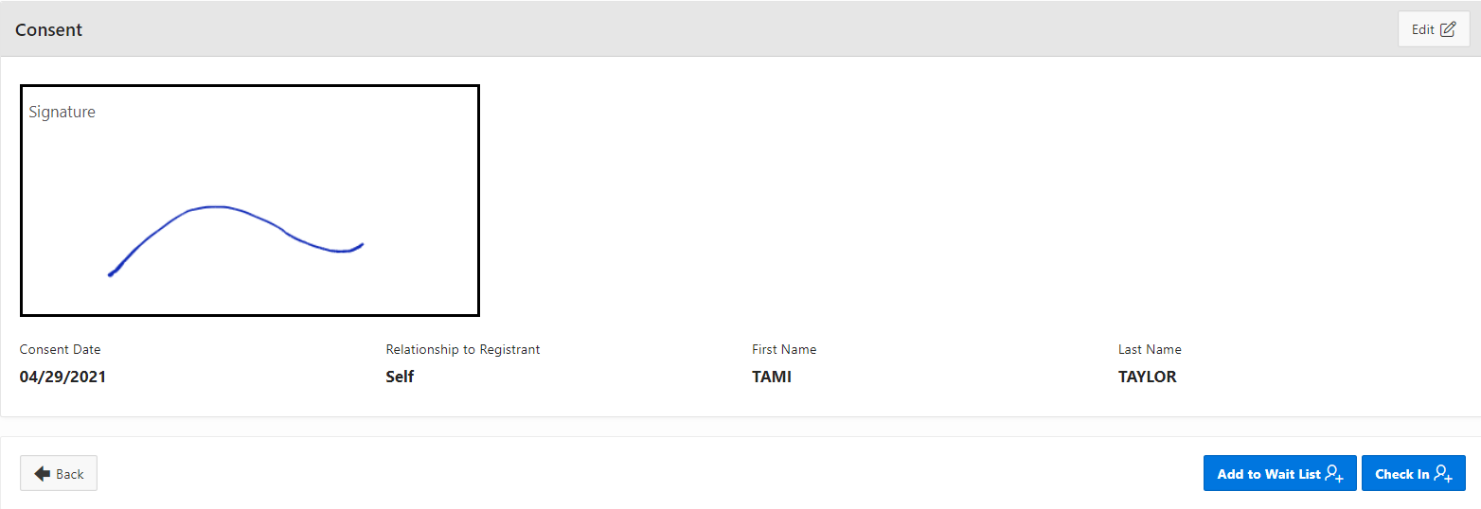
VASE+ Job Aid – Covid Testing Clinic Operations
Version 1.1
Fill out all patient information and obtain consent and patient signature (Figure 9).
Figure 9 – Fill out walk-in registrant’s information
The walk-in registrant can either be added to the “Wait List” or can be immediately checked-in and placed in the “Checked-In” category on the registrant list (Figure 10).
Figure 10 – Upon creating a walk-in registrant, they will be added to the Wait List
NOTES FOR WALK-IN REGISTRANTS WHO ARE MINORS:
If the registrant is a minor, in the “Consent” section the consent must be given by an adult accompanying the minor. The “Self” option will not be available for the registrant. The front desk operator must receive consent from an accompanying adult before checking the minor in.

Slide 5
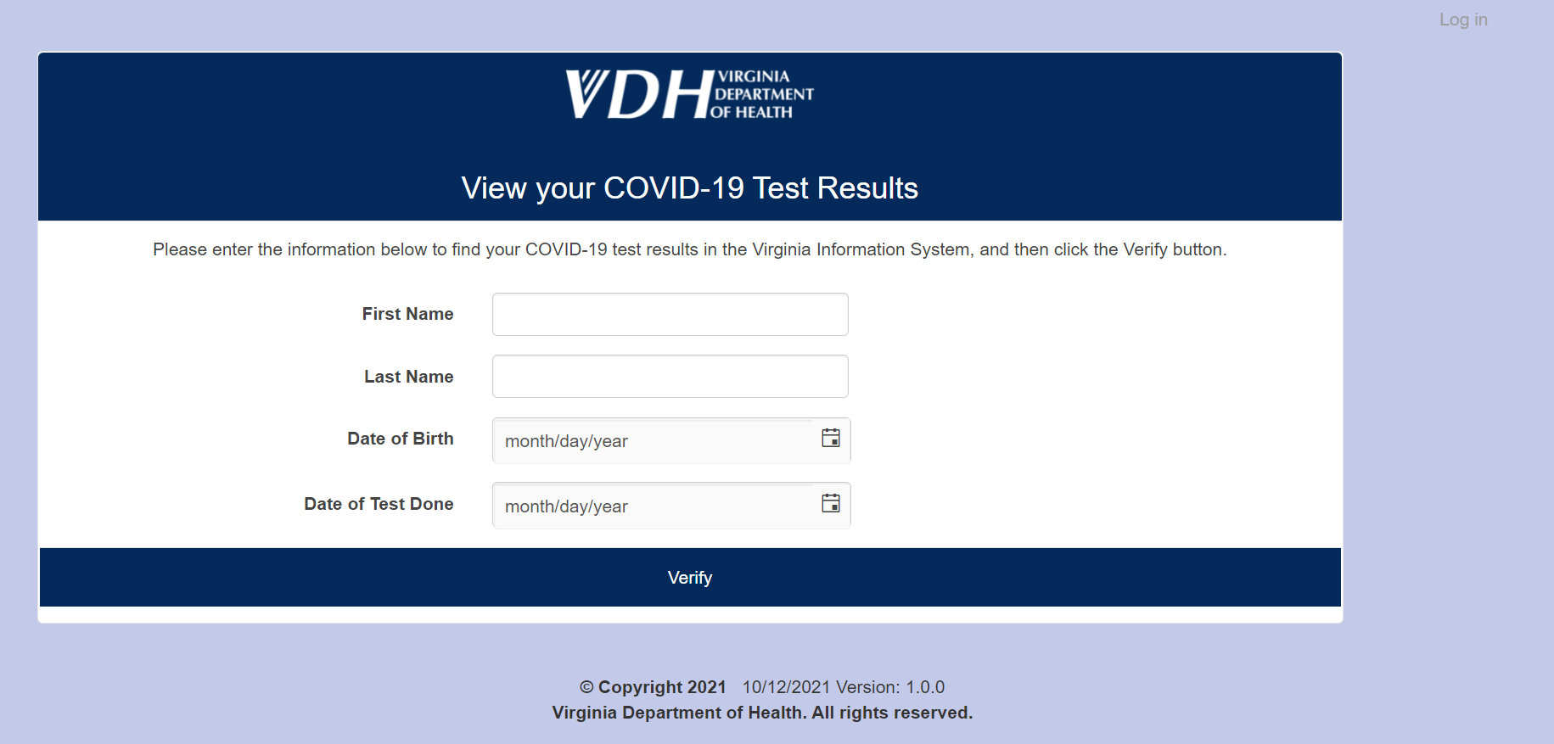
VASE+ Job Aid – Covid Testing Clinic Operations
Version 1.1
Test Result Notifications
Once VDH receives test results from the lab, it will be matched with data from VASE+. The system will automatically notify VASE+ registrants via SMS (and email, if on file) that their test results are available. This notification will include a link to access test results. Registrants will be prompted to enter their first name, last name, phone number, date of birth, and date of test (figure 11). Once information has been verified, registrants will be able to view and download their test results.
Figure 11– Test Results Portal

