Slide 1
VASE+ Release Notes
December 14th, 2021
Release 11.6

Slide 2
Pfizer 5-11 and 12+
Additional flexibility for Pfizer 5-11 and 12+ Scheduling
Children turning 12 within the next 30 days or have turned 12 in the last 30 days shall have the flexibility to schedule appointments for the Pfizer 5-11 vaccine or the Pfizer 12+ vaccine.
*Children who received Pfizer 12+ vaccine for their 1st dose can not get the 5–11-year-old vaccine in the 2nd dose.

Slide 3
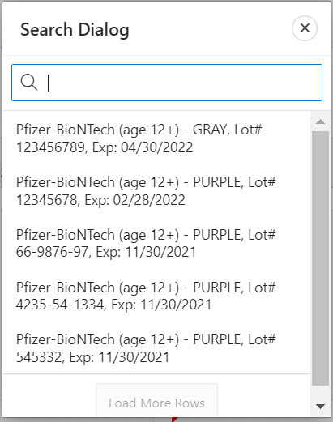
New Vaccine Record
A new vaccine record for Pfizer 12+ has been added to VASE+ (CVX Code – 217, Default Color Code – GRAY).
For Pfizer 12+ clinics, either Purple or Gray Vaccine lots can be selected

Slide 4
New Vaccine Record – Call Center and Public-Facing Scheduling
Both the call center, and public facing scheduling will see “Pfizer-BioNTech (age 12+)” displayed, regardless if the Vaccine is Purple or Gray type.

Slide 5
Boosters for AstraZeneca Primary Series Recipients
VASE+ validations have been relaxed to allow a booster dose of Pfizer 12+, Moderna, or J&J for registrants who previously received two doses of AstraZeneca vaccine

Slide 6
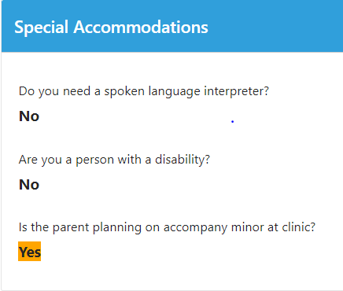
School-Based Clinics for Pfizer 5-11
VASE+ now asks an additional special accommodation question for school-based clinics occurring during school hours.
A new question is asked at the time of clinic creation for Pfizer 5-11 Vaccine Type Clinics. Answering “Yes” to this question will trigger an additional special accommodation option for registrants.
At the time of registration, there is an option to indicate if a parent is planning on accompanying the minor at a clinic
At the clinic, if this question was answered as “Yes”, the response will be highlighted in yellow on the Review page

Slide 7
VASE+ Release Notes 11.6
Here is a detailed view of all the release items
Children turning 12 within the next 30 days or have turned 12 in the last 30 days shall have the flexibility to schedule appointments for either 5–11-year-old vaccine or 12+ year old vaccine. However, children who got the +12-year-old vaccine in the 1st dose shall not be allowed to get the 5–11-year-old vaccine in the 2nd dose.
A new vaccine record (CVX Code - 217, Default Color Code - GREY) for Pfizer 12+ has been added to the VASE+.
For a Pfizer 12+ clinic, both Purple and Gray vaccine lots can be selected.
In the public app and call center staff search functionality, when the Pfizer Vaccine is selected, both Purple and Gray clinics should be displayed.
Validations have been relaxed to allow Booster doses for Registrants who previously got two doses of AstraZeneca vaccine.
Both Pfizer 12+ Purple and Gray clinics should be available for Clinic Selection for scheduling next dose appointments by clinic staff.
Second Dose appointment invitation emails should be sent by the scheduled job to the Pfizer 12+ first dose registrants when either of purple or gray clinics is available based on the interval logic.
Additional “Special Accommodation” option for Pfizer 5-11 School Based Clinics to indicate if a parent plans to be present at the time of vaccination

