Slide 1
VASE+ Release Notes
January 14th, 2022
Release 12.5

Slide 2
Clinic Cancellation
A new feature has been introduced to VASE+ that allows current and future clinics to be cancelled. This option will cancel any active appointments under the cancelled clinic, and it will notify those registrants.
This feature is only available to Administrators and Locality Admins.

Slide 3
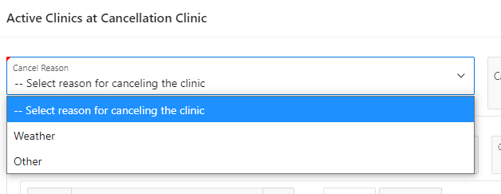
Cancellation Reason
Once on the clinic cancellation screen, Admins will have the ability to select a reason for cancellation. A pre-filled option is available when weather is selected, or a more customizable selection is available for “Other”.

Slide 4
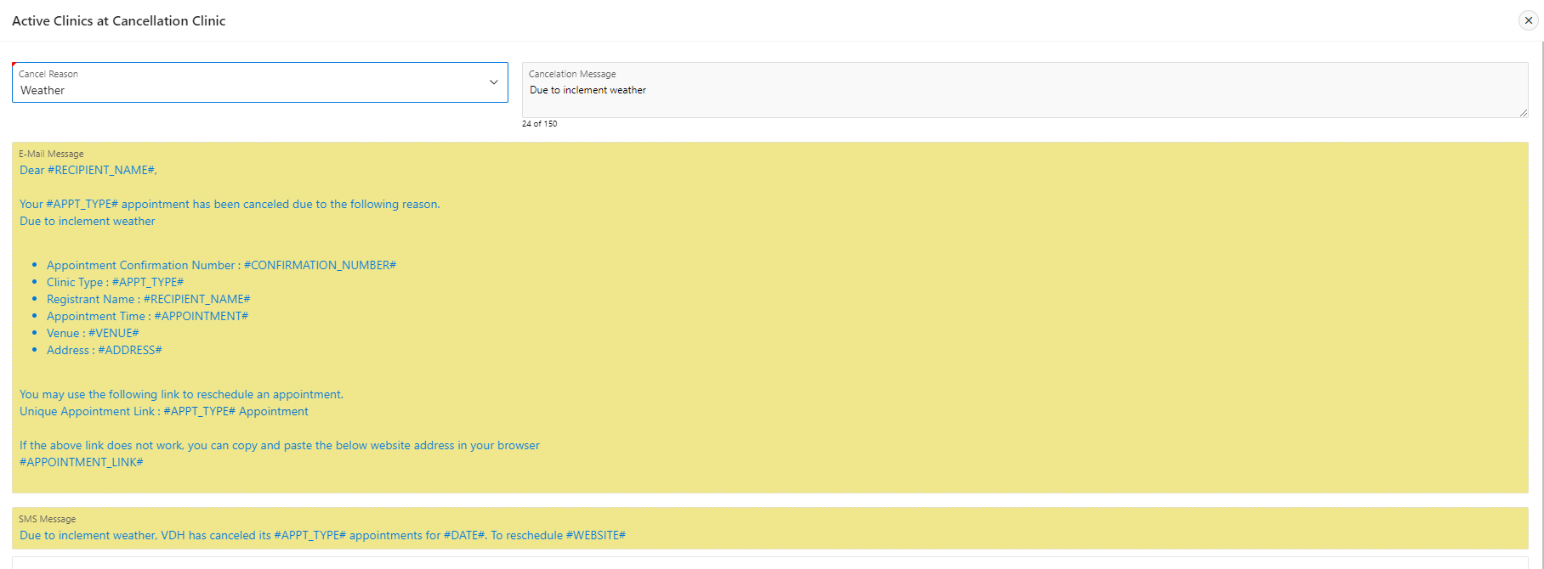
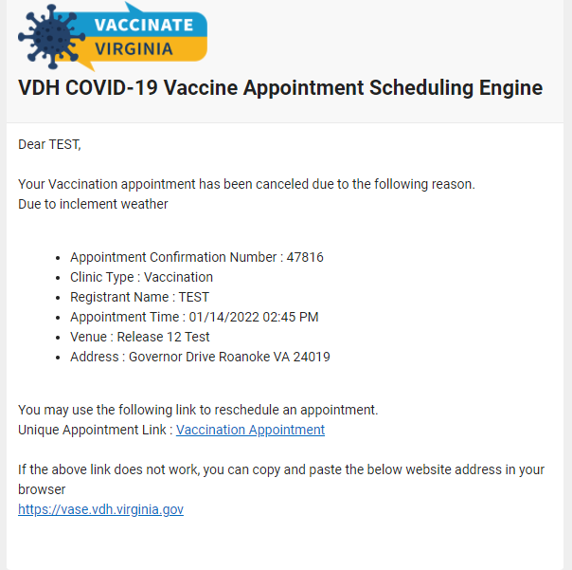
Notification - Weather
-
The following image displays what the E-mail and SMS content will be for the selected reason “Weather”.
This is a sample image of what the email notification looks like.

Slide 5
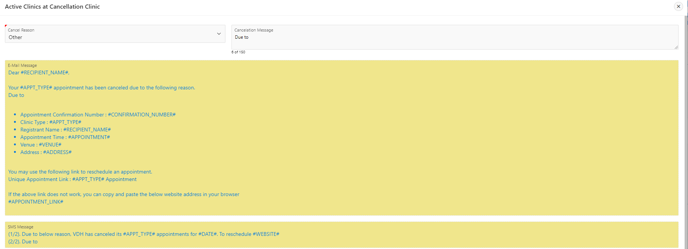
Notification - Other
The other options allows customizable reasoning to be put into the email and SMS notification. Admins can put up to 150 characters into text field which then will be added to the email and text body.

Slide 6
Clinic Selection for Cancelation
Either one or multiple clinics can be selected when cancelling a clinic. Both clinic types (testing or vaccination) can be cancelled at once.

Slide 7
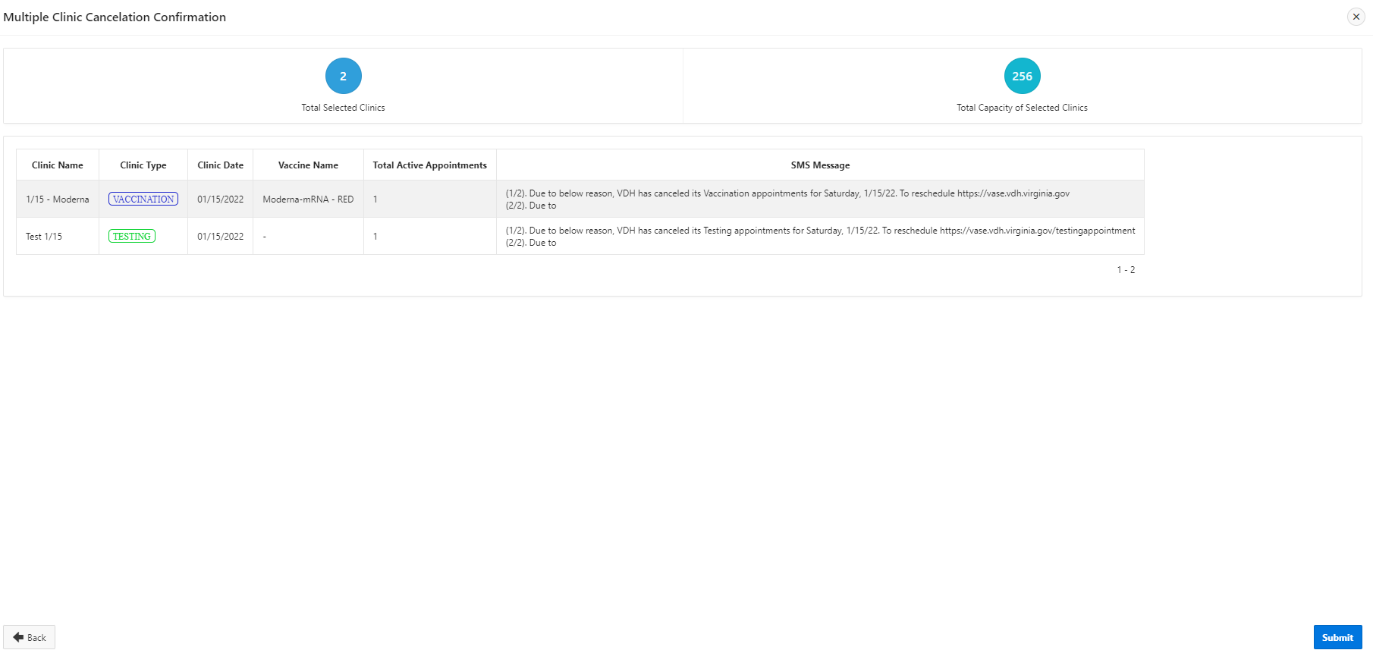
Clinic Cancelation Confirmation
The final screen will display the selected clinics along with the SMS message content. Once you have verified that the correct clinic is selected, hitting submit then confirming the cancellation will cancel all clinics and notify registrants.

