Slide 1
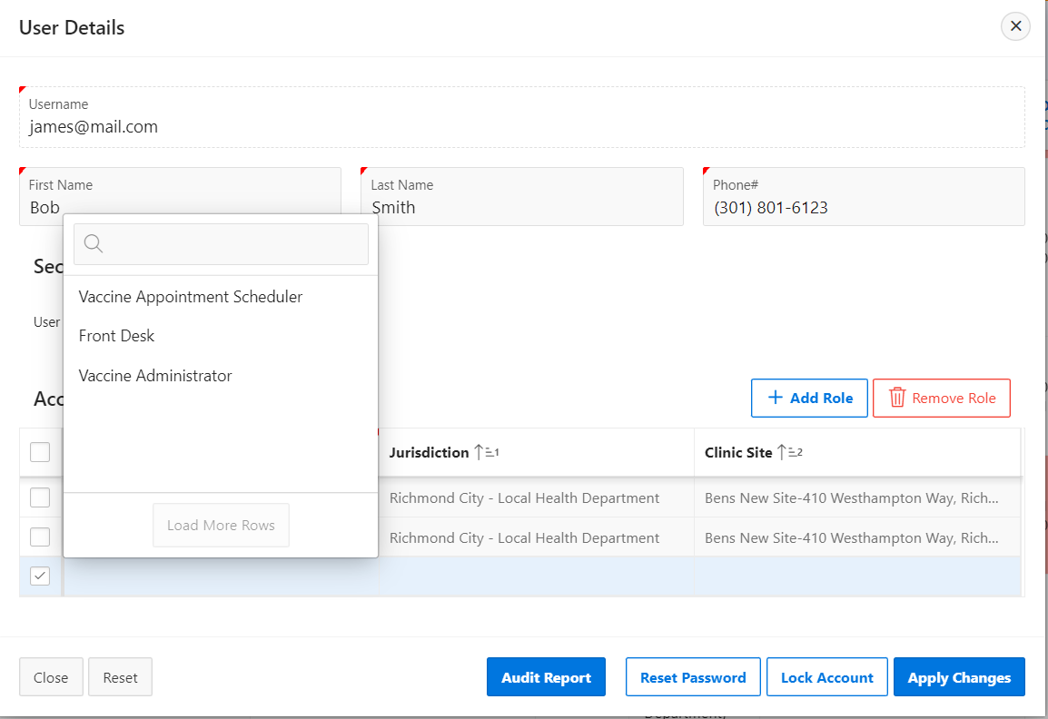
VASE+ Job Aid – Security Module: Adding & Editing User Roles
Version 1.1
In this job aid, users will learn the security parameters around assigning and editing user roles. This job aid applies to Administrators, Locality Admins, Site Admins, and Call Center Admins. User role assignment in VASE+ is based on a hierarchical model. Users can grant permissions to other users in roles that are lower in the hierarchy and share a jurisdiction. Please reference job aid #3 for additional information on assigning user roles. Users can also now add additional roles to those who have roles in another jurisdiction.
Editing users within your jurisdiction
Users (editor) can add/edit other users' roles that are within their jurisdiction. Only roles that are lower in the user role hierarchy than the editor will be able to be added/edited. Additionally, editors will only be able to assign roles to another user that are in the same jurisdiction or site as the editor.
When editing users that are unlocked, you will have access to the following 4 action buttons: audit report, reset password, lock account, and apply changes.
Figure 1 – User role limitations and action buttons

Slide 2
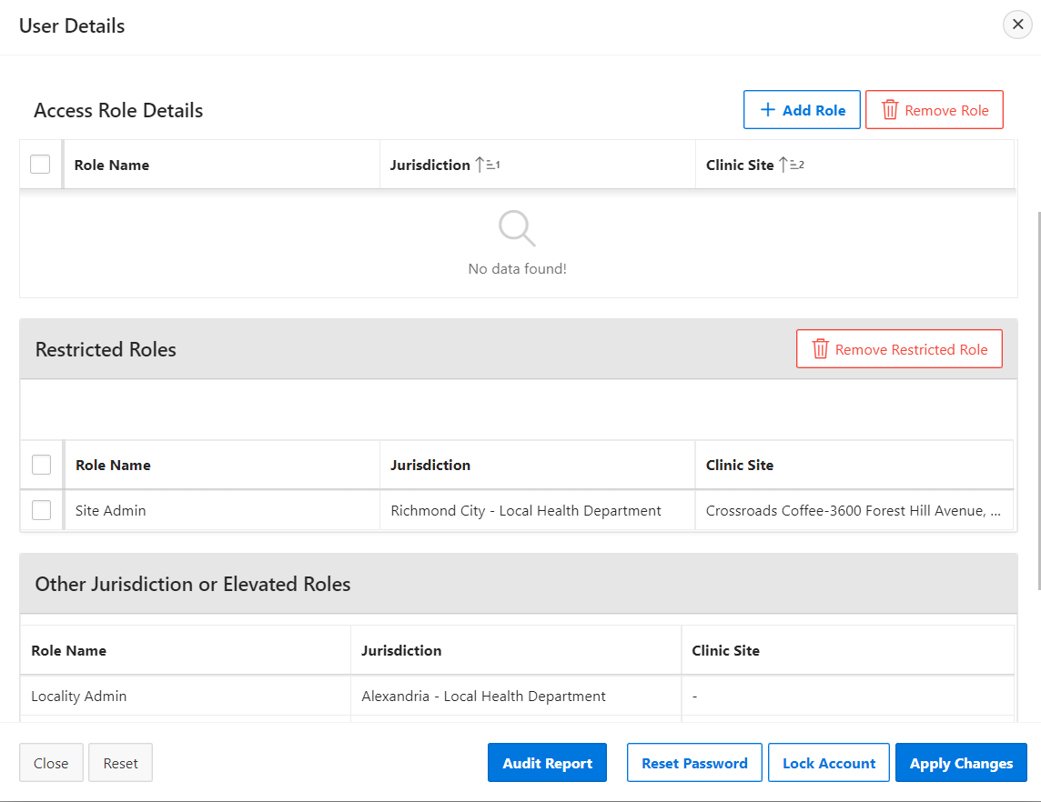
VASE+ Job Aid – Security Module: Adding & Editing User Roles
Version 1.1
Editing users with roles outside your jurisdiction
Existing users with roles outside your jurisdiction can be edited. While you will not be able to edit the specific outside jurisdiction/site roles, you will be able to add new roles that are within your jurisdiction/site.
Users with roles outside of your jurisdiction/site will not appear on your “all users” list. Rather, you can navigate to these individuals' user details by selecting “add user” and typing in their email address. The user’s account will then populate the rest of the user details page.
Figure 2 – add user button for navigating to user details for accounts with roles outside your jurisdiction
There are 3 categories that a user role can fall into.
Access Role Details: roles that the editor can remove/add. These roles fall below the editor's user role on the hierarchy and are within the same jurisdiction/site as the editor.
Restricted Roles: roles that are the same level as the editor on the hierarchy and are within the same jurisdiction/site as the editor. These roles can be removed but not added.
Other Jurisdiction or Elevated Roles: roles that are above the editor on the hierarchy and/or are in a different jurisdiction/site from the editor. These roles cannot be removed or added.
Figure 3 – editing a user with roles in another jurisdiction

Slide 3
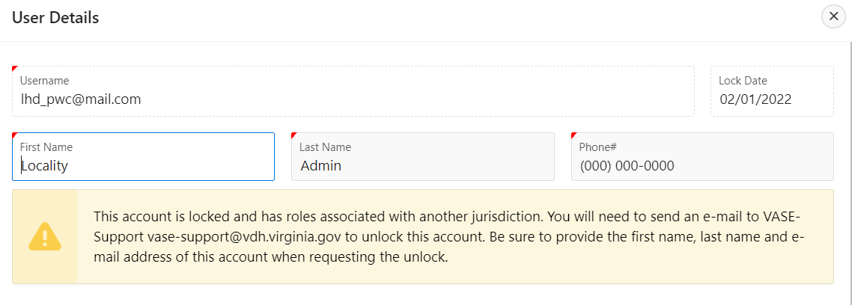
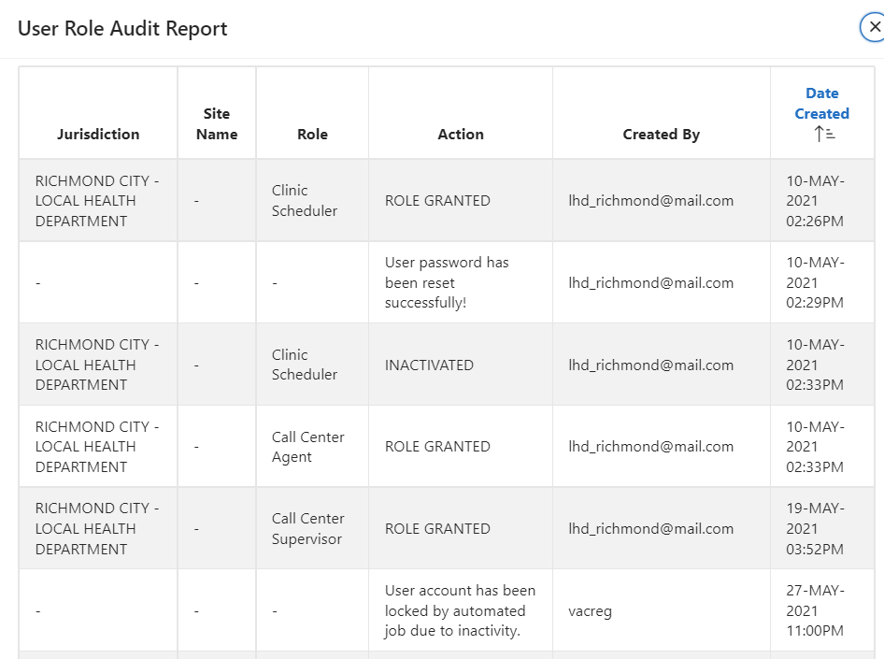
VASE+ Job Aid – Security Module: Adding & Editing User Roles
Version 1.1
Locked users
Editors will be able to lock accounts if they share a jurisdiction with the user, regardless of their role hierarchy level. Editors will only be able to unlock an account if they share a jurisdiction/site with the user and have a higher-ranking role. If attempting to add a role to a locked user who does not share a jurisdiction, Editors will be ineligible to unlock said account and will need to contact VASE+ Support for assistance. If an editor is ineligible to unlock an account, they will receive the following message on the user details page:
Figure 4 – User details of a locked account
Audit report
Editors will have access to a user’s audit report regardless of their user role hierarchy level or jurisdiction/site assignments. This report provides information regarding role granting and removing, lock dates, editor email, and date of each action.
Figure 5 – Audit report

