Slide 1
VASE+ Release Notes
February 4th, 2022
Release 12.8

Slide 2
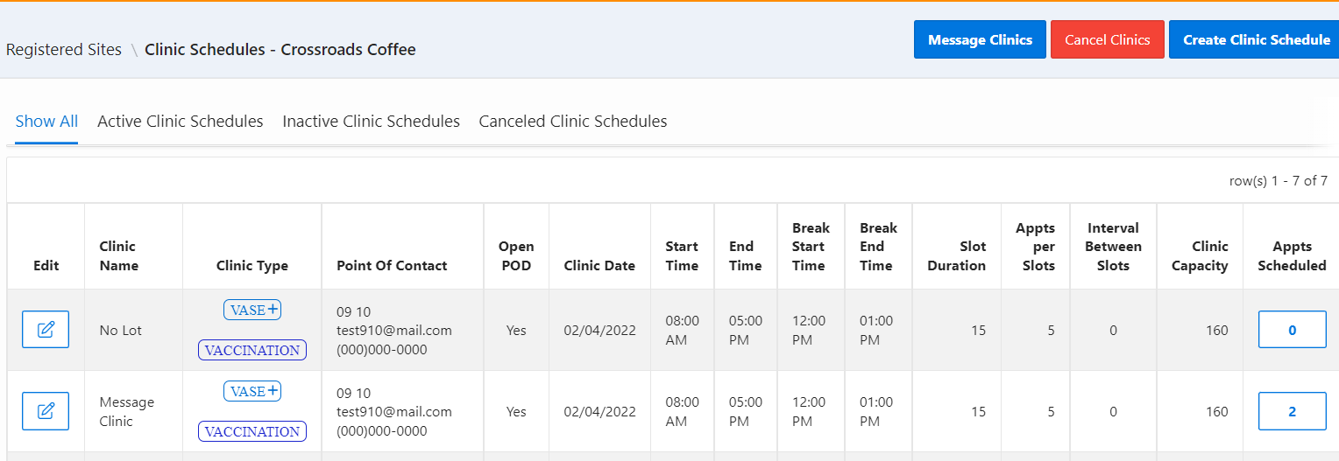
Clinic Communications
A new feature has been introduced to VASE+ that allows communications to registrants in current and future clinics. This option will message any registrants with active appointments under the clinics selected for communication.
This feature is only available to Administrators and Locality Admins.

Slide 3
Message Text
Once on the clinic messaging screen, Admins will have the ability to type free text into the email subject box, email message box, and the SMS message box.

Slide 4
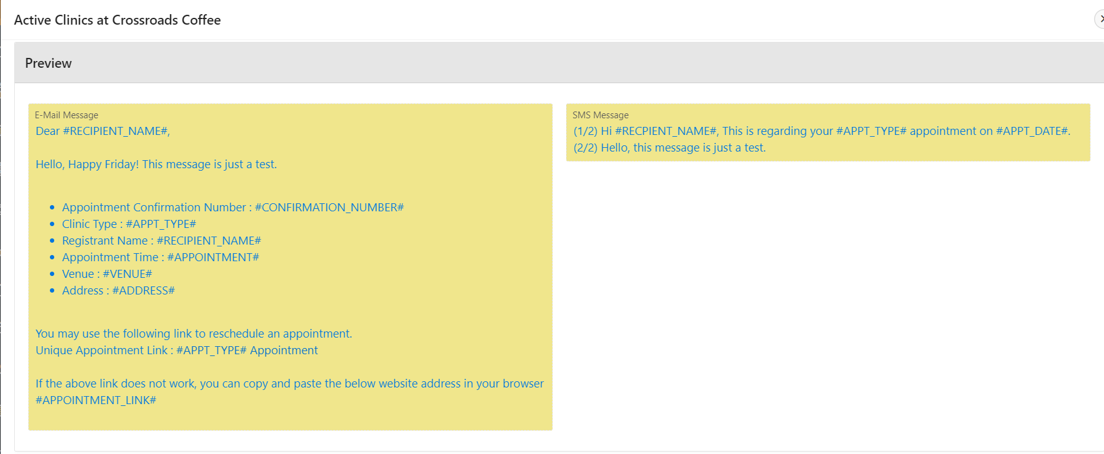
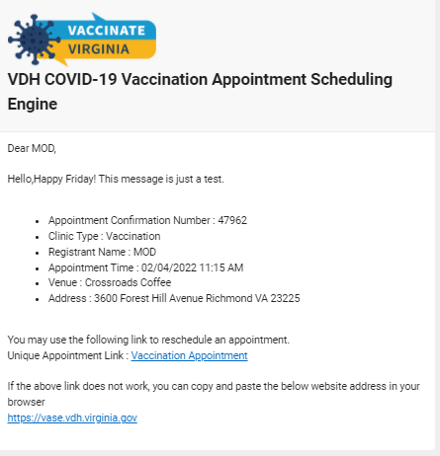
Notification
The following image displays what the E-mail and SMS content will be.
This is a sample image of what the email notification looks like.

Slide 5
Clinic Selection for Messaging
Either one or multiple clinics can be selected when messaging a clinic. Both clinic types (testing or vaccination) can be messaged at once.

Slide 6
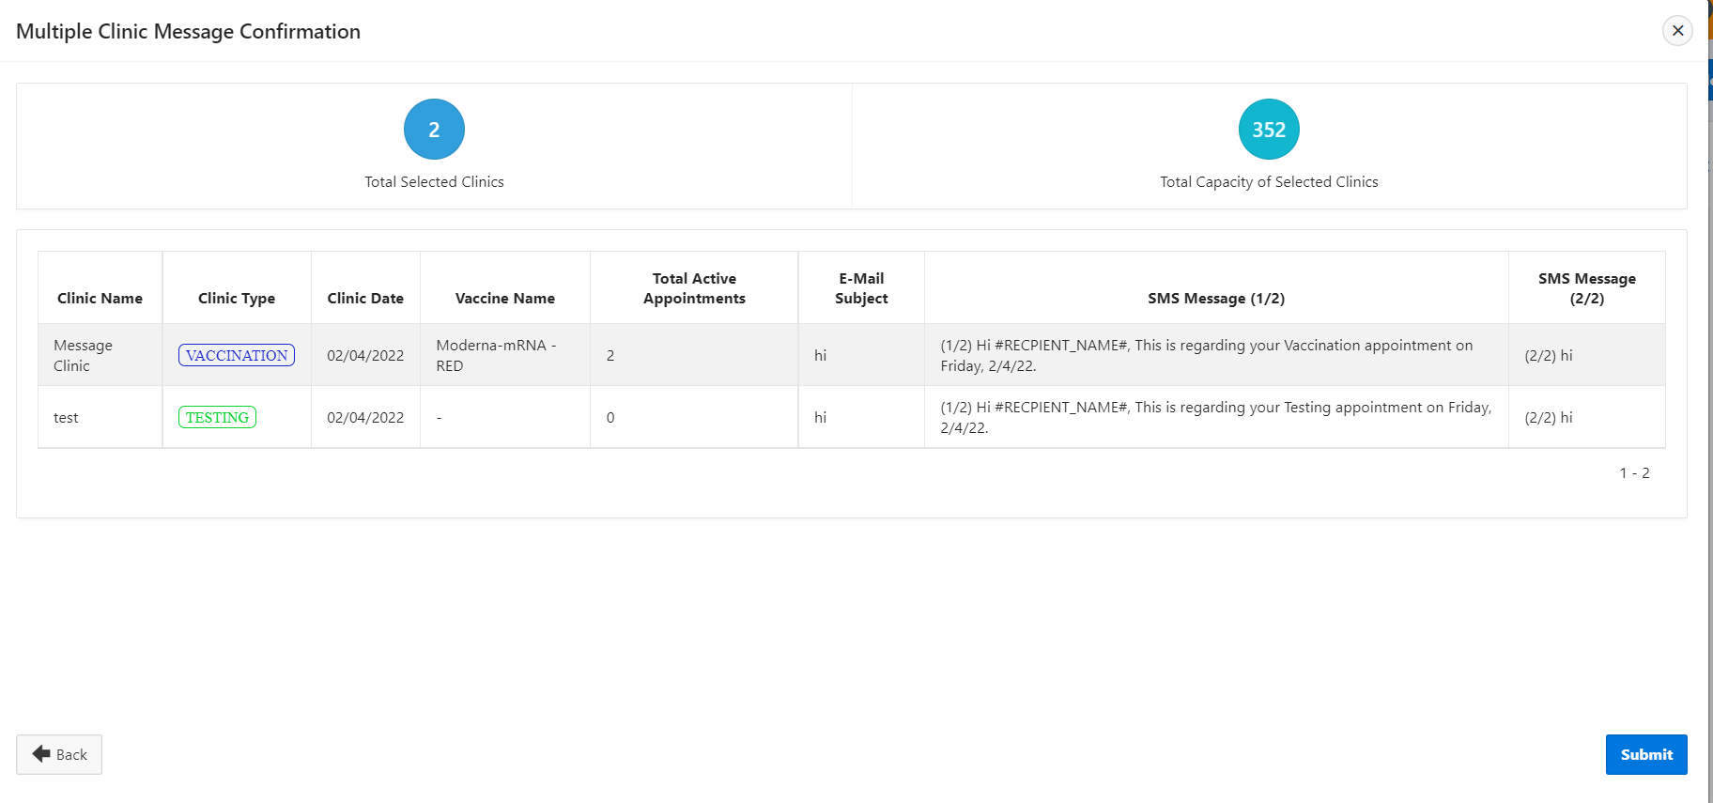
Clinic Message Confirmation
The final screen will display the selected clinics along with the email subject line and SMS message content. Once you have verified that the correct clinic/s is/are selected, and confirmed the message is correct, click submit to get the messages sent out.

Slide 7
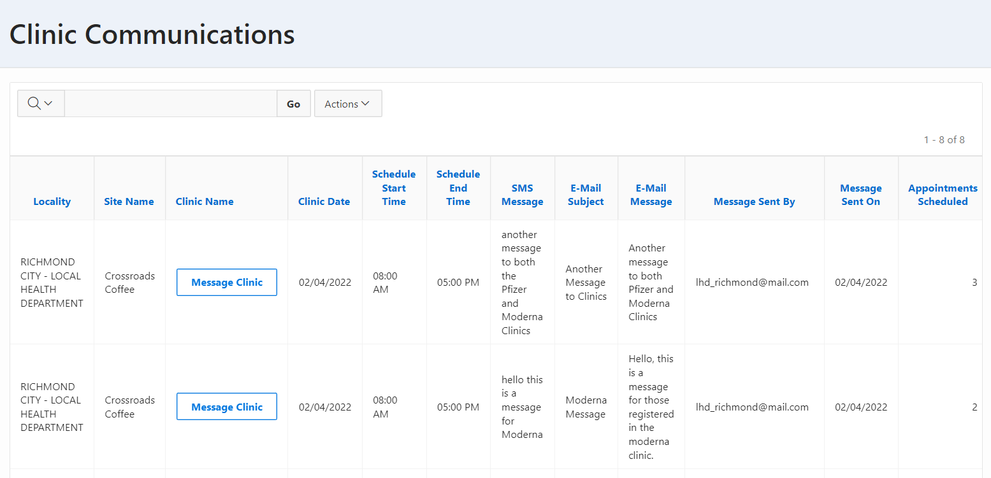
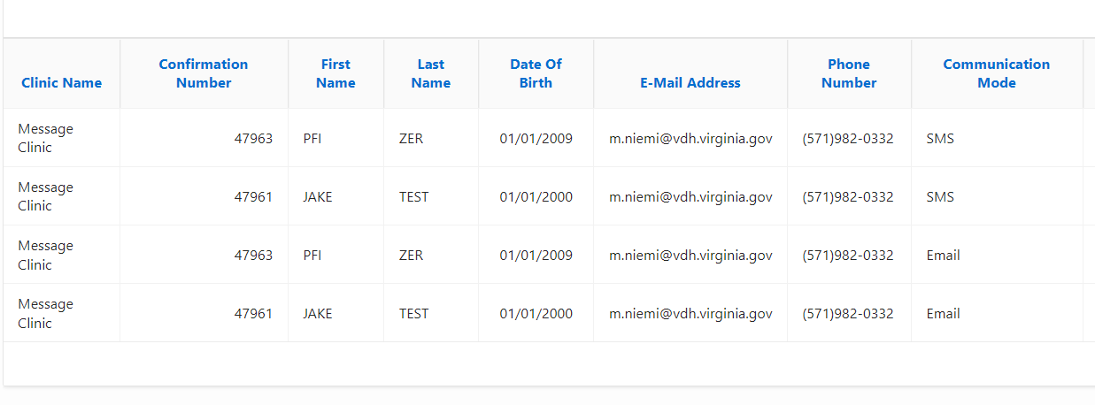
Reports – Clinic Communications
A new report titled “Clinic Communications” is now available. This report displays clinic details as well as message content and date sent.
A line list of registrant communications can be viewed by selecting “message clinics”.

