Slide 1
VASE+ Release Notes
March 10th, 2022
Release 13.4

Slide 2
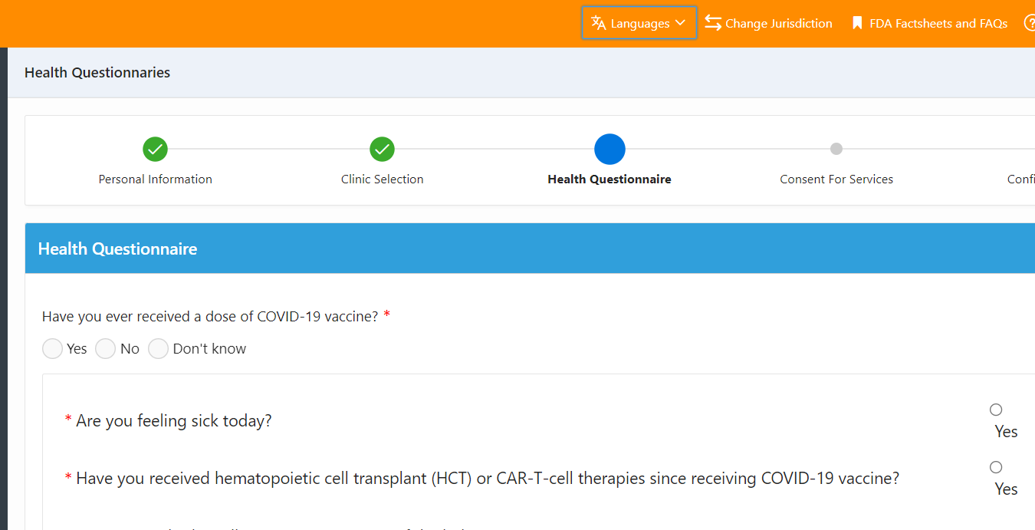
Translations in the VASE+ App
A new feature has been introduced to VASE+ that allows clinic staff to toggle between English, Spanish, and Arabic when adding a walk-in patient. These language options are available on the Health Questionnaire and Consent form pages.

Slide 3
Clinic Vaccination Summary Report
The Clinic Vaccination Summary report now has added dropdown search features to improve performance. Instead of typing wildcard searches, users can filter by site name and/or clinic date.

Slide 4
VIIS Lookup Zip Code Field
Users with access to the VIIS lookup page will now have the option to enter in a zip code when searching for a registrant. This field is optional but may help return a search result for some registrants.

Slide 5
Phone Number Consent
A message now appears under the phone number field in the personal information section. This message alerts registrants that by providing a phone number, they are providing consent to receive SMS notifications. This will display for self-registration via the public search portal, when adding a walk-in registrant, and when adding a registrant via call center.

Slide 6
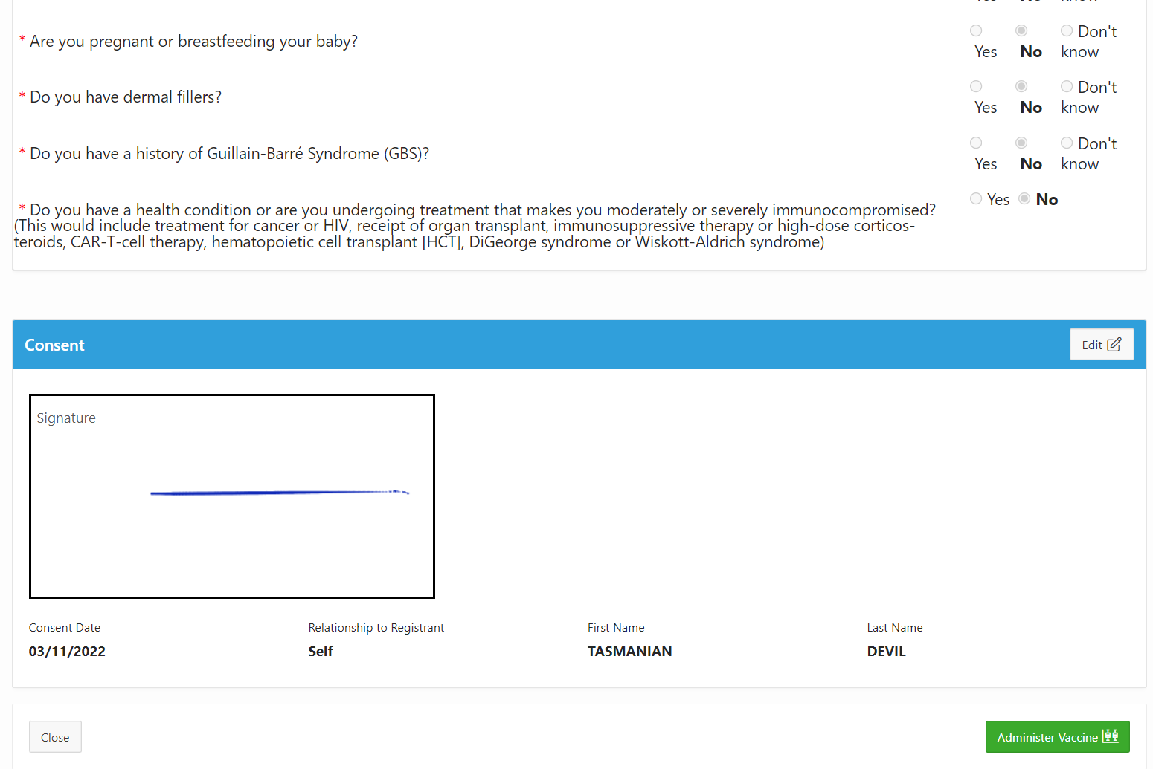
Administer Vaccine Button
The administer vaccine button has been removed from the “checked-in” bucket. In order to access this button, vaccine administrators will need to select the review button. At the bottom of the review page, they will have access to the administer vaccine button.

