Slide 1
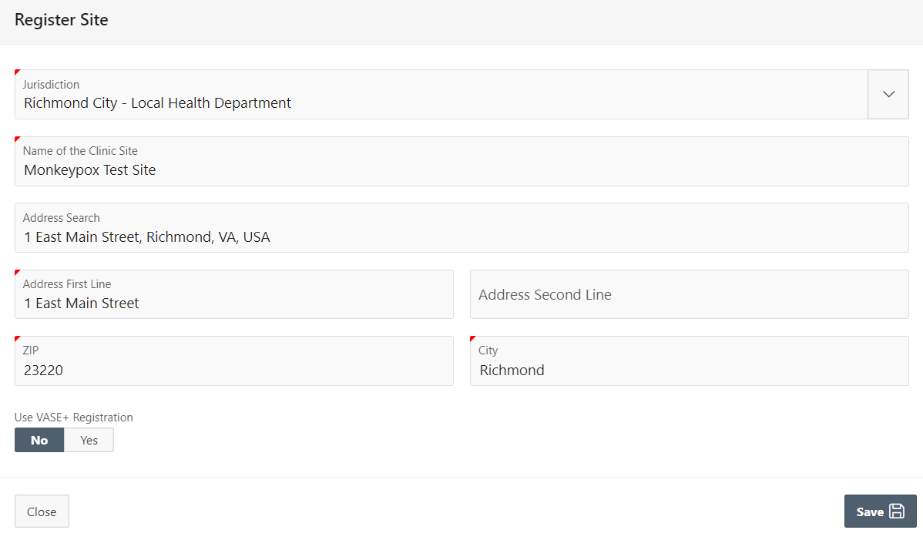
VASE+ Job Aid – Mpox Phase 1: VASE
Version 1.1
In this job aid, users will learn how to create VASE sites and schedules for mpox vaccination clinics. This job aid will also detail registrant scheduling options including Clinic Public Search URLs and the file upload workflow. The file upload workflow provides unique invite links to potential registrants that cannot be shared.
Please note that Phase 1 is for scheduling only. Documentation of vaccination will need to occur outside the VASE system. VDH recommends using WebVISION. Work is actively underway to record doses administered in VASE+ and will be included in a future release.
Additionally, JYNNEOS is the only mpox vaccine type currently available in VASE.
Creating a VASE Site
To set up mpox clinic schedules, first ensure that a VASE site is set up. The workflow to create a VASE site is available to Locality Administrators.
VASE sites are differentiated from VASE+ sites during site creation. To create a VASE site, toggle the VASE+ site indicator to “no” on the site creation page (figure 1).
Figure 1 – VASE+ indicator should be toggled to “no” on the clinic creation page
Creating a VASE Schedule
Mpox vaccination clinic schedules can be created at VASE sites. This workflow is available to Locality Admins, Site Admins, and Clinic Schedulers. To create a mpox vaccination clinic schedule, click the “schedule” button listed next to your VASE site (figure 2). Please note that newly created sites can be found in the “Inactive Sites” section.
Figure 2 – The schedule button is listed next to your VASE site

Slide 2
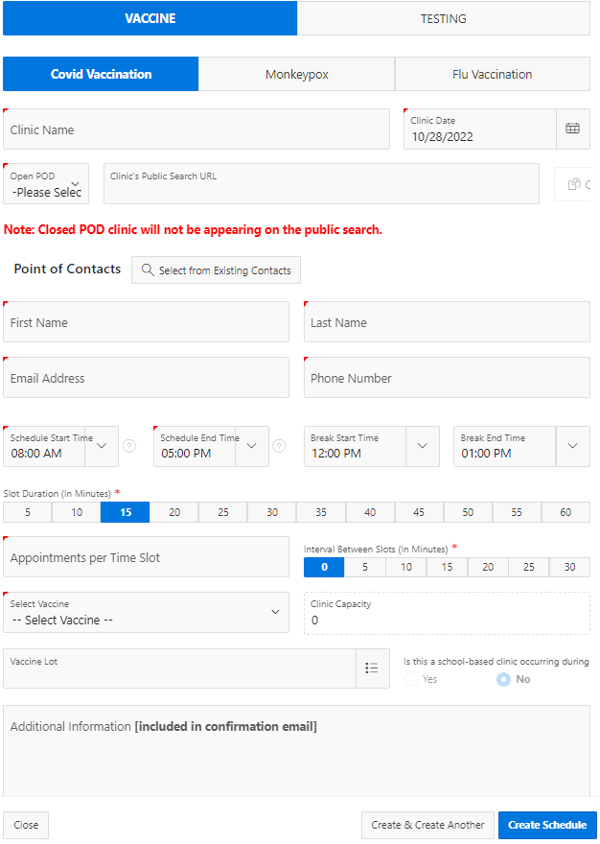
VASE+ Job Aid – Mpox Phase 1: VASE
Version 1.1
Navigate to the Clinic Schedules page, select “Create Clinic Schedule” to create a mpox vaccination clinic in the system (figure 3).
Figure 3 – Select Create Clinic Schedule
This triggers a pop-up screen to capture:​
Clinic Type: The planned type of clinic (vaccine or testing, COVID-19 or mpox) for this schedule​
Clinic Name & Date: This corresponds to the name of the clinic for the corresponding date under the Clinic site​
Open or Closed POD: Closed pod clinics will not display for call center users or on public search
Clinic Public Search URL: After the schedule has been saved, a link will be generated to use to direct registrants to that specific clinic​. This link can be shared, and potential registrants with this link will be able to register for the clinic with no extra identity validations
Points of Contact: This establishes the main point of contact for the clinic. Users can select an existing user users for clinics​
Clinic Schedule: The clinic schedule start and end time, the break start and end time, slot durations, appointments per slot, and intervals between slots​
The Clinic Capacity: (which sets a cap on the total number of appointment slots created) can be adjusted by increasing or reducing the slot duration or the interval between slots​
Vaccines Offered at the clinic: The planned vaccine type, and vaccine lot numbers (VASE is not capturing lot numbers for mpox clinic operations in Phase 1 so this field can be left blank). Currently, JYNNEOS is the only mpox vaccine type available in VASE.
Additional Information: Free text added to this section will be included in the confirmation emails that are sent to registrants
Figure 4 – Clinic Creation Pop-Up

Slide 3
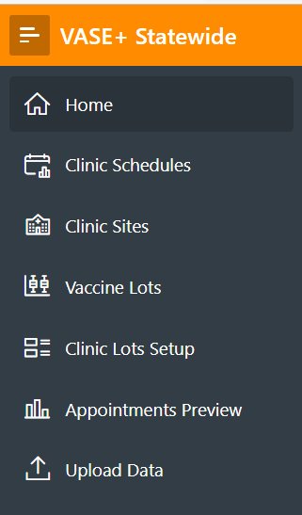
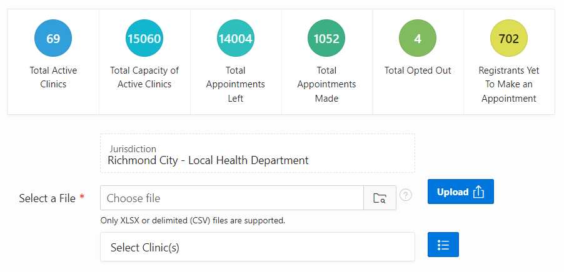
VASE+ Job Aid – Mpox Phase 1: VASE
Version 1.1
Inviting and Scheduling Potential Registrants
Potential registrants can be scheduled for a mpox clinic the following ways:
Using a direct clinic link (Clinic’s Public Search URL) provided on the Clinic Schedules page. This link may be copied and pasted to display on an email or distributed for use by registrants. Closed POD clinics will not appear on the public search, but a link will still be generated to send to potential registrants. ​Please note that any potential registrant who is provided this link will be able to register for the clinic that it points to. There are no identity validations in place with this workflow.
Using the file upload workflow (detailed below).
File Upload Workflow
To navigate to the file upload page, select the “Upload Data” tab. This tab is available to users with the “File Uploader” role within VASE/VASE+. If the tab is not available and access is needed contact your locality administrator or the VASE+ Support Team.
Figure 5 – Select Upload Data from the sidebar
On the Upload Data page, users can see summary metrics related to clinics and appointments. To upload a file, select the jurisdiction the data will be assigned to. The user will then click the blue icon next to the “Select Clinic(s)” field.
Figure 6 – Select the jurisdiction data will be assigned

Slide 4
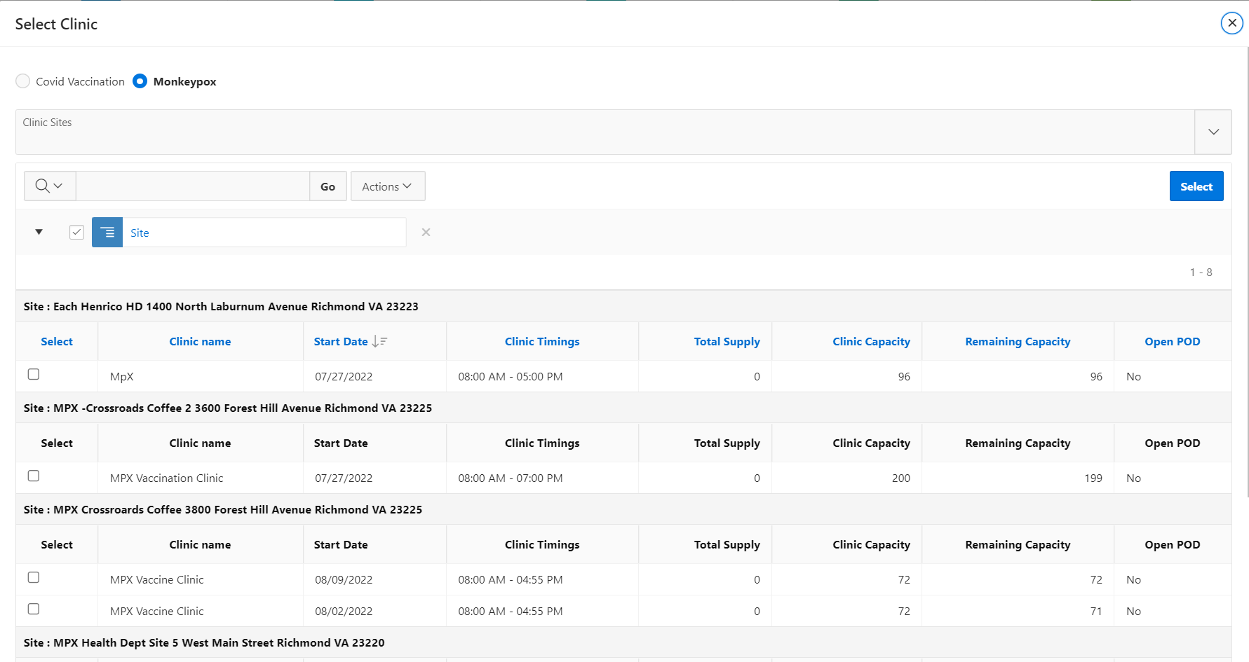
VASE+ Job Aid – Mpox Phase 1: VASE
Version 1.1
The Select Clinic pop-up will display available clinics and allow for a search of clinic sites that can be selected to upload the file data. Use the radio button at the top of the pop-up to select between COVID-19 and mpox clinics (figure 7). Data can be assigned to one or multiple clinics. After selecting the clinics by clicking the checkboxes, click the “Select” button to close the “Select Clinic” window.
Figure 7 – Select the clinics for file upload
To upload a file, select the folder icon and select the file to be uploaded (must be in XLSX or CVS format). Then click the “Upload” button.
There are three accepted file formats. Additional information on data fields for these formats can be found by clicking the “?” icon.
Figure 8 – Upload a file
Upon uploading the file, a results pop-up will display showing Total Records Processed, Total Records Uploaded, and Total Rejected Records. Note the Send Notifications button at the bottom of this pop-up.
Figure 9 – Data File Summary and Send Notifications button

Slide 5
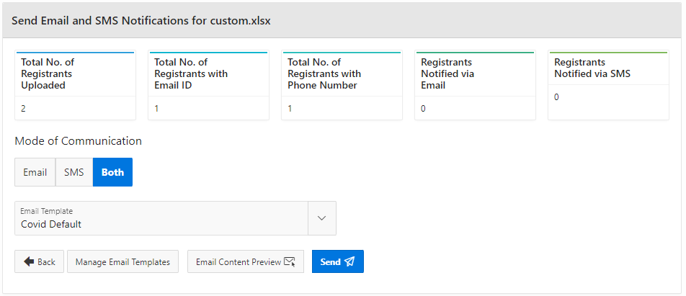
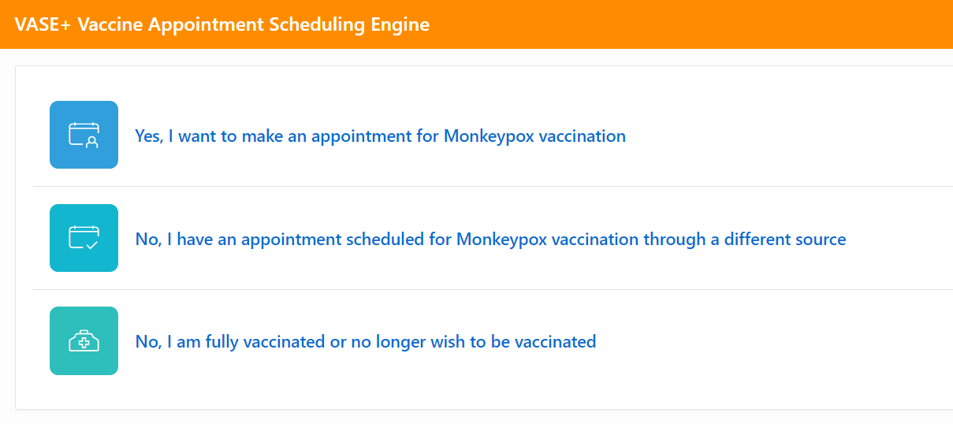
VASE+ Job Aid – Mpox Phase 1: VASE
Version 1.1
Upon clicking “Send Notifications”, the user will be directed to the Send Email and SMS Notifications which will show Registrants Uploaded, Registrants with Email ID, Registrants with Phone Number, Registrants Notified via Email, and Registrants Notified via SMS. To send notifications, select the Mode of Communications, then click “Send.” Users can also view “Email Content Preview” to review the contents of the email notifications being sent out.
Figure 10 – Send Notifications
Potential Registrant View – File Upload Invite
When a potential registrant is sent a notification via the file upload feature, they will be provided an invitation email and/or SMS message with a unique appointment link. Upon clicking the link, potential registrants will select if they would like to register for a vaccination (figure 11).
Figure 11 – Potential registrants indicate if they would like to schedule an appointment
If an individual would like to register for an appointment, they must verify their identity by entering their first name, last name, and date of birth. This information must match the information provided on the uploaded file, or the individual will not be able to schedule an appointment. The verification step prevents unauthorized link sharing and ensures that only those invited to the clinic can register (figure 12)
Figure 12 – Registrant information verification

Slide 6
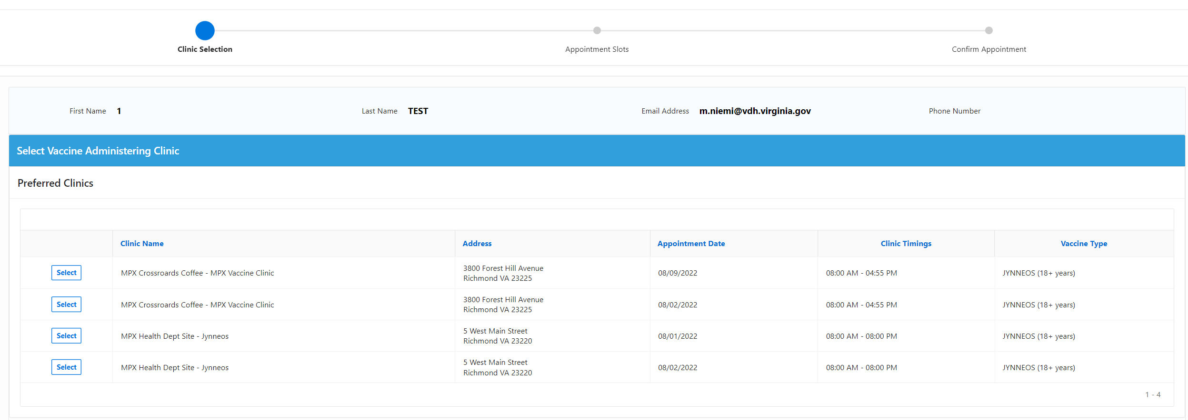
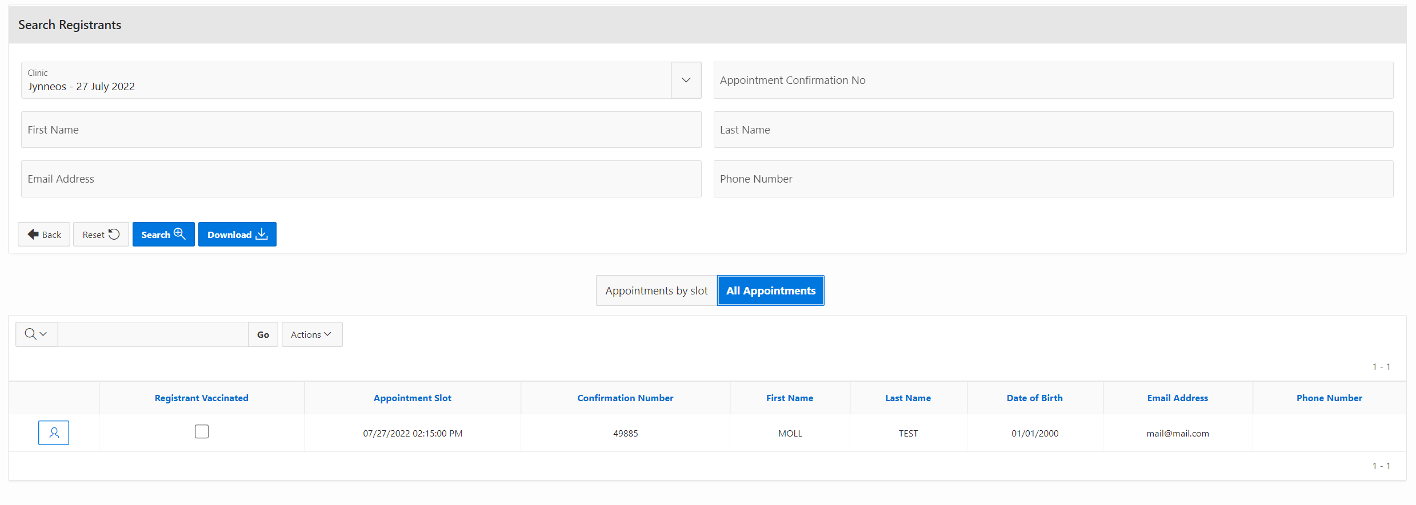
VASE+ Job Aid – Mpox Phase 1: VASE
Version 1.1
Once a potential registrant’s information has been successfully verified, they will be able to register for their clinic of choice and select an appointment timeslot (figure 13). The clinics displayed on this page correspond with the clinics selected during the file upload process. In some cases, registrants may only have one clinic option.
Figure 13 – Potential registrants can schedule in their preferred clinic
Clinic Operations
To access a mpox clinic in VASE, navigate to the clinic via the home screen.
Figure 14 – Navigate to your clinic on the home screen
On the clinic page, registrants can be searched, list of registrants can be downloaded, and appointments can be viewed by timeslot or as a list. If needed, clinic staff have the option to check off registrants as “vaccinated” on the All Appointments tab.
Figure 15 – Clinic operations screen

