Slide 1
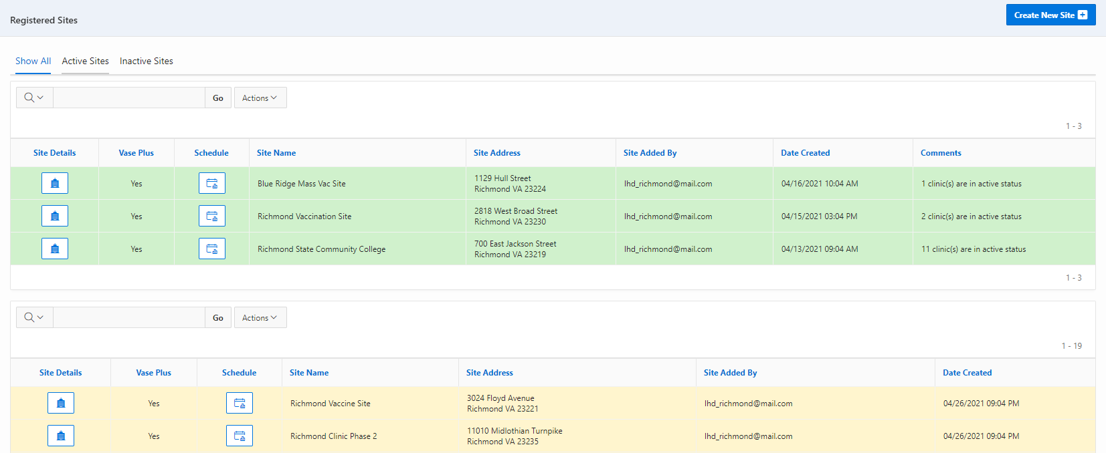
VASE+ Job Aid – Mpox Phase 2: Clinic Schedule
Version 1.1
Summary:
In this job aid, users will learn how to create a clinic schedule for the mpox vaccine using VASE+. Phase 2 supports end-to-end workflow including: walk-in and call center workflow, mpox screening & consent, administration of 1st and 2nd doses of the JYNNEOS vaccine, automatic daily data transfer to VIIS, and conversion of existing VASE sites to VASE+ sites. This vaccine is a two-dose series with a 28-day interval in between the 1st and 2nd dose.
Roles
The following user roles can create clinic schedules in the VASE system
Locality Admin
Site Admin
Clinic Scheduler
Create New Schedule
A clinic schedule can be created by clicking on the ‘Schedule’ button corresponding to each site. This can be done for both Active and Inactive clinic sites. Active sites are shaded in green and inactive sites are shaded in yellow
Figure 1 – Click on the schedule button to create a new clinic schedule
After clicking on the schedule button corresponding to a particular site, the user can view the Active Clinic Schedules (current and future), Inactive Clinic Schedules (History) and create new clinic schedules by clicking on the “Create Clinic Schedule” button on the top right.

Slide 2
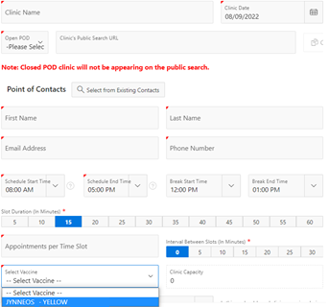
VASE+ Job Aid – Mpox Phase 2: Clinic Schedule
Version 1.1
Figure 2 – Create Clinic Schedule Button
This triggers a pop-up screen to capture:
Clinic Type: the planned type of clinic (vaccine or testing) for this schedule
Clinic Name: This corresponds to the name of the clinic for the corresponding date under the Clinic site
Open or Closed POD: after the schedule has been saved, a link will be generated to use to direct registrants to that specific clinic
Points of Contact: This establishes the main point of contact for the clinic. Users can select an existing user users for clinics
Clinic Schedule: The clinic schedule start and end time, the break start and end time, slot durations, appointments per slot, and intervals between slots
The clinic capacity (which sets a cap on the total number of appointment slots created) can be adjusted by increasing or reducing the slot duration or the interval between slots
Vaccines Offered at the clinic: The planned vaccine type, availability of vaccines, and vaccine lot numbers
Figure 3 – Creating a Clinic Schedule

