Slide 1
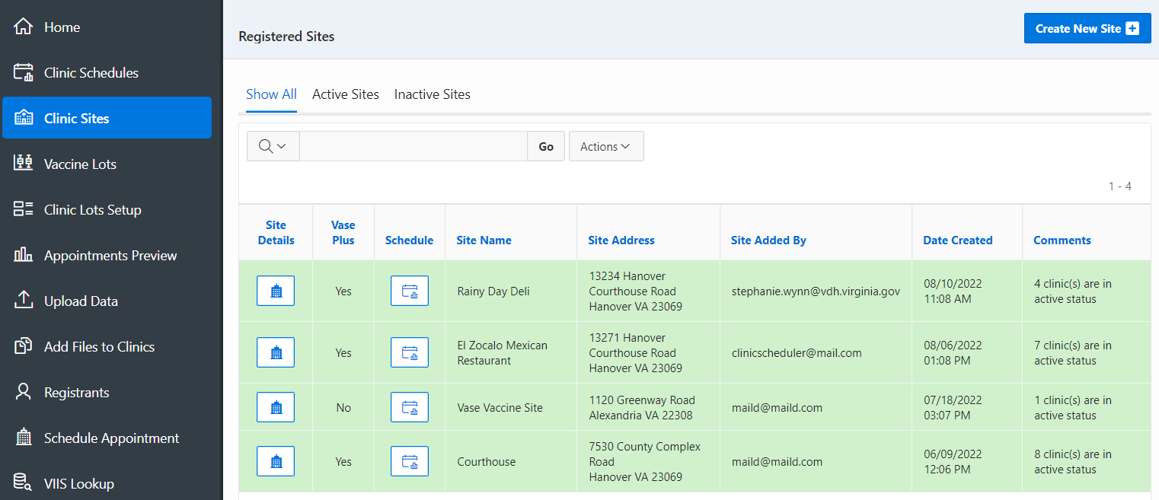
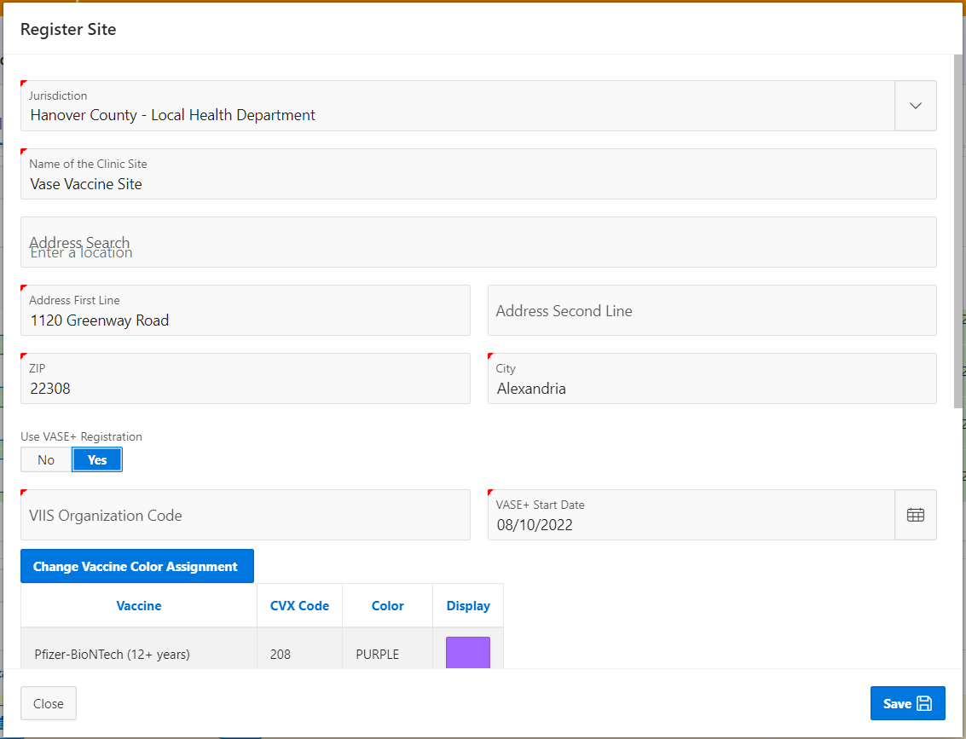
VASE+
Job Aid – Convert VASE site to VASE+
Version 1.0
Summary:
In this job aid, users will learn convert a VASE site to a VASE+ site. Only the locality administrator can covert sites.
Converting VASE to VASE+ Sites
Navigate to the clinic sites from the menu. An active or inactive VASE site can be converted to a VASE+ site. The VASE Plus column indicates yes or no if a site is a VASE+ site.
Click on the Site Details icon next to the site that will be converted.
Figure 1 – Clinic Sites List
Select yes to Use VASE+ Registration. You will be prompted to enter the VIIS organization code and VASE+ start date. When finished click save.
When a VASE site is converted to a VASE+ site, a health questionnaire link will be sent to active registrants via SMS and/or email 48 hours prior to their appointment.
Figure 2 – Site information

