Slide 1
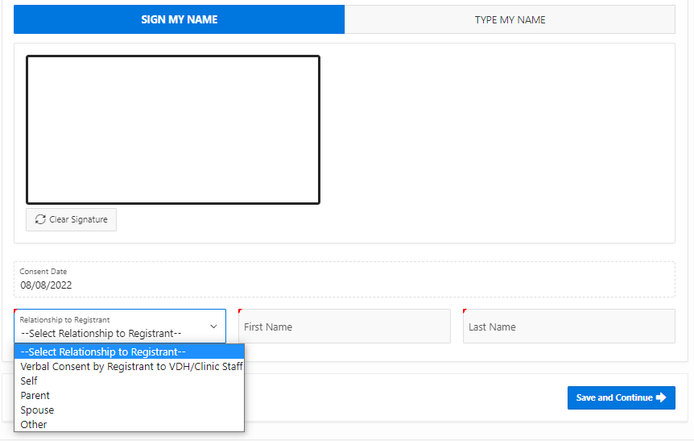
VASE+ Job Aid – Mpox Phase 2: Appointment Registration
Version 1.0
Completing Health Questionnaire
Registrants who are intending to receive a dose will be required to complete the health questionnaire, including if they have previously received a dose of a mpox/smallpox vaccine. (Figure 1).
Figure 1 – Health questionnaire
There are validations in place to ensure that potential registrants are only enrolling into clinics for which they are eligible. Potential registrants may receive an error message when registering if one of the following conditions occurs:
Their last dose date has not met the minimum interval between doses
They have not answered “yes” to one of the main eligibility questions (questions about items that apply to the registrant in the past 14 days)
After the completion of the health questionnaire the consent for vaccination must be signed. (Figure 2).
Figure 2 – Consent form

Slide 2
VASE+ Job Aid - Mpox Phase 2: Appointment Registration
Version 1.0
Once completed, the registrant can be checked in or added to the Wait List. (Figure 3).
Figure 3 – Registrants for mpox 18+ on wait list
NOTE:
Registrants that have not met the minimum time duration between doses will not be able to save their health questionnaire. These users will be hard-stopped by the system and will receive an error message with the date in which they can return for the vaccine. (Figure 4).
Figure 4 – Time interval error message
VIIS Data Transfer
The VASE+ System has daily automated data transfer to VIIS. At 11:15 PM on the day of a clinic, any registrant’s who are in the “checked out” tab will have their vaccination information automatically transferred to the VIIS system.

