Slide 1
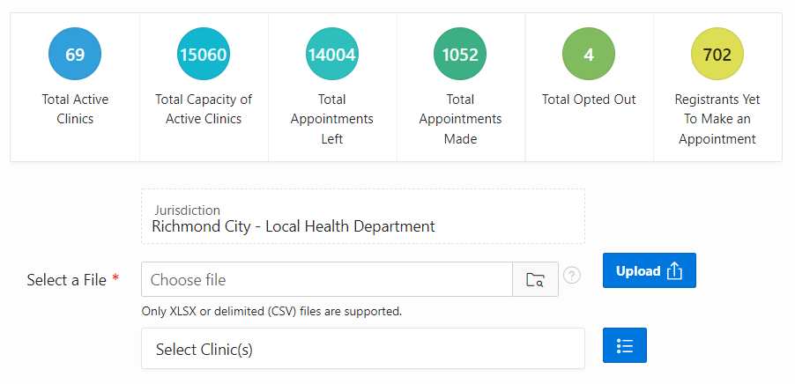
VASE+ Job Aid – Customizable File Upload
Version 1.1
In this job aid, users will learn how to use the customization feature when using the file upload in VASE+. This guide applies to the file upload user role.
File Upload
In the navigate menu select the “Upload Data” tab.
Figure 1 – Select Upload Data from the homepage
On the Upload Data page, users can see summary metrics related to clinics and appointments. To upload a file, the user will select the jurisdiction the data is assigned to. The user will then click the blue icon next to the “Select Clinic(s)” field.
Figure 2 – Select the jurisdiction data will be assigned
The Select Clinic pop-up will allow for a search of clinic sites the user wishes to assign the file data to. Data can be assigned to one or more clinics.

Slide 2
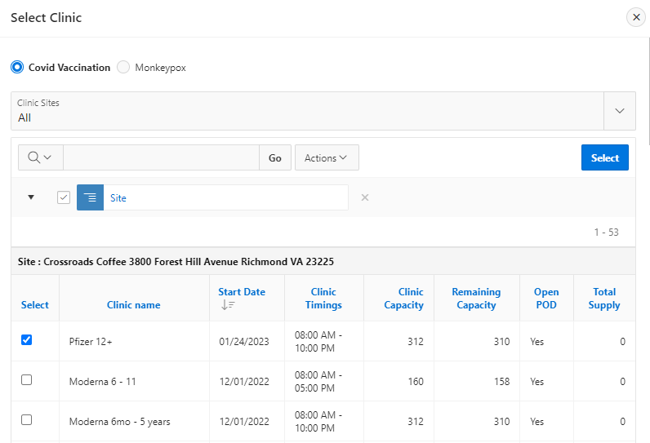
VASE+ Job Aid – File Upload
Version 1.1
Select the clinic type (Covid or Monkeypox) then select the relevant clinics by clicking the checkboxes, click the “Select” button to close the “Select Clinic” window.
Figure 3 – Select the clinics for the file upload
To upload a file, select the folder icon and navigate select the file to be uploaded (must be in XLSX or CVS format). The user will then select the “Upload” button.
Figure 4 – Upload a file
Upon uploading the file, a results pop-up will display showing Total Records Processed, Total Records Uploaded, and Total Rejected Records.
Figure 5 – Data File Summary

Slide 3
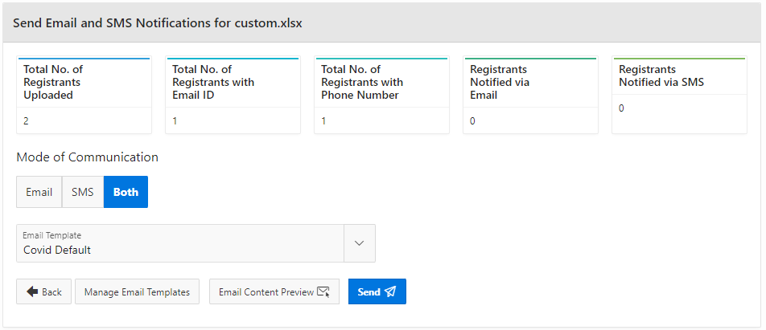
VASE+ Job Aid – File Upload
Version 1.1
After uploading a file, the relevant information will be shown in the “Notifications Not Yet Scheduled” section prior to sending out communications to registrants in the file. To send out notifications, click the icon below “Send Notifications.”
Figure 6 – View Uploaded Files and click Send Notifications
Upon clicking “Send Notifications”, the user will be directed to the Send Email and SMS Notifications which will show Registrants Uploaded, Registrants with Email ID, Registrants with Phone Number, Registrants Notified via Email, and Registrants Notified via SMS. To send notifications, select the Mode of Communications, then click “Send.” Users can also view “Email Content Preview” to review the contents of the email notifications being sent out.
Figure 7 – Send Notifications
To customize the Email template, click on the Manage email templates button.
Figure 8 – Manage Email Templates

Slide 4
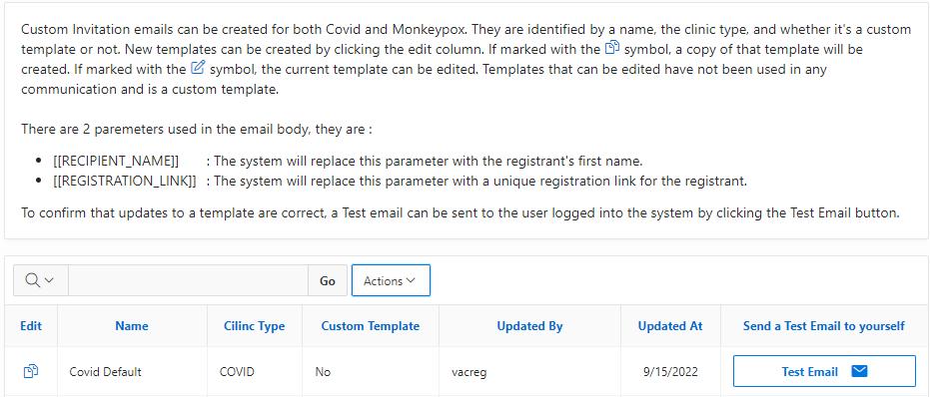
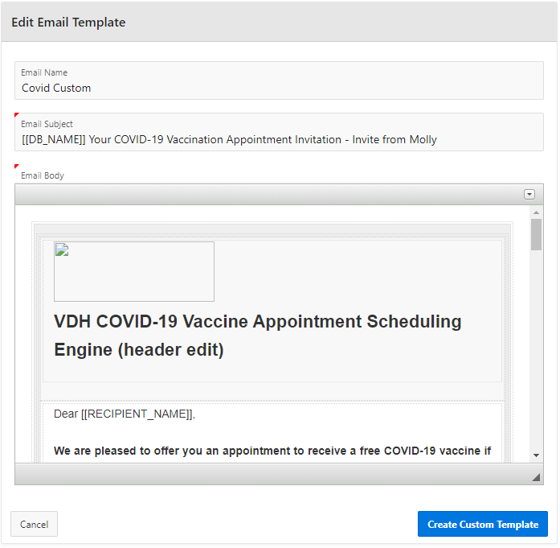
VASE+ Job Aid – File Upload
Version 1.1
The Email Templates screen will show a list of templates available including the default template and custom templates that have been created. Users will be able to duplicate and/or edit templates and send a test email to preview templates.
Figure 8 – Duplicate/Edit and send a test email of a custom template
After clicking “Edit” the user will see the Edit Email Template Screen. Here the user can edit the Email name, the Email Subject line, and Email body. The Email body is available in English and Spanish. Any text modified in English will not be automatically modified in Spanish. The user must update the Spanish text manually.
Figure 9– Save the custom template
When customization is complete click on “Create Custom Template.” Changes will be saved and the new template will appear on the template list.

Slide 5
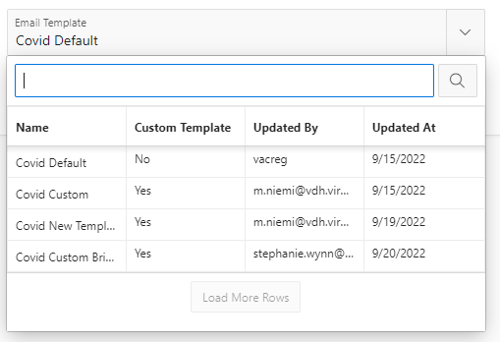
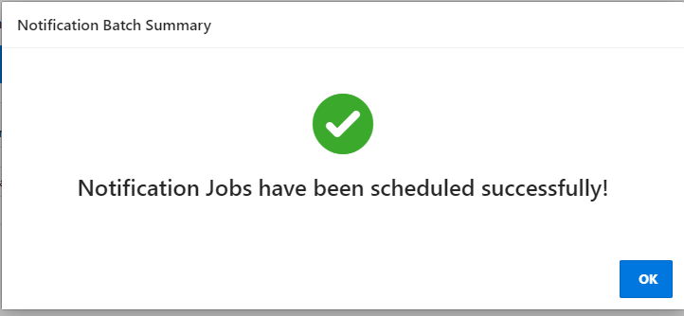
VASE+ Job Aid – File Upload
Version 1.1
The custom template will appear in the template drop down and can be selected. Select the correct template for that communication and Click Send.
Figure 10 – New templates appear on drop down
The email template can also be viewed from this screen but not edited. Click on “Email Content Preview” to view the email before to verify it is the one intended.
Figure 11 – Preview Email before sending
After clicking on “Send” a confirmation screen will appear to confirm notifications were sent successfully.
Figure 12 – Confirmation that notifications were sent successfully

Slide 6
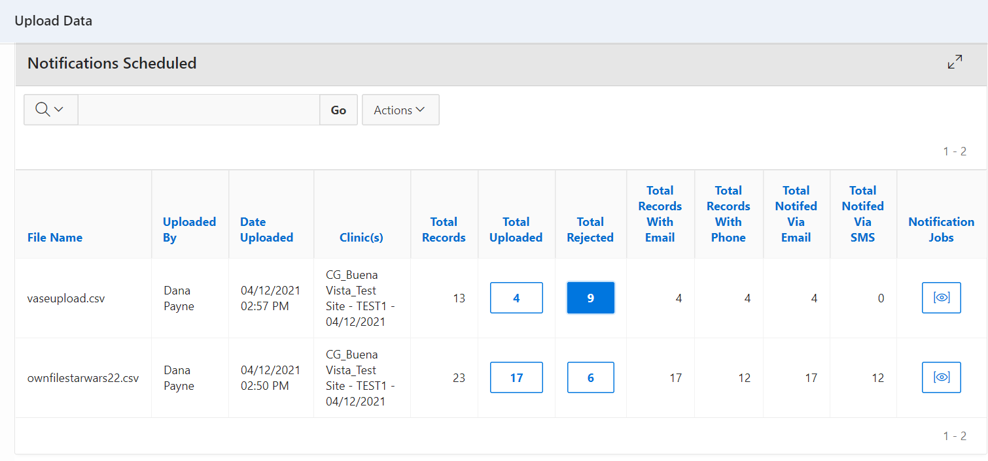
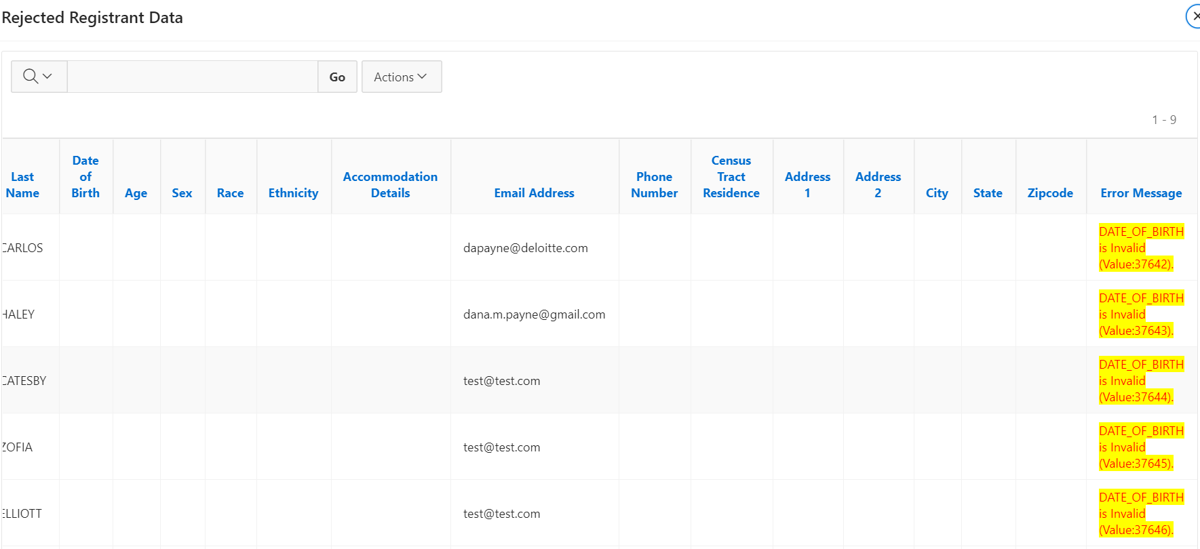
VASE+ Job Aid – File Upload
Version 1.1
File Upload Error
To view upload errors, click the box in the “Total Rejected” column to view record rejection cause.
Figure 9 – View Total Rejected
After scrolling all the way to the right in the Rejected Registrant Data table, the “Error Message” column will show the reason a specific record was rejected.
Figure 10 – View Error Messages

