Slide 1
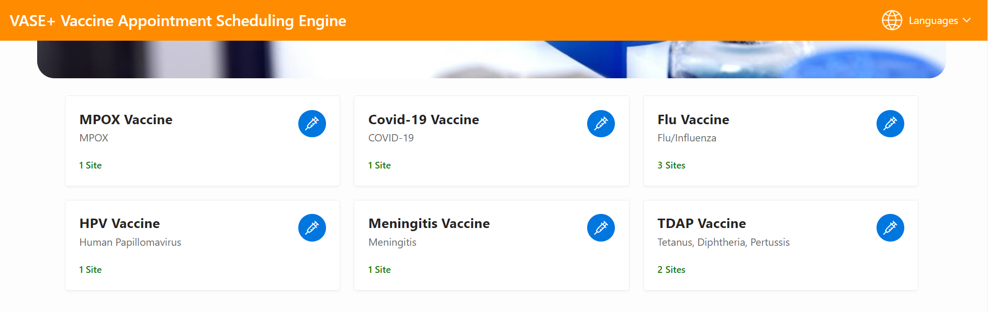
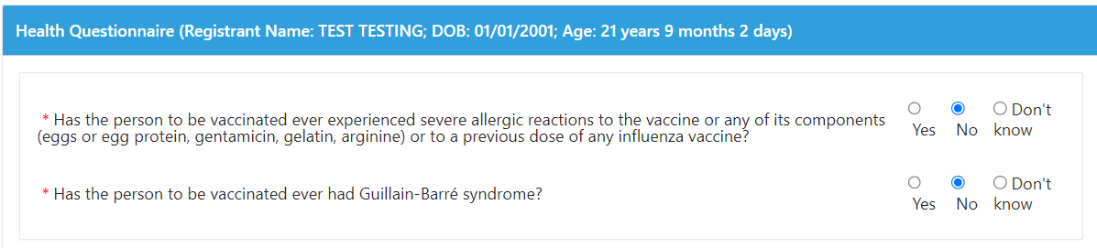
VASE+
Job Aid – EP&R Flu Vaccine Clinic: Appointment Registration
Version 1.1
Searching for an Appointment
Registrants who are searching for an open pod clinic on the public scheduler will select the “Flu” category to begin their search (Figure 1). Both EP&R flu clinics (using the VASE+ only workflow), and VASE+ WebVISION integrated clinics will display in the search results.
Clients who schedule into an EP&R event (VASE+ Only module) will not be prompted to enter guarantor information or insurance information. Clients scheduling into WebVISION integrated events will be prompted to enter this information.
Figure 1 – The flu category search returns both EP&R and WebVISION integrated clinic results
Completing Health Questionnaire
Registrants who are intending to receive a dose will be required to complete the health questionnaire (Figure 2). Please note that registrants that self-schedule using the public portal will complete all health questions at the time of registration, regardless of how far in advance they schedule.
Please note that registrants must be at least 6 months old by the clinic date to complete registration.
Figure 2 – Health questionnaire

Slide 2
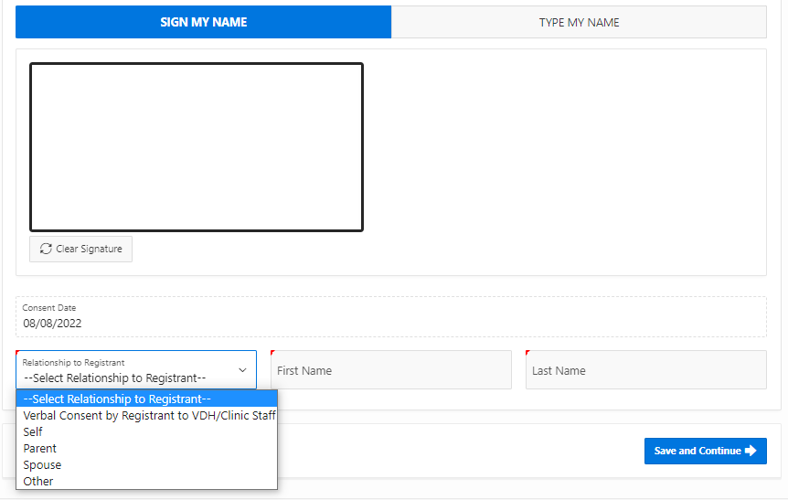
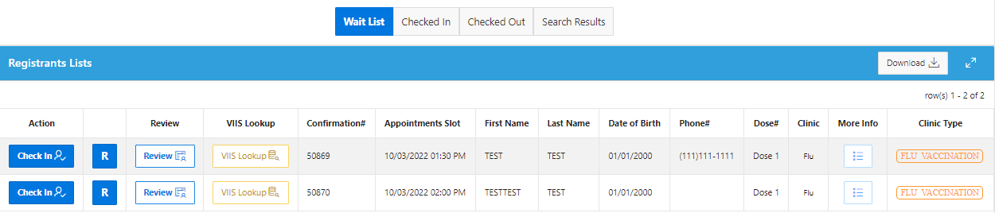
VASE+
Job Aid – EP&R Flu Vaccine Clinic: Appointment Registration
Version 1.1
After the completion of the health questionnaire the consent for vaccination must be signed. (Figure 3).
Figure 3 – Consent form
Once completed, the registrant will be added to the clinic Wait List in VASE+. (Figure 4).
Figure 4 – Registrants for Flu Vaccine on wait list
VIIS Data Transfer
The VASE+ System has daily automated data transfer to VIIS. At 11:15 PM on the day of a clinic, any registrant’s who are in the “checked out” tab will have their vaccination information automatically transferred to the VIIS system.

