Slide 1
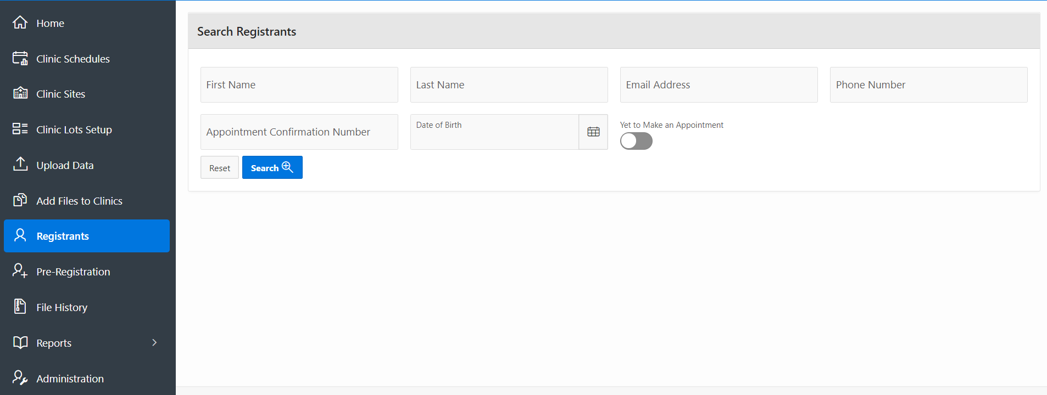
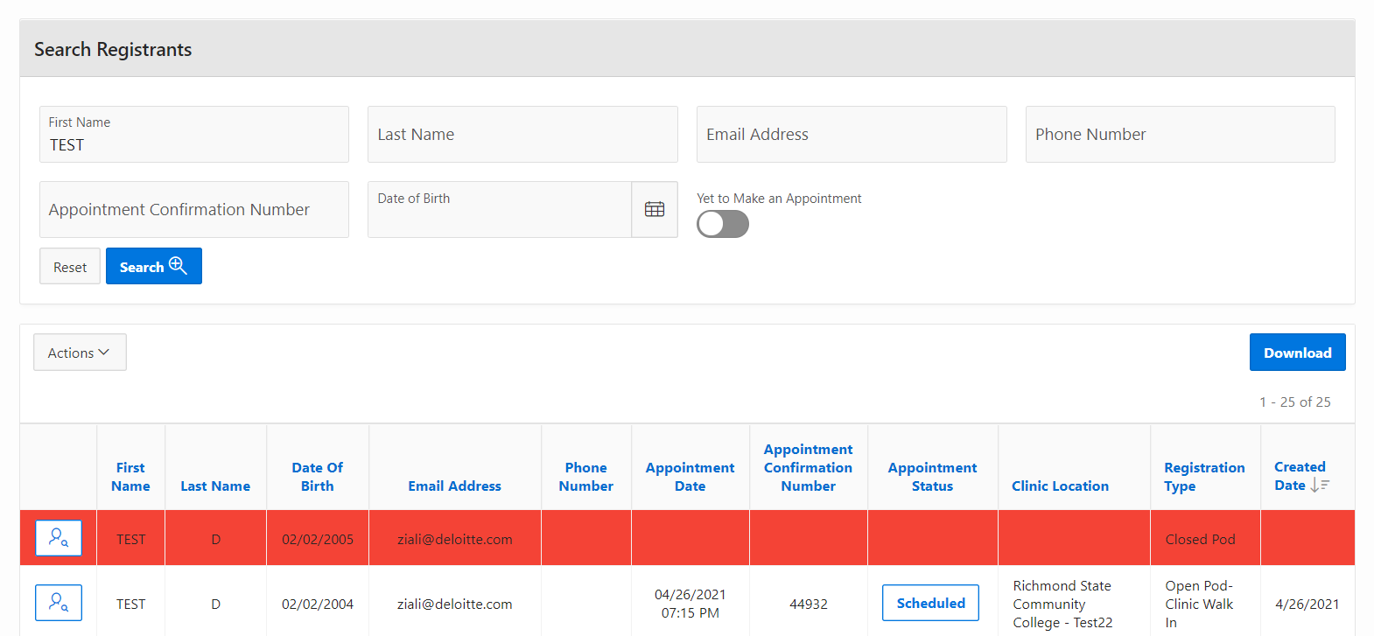
VASE+
Job Aid – Flu Call Center
Version 1.1
In this job aid, users will learn how to use the Search Registrants and Schedule Appointment features in VASE+. These features are available to Call Center roles, Administrator, and Locality Admin and will display all registrants within the jurisdiction of the operator. Registrants can search for individuals and view additional information on the status of an individual’s state in the registration process.
Search Registrants
Click on “Registrants” from the navigation menu on the left. In the Search Registrants search engine, a registrant can be searched by any this categories: Fist Name, Last Name, Email Address, Phone Number, Appointment Confirmation Number, and Date of Birth. (Note: Combining search criteria elements will yield the best results.)
The toggle switch “Yet to Make an Appointment” will look for people in the system that have yet to make an appointment allowing for prioritization scheduling of this individuals during a search.
Figure 1 – Search Registrants Engine
Results of the search will be displayed in a list at the bottom in color codes:
White colored rows indicate that there is current availability for an appointment.
Red colored rows indicate that there is no current availability for an appointment.
The search results can also be downloaded using the “Actions” button.
Click on the “View” icon to review a registrant.
Figure 2 – Administration Module from the Navigation Bar

Slide 2
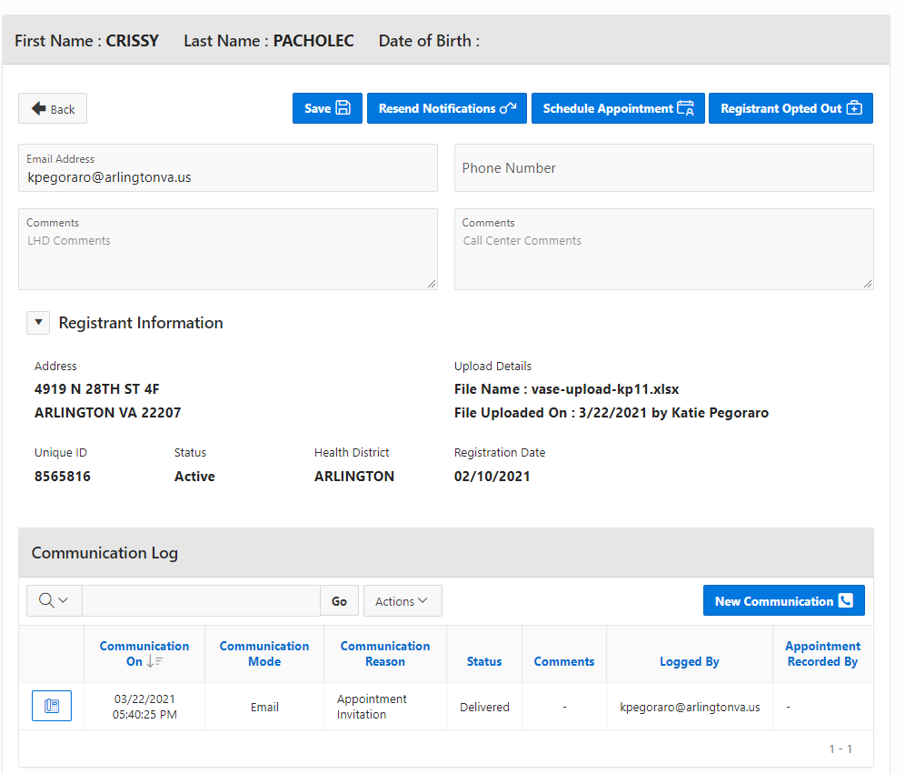
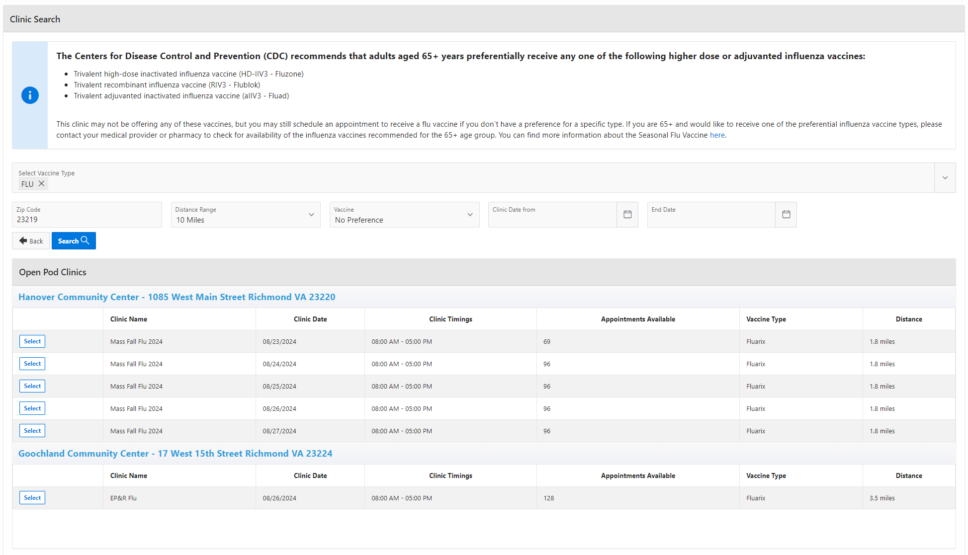
VASE+
Job Aid – Flu Call Center
Version 1.1
Operator permissions:
Resend Notifications
Contact the Recipient:
  Email
  SMS
  Phone
Schedule Appointment
Optout a Registrant per Recipient Request
Add Comments
Save changes
Figure 3 – White Row: Scheduling and Appointment Available
Schedule Appointment
To begin the scheduling process, select which type of clinic is needed from the dropdown list. Then enter the zip code to search for clinics being offered in that area (Figure 4). Call Center Users will see a CDC Preferential Flu Recommendation message for registrants over the age of 65 above the clinic selection area.
Figure 4 – Flu Clinic Search

Slide 3
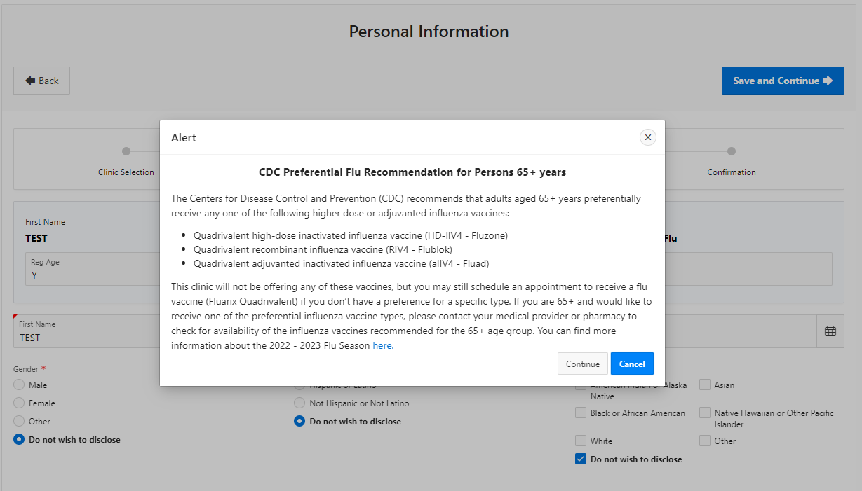
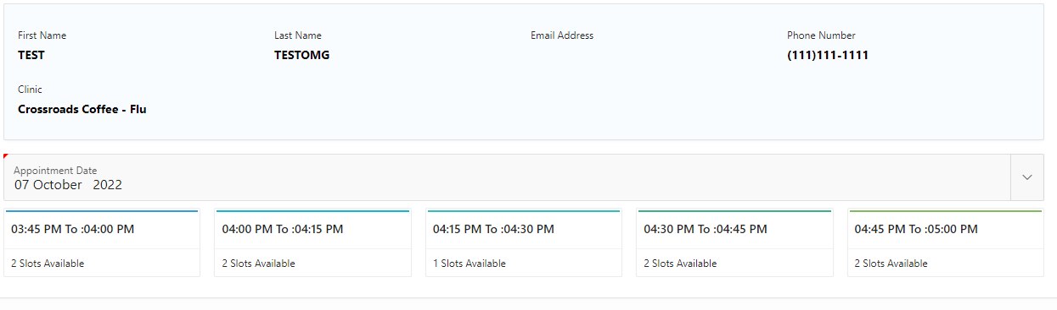
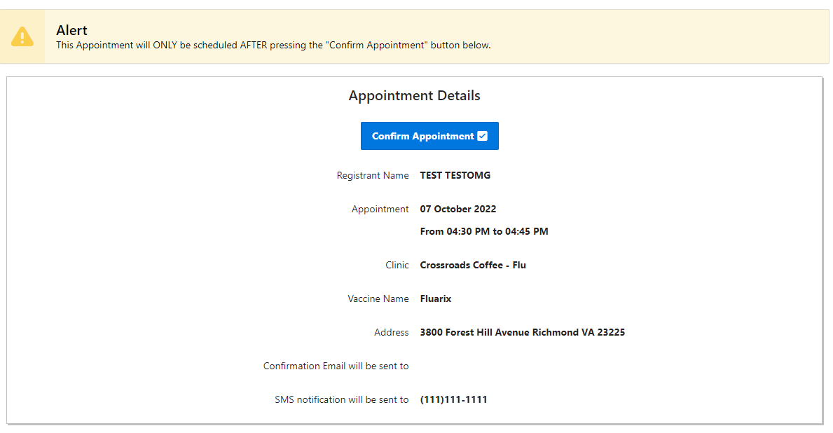
VASE+
Job Aid – Flu Call Center
Version 1.1
Another alert will also display after the call center user enters the registrant's information and the system determines that registrant is over the age of 65. The call center user may continue and schedule the appointment or click cancel (Figure 5).
Figure 5 – Over 65+ Alert
After clicking continue, the Call Center user will select the registrants preferred time slot from the times available (Figure 6).
Figure 6 – Appointment Time slot
After the Call Center user confirms the appointment, the appointment will be scheduled. Registrants using the call center to schedule their appointment will receive an email and/or SMS message 48 hours before their appointment to complete the health questionnaire. All other registrants (self registrants and walk ins) will complete it at the time of registration (Figure 7).
Figure 7 – Confirm appointment

