Slide 1
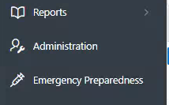
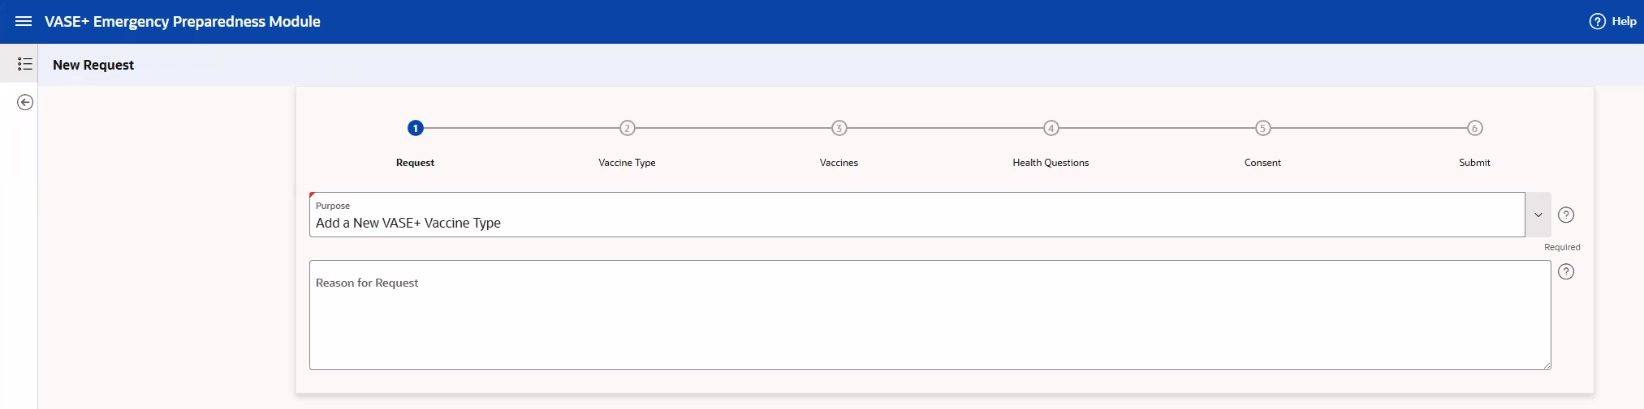
VASE+
Job Aid - Emergency Preparedness Module: Vaccine Request
Version 1
Objective:
This job aid provides step-by-step instructions for using the VASE+ Emergency Preparedness Module (EPM) to submit a vaccine request. This job aid is applicable to users with the EPM Requestor role.
Accessing the EPM
To access the EPM, users must log in to the VASE+ application and select the "Emergency Preparedness" menu item on the left-hand side (figure 1).
Figure 1 – Click on the Emergency Preparedness button menu item to access the EPM
Initiate a New Request
To initiate a new request, including adding a new vaccine and vaccine type to VASE+, select the new request button. Note: this button is only available to users with the EPM Requestor role.
Figure 1 – Click on the new request button to create a new vaccine request
Identify Vaccine Type
To complete a new request, the requestor will proceed through 6 steps. These include the following:
Request: Provide general information about the request
Vaccine Type: Provide information regarding the vaccine type
Vaccines: Provide specific details regarding the vaccine being requested
Health Questions: Select or create the health questions relevant to the vaccine request
Consent: Select the consent text relevant to the vaccine request
Submit: Review all information and submit
Figure 2 – Requestor must complete 6 steps to submit a request

Slide 2
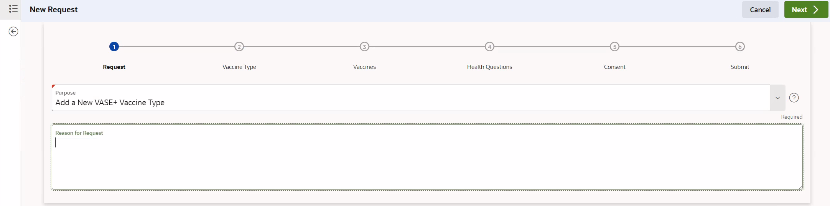
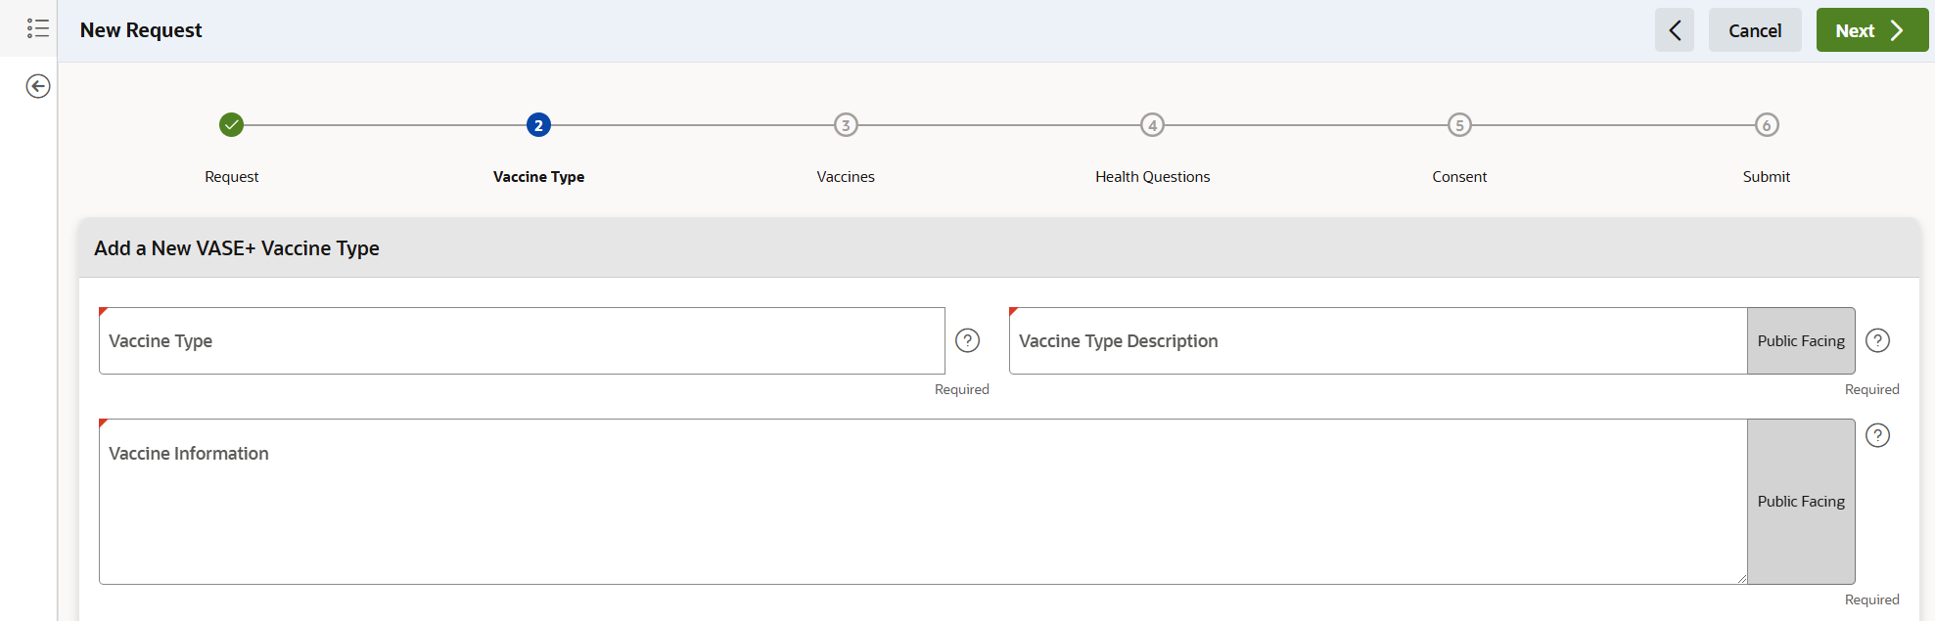
VASE+
Job Aid - Emergency Preparedness Module: Vaccine Request
Version 1
Step 1 : Request
Requestors will start by completing the fields on the request page, including the purpose and reason for request (figure 3). Additional details on these fields can be found below:
Purpose: A dropdown field where the requestor selects what the request is for. Currently, the only option is adding a new vaccine type to VASE+.
Reason for Request: A free text field where the requestor enters the reason that they are requesting the action listed in the purpose section. This field is only used within the EMP module, and will not appear anywhere within the VASE+ application once the request has been published.
Figure 3 – Request fields
Step 2 : Vaccine Type
Next, the requestor will enter details regarding the vaccine type and vaccine (figure 4). All fields that will be public-facing once the vaccine is published are noted with a label. Additional details on these fields can be found below:
Vaccine Type: Enter the general category of the vaccine being requested (e.g. TDaP, COVID-19, HPV)
Vaccine Type Description: Enter the general category of the vaccine (e.g. Tdap, COVID-19, HPV), which displays on the clinic creation page in the VASE+ application and public search page as the vaccine type category
Vaccine Information: Enter any relevant details for registrants scheduling an appointment for this vaccine. This information displays in the banner on the public search portal and call center search portal after a vaccine type category is selected.
Figure 4 – Vaccine Type fields

Slide 3
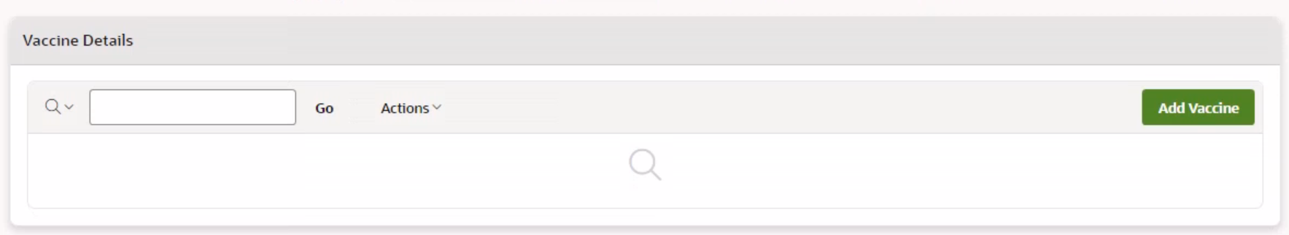
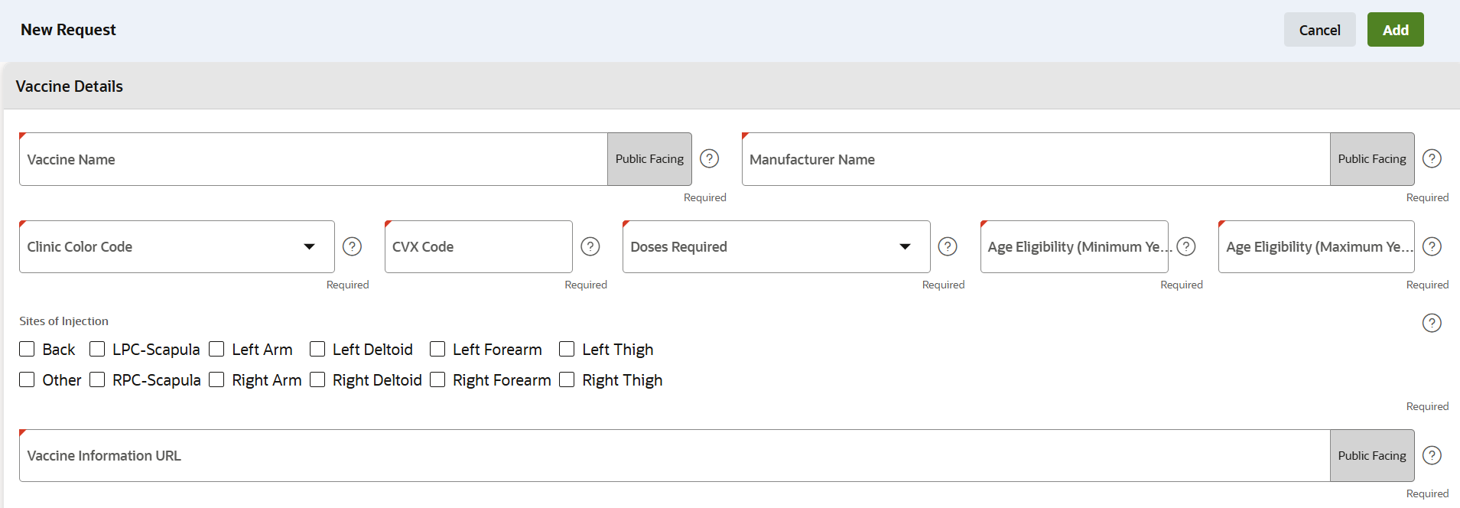
VASE+
Job Aid - Emergency Preparedness Module: Vaccine Request
Version 1
Step 3 : Vaccines
Requestors will now complete additional details regarding the vaccine such as the doses required in a series, and age requirements. To add a new vaccine, users will select the "Add Vaccine" option (figure 5). More than one vaccine can be added in a single request.
Figure 5 – Add Vaccine button
After selecting the "Add Vaccine" option, a new screen will appear where details regarding the vaccine will be entered (figure 6). Additional information on these fields can be found below:
Vaccine Name: Enter the specific name of the vaccine being requested (e.g. Jynneos or ACAM 2000 for the mpox vaccine type)
Manufacturer Name: Enter the name of the manufacturer of the vaccine product
Clinic Color Code: Select the color code that you would like to be associated with this clinic. The vaccine name will be highlighted in the specified color within a clinic event in the VASE+ Application
CVX Code:: Enter the standardized CVX (Clinical Vaccines Administered) code corresponding to the specific vaccine
Doses Required: Enter the total number of doses required to complete the vaccine series
Age eligibility: Enter the minimum and maximum age, in years, of registrants that are eligible to receive the vaccine
Site of Injection: Select the applicable anatomical sites where the vaccine is eligible to be administered
Vaccine Information URL: Enter the applicable URL to either the EUA or Vaccine Information Statement
Figure 6 – Vaccine Details

Slide 4
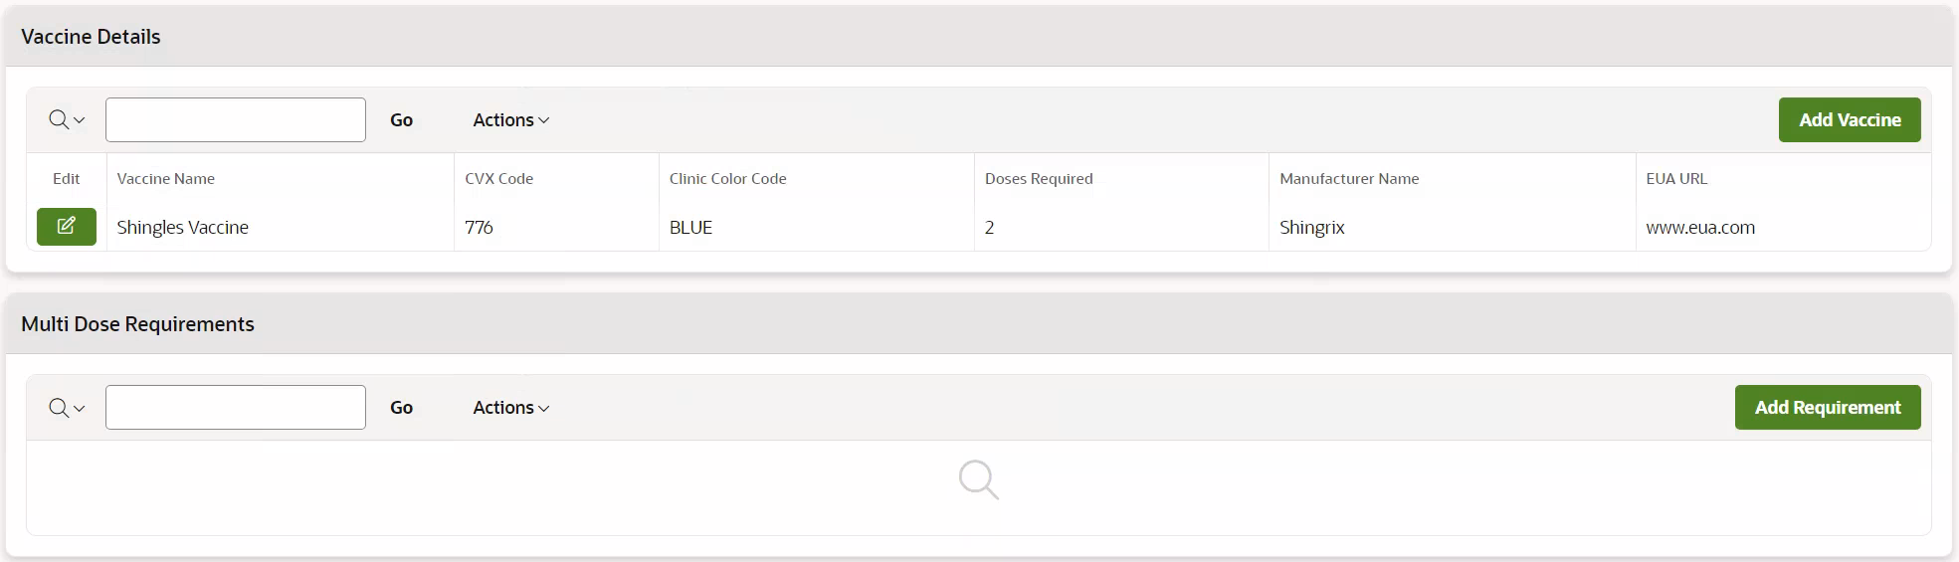
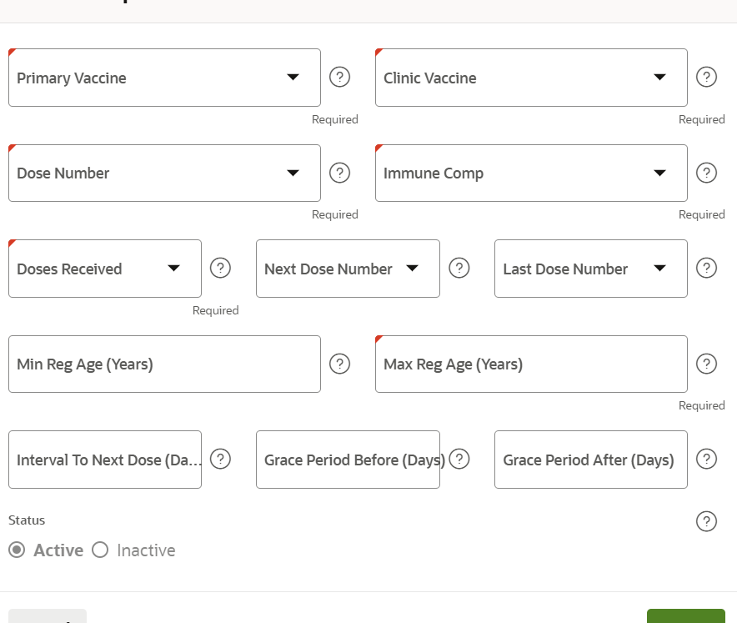
VASE+
Job Aid - Emergency Preparedness Module: Vaccine Request
Version 1
Step 3 : Vaccines (cont.)
If one or more of the vaccines added have a multi-dose series, requestors will see that a new field, “Multi Dose Requirements” appears upon saving the vaccine details. Requestors will enter details regarding the dose requirements by selecting the “Add Requirement” option (figure 7). Requestors can enter multiple requirements, as applicable to the vaccine they are requesting.
Figure 7 – Add New Requirement Information
After selecting the “Add Requirement” button, a new page titled "Vaccine Requirement" will appear (see Figure 8). On this page, requestors will input additional details regarding the vaccine dose eligibility. These parameters will inform system alerts when registrants are scheduling an appointment. Vaccine administrators are responsible for reviewing all information at the time of vaccination to ensure that registrants meet the eligibility criteria.
Primary Vaccine: This field represents the vaccine that was received as a previous dose. If a client is coming in for their first dose, the primary vaccine is the same as the clinic vaccine .
Clinic Vaccine: This field denotes the vaccine that the registrant is presenting to receive at the clinic.
Dose Number: This is the dose number that a registrant is presenting to receive
Immune Comp: This is a yes/no selection field that indicates whether the requirement is specifically applicable to registrants who are immunocompromised.
Doses Received: This field indicates the number of doses that the client has previously received before the current dose they are presenting for.
Figure 8 – Add Vaccine Requirement Details

Slide 5
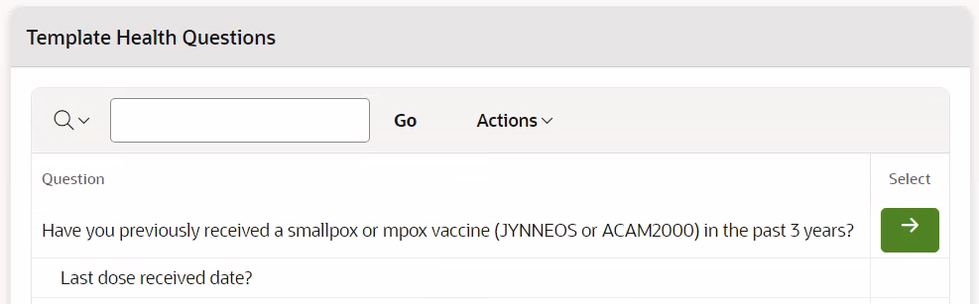
VASE+
Job Aid - Emergency Preparedness Module: Vaccine Request
Version 1
Step 3 : Vaccines (cont.)
Details on the additional fields on the Vaccine Requirement pop-up can be found below (figure 9).
Next Dose Number: If there is an additional dose in the series after the current dose, select the appropriate dose number. If this is the final dose in the series, leave this field blank.
Last Dose Number: This field indicates the total number of doses in the series, representing the final dose number.
Min Reg Age: This field specifies the minimum age, in years, to which these requirements apply.
Max Reg Age: This field specifies the maximum age, in years, to which these requirements apply.
Interval to Next Dose (in days): This field indicates the number of days between the current dose and when a registrant is eligible to receive their next dose.
Grace Period Before (in days): This field specifies the number of days before the interval to the next dose during which a registrant can schedule to receive the dose without triggering an alert message.
Grace Period After (in days): This field specifies the number of days after the interval to the next dose during which a registrant can schedule to receive the dose without triggering an alert message.
Status: This field is an active/inactive indicator to specify whether the requirement is currently relevant or not.
Figure 9 – Add Vaccine Requirement Details (cont.)
Step 4 : Health Questions
In this step, Requestors will either select existing health questions to be included in the health questionnaire for the new vaccine or create new health questions.
Adding Existing Health Questions (figure 10)
  To add an existing health question, click the green arrow in the “Select” column next to the desired question
  Note: existing health questions cannot be edited. However, the order in which these questions appear in the questionnaire can be edited
Figure 10 – Add Existing Health Questions

Slide 6
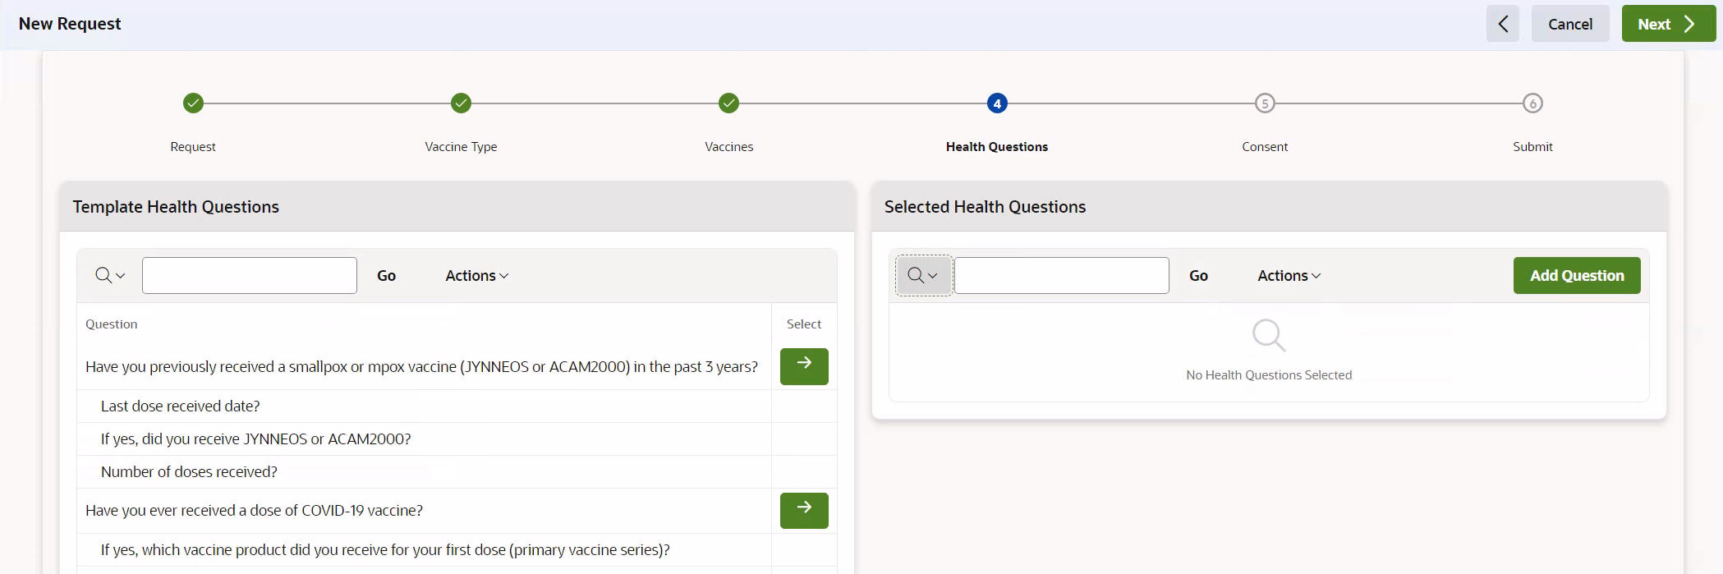
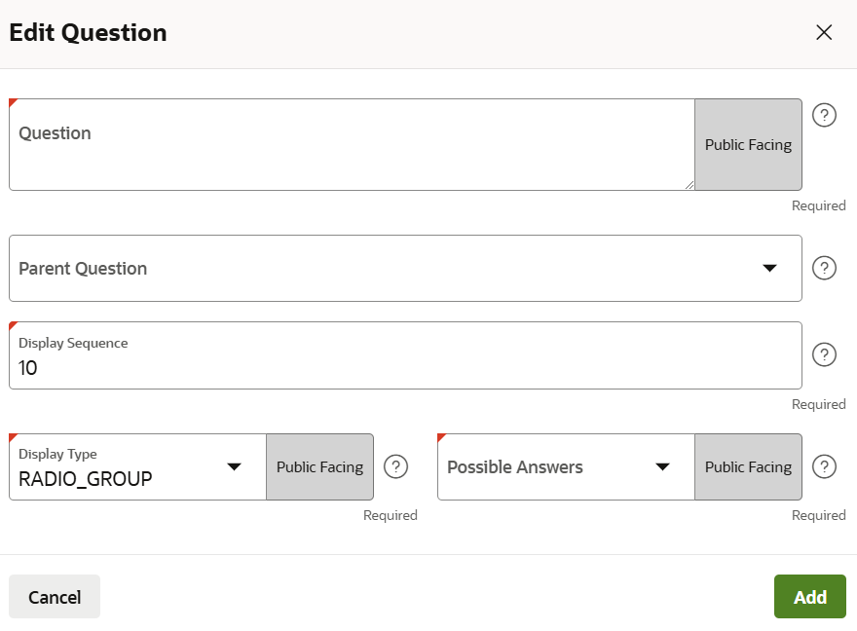
VASE+
Job Aid - Emergency Preparedness Module: Vaccine Request
Version 1
Step 4 : Health Questions (cont.)
Creating New Health Questions
  If you need to add a new health question, select the “Add Question” option located on the right-hand side of the page (figure 11)
  Follow the prompts to input the new question
Figure 11 – Add new health question
Adding or editing a health question occurs on the “Edit Question” pop-up. All fields are editable if adding a new health question. If editing an existing health question, only the display sequence is editable (figure 12). Additional details on the edit question fields can be found below:
Question: Enter the text of the new health question that will be added to the questionnaire
Parent Question: Use this field if the new question is a follow-up or dependent on a previous question. Select the parent question from the list of existing questions to establish this relationship
Display Sequence: Determine the order in which the question will appear in the questionnaire. Enter a numerical value to specify the position of this question relative to others. Questions will display in numerical order, even if the numbers are not consecutive.
Display Type: Specify the format in which questions will be displayed. Options include DISPLAY_TEXT for display only questions, and RADIO_GROUP for selection answers
Possible Answers: Select the possible answers for the question. Options include yes/no, and yes/no/don't know. Each possible answer option is separated by commas.
Figure 12 – Adding a new health question

Slide 7
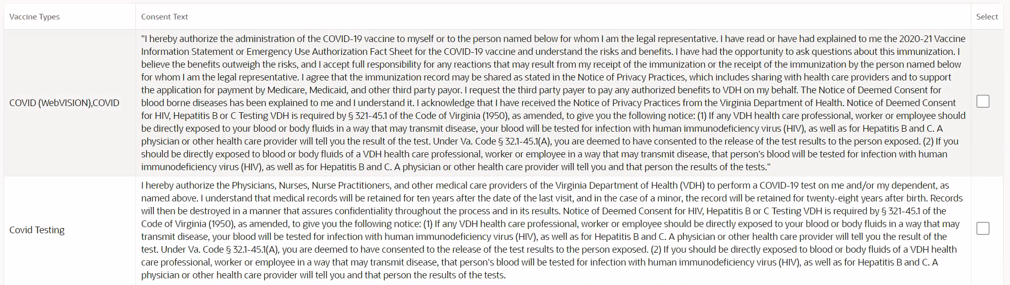
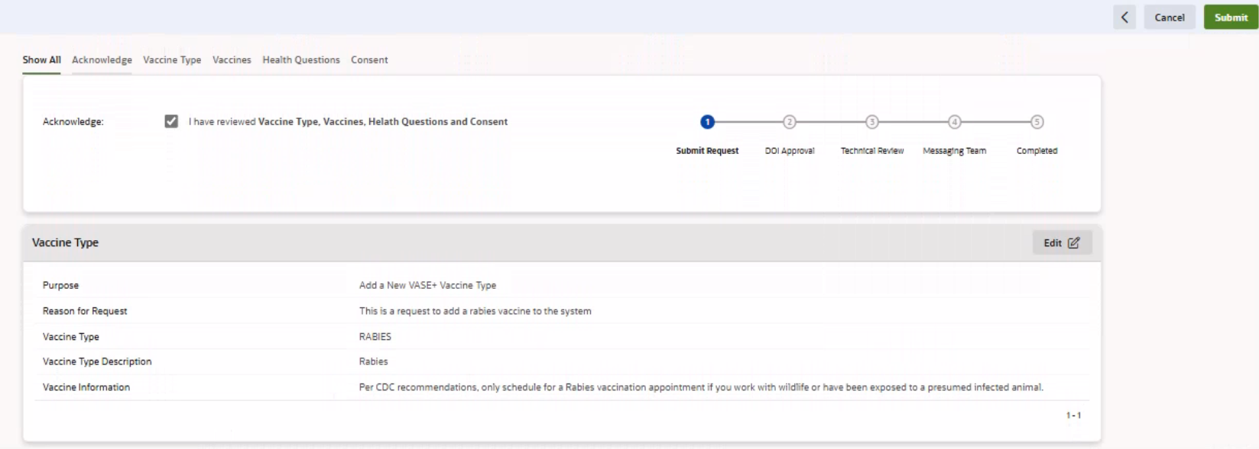
VASE+
Job Aid - Emergency Preparedness Module: Vaccine Request
Version 1
Step 5 : Consent Form
Requestors will now select the text block that they would like to appear on the consent form. Requestors will review the available text blocks provided on the page. To select a text block, check the checkbox next to the desired text (figure 13).
The vaccine type column denotes which vaccine types the consent text is currently used for in VASE+. Requestors can select the text block even if the vaccine types listed do not correspond to the vaccine type being requested.
All consent options available on this page have been provided and approved by CHS.
Figure 13 – Selecting consent text
Step 6 : Complete Acknowledgement and Submit
Once all information fields have been completed, Requestors will complete acknowledgement and submit their request. If any changes need to be made, they can select the edit button next to the relevant section and make updates. Once the acknowledgement has been checked and all fields are correct, the request can be submitted by selecting the submit button (figure 14).
Figure 14 – Acknowledgement, editing, and submitting a request
After the request is submitted, the Requestor will receive receipt of submission via email. Users with the Approver role will also receive a notification. Additional details about the approval process can be found in the EPM Approver job aid.

