Slide 1
Monkeypox Overview for Healthcare Providers
Brooke Rossheim, M.D., M.P.H.
Virginia Department of Health
Office of Epidemiology
October 21, 2022
Notes:
Good morning/afternoon. Today I will give an overview of monkeypox for HIV/AIDS providers
Additional Notes
This is a slide deck that contains key information on monkeypox. It can be used or adapted by VDH staff.
The slides are mainly geared toward a professional audience of HIV/AIDS providers.
Modify slides and speaker notes as needed. Additional resources included in notes when applicable.
You can adjust the font color in the slides.
Content is current as of 10/12/2022.
1

Slide 2
Outline
1. General Monkeypox Overview
2. Monkeypox Clinical Assessment and Evaluation
3. Monkeypox Infection Prevention and Control for Healthcare Settings
4. Monkeypox Testing
5. Monkeypox Vaccination
6. Monkeypox Treatment and Patient Management
High yield resources for clinicians:
CDC Information For Healthcare Professionals | Monkeypox
VDH Monkeypox Healthcare Provider Webpage

Slide 3
General Monkeypox Overview
Notes:
3

Slide 4
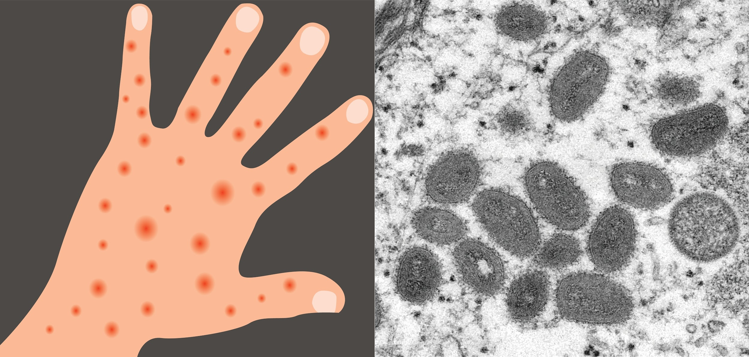
About Monkeypox
Caused by Monkeypox virus
Same family of viruses as smallpox
Two clades
Clade I: more severe illness
Clade II: current global outbreak
Symptoms similar to smallpox, but milder illness
Rarely fatal
Not related to chickenpox
cdc.gov/poxvirus/monkeypox/response/2022/world-map.html
Notes:
Disease caused by infection with the Monkeypox virus
Same family of viruses as smallpox
Two clades:
Clade I: more severe illness
Clade II: current global outbreak
Monkeypox symptoms are similar to smallpox symptoms, but milder; monkeypox is rarely fatal
Monkeypox is not related to chickenpox

Slide 5
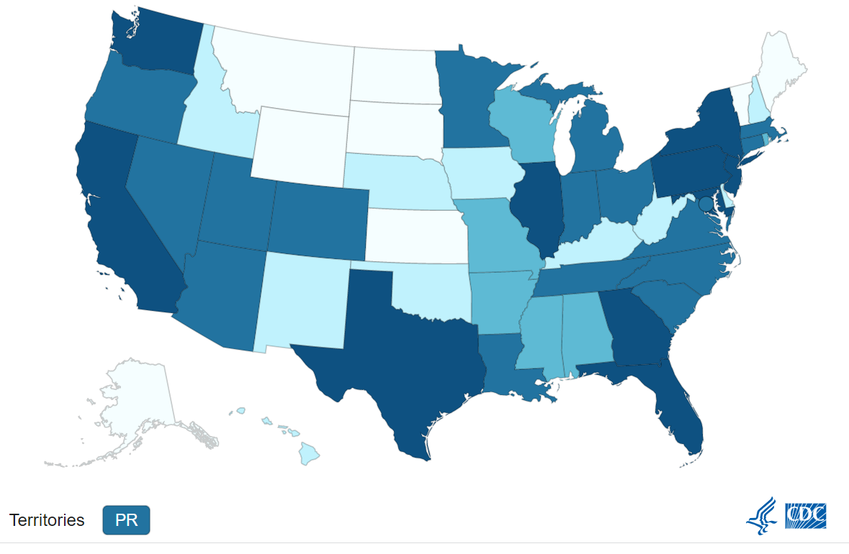
2022 Monkeypox Outbreak
Multinational outbreak of monkeypox
Recent MMWR summary of U.S. cases
~99% have occurred in men
~94% of whom reported recent intimate or sexual contact with other men
~41% had HIV infection
As of 10/20/2022, four fatal cases of monkeypox in the U.S.
Reported cases as of 10/20/22
75,166 cases reported from 109 countries globally
27,835 cases across the U.S.
cdc.gov/poxvirus/monkeypox/response/2022/us-map.html
Notes:
The multinational outbreak of monkeypox was first noted in May 2022.
A recent MMWR summary of U.S. cases found that 99% have occurred in men, 94% of whom reported recent intimate or sexual contact with other men, and 41% had HIV infection
As of 10/13/2022, two fatal cases of monkeypox in the U.S.
https://www.cdc.gov/poxvirus/monkeypox/response/2022/index.html

Slide 6
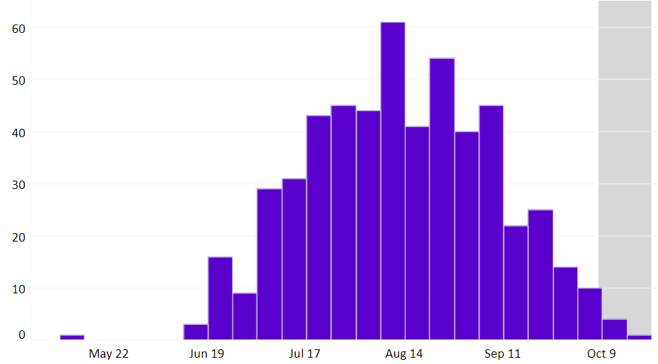
Data in Virginia
As of 10/20/22:
521 confirmed cases,
22 hospitalizations,
0 deaths
94% male
Middle age groups (20-29, 30-39 years)
Majority have reported race/ethnicity as Black, followed by white and Latino
vdh.virginia.gov/monkeypox/data-in-virginia/
Notes:
*The graph shows the number of monkeypox cases reported to VDH by the date closest to when the person became ill or got tested for the monkeypox virus.
Reported cases of monkeypox in Virginia may be decreasing slightly, but it is still too early to tell if this means the outbreak is slowing down in Virginia. Data are incomplete for the most recent weeks and that is why the right portion of the curve is shaded in gray.
VDH launched a data dashboard on August 22 that summarizes case data in Virginia. As of October 12, 2022 there have been 510 confirmed cases,22 hospitalizations, and 0 deaths. The majority of cases in Virginia have been male, predominately in middle age groups. Majority have reported race/ethnicity as Black, followed by white and Latino.

Slide 7
Monkeypox Transmission
Close contact with rash lesions or body fluids
Can occur during intimate contact
Can also spread via contaminated materials (e.g., bedding, towels) or large respiratory droplets
Most cases in people who identify as men who have sex with men (MSM)
Anyone can get and spread monkeypox through close contact (cases in females are gradually increasing)
Incubation Period: 3-17 days
Infectious from symptom onset until skin lesions have scabbed over, scabs have fallen off, and new skin has formed
Currently unknown whether HIV infection alters a person’s risk of acquiring monkeypox after exposure
Notes:
Most of the spread in the current outbreak is thought to be from close contact with rash lesions or body fluids from another person with monkeypox. This can occur during intimate contact.
Monkeypox can also spread via contaminated materials, such as bedding or towels, or from large respiratory droplets
Most cases identified so far have been in people who identify in men who have sex with men, but it is important to emphasize that anyone can get and spread monkeypox through close contact.
Spread from an infected person to a dog has been reported but this is very rare so far.
7

Slide 8
Scientists Researching Transmission Routes
If virus can spread when someone has no symptoms
How often does monkeypox spread through respiratory secretions, or when a person with monkeypox symptoms might be more likely to spread the virus through respiratory secretions
Extent of spread through contaminated objects
If it can spread via semen, vaginal fluids, urine, or feces
Notes:
Scientists are currently researching some of the unknowns about transmission routes in this outbreak.

Slide 9
Monkeypox Clinical Assessment and Evaluation
Notes:
9

Slide 10
Clinical Features
Prodrome
Fever, chills, headache, myalgia, back pain, fatigue, lymphadenopathy
Present before or after rash, or absent
Rash 1–3 days after prodrome
Oral mucosal lesions
Cutaneous lesions progress through stages - macules, papules, vesicles, pustules, scabs
Generally self-limited illness, lasts 2–4 weeks
Lesions can be very painful, itchy
See CDC’s Monkeypox Clinical Recognition webpage
Symptoms/signs of monkeypox virus infection are similar in people with or without HIV
Data indicate that people with advanced and uncontrolled HIV disease can be at higher risk of severe or prolonged monkeypox infection - same is true for people who are immunocompromised in general
Notes:
This slide summarizes the clinical features of monkeypox.
Classically, there is a prodrome followed by a rash 1 to 3 days later.
Atypical presentations, including rash location, have been noted among cases in the current outbreak.
During the current global outbreak:
Lesions often occur in the genital and anorectal areas or in the mouth.
Rash is not always disseminated across many sites on the body.
Rash may be confined to only a few lesions or only a single lesion.
Rash does not always appear on palms and soles.
10

Slide 11
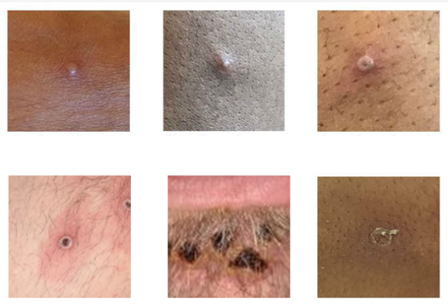
Key Rash Characteristics in Outbreak
Well circumscribed, firm, deep-seated lesions, often develop umbilication
Lesions often in genital and anorectal areas or in mouth
Rash not always disseminated across many sites
May only have a few lesions or even a single lesion
Rash not always on palms and soles
Rash can be confused with other illnesses
cdc.gov/poxvirus/monkeypox/clinicians/clinical-recognition.html
Notes:
These photos are examples of monkeypox lesions in the current outbreak. Lesions typically progress from macules to papules to vesicles to pustules and finally scabs.

Slide 12
Distinguishing Monkeypox
Monkeypox rash can be confused with STIs, especially if rash in genital and/or perianal area
STI diagnosis does not exclude monkeypox infection
Concurrent infections with STIs have been reported
Comprehensive evaluation
History of illness - prodrome, progression of rash, lesions may be painful or itchy
Social history clues - obtain sexual history from patient
Thorough physical exam looking for centrifugal rash distribution (rash concentrated on face, arms, legs), lesions in same stage of development in an area, or umbilicated lesions
Patients with a new characteristic rash or who meet one or more of the epidemiologic criteria and in whom there is a high suspicion should be tested for monkeypox.
Notes:
Monkeypox rash can be confused with STIs, especially if rash starts in genital or perianal area
The rash may not always disseminate to other parts of the body and typical prodromal symptoms may be mild or absent. These features of the newest monkeypox cases can easily be confused with sexually transmitted infections (STIs).
It is important to comprehensively evaluate patients presenting with genital or perianal ulcers for STIs. However, co-infections with monkeypox and STIs have been reported and the presence of an STI does not rule out monkeypox.
Perform thorough and comprehensive evaluation
Social history- contact with a person with suspected/confirmed monkeypox or close or intimate in-person contact with individuals in a social network experiencing monkeypox activity, this includes men who have sex with men (MSM)
Patients with a new characteristic rash or who meet one or more of the epidemiologic criteria and in which there is a high suspicion should be tested for monkeypox.

Slide 13
Patient Evaluation and Diagnosis
CDC Epidemiologic Criteria
Close contact with someone with a rash or who received a diagnosis of confirmed or probable monkeypox
Sexual contact with individuals in a social network experiencing monkeypox activity
Travel to a country with recent monkeypox cases or prior outbreaks
Animal exposures with live or dead wild animal or exotic pet that is an African endemic species
Isolate patient - standard and transmission-based precautions
Contact local health district immediately to report suspected case, either by telephone or using the Confidential Morbidity Report Portal
LHD Locator: vdh.virginia.gov/health-department-locator/
Testing for monkeypox and other illnesses
Notes:
These are the CDC epidemiologic criteria used when evaluating a person for possible monkeypox.
Close contact
Sexual contact
Travel outside the US to a country with confirmed cases of monkeypox or where Monkeypox virus is endemic
Animal exposures with a dead or live wild animal or exotic pet that is an African endemic species or used a product derived from such animals (e.g., game meat, creams, lotions, powders, etc.)
The patient should be placed in a private room, if possible, and standard and transmission-based precautions should be used.
Contact the LHD immediately to report a suspected case.
Additional Resources
Case Definitions for Use in the 2022 Monkeypox Response: https://www.cdc.gov/poxvirus/monkeypox/clinicians/case-definition.html
Clinical Recognition https://www.cdc.gov/poxvirus/monkeypox/clinicians/clinical-recognition.html
Isolation recommendations: https://www.cdc.gov/poxvirus/monkeypox/clinicians/isolation-procedures.html
Infection Prevention and Control of Monkeypox in Healthcare Settings: https://www.cdc.gov/poxvirus/monkeypox/clinicians/infection-control-healthcare.html
13

Slide 14
Resources: Clinical Assessment and Evaluation
VDH Monkeypox for Healthcare Providers
CDC Clinical Recognition
CDC Clinical Considerations for Monkeypox in Children and Adolescents
CDC Signs and Symptoms
What You Need to Know about Monkeypox if You are a Teen or Young Adult (print resource)
CDC What Clinicians Need to Know About Monkeypox (COCA webinar)

Slide 15
Monkeypox Infection Prevention and Control for Healthcare Settings
Notes:
15

Slide 16
Infection Prevention and Control Recommendations: Evaluating a Person Suspected to Have Monkeypox - 1
Isolate patient in a single room. Special air handling not required
Patient should be masked and lesions covered in shared spaces
HCP should use standard and transmission-based precautions
PPE: gown, gloves, N95 respirator, eye protection (goggles or face shield that covers the front and sides of the face)
Any procedures likely to spread oral secretions (intubation, extubation, etc.) should be performed in an airborne infection isolation room
Avoid activities that may spread material from lesions
Soiled laundry should be gently and promptly contained; avoid shaking or handling in a manner that may disperse infectious material
Avoid use of portable fans, dry dusting, sweeping, and vacuuming
cdc.gov/poxvirus/monkeypox/clinicians/infection-control-healthcare.html
Notes:
A patient suspected of having monkeypox should be isolated in a single room, given a face mask to wear, and lesions should be covered
The healthcare provider (HCP) should use standard and transmission-based precautions. PPE should include gloves, a gown, an N95 respirator, and eye protection (goggles or a face shield)
Any procedure done on the patient that’s likely to generate aerosols should be done in an airborne infection isolation room (also known as an AIIR room or a negative pressure room)
Do not shake soiled laundry since this may spread potentially infectious material

Slide 17
Infection Prevention and Control Recommendations: Evaluating a Person Suspected to Have Monkeypox - 2
When testing, collect specimens following CDC IPC guidance
Manage waste according to U.S. Department of Transportation (DOT) Hazardous Materials Regulations and state and local regulations
If patient does not have known epi risk for Monkeypox virus Clade I exposure (e.g., history of travel to the Democratic Republic of the Congo (DRC), the Republic of Congo, the Central African Republic, Cameroon or Gabon in prior 21 days), patient waste may be managed as Regulated Medical Waste.
If patient has risk for Clade I exposure, waste should be managed as Category A pending clade confirmation.
cdc.gov/poxvirus/monkeypox/clinicians/infection-control-healthcare.html
Notes:
Follow infection prevention and control guidance when collecting specimens for monkeypox testing
Because the current monkeypox outbreak involves Monkeypox virus clade II, medical waste can be handled as Regulated Medical Waste, just as other medical waste (other than sharps) is handled
If a patient has a risk factor for clade I Monkeypox virus, the medical waste should be handled as Category A waste pending confirmation of the clade.

Slide 18
Monkeypox Transmission in Healthcare Settings
Exposure through needle stick injury, direct contact with the specimen or skin lesions, or aerosols generated in a laboratory
HCPs collecting specimens should wear gloves, gown, N95 respirator, and eye protection (goggles or face shield)
No need to de-roof skin lesions to collect specimens - can lead to unnecessary exposure to lesion - recent case of a nurse in Florida who acquired monkeypox via needlestick
https://www.cdc.gov/poxvirus/monkeypox/clinicians/prep-collection-specimens.html
Notes:
Transmission of monkeypox can occur in an outpatient or inpatient healthcare setting
Examples of possible exposures include needlestick injuries, direct contact by the HCP with the specimen or the skin lesion, or being in a space (a lab, for example) where aerosols are being generated, but the HCP is not wearing proper PPE
For HCPs who are collecting specimens, appropriate personal protective equipment (PPE) includes gloves, gown, eye protection (goggles or face shield), and an N95 respirator
When collecting a specimen from the skin, there’s no need to de-roof the lesion. This may lead to unnecessary exposure to the lesion. (CDC has advised that the scab itself has enough active virus present to obtain samples)

Slide 19
Patients with Monkeypox: Isolation & Prevention Practices in a Non-healthcare Setting - 1
CDC recommends that people with monkeypox isolate at home or another location for the duration of the illness - applies to adults and children
Current data suggest that people are contagious from the time symptoms start until all symptoms are resolved and all skin lesions are fully healed
Typical duration of isolation is 2-4 weeks
cdc.gov/poxvirus/monkeypox/clinicians/isolation-procedures.html
Notes:
CDC recommends that people with monkeypox isolate at home or another location for the duration of the illness if possible
Current data suggest that people are contagious from the time of symptom onset until all symptoms are resolved and all skin lesions are fully healed
Typical duration of isolation is 2-4 weeks

Slide 20
Patients with Monkeypox: Isolation & Prevention Practices in a Non-healthcare Setting - 2
If patients are not able to isolate fully for the duration of the illness, CDC recommends the following:
While the patient is symptomatic with fever and any respiratory symptoms, they are advised to remain isolated - patients are advised to avoid close or physical contact with other people or animals
Cover the skin lesions, wear a well fitting mask, and avoid public transportation
If a rash persists in the absence of fever or respiratory symptoms, it’s recommended that all parts of the rash be covered with clothing, gloves, and/or bandages. Patients should also wear a well-fitting mask to prevent the spread of oral and/or respiratory secretions
cdc.gov/poxvirus/monkeypox/clinicians/isolation-procedures.html
Notes:
If patients are not able to fully isolate for the duration of the illness, CDC provides recommendations for patients which are detailed in the slide

Slide 21
Patients with Monkeypox: Isolation & Prevention Practices in a Non-healthcare Setting - 3
Until all signs and symptoms of monkeypox illness have fully resolved, patients should be advised about the following:
Do not share items that have been worn or handled with other people or animals. Launder or disinfect items that have been worn or handled and surfaces that have been touched by a lesion.
Avoid close physical contact, including sexual and/or close intimate contact, with other people.
Avoid sharing utensils or cups. Items should be cleaned and disinfected before use by others.
Avoid crowds and congregate settings.
Wash hands often with soap and water or use an alcohol-based hand sanitizer, especially after direct contact with the rash.
cdc.gov/poxvirus/monkeypox/clinicians/isolation-procedures.html
Notes:
This slide provides current CDC recommendations for patients with monkeypox to take until the illness has fully resolved
These recommendations pertain to infection control and prevention in a non-healthcare setting

Slide 22
Patients with Monkeypox: Isolation & Prevention Practices in a Non-healthcare Setting - 4
The recommendations on the previous slide can also apply to the workplace. Employers can learn more on the Workplaces and Businesses webpage
Employers can take actions to prevent the spread of monkeypox in the workplace
Ensure that workers with monkeypox follow the isolation practices
Offer telework or flexible, non-punitive sick leave to workers with monkeypox
cdc.gov/poxvirus/monkeypox/clinicians/isolation-procedures.html
Notes:
The recommendations provided in the previous slide (slide 3) can also apply to the workplace
CDC has a helpful webpage about monkeypox for workplaces and businesses - the link is in the slide above
CDC provides specific recommendations that employers can take to help prevent the spread of monkeypox in the workplace

Slide 23
Patients with Monkeypox: Isolation & Prevention Practices in a Non-healthcare Setting - 5
Routinely clean and disinfect commonly touched surfaces and items, such as counters or light switches, using an EPA-registered disinfectant (such as List Q) in accordance with the manufacturer’s instructions.
Avoid use of contact lenses to prevent inadvertent infection of the eye.
Avoid shaving rash-covered areas of the body as this can lead to spread of the virus.
Bathroom usage:
If possible, use a separate bathroom if there are others who live in the same household.
If there is not a separate bathroom in the home, the patient should clean and disinfect surfaces such as counters, toilet seats, faucets, using an EPA-registered disinfectant (such as List Q) after using a shared space. This may include during activities like showering, using the toilet, or changing bandages that cover the rash. Consider disposable glove use while cleaning if rash is present on the hands.
Limit contamination within household:
Try to avoid contaminating upholstered furniture and other porous materials that cannot be laundered by placing coversheets, waterproof mattress covers, blankets, or tarps over these surfaces.
Additional precautions such as steam cleaning can be considered if there is concern about contamination.
www.cdc.gov/poxvirus/monkeypox/clinicians/infection-control-home.html
Notes:
-These isolation and prevention practices apply to people with monkeypox who are in a non-healthcare setting, such as a home
-Routine cleaning and disinfection of commonly touched surfaces should be done with an appropriate EPA-registered disinfectant (see List Q)
-If possible, a person with monkeypox should use a separate bathroom if there are other people at home
-CDC provides additional recommendations about how to limit contamination of items within the home

Slide 24
Resources: Infection Control
Isolation and Prevention Practices for People with Monkeypox
Infection Control: Healthcare Settings
Isolation and Infection Control at Home
Monitoring and Risk Assessment for Persons Exposed in the Community

Slide 25
Monkeypox Testing
Notes:
25

Slide 26
Testing
Multiple commercial labs offer testing
Aegis, LabCorp, Mayo Medical Labs, and Sonic Healthcare use CDC’s PCR test to detect non-variola orthopoxviruses; Quest uses its own dual target PCR test to detect non-variola orthopoxvirus and monkeypox viral DNA
Not free, out-of-pocket costs vary
Refer to lab for ordering and specimen collection information
Positive specimens might be sent to CDC for additional characterization
Public health testing at Division of Consolidated Lab Services (DCLS)
Free if patients meet clinical and epidemiologic criteria
Preapproval by LHD is required
Patients suspected of having monkeypox (or who have the illness) should be tested for HIV and other STIs (gonorrhea, syphilis, herpes, chlamydia)
Immediately report any suspected case to Local Health District
Use the Confidential Morbidity Report Portal (Epi-1) or telephone, even if testing is being conducted at a commercial laboratory.
Notes:
Monkeypox virus testing is available at multiple commercial laboratories. This testing is not free and out-of-pocket costs will vary. Providers should refer to the laboratory’s website for specific instructions, including how to order testing and collect specimens.
VDH encourages providers to use commercial labs for monkeypox virus testing whenever possible.
Public health can perform testing at the Division of Consolidated Laboratory Services (or DCLS) for patients who meet CDC’s clinical and epidemiologic criteria. This public health testing is free, but requires preapproval by the local health department. Priority is given to certain patients (e.g., patients who are uninsured or underinsured, those at high risk of severe illness, close contacts being monitored by public health, healthcare workers, those who live or work in a congregate setting, and those evaluated at a VDH clinic).
Monkeypox can look like other diseases and coinfections have been reported. Providers should consider testing for other infections like HIV, gonorrhea, chlamydia, and syphilis. For children, monkeypox can be confused with other common rash illnesses in children, such as varicella (chickenpox); hand, foot, and mouth disease; measles; scabies; molluscum contagiosum; herpes; syphilis (including congenital syphilis); allergic skin rashes; and drug eruptions.
Providers should immediate report suspected cases to the local health department, even if testing is being performed at a commercial laboratory. Timely reporting allows the LHD to prepare for access to treatment, contact tracing, and postexposure prophylaxis.
Additional Resources
The National Emerging Special Pathogens Training and Education Center provides information on How to Collect a Monkeypox Specimen for Diagnostic Testing.
CDC Clinical Considerations for Monkeypox in Children and Adolescents https://www.cdc.gov/poxvirus/monkeypox/clinicians/pediatric.html

Slide 27
Specimen Collection
Wear appropriate PPE
Collect material from surface of lesion or crust from healing lesion
Collect 2 swabs from each lesion (2-3 lesions should be sufficient)
Prefer different locations or lesions that appear different
Use sterile synthetic swabs with plastic, wood, or thin aluminum shaft
Do not use cotton swabs
Swab surface of lesion vigorously to collect adequate DNA
Do not need to de-roof or lance lesion before swabbing
Put each swab into separate container
cdc.gov/poxvirus/monkeypox/clinicians/prep-collection-specimens.html
Notes:
When collecting specimens for monkeypox virus testing is it important to wear appropriate personal protective equipment or PPE (e.g., gown, gloves, eye protection, N95 respirator or higher)
The recommended specimen type is material collected from the surface of a lesion or crust from a healing lesion. CDC recommends that three lesions per patient be swabbed and two swabs from each lesion be collected, preferably from different locations on the body or from lesions which differ in appearance.
Using a sterile, dry synthetic swab, swab the surface of the lesion vigorously to collect adequate DNA. It is not necessary nor recommended to de-roof or lance the lesion before swabbing. Put each swab into a separate container.
For some individuals, the lesions may not be overtly visible (such as within the oral cavity or within the rectum), therefore clinicians should perform a thorough evaluation including a full body skin, oral, genital, and rectal examination to identify appropriate lesions for sampling.
Different laboratories may vary in their specimen preparation requirements. Please contact the appropriate public health department or commercial laboratory to determine acceptable specimens.

Slide 28
Guidance if Patient Tests Positive
Positive test from lab is actionable for clinical and epidemiologic purposes
Report to Local Health District, if haven’t done so already
Use the Confidential Morbidity Report Portal (Epi-1) or telephone, even if testing is being conducted at a commercial laboratory.
Evaluate patient for treatment
Counsel patient to:
Notify close contacts
Stay home except for emergencies or medical care
Stay away from others in home, including pets
Avoid contact with others (including sexual contact)
Wear mask if have to be around others at home
Do not share items that could be contaminated (linens, clothing)
Do not use contact lenses
Wash hands often with soap and water or alcohol based hand sanitizer
Notes:
If a patient tests positive, then that is actionable. Providers do not need to wait for additional CDC confirmation.
Report the patient to the local health department, if you haven’t done so already.
Evaluate the patient for treatment. This includes supportive care, as well as antiviral treatment.
Counsel the patient to do the things listed here.

Slide 29
Monkeypox Testing: Commercial Labs
 | Quest | Labcorp | Aegis | Mayo | Sonic
Reference Website | Monkeypox Virus DNA, Qualitative, Real-Time PCR | Quest Diagnostics | Monkeypox (Orthopoxvirus), DNA, PCR Test | Labcorp | Monkeypox Testing | Aegis Sciences Corporation (aegislabs.com) | MPXDX - Overview: Orthopoxvirus Molecular Detection PCR, Swab (mayocliniclabs.com) | Monkeypox | Sonic Reference Laboratory
Test Code | 12084 | 140230 | 06575 |  | Contact the laboratory partner: Our Divisions | Sonic Healthcare USA
Expected Turnaround | 2-3 days | 3-4 days | 24 hours | 2 to 5 days | 2-3 days
Additional Information | Quest Collection Guide | Labcorp Collection Instructions
Last updated 9/16/2022. Please refer to the individual lab website for the most updated information.
Notes:
This slide lists websites, test codes, and expected turn around times for testing at commercial labs. Recommend to contact the lab for the most updated or additional information.

Slide 30
Resources: Testing
CDC Preparation and Collection of Specimens
CDC Testing Patients for Monkeypox (print resource)
CDC Tips for Adequate Collection (print resource)
NETEC How to collect Monkeypox Specimen - VIDEO
NETEC Monkeypox specimen collection - VIDEO
NETEC Monkeypox Specimen Collection - Breaking the Swab Shaft - VIDEO

Slide 31
Monkeypox Vaccination
Notes:
31

Slide 32
Available Vaccines
Two vaccines available for preventing smallpox and monkeypox infection
JYNNEOS™
Replication deficient attenuated live vaccinia virus vaccine
Approved in 2019 by the FDA for prevention of smallpox and monkeypox for individuals 18 years or older
Authorized for individuals less than 18 years of age, under an FDA Emergency Use Authorization for prevention of monkeypox; EUA for intradermal injection
ACAM2000®
Replication competent live vaccinia virus vaccine
FDA licensed in 2007 for people at high risk for smallpox infection
Not approved or authorized by FDA for use for monkeypox prevention, use must be approved by CDC under an Expanded-Access Investigational New Drug (EA-IND) protocol
Should not be given to people with HIV, regardless of immune status
Currently, JYNNEOS is the primary vaccine being used in Virginia
Notes:
Two vaccines are available, either can be used for prophylaxis
Jynneos (pronounced jah - NAY-os) is the primary vaccine being used in Virginia
ACAM2000 is also available from the Strategic National Stockpile.
VDH can also request shipments of the ACAM2000 vaccine, which is in much greater supply, but because of the significant risk of side effects, is not recommended for everyone. ACAM2000 administration is not a current part of the routine VDH monkeypox vaccine strategy at this time
ACAM 2000 should not be given to people with HIV, regardless of immune status, due to risk of severe localized or systemic infection with vaccinia (progressive vaccinia) in people with weakened immune systems,

Slide 33
JYNNEOS
Two dose series, separated by four weeks
Considered vaccinated two weeks after receipt of second dose
No visible “take” so no risk for spread to other body parts or people
Vaccination for healthcare workers prior to vaccine administration is NOT required
Contraindication: history of severe allergic reaction to previous dose
Precautions: severe allergic reaction to gentamicin or ciprofloxacin, OR history of severe allergic reaction to chicken or egg protein AND currently avoiding exposure to all chicken or egg products
Safe for most immunocompromised persons (including people with HIV and/or AIDS)
Notes:
Jynneos may be administered via subcutaneous or intradermal injection
Two dose series, separated by four weeks
Considered vaccinated two weeks after receipt of second dose
No visible “take”
Vaccination for healthcare workers prior to vaccine administration is NOT required.
History of a severe allergic reaction (e.g., anaphylaxis) after a previous dose of JYNNEOS: Contraindiction: Do not vaccinate. Referral to an allergist-immunologist should be considered to assess the risks versus benefits of administering a dose.
History of severe allergic reaction (e.g., anaphylaxis) following gentamicin or ciprofloxacin, OR History of severe allergic reaction (e.g., anaphylaxis) to chicken or egg protein AND are currently avoiding exposure to all chicken or egg products1: Precaution; Discuss risks and benefits with potential recipients. They may be vaccinated with a 30-minute observation period; Alternatively, vaccination can be delayed until an allergist-immunologist is consulted, but the impact of delaying vaccination should be considered.

Slide 34
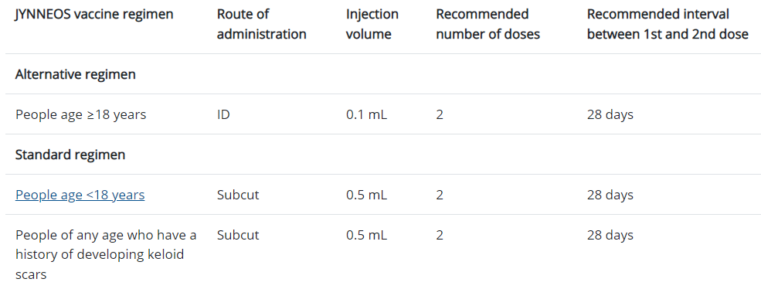
JYNNEOS Emergency Use Authorization (EUA)
EUA (8/9/22) for immunization of those at high risk for monkeypox infection:
18 years of age and older: should receive an intradermal injection. There are 2 exceptions to intradermal administration:
Those who have a contraindication to ID injection (e.g., those with a history of keloid formation or those unable to tolerate ID injections)
Those under 18 years of age
Under 18 years of age: should receive subcutaneous injection only
Notes:
An EUA was issued on August 9, 2022 for active immunization for individuals determined to be at high risk for monkeypox infection.
This EUA allows an alternative regimen for people aged 18 years and older to receive injection of 0.1 ml of Jynneos via an ID route, rather than the standard 0.5 ml given through the SQ route.
Results from a study in 2015 demonstrated that ID administration of the vaccine produced a similar immune response to SQ administration.
Standard subcutaneous injection is recommended for people under the age of 18 and for people of any age who have a history of developing keloid scars.

Slide 35
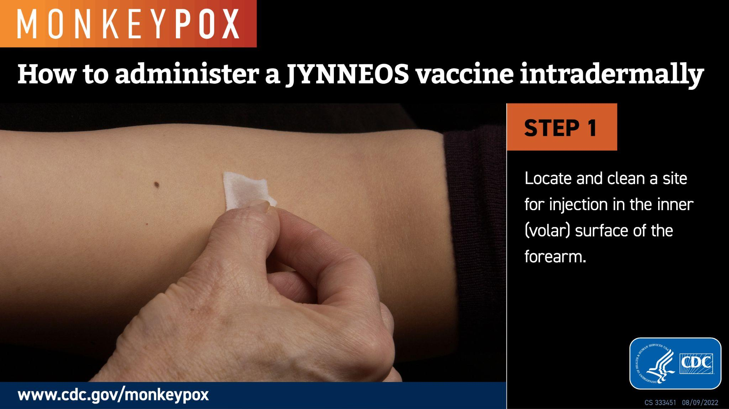
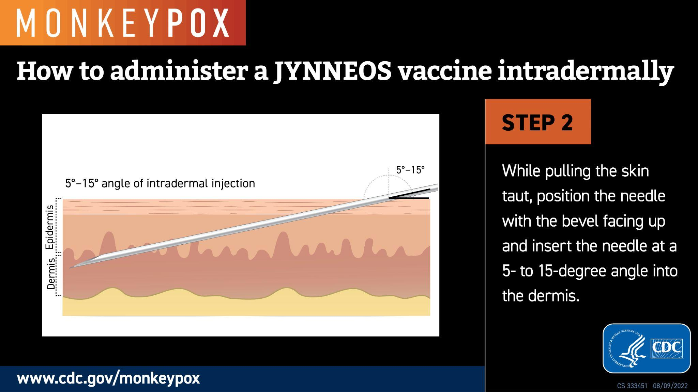
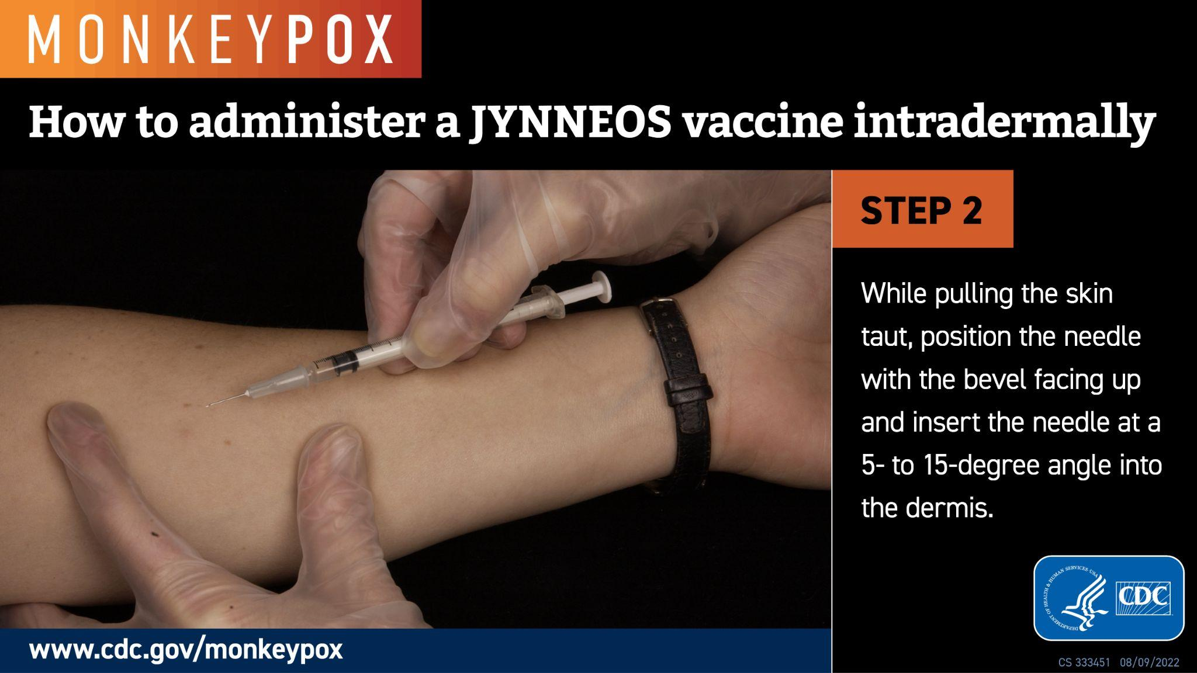
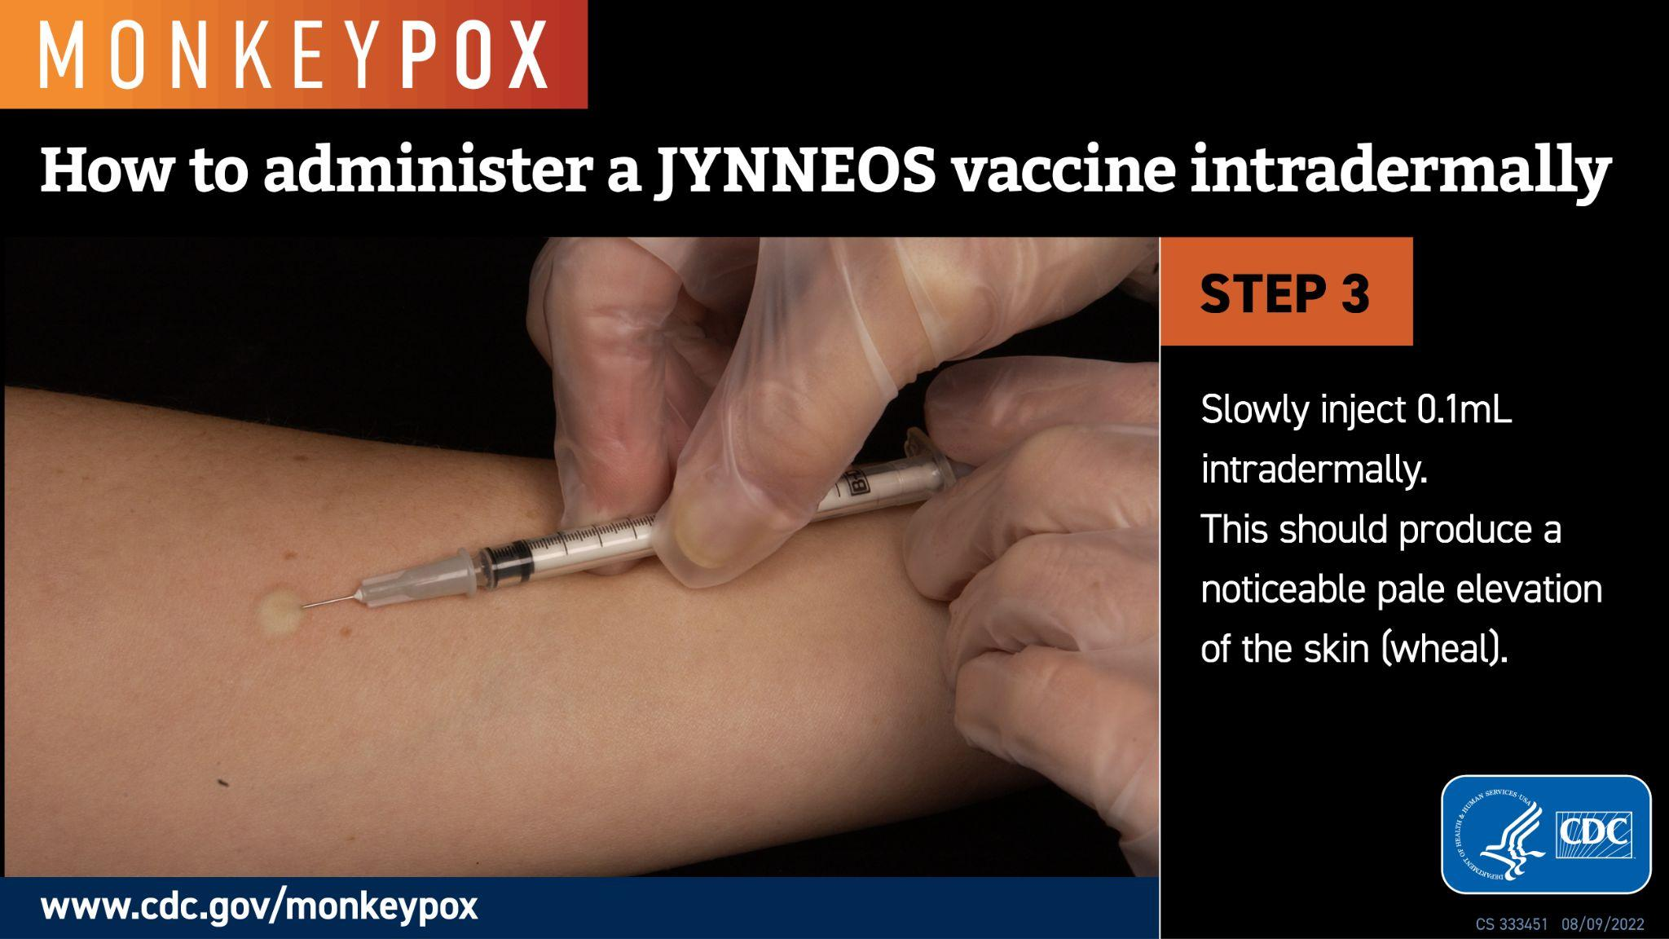
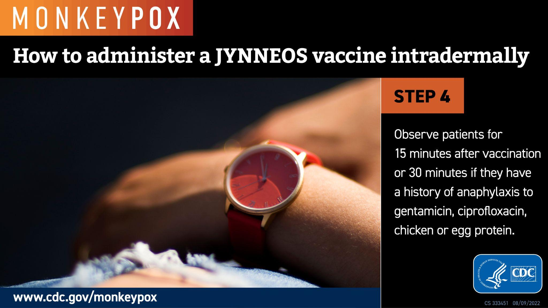
Vaccine Administration Intradermal JYNNEOS
ID administration: injecting vaccine between the epidermis & hypodermis layers of the skin, typically of the volar aspect (inner side) of the forearm
This should produce a noticeable pale elevation of the skin (wheal)
CDC PDF Training
YouTube ID Video
Notes:
These images demonstrate how to administer JYNNEOS vaccine intradermally.
Intradermal administration is the preferred route of administration for JYNNEOS vaccine.
With the ID route, people might be more likely to have redness that could last for several weeks and itching at the injection site than people who received the vaccine by the SQ route. Other vaccine reactions, like feeling tired, headache, or muscle aches, are expected to be similar for both routes.
Link to training video in slide.
When non-LHD providers come online and are providing vaccine, we should add either a new section or update this section to include related information:
In addition, CDC provides this additional guidance related to failed intradermal vaccine administrations:
ID administration, no wheal, and no leakage = valid dose
ID administration, no wheal and visible leakage = repeat ID dose at least 2 inches away from original dose
Two ID administrations with visible leakage = 3rd dose administered subq 0.5mL

Slide 36
Vaccine Effectiveness
Data not yet available on effectiveness of vaccines in current outbreak
Do not know duration of protection or if protection decreases over time
CDC is working with its partners to collect data on vaccine safety and vaccine effectiveness
Will know more in the coming months about how effective the JYNNEOS vaccine is in the 2022 monkeypox outbreak
Peak immunity is expected 14 days after the second dose of JYNNEOS and 4 weeks after vaccination with ACAM2000.
People who are vaccinated are encouraged to continue to take steps to protect themselves
Avoid close, skin-to-skin contact with people who have a rash that looks like monkeypox
Avoid contact with objects and materials that a person with monkeypox has used
Wash hands often
Notes:
Data are not yet available on the effectiveness of vaccines in the current outbreak
CDC working with its partners to collect data on vaccine safety and vaccine effectiveness
Peak immunity is expected to occur 14 days after the second dose of JYNNEOS, and 4 weeks after ACAM2000 vaccination. The duration of immunity after receipt of either vaccine is unknown.
People who are vaccinated are encouraged to continue to take steps to protect themselves
Interim Clinical Considerations for Use of JYNNEOS and ACAM2000 Vaccines during the 2022 U.S. Monkeypox Outbreak | Monkeypox | Poxvirus | CDC
Clinician FAQs | Monkeypox | Poxvirus | CDC

Slide 37
Traditional Post-Exposure Prophylaxis (PEP)
Goal is to vaccinate people following known exposure to help prevent illness or minimize severity of illness
Vaccine works best when given quickly after exposure
If given within 4 days of exposure: best chance to prevent onset of symptoms/disease
If given between 4 and 14 days of exposure: may reduce, but not prevent, symptoms
When coupled with self-isolation and other prevention measures, PEP important for preventing further transmission of monkeypox
If patient already diagnosed with monkeypox, PEP is not indicated
Notes:
The goal of traditional postexposure prophylaxis, or PEP, is to vaccinate people following a known exposure
Vaccine works best when given quickly after exposure

Slide 38
Expanded PEP (or PEP++)
Goal is to vaccinate people with certain risk factors who are more likely to have had recent exposure, even if they have not had a documented/confirmed exposure
Virginia recommended groups, effective 9/26/22
People, of any sexual orientation or gender, who have had anonymous or more than one sexual partner in the last two weeks; or
Sex workers of any sexual orientation or gender; or
Staff, of any sexual orientation or gender, at establishments or events where sexual activity occurs; or
Person of any sexual orientation or gender who is living with HIV/AIDS; or
Person of any sexual orientation or gender diagnosed with any sexually transmitted infection in the past three months.
Persons living with HIV or other immune-compromising conditions may be at higher risk for severe outcomes and should be a high priority for vaccination.
Virginia continues to evaluate categories eligible for Expanded PEP. Please check the VDH Healthcare Providers Vaccine Guidance Webpage for the latest guidance.
Notes:
People with certain risk factors are more likely to have been recently exposed to monkeypox. The goal of expanded PEP is to reach these people for postexposure prophylaxis, even if they have not had documented or confirmed exposure to someone with monkeypox.
These are the VDH recommended groups for expanded PEP, effective 9/26/2022.
These are in line with the CDC recommended groups for expanded PEP.

Slide 39
Pre-Exposure Prophylaxis (PrEP)
Goal with PrEP is to vaccinate people whose jobs might expose them to orthopoxviruses, such as monkeypox
At this time, CDC recommendation is that most clinicians and laboratorians are not advised to receive PrEP
The following groups may be eligible to receive PrEP based on CDC recommendations
Clinical lab personnel who perform testing to diagnose orthopoxviruses, including PCR assays to diagnose orthopoxviruses
Research laboratory workers who directly handle cultures or animals contaminated or infected with orthopoxviruses that infect humans
Certain designated healthcare and public health response team members for preparedness purposes (i.e. those who plan to administer ACAM2000)
Notes:
The goal with PrEP is to vaccinate people whose jobs might expose them to orthopoxviruses
At this time, CDC recommendation is that most clinicians and laboratorians are not advised to receive PrEP
CDC requires approval before administering vaccine for PrEP

Slide 40
Providers Wanting to Administer JYNNEOS
States get allocations based on underlying population who may benefit (i.e. HIV+, gay, bisexual, other men who have sex with men (MSM), eligible for HIV PrEP)
At this time, majority of vaccines will be available at local health districts and select community partners who are more likely to care for high risk individuals.
To enroll as a monkeypox vaccine provider, please complete the following:
Review the HHS Provider Agreement to understand requirements of Monkeypox vaccine providers and prepare to attest to these requirements.
Watch the following 7 minute video: VERIP (Virginia Electronic Registration for Immunization Programs) Training Video
Email the VaxMaX Help Desk at vaxmax_help@vdh.virginia.gov to declare intent to order and administer the monkeypox vaccines in accordance with the HHS Provider Agreement requirements. VaXMaX will provide next steps for attestation.
Review the following VDH resources that may be adapted to fit your practice site.
Consent Form Template
Intradermal Injection Training Resources
Standing Order Template
Vaccination Checklist
Vaccine Guide for Private Providers (VDH)
Report vaccine doses administered in VIIS; report adverse events to VAERS
HHS Monkeypox Vaccination Provider Agreement
VDH Vaccine Guidance for Healthcare Providers
Notes:
States get allocations of vaccine based on the number of cases reported and the underlying population who may benefit from vaccination
Majority of vaccines are available at local health districts and select community partners who are more likely to care for high risk individuals.
Providers should request vaccine through their local health district
All vaccine providers in Virginia must report any doses administered to the Virginia Immunization Information System (VIIS)..
Vaccine adverse events for monkeypox vaccines will be monitored through Vaccine Adverse Events Reporting System (VAERS).
In the future, will expand vaccine access to interested providers who will be able to order in VaxMax
Please see the instructions on the slide if you are interested in becoming a JYNNEOS provider

Slide 41
Resources: Vaccine
Helpful Clinician Resources:
Vaccine Administration Errors and Deviations
Vaccination Interim Guidance
Dosing Intervals
Vaccine Administration
Interchangeability of Dosing Regimens
JYNNEOS Coadministration with Other Vaccines
Patient Counseling
Vaccine Administration in Special Populations
Reporting of Adverse Events
General best practice guidelines for immunization
Clinician FAQs
Vaccine Resources:
JYNNEOS Package Insert
JYNNEOS Vaccine Information Statement (VIS)
JYNNEOS Storage and Handling Summary
JYNNEOS Standing Orders (Standard Regimen)
JYNNEOS Standing Orders (Alternative Regimen)
JYNNEOS Preparation and Administration Summary (Standard Regimen)
JYNNEOS Preparation and Administration Summary (Alternative Regimen)
FDA EUA Fact Sheet for Providers
FDA EUA Fact Sheet for Patients and Caregivers

Slide 42
Monkeypox Treatment and Patient Management
Notes:
42

Slide 43
Monkeypox Treatment Considerations
Many individuals infected have mild, self-limiting course
No treatment specifically approved for monkeypox virus infections, but antiviral drugs used for smallpox may be beneficial
Treatment may be considered in people with:
Severe disease (i.e., hemorrhagic disease, confluent lesions, sepsis, encephalitis, ocular or periorbital infections, or other conditions requiring hospitalization)
Involvement of anatomic areas which might result in serious sequelae (including scarring or strictures), including lesions directly involving the pharynx; penile foreskin, vulva, vagina, urethra, or rectum; anal lesions; and severe infections (including secondary bacterial skin infections)
High risk of severe disease (i.e., immunocompromising conditions including HIV/AIDS, patients <8 years of age, pregnant/breastfeeding, people with a condition affecting skin integrity, such as atopic dermatitis)
CDC Treatment Information for Healthcare Professionals
Notes:
Many individuals infected have mild, self-limiting course.
There is no treatment specifically approved for monkeypox. However, there are several treatment options available that can be considered for certain individuals.
These are the indications for treatment with TPOXX. It may be considered for treatment in people with severe disease, those who have involvement of anatomic areas which might result in serious sequelae, and those at high risk of severe disease. For patients at high risk for progression to severe disease, treatment should be administered early in the course of illness along with supportive care and pain control.
Involvement of anatomic areas which might result in serious sequelae that include scarring or strictures: lesions of the pharynx causing dysphagia, inability to control secretions, or need for parenteral feeding; penile foreskin, vulva, vagina, urethra, or rectum with the potential for causing strictures or requiring catheterization; anal lesions interfering with bowel movements (for example, severe pain); and severe infections (including secondary bacterial skin infections), especially those that require surgical intervention such as debridement.
Skin conditions can include conditions such as atopic dermatitis, eczema, burns, impetigo, varicella zoster virus infection, herpes simplex virus infection, severe acne, severe diaper dermatitis with extensive areas of denuded skin, psoriasis, or Darier disease (keratosis follicularis)
CDC Treatment Information for Healthcare Professionals: cdc.gov/poxvirus/monkeypox/clinicians/treatment.html
CDC Clinical Recognition: cdc.gov/poxvirus/monkeypox/clinicians/clinical-recognition.html

Slide 44
Treatment Options
Tecovirimat (TPOXX) is the preferred antiviral treatment
Can be accessed through the federal government’s Strategic National Stockpile under an Expanded Access-IND protocol
Treatment Option | Indication | Formulations Available
Tecovirimat (TPOXX or ST-246) *antiviral | Per EA-IND, for patients with laboratory confirmed non-variola orthopoxvirus infection or suspected infection based on known exposure(s) and/or clinical manifestations of disease | Oral (200 mg capsule)* Injection for intravenous administration *ability to mix with semi-solid food for pediatrics < 13 kg
Cidofovir (Vistide) *antiviral | FDA approved for treatment of cytomegalovirus retinitis in patients with AIDS | Intravenous infusion single-unit vial
Vaccinia Immune Globulin Intravenous (VIGIV) | FDA licensed for treatment of complications due to vaccinia vaccination | Intravenous infusion single-dose vial
Brincidofovir (Tembexa) *antiviral | FDA approved for the treatment of smallpox in adults and pediatrics, including neonates *Not currently available, but CDC is currently developing an EA-IND | Oral (100 mg tablet or 10 mg/mL suspension)
Notes:
TPOXX is the preferred treatment option for monkeypox. CDC allows pre-positioning of TPOXX, which is not the case for the other treatment options listed.
Please note that brincidofovir is not currently available, but CDC is currently developing an EA-IND.
Please note that TPOXX can be started in a patient with suspected disease who meets criteria without waiting for laboratory confirmation.
Clinicians should Instruct patients with suspected monkeypox infection to isolate themselves and avoid close contact with other people and animals, including pets. Patients who do not require hospitalization, but who are potentially infectious to others, should be isolated at home. (See When a patient is isolating in their home, what should they do?)
For more information, refer to
CDC’s Interim Clinical Guidance for the Treatment of Monkeypox (https://www.cdc.gov/poxvirus/monkeypox/clinicians/treatment.html)
CDC’s Tecovirimat website (https://www.cdc.gov/poxvirus/monkeypox/clinicians/Tecovirimat.html)
CDC’s Obtaining and Using TPOXX (Tecovirimat) (https://www.cdc.gov/poxvirus/monkeypox/clinicians/obtaining-tecovirimat.html)
VDH’s Monkeypox Medical Countermeasure Distribution and Dispensing Guide for Local Health Districts (https://vdhweb.vdh.virginia.gov/surveillance-and-investigation/wp-content/uploads/sites/26/2022/06/Monkeypox-Medical-Countermeasures-Guide.pdf)
FDA’s websites for each treatment (links in table)
44

Slide 45
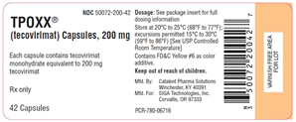
TPOXX Treatment
TPOXX is FDA-approved treatment of smallpox in adults and children
Data on effectiveness in treating monkeypox infections in humans are not available
Animal studies showed drug effective in treating disease caused by orthopoxviruses
A case series of individuals infected with Monkeypox virus, which included one patient treated with tecovirimat, suggests that tecovirimat may shorten the duration of illness and viral shedding (Lancet 2022)
Clinical trials in people showed drug was safe and had only minor side effects
Common adverse reactions with oral treatment: headache (12%), nausea (5%), abdominal pain (2%), and vomiting (2%)
Drug-drug interactions have been reported with repaglinide (hypoglycemia) and midazolam (decreased effectiveness of midazolam).
If there is an appropriate clinical indication, empiric treatment can be considered prior to laboratory confirmation, especially in the context of limited or delayed testing.
cdc.gov/poxvirus/monkeypox/clinicians/treatment.html
Notes:
TPOXX is approved to treat smallpox in adults and children under FDA’s Animal Rule, but it is not approved to treat monkeypox.
TPOXX can be initiated for patients with laboratory confirmed non-variola orthopoxvirus infection or suspected infection based on known exposure(s) and/or clinical manifestations of disease.
Patients with an initial negative OPXV test, but for whom both epidemiologic and clinical evidence suggests OPXV disease (particularly if clinical progression is worsening), should be re-tested but be treated with tecovirimat while results are pending. If results from re-testing confirm orthopoxvirus, patients should continue tecovirimat treatment. If results from re-testing are in agreement with the initial negative orthopoxvirus results, tecovirimat should be suspended in those patients.
Healthcare providers should not prescribe TPOXX to people with milder monkeypox symptoms. If prescribed too often to people with milder monkeypox symptoms, it may increase the chance that the monkeypox virus develops resistance to the medication.
Data are not available on effectiveness of TPOXX in treating monkeypox infections in humans.
Animal studies showed effective in treating disease caused by orthopoxviruses, when given early in the disease course.
Clinical trials in people showed drug was safe and had only minor side effects. Commonly reported adverse reactions with oral treatment included headache (12%), nausea (5%), abdominal pain (2%), and vomiting (2%).
A case series of individuals infected with Monkeypox virus, which included one patient treated with tecovirimat, suggests that tecovirimat may shorten the duration of illness and viral shedding (Lancet 2022)
Available to treat monkeypox under CDC’s expanded access protocol
TPOXX is available as a pill or an injection
Drug absorption of oral formulation is dependent on adequate concurrent intake of a full, fatty meal.
For children who weigh less than 28.6 pounds, the capsule can be opened, and medicine mixed with semi-solid food. The entire mixture should be administered within 30 minutes of its preparation.
CDC MMWR Clinical Use of Tecovirimat (Tpoxx) for Treatment of Monkeypox Under an Investigational New Drug Protocol — United States, May–August 2022: Among 549 patients with Monkeypox virus infection treated with tecovirimat under an Expanded Access Investigational New Drug protocol, 99.8% received it orally as an outpatient. Among 369 patients, few adverse events were reported.
The median interval from initiation of tecovirimat to subjective improvement was 3 days and did not differ by HIV infection status. No control group was available for comparison; therefore, no conclusions can be drawn regarding the effectiveness of tecovirimat to treat monkeypox based on these data.
Adverse events were reported for 12 (3.5%) of 340 patients with information on adverse events; these included headache (three), nausea (two), visual disturbance (two), weakness (two), and hospitalization for psychiatric reasons.
Image source: https://aspr.hhs.gov/monkeypox/TPOXXOperationalGuidance/Pages/TPOXX-tecovirimat.aspx
CDC Treatment Information for Healthcare Professionals
CDC Guidance for Tecovirimat Use Under Expanded Access Investigational New Drug Protocol during 2022 U.S. Monkeypox Cases
Expanded Access IND Protocol: Use of Tecovirimat (TPOXX®) for Treatment of Human Non-Variola Orthopoxvirus Infections in Adults and Children

Slide 46
Considerations with TPOXX
Clinicians and patients should understand:
Lack of tecovirimat effectiveness data in people with monkeypox
Lack of data indicating which patients might benefit the most
Concern for the development of resistance which could render the drug ineffective for any treated patients
Recent FDA data suggest there may be a low barrier to virus developing resistance to tecovirimat
Indiscriminate use could promote resistance
Alternate therapeutics have more concerning safety profiles than tecovirimat.
.cdc.gov/poxvirus/monkeypox/clinicians/Tecovirimat.html
Notes:
Clinicians and patient should be aware of and understand the following issues related to prescribing and taking TPOXX.

Slide 47
Step-by-Step Instructions for TPOXX Treatment
The following steps are required to obtain and initiate TPOXX treatment:
Have the patient sign the Informed Consent Form (English, other languages)
Complete the VDH TPOXX Provider Treatment Initiation Interest Form that includes details on shipping to patient, provider office, or provider office for provider dispensement (labels drug)
Submit to CDC by email (regaffairs@cdc.gov) within 7 days of initiating treatment:
Patient Intake Form - required for each individual prescription
FDA Form 1572 - only 1 signed form per facility
Complete the TPOXX Inventory & Patient Initiation Survey for all patients who are started on TPOXX
Report any life-threatening or serious adverse events associated with TPOXX by sending a completed MedWatch Form to regaffairs@cdc.gov within 72 hours of awareness
Notes:
These steps are required for a provider to obtain and initiate TPOXX treatment.

Slide 48
Guidance and Supportive Care for Patients
Educate patients on the natural course of monkeypox illness and isolation/prevention practices.
While most patients with monkeypox have a mild, self-limited course, all patients should be assessed and given supportive care for management of their symptoms.
Symptoms should be addressed early in management.
Supportive care includes maintenance of fluid balance, pain management, treatment of bacterial superinfections, co-occurring sexually transmitted infections, or superimposed bacterial skin infections.
Supportive care may require hospitalization in patients with dehydration, severe pain, or complications.
nyc.gov/assets/doh/downloads/pdf/cd/monkeypox-treatment-guidance-interim.pdf
Notes:
While most patients with monkeypox have a self-limited course, all patients should be assessed and given supportive care for management of their symptoms.
Supportive care includes maintenance of fluid balance, pain management, treatment of bacterial superinfections or co-occurring sexually transmitted or superimposed bacterial skin infections.
Providers should give detailed guidance on supportive care and address these symptoms early to prevent hospitalizations.
Additional details
Monkeypox patients could benefit from clinical support to lessen the consequences of compromised skin and mucosa.
This should include prevention and treatment of secondary bacterial infections (and other complications), ensuring hydration and nutrition, and protecting vulnerable anatomical locations such as the eyes and genitals.
Skin lesions should be kept clean and dry when not showering or bathing to prevent bacterial superinfection.
Warm oatmeal baths can also reduce itching and pain.
For oral lesions, patients can rinse their mouths with salt water at least four times per day.
Alcohol-free oral antiseptics (such as Listerine Zero Alcohol and chlorhexidine mouthwash) can be used to keep lesions clean.
For pain, patients can suck on ice chips or ice pops, or use compounds such as “magic” or “miracle” mouthwashes (prescription solutions used to treat mucositis).
Topical treatments such as patches (for example, Dentemp Canker Covers) and benzocaine or lidocaine gels can be used for temporary relief, especially to facilitate eating and drinking, but should be limited to recommended doses.
For painful genital and anorectal lesions, warm sitz baths lasting at least 10 minutes several times per day may be helpful.
Topical benzocaine or lidocaine gels or creams at the recommended doses may provide temporary relief.
Proctitis can occur with or without internal or external lesions and, though often manageable with appropriate supportive care, can progress to become severe and debilitating.
Stool softeners such as docusate should be initiated early. Sitz baths are also useful for proctitis and may calm inflammation.
Topical anesthetics such as dibucaine ointment, often used for hemorrhoids, and lidocaine gel have been effective for temporary relief.
Please refer to NYC Health’s Interim Guidance for Treatment of Monkeypox for specific treatment steps and tools, including detailed information on pain management for lesions in various locations. Additional information for patients - CDC What to Do If You Are Sick

Slide 49
Clinical Considerations for Pain Management
Healthcare professionals should assess pain in all patients with monkeypox virus infection and recognize that substantial pain may exist from mucosal lesions not evident on physical exam.
Topical and systemic strategies should be used to manage pain.
General pain control: OTC medications (e.g., acetaminophen, NSAIDs)
Local pain control: Topical steroids and anesthetics such as lidocaine
Topical lidocaine or other topical anesthetics should be used with caution on broken skin or on open or draining wounds.
Prescription pain meds such as gabapentin and opioids have been used for short-term management of severe pain. Consider the risks/benefits.
Appropriate pain control may require hospitalization.
CDC Clinical Considerations for Pain Management of Monkeypox
Notes:
Monkeypox can commonly cause severe pain and can affect vulnerable areas, including the genitals and oropharynx, which can lead to other complications.
Genital and mucosal lesions can be associated with pain out of proportion to their appearance.
Use of opioids for pain control should be balanced against the risk of side effects such as constipation and other risks such as potential for unintended long-term use of opioids, development of an opioid use disorder, and overdose.
If opioids are prescribed, immediate-release opioids at the lowest effective dose should be prescribed for no longer than the expected duration of pain severe enough to require opioids.
References:
Clinical Considerations for Pain Management of Monkeypox
CDC What to Do If You Are Sick

Slide 50
Management of Rash and Skin Lesions
Instruct patients to monitor for any increased redness, warmth, or purulence around lesions and seek care if these develop.
Puritis: Oral antihistamines; Topical agents such as calamine lotion, petroleum jelly, or colloidal oatmeal
Oropharyngeal lesions: Clean saltwater gargle four times a day, oral antiseptic (e.g., chlorhexidine mouthwash), local anesthetic (e.g., viscous lidocaine), and prescription analgesic mouthwash (sometimes called “magic mouthwash”)
Genital/ anorectal lesions: Warm sitz baths, for 10 minutes several times a day. Adding Epsom salt, vinegar, or baking soda to the water may be helpful.
Sitz baths should be drained and disinfected after use to mitigate risk of autoinoculation or person to person transmission.
Notes:
Skin lesions should be kept clean and dry when not showering or bathing to prevent bacterial superinfection.
For oral lesions: for temporary relief, can consider topical treatments such as patches (for example, Dentemp Canker Covers) and benzocaine or lidocaine gels. Should limited to recommended doses.
For Genital/ anorectal lesions: for temporary relief, can consider topical benzocaine or lidocaine gels or creams
Patients will have to watch for symptoms like blood in their urine, difficulty urinating, phimosis (unable to retract their foreskin), or paraphimosis (foreskin cannot return to its normal
position after being retracted)
Clinician resource: CDC Clinical Considerations for Pain Management of Monkeypox
Interim Guidance for Treatment of Monkeypox (nyc.gov)
Patient resource: CDC What to Do If You Are Sick

Slide 51
Resources: Treatment
CDC Treatment Information for Healthcare Professionals
CDC Clinical Considerations for Pain Management of Monkeypox
CDC Guidance for Tecovirimat Use Under Expanded Access Investigational New Drug Protocol during 2022 U.S. Monkeypox Outbreak
CDC Information for Healthcare Providers on Obtaining and Using TPOXX (Tecovirimat) for Treatment of Monkeypox
CDC Clinical Considerations for Treatment and Prophylaxis of Monkeypox Virus Infection in People with HIV
CDC What To Do If You Suspect Monkeypox
CDC can assist physicians in the diagnosis and management of patients with suspected or confirmed monkeypox. If VIGIV or antivirals are needed, or additional information is required, physicians should contact the CDC Emergency Operations Center at 770-488-7100, Monday through Friday 8 AM to 4:30 PM Eastern Standard Time; at other times call (404) 639-2888.

Slide 52
Thank you for your attention!
Questions?
Notes:
52

