Slide 1

Walk-in Clinic Provider Huddle STOP Syphilis A regional action plan to end syphilis Susan Girois, MD MPH FACP Director, Norfolk Department of Public Health susan.Girois@vdh.virginia.gov September 17, 2024
Notes:
Oana

Slide 2

Overview
Case Study
Eastern Region Syphilis Epidemiology
STOP Syphilis: A regional action plan to end syphilis
Syphilis 101, Testing and Treatment
Discussion
Notes:
Chris

Slide 3
Case study (Lopes Almeida Gomes, L et al. Two-Stage Syphilis Testing. JAMA.2024;332(4):331-332)
A 54-year-old woman was evaluated for a rash on her face, trunk, arms, and proximal thighs that developed 10 months prior to presentation. She had arthralgias and fatigue and reported transient oral ulcers on her buccal mucosa.
The patient had false-positive syphilis test results during 2 pregnancies, 25 and 22 years prior, based on a positive blood rapid plasma regain (RPR) test result (titer, 1:2 [reference, nonreactive]) and negative fluorescent tremonemal antibody (FTA-ABS) test result.
On presentation, she had erythematous annular and indurated plaques on her face, trunk, and extremities. Laboratory testing revealed an RPR titer of 1:1024.
The patient was not taking any new prescriptions or OTC medications and did not use herbal supplements. She had no history of STIs and was sexually active with 1 male partner for the past 12 months.

Slide 4


Slide 5
Eastern Region Syphilis Epidemiology Data in Virginia - Syphilis
Notes:
Oana

Slide 6
BLUF (bottom line up front):
Drop in testing for syphilis
Treatment and partner notification challenges
Increasing rates of early syphilis and congenital syphilis
Increasing rates in all demographics

Slide 7
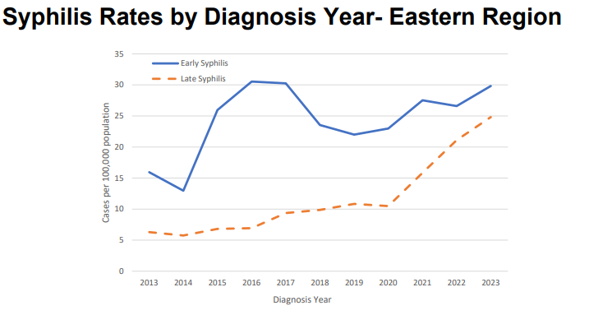

Slide 8
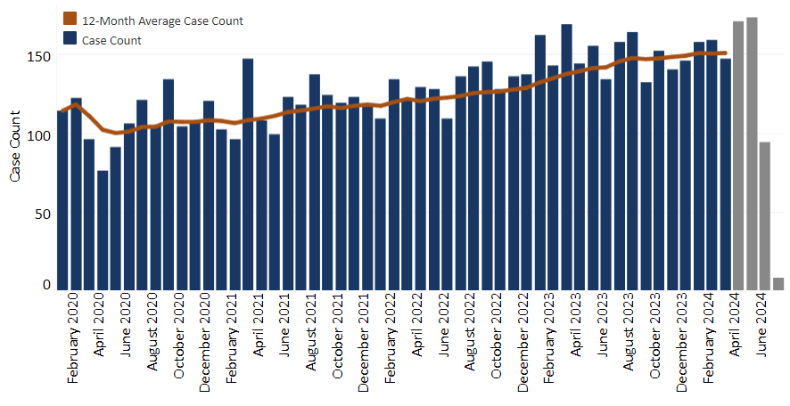
Current Situation Overview: Case Count
As of 7/18/24, there were 954 early
syphilis cases diagnosed and
reported to VDH in CY24.
* Shaded area of the graph indicates case counts are incomplete due to reporting delays. Source: dashboard last updated 7/21/2024: https://www.vdh.virginia.gov/syphilis/data-in-virginia
Notes:
Oana
Monthly counts of total early syphilis (TES) cases are based on date of diagnosis. Data for the most recent three months (shown as gray bars in the chart) represent incomplete data due to ongoing case investigations.

Slide 9
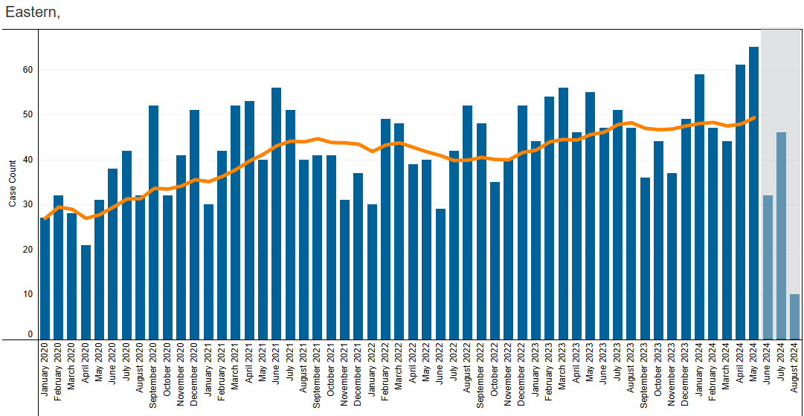
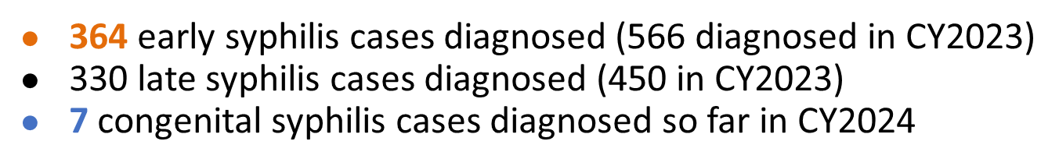
Eastern Region
Chesapeake
Eastern Shore
Hampton/Peninsula
Norfolk
Portsmouth
“Three Rivers”
Western Tidewater
Virginia Beach
As of 7/18/24:

Slide 10
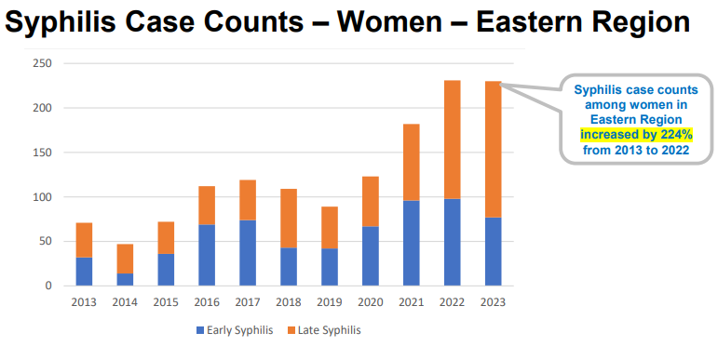

Slide 11
Over the past 5+ years:
YoY increase in incidence of early syphilis
YoY increase in cases among women
YoY increase in teens (15-19 yo) and older adults (50 – 65+ yo)
YoY increase in people self-reporting substance use
YoY increase among people living with HIV
Increasing reports of neurological/ocular/otic manifestations
Notes:
Oana

Slide 12
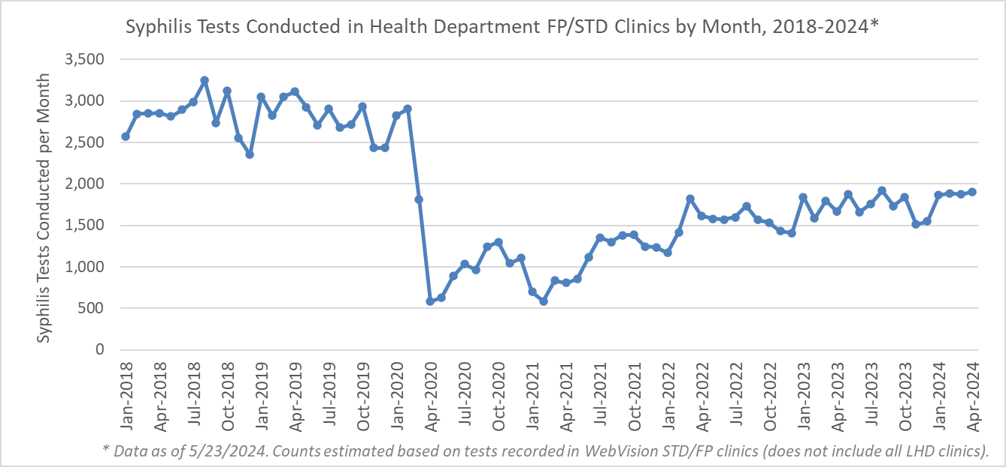
VDH testing over the past five years:
Notes:
Bryan

Slide 13
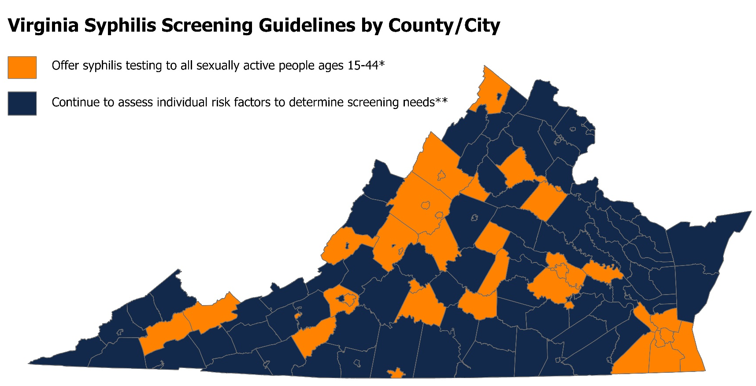
49
Alleghany County | Fluvanna County | Roanoke County | Rockingham County
Augusta County | Frederick County | Newport News City | Russell County
Buena Vista City | Fredericksburg City | Norfolk City | Spotsylvania County
Campbell County | Greene County | Petersburg City | Staunton City
Chesapeake City | Hampton City | Portsmouth City | Suffolk City
Chesterfield County | Harrisonburg City | Prince Edward County | Tazewell County
Culpeper County | Henrico County | Radford City | Virginia Beach City
Cumberland County | Lynchburg City | Richmond City | Waynesboro City
Danville City | Nelson County | Roanoke City
Floyd County | New Kent County | Rockbridge County
* Also: test during pregnancy in the third trimester and at delivery
Notes:
Bryan

Slide 14
So what are we doing about it?

Slide 15
Aims of the Eastern Region STOP Syphilis initiative In the next 5 years, reduce the incidence of syphilis in all demographics. In the next 2 years, eliminate congenital syphilis.
* Co-led by VDH and the M. Foscue Brock Institute for Community and Global Health
Notes:
Oana

Slide 16
An ecosystem of partners who meet and act…
Improve access to data for all stakeholders utilizing data sets and a regional dashboard
Increase testing for sexually active people throughout the region
Strengthen case management and partner services
Build community awareness and access to information and testing (April 2025 campaign)
* Co-led by VDH and the M. Foscue Brock Institute for Community and Global Health
Notes:
Oana

Slide 17
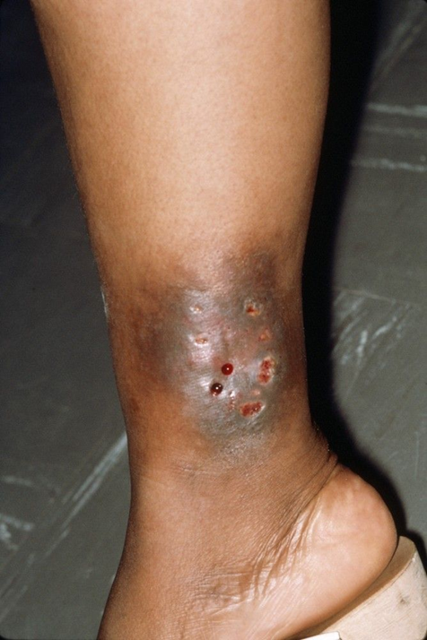
Syphilis 101 (1/2) – T. pallidum
Stages:
Primary – chancre
Secondary – skin rash, mucocutaneous lesions, lymphadenopathy
Tertiary – cardiac involvement, gummatous lesions, tabes dorsalis, general paresis
Latent infections (i.e. lacking clinical manifestations) are detected by serologic testing.
Early latent – < 1 year
Late latent – > 1 year or unknown duration
Stages guide treatment and follow-up.

Slide 18
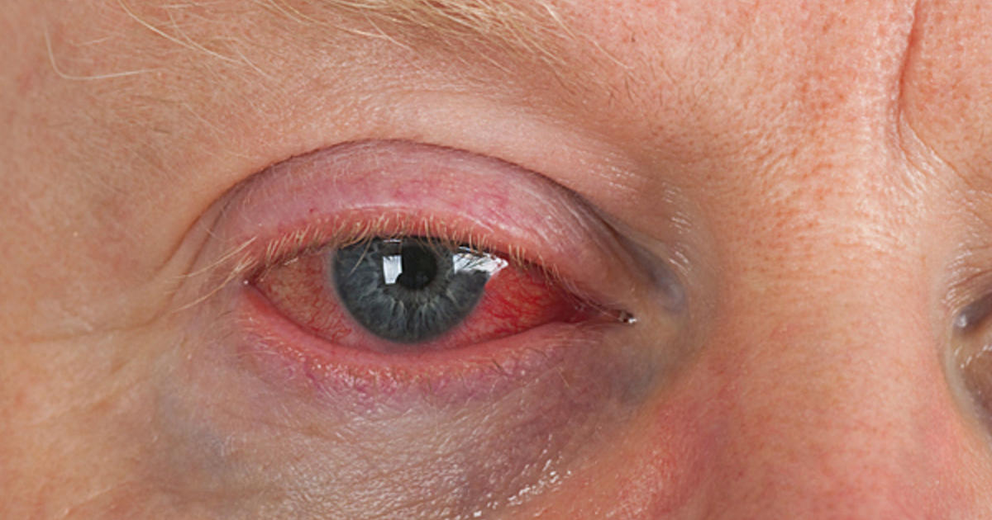
Syphilis 101 (2/2)
Neurosyphilis can occur at any stage
Syphilitic meningitis (early) – CN dysfunction, meningitis, stroke, AMS change
Late neurologic manifestations (tabes dorsalis, general paresis) – 10 to >30 years after infection
Ocular syphilis (early)
Panuveitis, conjunctivitis, anterior uveitis, optic neuropathy, retinal vasculitis.
Can result in permanent vision loss.
Otosyphilis
Cochleo-vestibular symptoms (tinnitus, vertigo, sensorineural hearing loss).
Hearing loss is unilateral or bilateral, sudden onset, progresses rapidly.
Can result in permanent hearing loss.
Notes:
Early neurosyphilis
Early forms of neurosyphilis include:
Asymptomatic neurosyphilis (ANS): This form doesn’t cause any neurological symptoms. It occurs before you develop symptoms of syphilis, too. Healthcare providers diagnose this form when a cerebrospinal fluid (CSF) analysis finds evidence of syphilis but you don’t have symptoms. If you have syphilis and don’t receive treatment, ANS generally occurs between the first few weeks to the first few years of getting the infection.
Meningeal neurosyphilis: This form happens when the syphilis bacteria cause inflammation of your meninges — the three layers of tissue that protect your brain and spinal cord. It causes symptoms such as headache, nausea and vomiting. If you have syphilis and don’t receive treatment, this form can occur within the first few months to several years after infection.
Meningovascular neurosyphilis: This form happens when the syphilis bacteria cause inflammation of your meninges arterial walls (endarteritis). This causes thrombosis (when blood clots block veins or arteries) and obstructs blood flow to brain tissue. It causes a variety of issues, including stroke. If you have syphilis and don’t receive treatment, this form can develop within the first few months to several years after infection.
Late neurosyphilis
Late neurosyphilis (parenchymal) forms include:
General paresis: This form happens due to chronic inflammation of your meninges (meningoencephalitis), resulting in a breakdown of brain tissue. It causes a variety of psychological symptoms and conditions. Early symptoms include mood disturbances and personality changes. If you have syphilis and don’t receive treatment, this form can occur three to 30 years after the initial infection.
Tabes dorsalis: This is the most severe form of neurosyphilis. It results from the breakdown of the posterior (dorsal) column and roots of your spinal cord. It causes a variety of symptoms, including movement issues, nerve pain and bladder dysfunction. If you have syphilis and don’t receive treatment, tabes dorsalis can occur anywhere from five to 50 years after infection.

Slide 19
Two-Stage Syphilis Testing
Nontreponemal tests (NTT) – RPR, VDRL – provide titer that reflects activity of the syphilitic infection, monitors treatment.
Treponemal tests (TT) – FTA-ABS, TP-PA, TP-EIA, CIA – greater specificity than NTT, can be positive for life, do not differentiate between treated and untreated syphilis infections.
Two-step testing for syphilis should be performed using:
NTT → TT (traditional algorithm)
TT → NTT (reverse algorithm)
Point-of-care (POC) testing for syphilis (and HIV) – fingerstick, 20 minutes. Positive POC result should have NTT titer testing to monitor treatment.
CDC Laboratory Recommendations for Syphilis Testing, United States, 2024 | MMWR
Notes:
RPR – Rapid plasma regain
FTA-ABS – fluorescent treponemal antibody
POC often combined with HIV rapid test

Slide 20
Syphilis treatment and DoxyPEP
2.4 million units of benzathine penicillin G (Bicillin)
or
Doxycycline 100mg BID for 14 days
(non-pregnant)
* Stages guide treatment and follow-up.
* If treatment cannot be provided at the time the testing, there should be a plan in place for linkage to treatment and follow up.
DoxyPEP - self-administration of 200 mg of doxycycline within 72 hours of sex to prevent transmission of syphilis, chlamydia, gonorrhea

Slide 21
Special considerations
Pregnancy → immediate treatment, referral for pre-natal care
Neurologic symptoms → urgent specialist evaluation → IV therapy
Required reporting → Confidential Morbidity Report (virginia.gov)
Collaboration with the local health department
Healthcare Providers - Syphilis (virginia.gov)

Slide 22
Collaboration with the local health department
Specialized STI testing and treatment – community outreach, confirmatory testing, treatment, counseling, case management, partner services, DoxyPEP, HIV PrEP
VDH Disease Intervention Specialist (DIS) - highly trained public health professionals that primarily work with STIs.
Specialized in public health investigations, case management and analysis, provider and community engagement, and outbreak detection/response.
Use contact tracing and case investigation, i.e. identifying and supporting people who may have been infected and/or exposed to an individual with syphilis or HIV.
Extensive database access: VEDSS, Webvision, eHARS, Maven, LabCorp, Sentara EPIC, and LexisNexis (DIS Supervisor).
VDH Disease Prevention Hotline – Toll free at (800) 533-4148 or by email at hiv-stdhotline@vdh.virginia.gov.

Slide 23
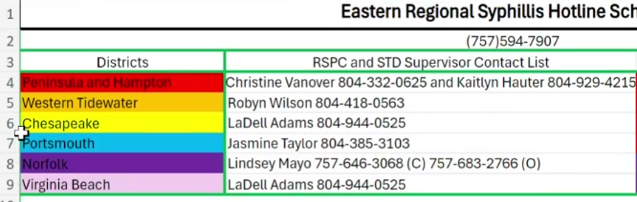
Eastern Region VDH DIS contacts

Slide 24

Let’s do it. Sexually Transmitted Infections Treatment Guidelines, 2021 | MMWR (cdc.gov)

