Slide 1

EMS Advisory Board
New Board Member Orientation

Slide 2
Who We Are
28 Governor appointees
Stakeholder groups
  American Academy of Pediatrics
  Virginia Ambulance Association (VAA)
  American College of Surgeons
  Associated Public Safety Communications Officers (APCO)
  Consumer
  Medical Society of Virginia
Notes:
Give acronym list

Slide 3
Who We Are
Stakeholder groups (continued)
  Regional EMS Councils (11)
  Virginia Association of Counties (VACO)
  Virginia Association of Governmental EMS Administrators (VAGEMSA)
  Virginia Association of Volunteer Rescue Squads (VAVRS)
  Virginia Chapter of the International Association of Fire Fighters (VPFF)

Slide 4
Who We Are
Stakeholder groups (continued)
  Virginia College of Emergency Physicians
  Virginia Emergency Nurses Association / Virginia Nurses Association
  Virginia State Firefighters Associations (VSFA)
  Virginia Fire Chief’s Association (VFCA)
  Virginia Hospital & Healthcare Association (VHHA)
  Virginia Municipal League (VML)

Slide 5
What We Do
Formal liaison between OEMS and the public
Provides advice and counsel regarding methods and procedures for planning, developing and maintaining a statewide emergency medical services (EMS) system to the OEMS and the State Board of Health (BoH)

Slide 6
What We Do
Advise on administration of Title 32.1, Chapter 4, Article 2.1 of the Code of Virginia
Review & revise the statewide EMS plan
Review annual VAVRS report
Review status reports regarding the statewide EMS system
  Financial Assistance Review Committee (FARC)
  Rescue Squad Assistance Fund (RSAF)
  Regional EMS councils

Slide 7
What We Do
Provide EMS system information to the Governor, state legislators, local officials, and citizens
Prepare annual report of activities for submission to OEMS, the State BoH, State Health Commissioner and the Governor
Recommend from the EMS Community an EMS Representative to the State BoH
Perform other duties as assigned

Slide 8
How We Do It
Collaboration and coordination
  With your stakeholder group
  With other Board members
  With OEMS staff
EMS Advisory Board Meetings
  Quarterly
  Location: Three in Richmond area; One in Norfolk (EMS Symposium)
  1:00 pm start time
  No proxy votes

Slide 9
Rules of Procedures
Bylaws
Roberts Rules
Form for Motions
  Motions from Committees
  Motions from Board members
Notes:
Hand out by-laws & motion form

Slide 10

Member Expectations
Code of Ethics
Freedom of Information Act (FOIA)
Meeting Attendance
  OEMS Quarterly Report
Committee Participation
  Participate with a minimum of one committee

Slide 11
Member Expectations
Annual Financial Disclosure Statement
Expenses
  Lodging – master account
  Eligible for reimbursement
    Per Diem
    Mileage

Slide 12

Board Structure
Board Officers
  Chair
  Vice-Chair
  Five coordinators
Elected annually in November

Slide 13

Coordinators & Committees
Executive Committee of Board Officers
Financial Assistance Review Committee (FARC)

Slide 14
Coordinators & Committees
Administrative Coordinator
  Rules and Regulations Committee
  Legislative and Planning Committee
Infrastructure Coordinator
  Transportation Committee
  Communication Committee
  EMS Emergency Management Committee

Slide 15
Coordinators & Committees
Patient Care Coordinator
  Medical Direction Committee
  Medevac Committee
  EMS for Children (EMSC)
Professional Development Coordinator
  Training and Certification Committee
  Workforce Development Committee
  Provider Health and Safety Committee

Slide 16
Coordinators and Committees
Trauma System Coordinator
- Trauma Administrative and Governance
- System Improvement
- Injury and Violence Prevention
- Prehospital Care
- Acute Care
- Post-Acute Care

Slide 17
Organization Chart
EMS Advisory Board
Financial Assistance
Review Committee (FARC)
EMS Advisory Board
Chair
Ad Hoc Committees
Nomination
By-Laws
Others as Needed
Executive Committee
Individual Board
Members

Slide 18
EMS Advisory Board Org. Chart
Executive
Committee
Chair
Vice Chair
Administrative
Coordinator
Rules & Regulations
Committee
Legislative &
Planning
Committee
Infrastructure
Coordinator
Transportation
Committee
Communications
Committee
Emergency
Management
Committee
Patient Care
Coordinator
Medical Direction
Committee
Medevac
Committee
Trauma System
Oversight & Mgmt
Committee
EMS for Children
Professional
Development
Coordinator
Training &
Certification
Committee
Workforce
Development
Committee
Provider Health &
Safety Committee
BOH
Representative

Slide 19
Tools to Help You
Web site - http://www.vdh.virginia.gov/oems
  Vast information
  Board contact and meeting information
  OEMS Staff contact information
  Resources (State EMS Plan, Rules & Regs, etc.)
  Links
OEMS staff members
Board members
Quarterly reports

Slide 20
Questions?

Slide 21
Public Information and Education

Slide 22
Public Information and Outreach
Our goal is to increase awareness of OEMS through the distribution of public information, and to provide clear and concise messages about its programs to key stakeholder groups.
  EMS agencies and providers
  Local governments
  EMS organizations (VAGEMSA, VAVRS, etc.)
  Regional EMS Councils
  Fire services (Department of Fire Programs, VSFA, etc.)
  Governor’s EMS Advisory Board
  Trauma centers, ERs, emergency nurses and physicians

Slide 23
VDH Office of Risk Communication and Education
The OEMS Public Relations (PR) Coordinator is part of the VDH Office of Communications (COMO)
  The OEMS PR Coordinator holds a dual role, representing the OEMS and COMO team.
  The COMO team, comprised of seven Public Information Officers (PIOs), works together to provide updates in each of the PIOs respective health regions/offices, pertaining to upcoming events, projects, etc. We regularly collaborate on VDH projects and team assignments, including the commissioner’s email, social media, VDH in the News, Media Alerts, Clinician Letters, etc.
  In times of crisis we all work together, on behalf of VDH, to respond to public health emergencies (i.e. H1N1, COVID-19) and to provide PR support at the Virginia Department of Emergency Management’s Joint Information Center (JIC).
  The OEMS Public Relations Assistant’s primary job duties fall within the OEMS. However, this role also assists with COMO on Clinician Letters, Media Alerts and FOIA.

Slide 24
OEMS Program Support
The Public Relations team supports OEMS programs by:
  Identifying divisions that need promotional assistance and designing program fliers, handouts, brochures, etc.
  Creating a strategic marketing plan based upon identified priorities from the State EMS Plan.
  Implementing a plan through a variety of outreach methods and researching new ways of reaching our target market.
  Working with key stakeholder groups to promote joint programs and projects.
  Managing the OEMS general email box and responding to program-related inquiries from the public.
  Assisting with the coordination of program surveys via Survey Monkey.
  Scheduling attendance at local conferences (i.e. VAVRS, Virginia Fire Chiefs, etc. ) to help promote OEMS.
  Providing giveaway items to local organizations seeking EMS-related fliers or promotional materials.

Slide 25
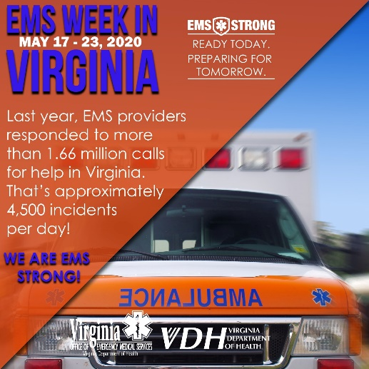
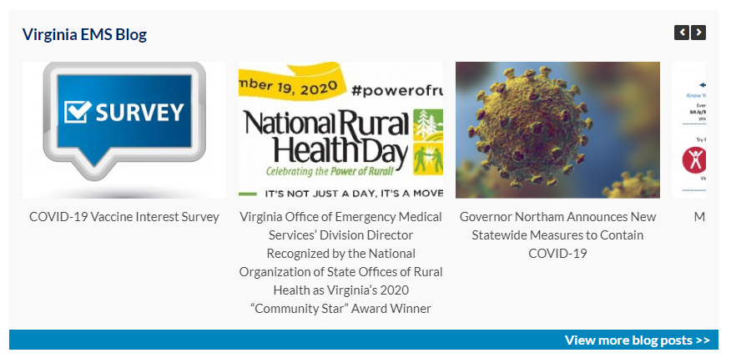


Outreach Methods
Work closely with the division managers to support and promote events and programs to our key stakeholder groups. We do this by utilizing several methods:
  OEMS website
  Social media (Facebook 8,200+ likes, Twitter, 5,200+ followers, YouTube)
  Virginia EMS Blog
  Listserv emails (apx. 32,000 contacts)
  Regional EMS Councils
  Media relations
  Promotional mailings
  Event promotion
  Submitting articles to EMS/Fire Trade Publications
  Designing and producing printed promotional items
  Submitting stories to Commissioner’s weekly email and Governor’s weekly report

Slide 26


Marketing Campaigns
The Public Relations team creates, implements and manages new campaigns for the office. We do this by creating and disseminating promotional materials with a clear, concise and unified message.
Past campaigns include:
  #MaketheCall Mental Health Awareness
  Campaign to promote Regional and Governor’s EMS Awards
  Christopher Reeve recruitment campaign
  Future campaigns might include:
  Division of Edu. Certificate Program
  Social Media campaign promoting
  EMS in Virginia
  Public education campaign on illness and injury prevention
  EMS education campaign (the EMS System or proper uses for 911)
  Recruitment and retention

Slide 27
EMS Events
  Work closely with OEMS program managers to promote OEMS events, in addition to the Symposium.
  Work to promote national EMS events and days of recognition
  EMS Week in Virginia/National EMS Week
  National EMS for Children Day
  Fire and EMS Memorial Week
  Public Service Week
  National Public Health Week
  National EMS Memorial Service
  National EMS Memorial Bike Ride
  National Volunteer Week
  National Trauma Month (Head Injury Prevention Month)

Slide 28
Virginia EMS Symposium
Provide management support and event coordination to Symposium committees.
  Promote the Symposium to the EMS community through social media, e-blasts, advertising, local partners, stakeholders, etc.
Provide event planning functions:
  Coordinate sponsor promotion/solicitation via sponsorship packet
  Produce printed materials (catalog, on-site guide, promotional mailer, fliers, banners, signage, etc.)
  Coordinate event advertising
  Create event press release
  Field event-related media inquiries
  Manage Symposium website
  Create and update Symposium App
  Coordinate event giveaways and promotional items
  Manage onsite signage
  Organize registration packets and name badges
  Manage on-site events: Flu shot clinic, Governor’s
  EMS Awards, nightly activities

Slide 29
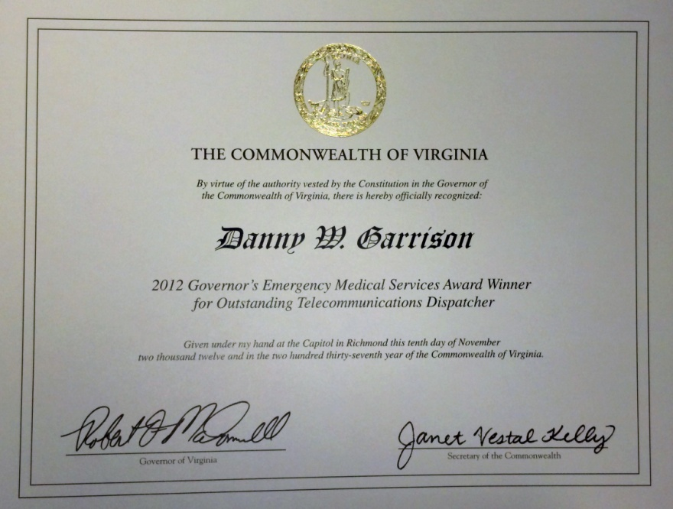

Governor’s EMS Awards
Manage all aspects of the Governor’s EMS Awards program.
  Assist with the marketing and promotion of the Regional EMS Council Awards.
  Work closely with the Regional EMS Councils to ensure that the best nominees are presented to the selection committee.
  Organize Governor’s EMS Awards nomination committee meetings.
  Work with the Governor's Office to formally recognize the winners with a signed certificate from the Governor and an engraved award.
  Promote regional and state level winners to local media through press releases.

Slide 30
Internal and External Communications
Work with executive management and division managers to provide assistance with internal and external communications.
  Review and edit documents (as requested) to meet the VDH communications standards.
  Provide access to preapproved templates, PowerPoints, logos, etc. that have been approved by VDH. Note: Anytime OEMS logo is used, VDH logo must be used.
  Assist with review and/or preparation of event and media notifications, constituent call sheets, legislative contact sheets.
  Submit media alerts via Media Alert Generator (MAG) on behalf of staff who are interviewed by media. The MAG site is: www.vdh.virginia.gov/mag/
  Important documents and policies* to familiarize yourself with: VDH Branding Guidance, VDH Correspondence Handbook, Guidance for Preparing Studies and Reports to the General Assembly, Social Media Guidance, Freedom of Information Act.
  *Documents can be found on L:drive> Division of Executive Management> Public Information Education. You can also find other helpful info and policies on the VDH
  intranet at: http://vdhweb/

Slide 31
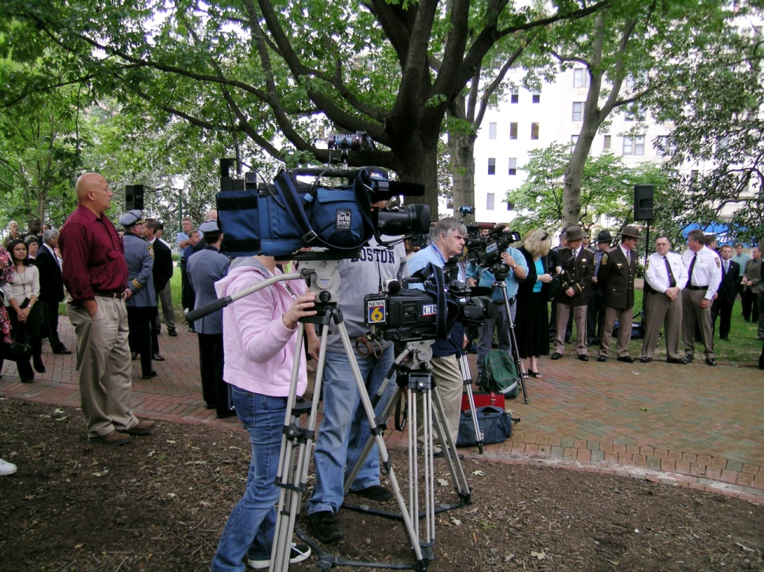
Media Relations
Manage all aspects of media relations
  Outreach to media to promote programs, events, public health emergencies, etc.
  Field and facilitate media calls related
  to EMS/VDH issues.
  Work as a VDH representative in the Joint Information Center during crisis response or disaster situations.
  Track media mentions of OEMS/EMS-related topics and submit to VDH in the News.
  Submit Media Alerts when OEMS staff has been quoted or worked with the media.
  Work with COMO team to create media training segments to be posted on TRAIN Virginia website.

Slide 32
Meet the PR Team
Marian Hunter
Public Relations Coordinator
Marian.Hunter@vdh.virginia.gov
804-888-9116
Tristen Graves
Public Relations Assistant
Tristen.Graves@vdh.virginia.gov
804-888-9115

Slide 33
EMS Funding & Support

Slide 34
History of EMS Funding
1968 – Office of Emergency Medical Services established ; state general funds and federal funds.
1978 – Virginia Rescue Squad Assistance Fund created by legislation. First grants awarded in June 1979.
1983 – “One For Life” legislation, adding a $1.00 fee on motor vehicle registration to support EMS.
1990 – “Two For Life” legislation passed.
2002 – “Four for Life” legislation passed; withheld funding
2006 – “Four for Life” was fully enacted
2008 – “Four for Life” increase by $0.25
2010 – Budget Amendment approved a $2.00 increase in funding:
  General Fund ($10,518,587)
  VA State Police ($2,052,723)
Notes:
History:
1968 – The Office (formerly, Bureau) of Emergency Medical Services was established within the Department of Health with the passage of the Virginia Ambulance Law. Funding was provided through the state’s general fund and federal funds.
1978 – Virginia Rescue Squad Assistance Fund created by legislation. First grants awarded in June 1979.
1983 – “One For Life" legislation, adding a $1.00 fee on motor vehicle registration to support EMS.
1990 – “Two For Life” legislation passed following a two year Joint Legislative Subcommittee studying the governance, training, recruitment and retention of EMS personnel.
2002 – “Four for Life” legislation passed; however, the increased funding was withheld for Virginia’s Homeland Security general fund.
2004 – “Four for Life” less $3.45 million retained in general funds was provided to the EMS system ($20.9 million provided to EMS in FY05).
2006 – “Four for Life” was fully enacted by budget bill ($23.5 million in FY06) and revised the % distribution.
2008 – General Assembly (HJR 743) approved a $0.25 increase in “Four for Life” restricting the use of the increase to EMS training and continuing education as a recruitment and retention initiative.
2010 – General Assembly Budget Amendment approved a $2.00 increase in funding; to be retained in the general fund ($10,518,587) and VA State Police ($2,052,723)

Slide 35
§ 46.2-694 Code of Virginia
Para. 13 – EMS Funding
Commonly referred to as “Four for Life” Funding
$4.25 of vehicle registration:
  $0.25 for the costs associated with the certification and recertification training of EMS personnel.
  $4.00 set aside for emergency medical service purposes.
Distribution of these funds shall be:
  $0.25 shall be deposited into the Rescue Squad Assistance Fund (Special Dedicated – 0910)
  $4.00 portion is distributed as follows:
    Special Fund – 0213
      2% - Virginia Association of Volunteer Rescue Squads
      30% - State Department of Health to support
      10% - State Department of Health for OEMS operations
      26% - Return to Locality in which vehicle was registered
    Special Dedicated – 0910
      32% - Rescue Squad Assistance Fund (Grant Program)
Notes:
§ 46.2-694 Para. 13 – EMS Funding
An additional $4.25 per vehicle registration per year shall be charged and collected by DMV for each automobile and pick-up or panel truck
All funds collected from $4 of the $4.25 fee shall be paid into the state treasury and shall be set aside as a special fund to be used only for emergency medical service purposes.
All revenues generated by the remaining $0.25 of the $4.25 fee approved by the 2008 Session of the General Assembly shall be deposited into the Rescue Squad Assistance Fund and used only to pay for the costs associated with the certification and recertification training of emergency medical services personnel.
Distribution of these funds shall be:
$0.25 shall be deposited into the Rescue Squad Assistance Fund (Special Dedicated – 0910)
Used as a recruitment and retention incentive for the costs associated with certification and recertification training of EMS personnel (HJR 743)
$4.00 portion is distributed as follows:
Special Fund – 0213:
2% - Virginia Association of Volunteer Rescue Squads
30% - State Department of Health to support
Basic Life Support and Advanced Life Support Training
Recruitment and Retention programs/Technical Assistance
EMS system development, initiatives, and priorities
Technology and radio communication enhancements
HMERT & Coordination Response Teams
10% - State Department of Health for OEMS operations
26% - Return to Locality in which vehicle was registered
Special Dedicated – 0910
32% - Rescue Squad Assistance Fund (Grant Programs)

Slide 36
Additional $2.00 in DMV Registration Fees Set-Aside General Fund and State Police
Projected revenue of $12,518,587 to support the General Fund and VA State Police (med-flight):
  $10,518,587 to the General Fund
  $2,052,723 to the Department of State Police for aviation (med-flight) operations.
    Note: Additional $1,045,375 from the RSAF grant fund.
Notes:
Additional $2.00 in DMV Registration Fees Set-Aside General Fund and State Police
2010 General Assembly budget amendment approved an additional $2.00 in motor vehicle registration fees collected.
Projected revenue of $12,518,587 generated to support the General Fund and VA State Police (med-flight):
On or before June 30 each year, the State Comptroller shall transfer $10,518,587 the first year and $10,518,587 the second year to the general fund from the $2.00 increase in the annual vehicle registration fee from the special emergency medical services fund contained in the Department of Health's Emergency Medical Services Program (40200).
Out of this appropriation, $2,052,723 the first year and $2,052,723 the second year from the special emergency medical services fund shall be provided to the Department of State Police for aviation (med-flight) operations.
State Police Med-flight receives an additional $1,045,375 from the RSAF grant fund for a total of $3,098,098

Slide 37
Notes:
$29,939,960.19
$0.25 for Training - $1,759,104.59
$4.00 for Life - $28,180,855.60

Slide 38
Return to Localities 26%
§ 46.2-694 Code of Virginia
Shall be returned to the locality in which vehicle is registered.
Funds to be used by licensed, nonprofit or governmental EMS agencies for:
  Training of Volunteer or Salaried EMS personnel
  Purchase of Necessary Equipment & Supplies
Funds shall NOT be used to supplant
  local funds or
  RSAF grant
Local governing body shall report on the use of these funds.
  If a report is NOT submitted funds for the next FY will be withheld until such report is received.

Slide 39
Return to Localities 26%
Listing of Potential Uses
Training Related Expenses to include:
  textbooks, workbooks
  supplies used in training
  training equipment (manikins, films, videos, etc)
  expenses related to certification programs
  expenses associated with specialty training programs
  regional training programs
Equipment & Supplies to:
  gain access to patients
  assess patient’s medical condition
  provide immediate medical care
  transport patient to medical facility
  communicate with dispatcher/medical facility
  Personal Protective Equipment (PPE) for EMT personnel

Slide 40
Return to Localities 26%
Items that do NOT conform with the intent
Furnishings or appliances for squad buildings
Vehicle/building maintenance items
Building utilities (electric, gas, water, telephone, etc)
Housekeeping expenses
Capital improvements
Special use equipment for fire suppression
Fund raising or public relations
Office management
Law enforcement
Firefighter PPE/turnout gear
Fund raising or public relations expenses
Articles of clothing (t-shirts, hats, etc) that are not personal protective clothing

Slide 41
§ 32.1-111.12. Virginia Rescue Squads Assistance Fund
For the purpose of providing financial assistance to rescue squads and other emergency medical services organizations in the Commonwealth
  For providing the requisite training for emergency medical service personnel, and of purchasing equipment needed by such rescue squads and organizations,
  Created in the Department of the Treasury a special non-reverting fund which shall be known as the Virginia Rescue Squads Assistance Fund.
  any such moneys unexpended at the end of a fiscal biennium shall remain in the Fund and shall not revert to the general fund.
Code established the Financial Assistance and Review Committee (FARC)
  6 members; representatives of the regions encompassed by the emergency medical services councils.
  Appointed by the State Emergency Medical Services Advisory Board.
  The Financial Assistance and Review Committee shall:
    1. Administer the Rescue Squads Assistance Fund in accordance with the rules and regulations of the State Board of Health as shall be established for the Fund;
    2. Review the Rescue Squads Assistance Fund grant applications from eligible emergency medical services agencies and make recommendations on the funding of such grant applications to the Commissioner of Health; and
    3. Report biannually, after each funding cycle,
      # of grant applications received,
      Total costs of grant applications funded,
      # of grant applications denied funding, t
      Total costs of grant applications denied funding, and the nature of the denied requests and the reasons for denying funding, to the State Emergency Medical Services Advisory Board and the Commissioner.

Slide 42
RESCUE SQUAD ASSISTANCE FUND (RSAF) GRANT PROGRAM
$9 + million available annually.
Requires matching funds
  Regular 50/50
  Hardship 80/20 (special circumstances)
  Unusual 100/0 (extreme cases)
Two Grant Cycles Annually
  Deadlines - March 15th and September 15th
  Awards – July 1st and January 1st
The primary goal of this program is to financially assist non-profit EMS agencies and organizations to purchase
  EMS Equipment
  EMS Training
  EMS Supplies
  Other EMS initiatives, programs and projects.
RSAF is primarily a reimbursement grant that requires the grantee to make the purchase for the awarded item/program/project and then submit an invoice for reimbursement.

Slide 43
Other Sources of Revenues & Programs
Trauma Fund – (> $15,100,000)
  Fund Code 0902 - - Special Dedicated Funds
    § 18.2-270.01. Multiple (DUI) offenders; payment to Trauma Center Fund.
    § 46.2-411. Reinstatement of suspended or revoked license or other privilege to operate or register a motor vehicle
  Pass through to designated Trauma Centers
Federal Grants
  EMS for Children ($130,000)

Slide 44
Questions
???

Slide 45
Division of Trauma and Critical Care
Staff
Cam Crittenden, RN, Division Director
Open, Trauma and Critical Care Program Manager
Jessica Rosner, Epidemiology Program Manager
  Narad Mishra, Epidemiologist
Bryan Hodges, Patient Care Informatics Supervisor
  Barry Reeves, VSTR Support
  Sayad Sadaat, VPHIB Support
David Edwards, Virginia EMS for Children Coordinator

Slide 46
Division Programs
Trauma and Critical Care Program
  Virginia Trauma Center Designation
  Virginia Trauma Fund
  Virginia Trauma Triage Plan
  Virginia Stroke Triage Plan
  EMS Advisory Board Trauma System Committees
Virginia EMS for Children
Patient Care Informatics
  Virginia Elite
  Virginia State Trauma Registry
  Epidemiology Program

Slide 47
Trauma and Critical Care Program
Trauma Center Designation
The purpose of the trauma designation process is to ensure a consistent minimum level performance of trauma centers in Virginia and to promote continued improvement and development.
Virginia recognizes 5 levels of designation: Level I (Adult, Burn, Pediatric) Level II, Level III
Level I
Level II
Centra Lynchburg
Level III
Carilion New River Valley
Carilion Roanoke Memorial Hospital (Adult and Pediatric)
Children’s Hospital of the Kings Daughters (Pediatric)
Chippenham Hospital (Adult)
Inova Fairfax Hospital (Adult)
Sentara Norfolk General Hospital (Adult and Burn)
University of Virginia Health System (Adult)
VCU Health System (Adult, Pediatric, and Burn
Henrico Doctors-Forest
Mary Washington Hospital Center
Reston Hospital Center
Riverside Regional Medical Center
Winchester Medical Center
Inova Loudon Hospital
LewisGale Hospital-Montgomery
Sentara Virginia Beach General
Southside Regional Medical Center
Sentara Northern Virginia Medical Center (Provisional)

Slide 48
Trauma and Critical Care Program
Trauma Center Designation
Designation is voluntary in Virginia. Designated hospitals have made a significant commitment to provide a given level of care to the seriously injured or burned patient
Per the COV the minimum criteria for designation is based on accepted national standards and may in some instances exceed the national standard
The current criteria are found in the Board of Health Approved Virginia Trauma Center Designation Manual v2015.4
Each designated facility must undergo a verification site survey visit every three years to maintain designation
The survey teams are comprised of practicing Virginia trauma surgeons, emergency medicine physicians, critical care nurses, hospital administrators, and Division staff

Slide 49
Trauma and Critical Care Program
Trauma Center Designation
Site review team tours the facility to evaluate infrastructure and to interview hospital staff in critical areas
  Emergency Department: trauma bays, communications center, helipad, decontamination
  Laboratory
  Radiology (Imaging and Interventional)
  STICU
  OR
Majority of the time is spent doing in-depth trauma patient medical record review to determine if clinical performance meets current trauma standards of care and evidence based guidelines
Considerable evaluation of the trauma programs Performance Improvement Program (PIPS) to include clinical outcomes, application of mandatory state audit filters and changes in process based on identified issues
Team makes recommendation for continued designation, conditional designation or withdrawal. State Health Commissioner has final authority on designation

Slide 50
Trauma and Critical Care Program
Virginia Trauma Center Fund
2004 JLARC study estimated that Virginia Trauma Centers (14 at the time) were losing a combined $44 million per year (uncompensated, under-compensated, and readiness costs). HB 1143 established the Trauma Fund
Revenue from a portion of the fees collected for the reinstatement of revoked/suspended drivers licenses and repeat DUI offenders
Funds are disbursed annually to trauma centers as outlined in the Trauma Fund Distribution Policy
Distributions and expenditures are reported out to the GA annually and can be found here: Trauma Fund Annual Reports
Notes:
11/2020
Revenues have been between $10-14 million annually until this year. Recent law changes eliminating suspension of driving privileges for non driving related offenses eliminated.
FY 2021 is on track for only $4 million annual payout as of this month

Slide 51
Trauma and Critical Care Program
Virginia Trauma Triage Plan
The Advisory Board, in consultation with the Virginia Chapter of the American College of Surgeons, the Virginia College of Emergency Physicians, the Virginia Hospital and Healthcare Association, and prehospital care providers is responsible for creating and maintaining the plan
Is a broad statewide guidance document based on the CDC’s 2011 Guidelines for Field Triage of Injured Patients
Allows for Regional Councils to adapt the state plan regionally based on local resources and geography
Notes:
11/2020 The ACS and NHTSA are in the process of revising the current guidelines and the state plan should be updated to reflect the recommended changes once they are announced

Slide 52
Trauma and Critical Care Program
Virginia Stroke Triage Plan
The purpose of the Statewide Stroke Triage Plan is to establish a uniform set of criteria for the prehospital and inter-hospital triage and transport of acute stroke patients.
The primary focus of the plan is to provide guidelines to facilitate the early recognition of patients suffering from acute stroke and to expedite their transport to a center able to provide definitive care within an appropriate time window
Virginia recognizes multiple levels of stroke certification (a Certified Stroke Center) consistent with recommendations of the Brain Attack Coalition. These are Comprehensive Stroke Centers, Primary Stroke Centers, Primary Stroke Centers with supplementary levels of stroke care distinction, and Acute Stroke Ready hospitals.
Formal regional or local stroke triage plans may augment the State Stroke Triage Plan to acknowledge and address variations in each region's EMS and hospital resources.
Notes:
11/2020
The Plan was last updated in July 2018. Broad group of stakeholders. TCC also participates in the Virginia Stroke System Taskforce, Virginia Stroke Coordinators Consortium and Virginai Stroke Care Quality Improvement Advisory Group

Slide 53
Trauma and Critical Care Program
EMS Advisory Board Committees
In September 2015 OEMS underwent a voluntary state trauma system assessment by the American College of Surgeons using the HRSA public health focused Model Trauma System Planning and Evaluation Guide
The assessment identified priority issues for trauma system development in Virginia (ACS Trauma System Consultation Report)
Acting on behalf of the Advisory Board Executive Committee the Trauma System Plan Taskforce was convened to create the Virginia Trauma System Plan (COVATS). The purpose of this document is to provide Virginia Trauma System stakeholders – including healthcare providers, government regulators and the public – with a road map of the steps needed to close identified gaps in the system. This will help ensure people injured in the Commonwealth are taken to the right hospital, in the right manner, and in the right amount of time.
Notes:
The taskforce was comprised of approximately 125 stakeholders from all spectrums of trauma care.
The group was broken into 7 phases/stages of trauma met 90 times over the course of two years

Slide 54
Trauma and Critical Care Program
Trauma System EMS Advisory Board Committees
Advisory Board Bylaws were amended to incorporate 7 trauma system committees that represent the continuum of care for the injured and created a Trauma System Coordinator
Trauma Administrative and Governance Committee (TAG)
  Support the development and sustainability of a comprehensive trauma system
  Assure that injured persons within the Commonwealth have rapid access to optimal, equitable, efficient specialized trauma care to prevent further disability.
  System Improvement (SIC)
    Assure that trauma system initiatives such as education, performance improvement, injury and prevention, public health planning and research are data driven
    Use data to develop and implement best practices and clinical guidelines for all phases of trauma care
Notes:
Refer to COVATS plan for the current goals and objectives of each committee. The plan will be updated and modified at key intervals to reflect the status of current goals and to add or remove goals as needed
TAG was TSO&MC. They are still tasked with COV objectives, however they may assign responsibility for these code mandates other TSC Committees:
Maintain a process for trauma center designation. ( 32.1-111.3:A.10)
Maintain a statewide pre-hospital and inter hospital trauma triage plan. ( 32.1-111.3:19.B)
Maintain a performance improvement process that supports the designation process, trauma triage and trauma care statewide. ( 32.1- 111.3:B.3)

Slide 55
Trauma and Critical Care Program
Trauma System EMS Advisory Board Committees
Injury and Violence Prevention
  Thru the use of integrated data systems analysis, establish statewide injury and violence prevention initiatives
  Build a sustainable infrastructure to provide leadership, data, and technical assistance for advancing injury and violence prevention in trauma systems
  Prehospital Care Committee
    Develop and make practice recommendations for the treatment and transport of injured pediatric, adult and geriatric patients
    Acute Care Committee
      Provide technical assistance to ensure that all acute care facilities in VA are engaged in the trauma system
      Evaluate and manage the trauma center designation process to reflect current national standards

Slide 56
Trauma and Critical Care Program
Trauma System EMS Advisory Board Committees
Post-Acute Care Committee
  Work with community stakeholders to integrate rehabilitation facilities and services into the trauma system
  Assure that these resources are available to all populations
  Emergency Preparedness and Response
    Work with the Emergency Management Committee, Regional Councils and local EMS agencies to ensure that the trauma system is engaged in state disaster planning process

Slide 57
Virginia EMS for Children
National initiative who’s mission is to reduce child and youth mortality and morbidity resulting from severe illness of trauma
State partnership program established in Virginia in 1997 and has been housed at OEMS since 2007
EMSC for Children Advisory Board Committee
Focus Areas
  Trauma-identifying and disseminating best practice/evidence based guidelines for pediatric trauma care
  Disaster Preparedness-ensure that the specific needs of children are taken into consideration during disaster planning at all levels
  Prehospital Care-pediatric education, injury prevention, treatment and transport
  Hospital Based Care-National Pediatric Readiness Program which ensures that U.S. ED’s have pediatric specific EBG’s and equipment
  Research-National EMSC Data Analysis Resource Center (NEDARC) and Pediatric Emergency Care Applied Research Network (PECARN)
Notes:
11/2020
)

Slide 58
Virginia EMS for Children
Current Performance Measures
  EMSC 01 Submission of NEMSIS Compliant Version 3 Data-√
  EMSC 02 Pediatric Emergency Care Coordinator (PECC)
  EMSC 03 Use of Pediatric Specific Equipment- √
  EMSC 04 Hospital Recognition for Pediatric Emergencies
  EMSC 05 Hospital Recognition for Pediatric Trauma- √
  EMSC 06 Inter-Facility Transfer Guidelines
  EMSC 07 Inter-Facility Transfer Agreements
  EMSC 08 Permanence of EMSC- √
  EMSC 09 Integration of EMSC Priorities into Statutes or Regulations- √
Notes:
Upcoming survey launches January 6, 2021
All Virginia DEERA agencies
Collecting Performance Measure 02 (% of agencies that have a designated individual who coordinates pediatric emergency care)
Performance Measure 03 (% of agencies that have a process that requires providers to physically demonstrate the correct use of pediatric specific equipment

Slide 59
Patient Care Informatics
Virginia Statewide Trauma Registry (VSTR)
  Collects 40,000 patient records/year from all Virginia hospitals
  Information on the incident, causes of injury, severity of injury, and outcomes of trauma incidents is compiled to assist with oversight and planning for the system
  Non designate hospitals submit data monthly and designated centers submit data quarterly
  Based on a national standard which allows for benchmarking system performance across the nation
  Data quality and compliance are measured monthly and standards, inclusion and exclusion criteria, and process are outlined in the VSTR Administrative Procedure
  Data from this system is used in the Trauma Triage Report that is submitted to the Advisory Board quarterly
Notes:
32.1-116.1 Prehospital patient care reporting procedure; trauma registry;
A. In order to collect data on the incidence, severity, and cause of trauma; integrate the information available from other state agencies on trauma; improve the delivery of prehospital and hospital emergency medical services, the quality of patient care, and access to medical services; and make other system improvements, there is hereby established the Emergency Medical Services Patient Care Information System. The Emergency Medical Services Patient Care Information System shall include the Virginia Emergency Medical Services (EMS) Registry and the Virginia Statewide Trauma Registry.
C. All licensed hospitals which render emergency medical services shall participate in the Virginia Statewide Trauma Registry by making available to the Commissioner or his designees abstracts of the records of all patients admitted to the institutions with diagnoses related to trauma. The abstracts shall be submitted in the format prescribed by the Department and shall include the minimum data set prescribed by the Board. Such abstracts shall also be provided to regional emergency medical services councils upon request, for uses limited to monitoring and improving the quality of emergency medical services pursuant to § 32.1-111.3.
Detailed information can be found at the OEMS Knowledge Base

Slide 60
Patient Care Informatics
Virginia EMS Patient Care Information System (EMSPCIS)
  Data repository for approximately 1.5 million EMS incidents annually
    V2 and V3 data sets
  Our support team manages the statewide NEMSIS compliant patient medical record system for 275 EMS agencies (direct entry)
  Remaining EMS agencies have contracted individually with alternate NEMSIS compliant software systems and upload the required data to the state repository (3rd party)
  EMS agencies retain ownership of the complete patient medical record-COV has rights to the data elements in the dictionary
  Each agency has access to a reporting tool and it’s own data
  Regional Councils have access to data set to conduct contracted performance improvement functions
Notes:
§ 32.1-116.1. Prehospital patient care reporting procedure; trauma registry;
B. All licensed emergency medical services agencies shall participate in the Virginia EMS Registry by making available to the Commissioner or his designees the minimum data set in the format prescribed by the Board or any other format which contain equivalent information and meets any technical specifications of the Board. The minimum data set shall include, but not be limited to, the type of medical emergency or nature of the call, the response time, the treatment provided and other items as prescribed by the Board.
Out for bid. Close date of 11/20/2020. Evaluating proposals now

Slide 61
Epidemiology Program
EMS and Trauma Data Reporting
Data in both systems is exempt from FOIA per policy and COV (FOIA Policy)
  OEMS does provide de-identified data on a case by case basis
  All requests must be submitted through an online Data Request Form
  Specially trained Epidemiologists are responsible for fulfilling requests
  Staff can provide raw data or a detailed analysis of the data set requested
  Any data or analysis to be published must be reviewed and approved by OEMS prior to publication
  Requests are prioritized to support mandated programs, VDH/OEMS and the agencies/hospitals that contribute to the databases

Slide 62

Notes:
Photo: Roanoke Fire-EMS (Western EMS Council)
Lead Presenter: Chad
Total Time: 60 minutes
Resources Needed:
A/V – Projector
Course Enrollment Forms
Goals:
Explaining EMS Scholarship and Grant process
Activity: (XX minutes)
XX

Slide 63
Division of Accreditation, Certification & Education
The ACE Division—as we are known—is the most publically facing division in the Office.
  60-70% of calls and e-mail messages coming into the Office are for the ACE Division staff. Our staff:
    interact with 36,000 + EMS providers and 10,000 + individuals in reentry,
    issue over 5,000 new provider level certifications per year,
    certify and oversee 650 + Education Coordinators and 75 + ALS Coordinators.
    approve on average 335 + initial certification courses and 1,070 continuing education programs.
Notes:
Presenter: Warren
Explain where our physical location for DED

Slide 64
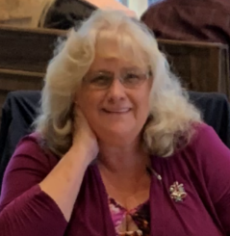


Division of Accreditation, Certification & Education
Debbie Akers
Director, Division of Accreditation, Certification & Education
Chad Blosser
Education Program Manager
Vacant
Accreditation Program Manager
Notes:
Presenter: Warren
13 seconds - Friends theme song to play when slide opens
Introduce the staff of OEMS
Each staff member will explain their sections following this slide

Slide 65

ACE Division Manager
Debbie Akers
Director, Division of Accreditation, Certification & Education
Continuing Education Certification
National Registry Liaison Medical Direction Committee
Toni Twyman
Certification Issues Testing Problems
Challenges/Reciprocity/Legal Recognition
Norma Howard
General Information CE Questions
Re-Entry Inquires CE Report Problems
Jackie Hunter
EMS Scholarship
Accreditation Site Visit Coordinator
Notes:
Presenter: Debbie
Introduction of role and support team

Slide 66

Education Program Manager
Chad Blosser
Education Program Manager
Education Coordinator Program
Virginia EMS Scholarship Virginia EMS Portal
Training and Certification Committee
Tracie Jones
Course Approvals Changes to Courses
Customized CE
Crystal Cuffley
OEMS Help Desk Technician
OEMS-AppSupport@vdh.virginia.gov
Notes:
Presenter: Billy
Introduction of role and support team

Slide 67
Accreditation
Accreditation is an effort to assess the quality of institutions, programs and services, measuring them against agreed-upon standards and thereby assuring that they meet those standards.
In the case of post-secondary education and training, there are two kinds of accreditation: institutional and programmatic (or specialized). Institutional accreditation helps to assure potential students that a school is a sound institution and has met certain minimum standards in terms of administration, resources, faculty and facilities.
Programmatic (or specialized) accreditation conducts an in-depth assessment of specialized or professional programs to ensure that education provided meets acceptable levels of quality.

Slide 68
Accreditation
The ACE Division administers accreditation for EMS educational programs across the Commonwealth.
  Develop, administer and oversee state accreditation of EMT and Advanced EMT programs.
  Liaise with the Committee on Accreditation of Educational Programs for the Emergency Medical Services Professions (CoAEMSP) which oversees accreditation of paramedic training programs in the United States.

Slide 70
Certification
ACE Division staff manage and administer the certification process for all EMS providers in the Commonwealth. The ACE staff work closely with National Registry (NREMT) to ensure certification meets or exceeds their requirements.
The process includes:
  oversight of certification programs,
  administration of psychomotor testing for all levels,
  monitoring certification data sharing with National Registry of EMT’s, and
  issuing state certification.

Slide 71
Certification (cont)
Basic Life Support (BLS) programs require the successful completion of:
    An approved initial certification program.
    A state administered psychomotor examination.
    A National Registry administered cognitive examination.
Advanced Life Support (ALS) programs require the successful completion of:
    An approved initial certification program.
    A National Registry administered psychomotor examination.
    A National Registry administered cognitive examination.

Slide 72
Certification (cont)
The ACE Division also oversees the awarding of certification for individuals coming into the Commonwealth from other states or territories:
  Reciprocity – recognition of a National Registry certification from someone who was not trained in Virginia.
  Legal Recognition – recognition of a certification from a provider in another state who does not have a National Registry certification.
  Challenge – recognition of a valid medical license held by a nurse, nurse practitioner, physicians assistant or a medical or osteopathic doctor allowing them to “challenge” the EMT exam without having to take an initial certification program.

Slide 75
Education
The ACE Division oversees all EMS educational programming—both initial certification and continuing education (CE)—conducted in the Commonwealth. This is accomplished through:
  a network of over 650 + certified Education Coordinators and 70 + ALS Coordinators across the state.
  working in concert with our constituent base through the Training & Certification Committee and the Medical Direction Committee—sub-committees of the EMS Advisory Board.

Slide 76
Education
  establishing minimum educational standards which must be taught through the adoption of the National EMS Education Standards
  publishing and maintaining an up-to-date Virginia Scope of Practice Procedures & Formulary.
  approval of all courses by the central office.
    monitoring of all student enrollments in initial programs, and
    receipt, processing and monitoring of all CE records submitted
  use of contracted staff by way of regionally-based EMS educators to conduct CAT 1 continuing education that meets the National Core Competency Requirements (NCCR).

Slide 78


Virginia Office of EMS
Division of Emergency Operations

Slide 79
Division of Emergency Operations Staff
Division Director – Karen Owens
Karen.Owens@vdh.virginia.gov
Emergency Services Coordinator – Sam Burnette
Samuel.Burnette@vdh.virginia.gov
Emergency Operations Specialist – Richard Troshak
Richard.Troshak@vdh.virginia.gov
Emergency Operations Planner – Caron Nazario
Caron.Nazario@vdh.virginia.gov
Epidemiologist – Vince Valeriano
Vincent.Valeriano@vdh.virginia.gov

Slide 80
EMS Advisory Board Committees
EMS Communications Committee
  Primary - Rich Troshak
  Secondary – Sam Burnette
EMS Emergency Management Committee
  Primary – Caron Nazario
  Secondary – Karen Owens
Provider Health and Safety Committee
  Primary – Karen Owens
  Secondary – Vince Valeriano

Slide 81
Statewide Emergency Medical Services Plan
Emergency Operations Specific Areas:
  Strategic Initiative 2.1 – Coordinate response to natural, man-made, and public health emergencies
  Strategic Initiative 3.3 – Upgrade technology and communications systems
  Strategic Initiative 4.3 – Pursue initiatives that support EMS
    Safety, health, and wellness of first responders
    Response to hostile environment events

Slide 82
Emergency Response Capabilities
Lead Staff – Karen Owens

Slide 83

Field Resources
Health and Medical Emergency Response Teams (HMERT)
  Coordination Teams
  EMS Task Forces
Incident Support Trailer
  Command Office Space
  Communications Equipment
    State agency radio system (STARS)
    Multi-band digital interoperability radio*
    COMMLINC tactical radio*
    Radio cache of 80 analog/digital P25-ready handheld radios with transportable repeater

Slide 84
Virginia Emergency Support Team (VEST)
Support Emergency Support Function (ESF) – 8 – Public Health
Provide staffing at the state Emergency Operations Center during emergency and non-emergency large scale events
Coordinate response to EMS resource requests during events

Slide 85
Provider Health and Safety
Lead Staff – Karen Owens and Vince Valeriano

Slide 86
Mental Health and Resiliency
Peer Support/Critical Incident Stress Management Accreditation Program
Make The Call Campaign
2019 EMS Provider Mental Health Survey
Comprehensive Website
Monthly health and safety bulletins

Slide 87
Physical Health
Public Safety Provider Exposure Workgroup
  Development of standardized prevention of and response to public safety exposure incidents
Health and Safety Pledge
  Provider and Agency

Slide 88
Emergency Operations Training
Lead Staff – Sam Burnette

Slide 89
Training Relationships
  Virginia Department of Emergency Management (VDEM)
  Virginia Department of Fire Programs (VDFP)
  Virginia Association of Volunteer Rescue Squads (VAVRS)
  Virginia Department of Health – Office of Emergency Preparedness (VDH-OEP)

Slide 90
Training Courses
Mass Casualty Incident Management
  Module I – Awareness
  Module II – Operations
Mass Casualty Incident Management Instructor
Vehicle Rescue
National Incident Management System (NIMS)/Incident Command System (ICS)
  ICS 300 – Intermediate Incident Command
  ICS 400 – Advanced ICS and General Staff

Slide 91
Communications Programs
Lead Staff – Rich Troshak

Slide 92
Public Safety Access Points (PSAP)/9-1-1 Centers
  OEMS conducts outreach and provides technical assistance to 911 centers to promote and assist with the implementation of EMD statewide
  Oversight of EMD Accreditation Program
  Oversight of compliance with requirements set forth by legislation mandating tCPR and eventually EMD

Slide 93
EMD Accreditation Program
  EMD is defined as: “Trained communicators, using locally approved guidelines, dispatch appropriate resources to a medical call and provide instructions to the caller to treat the patient until first responders arrive.”
A voluntary accreditation program for 911 centers implementing emergency medical dispatch
Requires all personnel in and accredited agency to be trained in EMD by an OEMS recognized training organization within two years of initial employment and to comply with continuing education requirements

Slide 94
Other Communications Activities
FCC Coordination for EMS agencies or hospitals seeking to operate on EMS designated channels
FirstNet
Communications Directory
  Provides contact information for the 911 centers

Slide 95
Emergency Operations Planning
Lead Staff – Caron Nazario

Slide 96
Emergency Planning Assistance
Provide assistance for:
  Writing and evaluating Comprehensive Emergency Management Plans
  Outlining the steps for requesting state and federal assistance
  Writing and evaluating Comprehensive Mass Casualty Plans
  Provide guidance for Contingency planning for special events

Slide 97
Other Programs

Slide 98
Other Areas of Focus
Human Trafficking Awareness Education
Opioid Crisis Response
Emergency Infectious Diseases
Symposium Communications Coordination

Slide 99

Regulation & Compliance Enforcement
Ronald D. Passmore, NRP
Division Director
Virginia Office of EMS
December 2020

Slide 100

Regulation and Compliance Enforcement

Slide 101
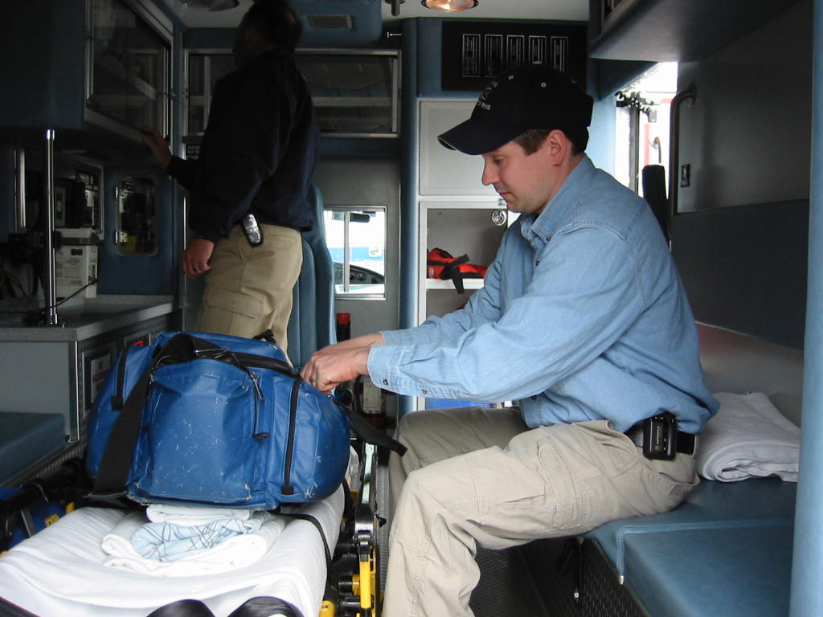
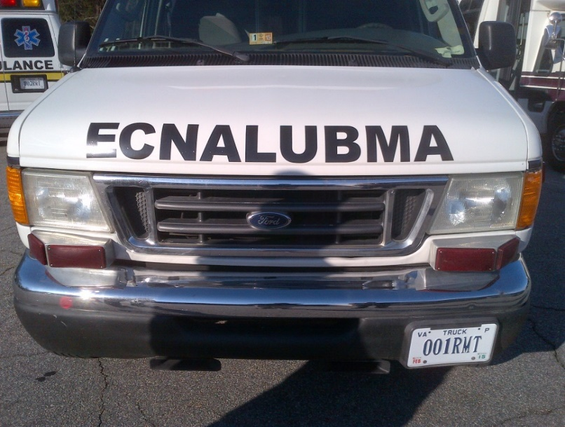
Regulation & Compliance Enforcement
License Regulate Develop & Enforce
EMS Agencies EMS Agencies EMS & DDNR Reg’s
EMS Vehicles EMS Providers Investigations
EMS Aircraft EMS Physicians Regulatory Action
Provide SME resources to Agencies, Providers, & Localities

Slide 102

Regulation & Compliance Enforcement

Slide 103
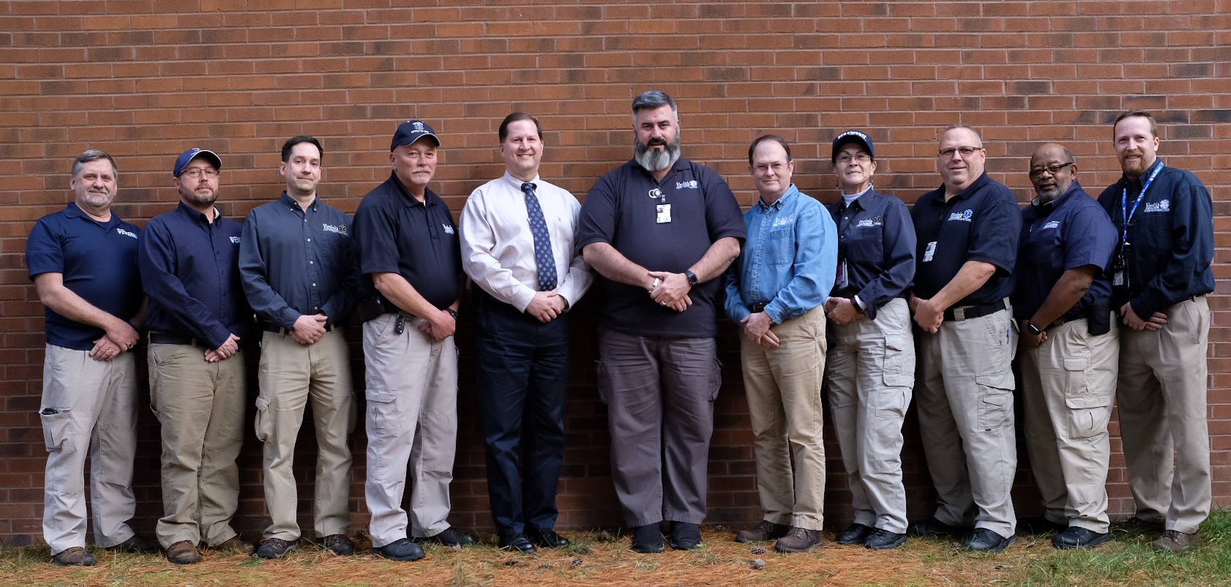
Field Staff

Slide 104
Regulation & Compliance Enforcement
Division Director
Ron Passmore
Senior Supervisor
Supervisor
Division Support
Jimmy Burch
Marybeth Mizell
Paul Fleenor
Program Rep
Background Investigations
Program Rep
Steve McNeer
Katie Hodges
Ron Kendrick
Program Rep
Program Rep
Doug Layton
Scotty Williams
Program Rep
Program Rep
Wayne Berry
Len Mascaro

Slide 105
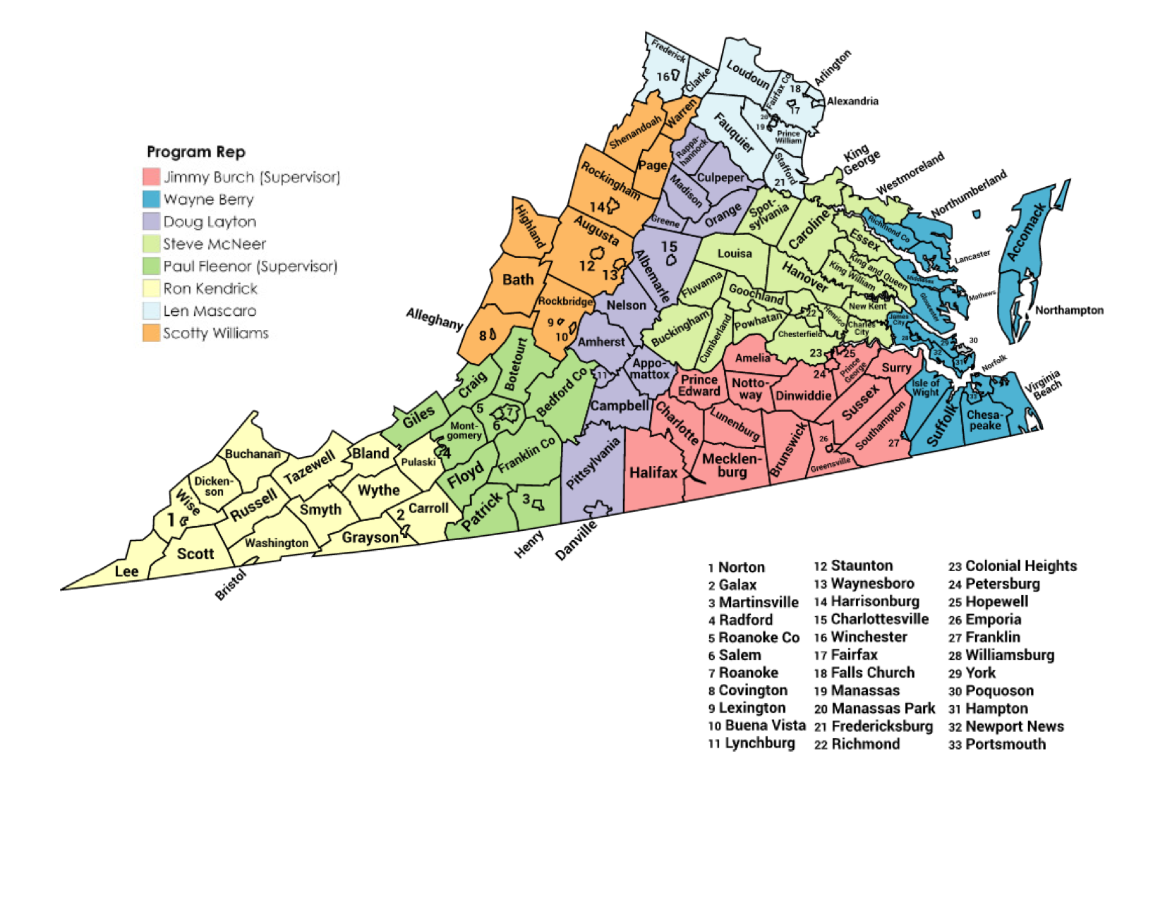

Slide 106
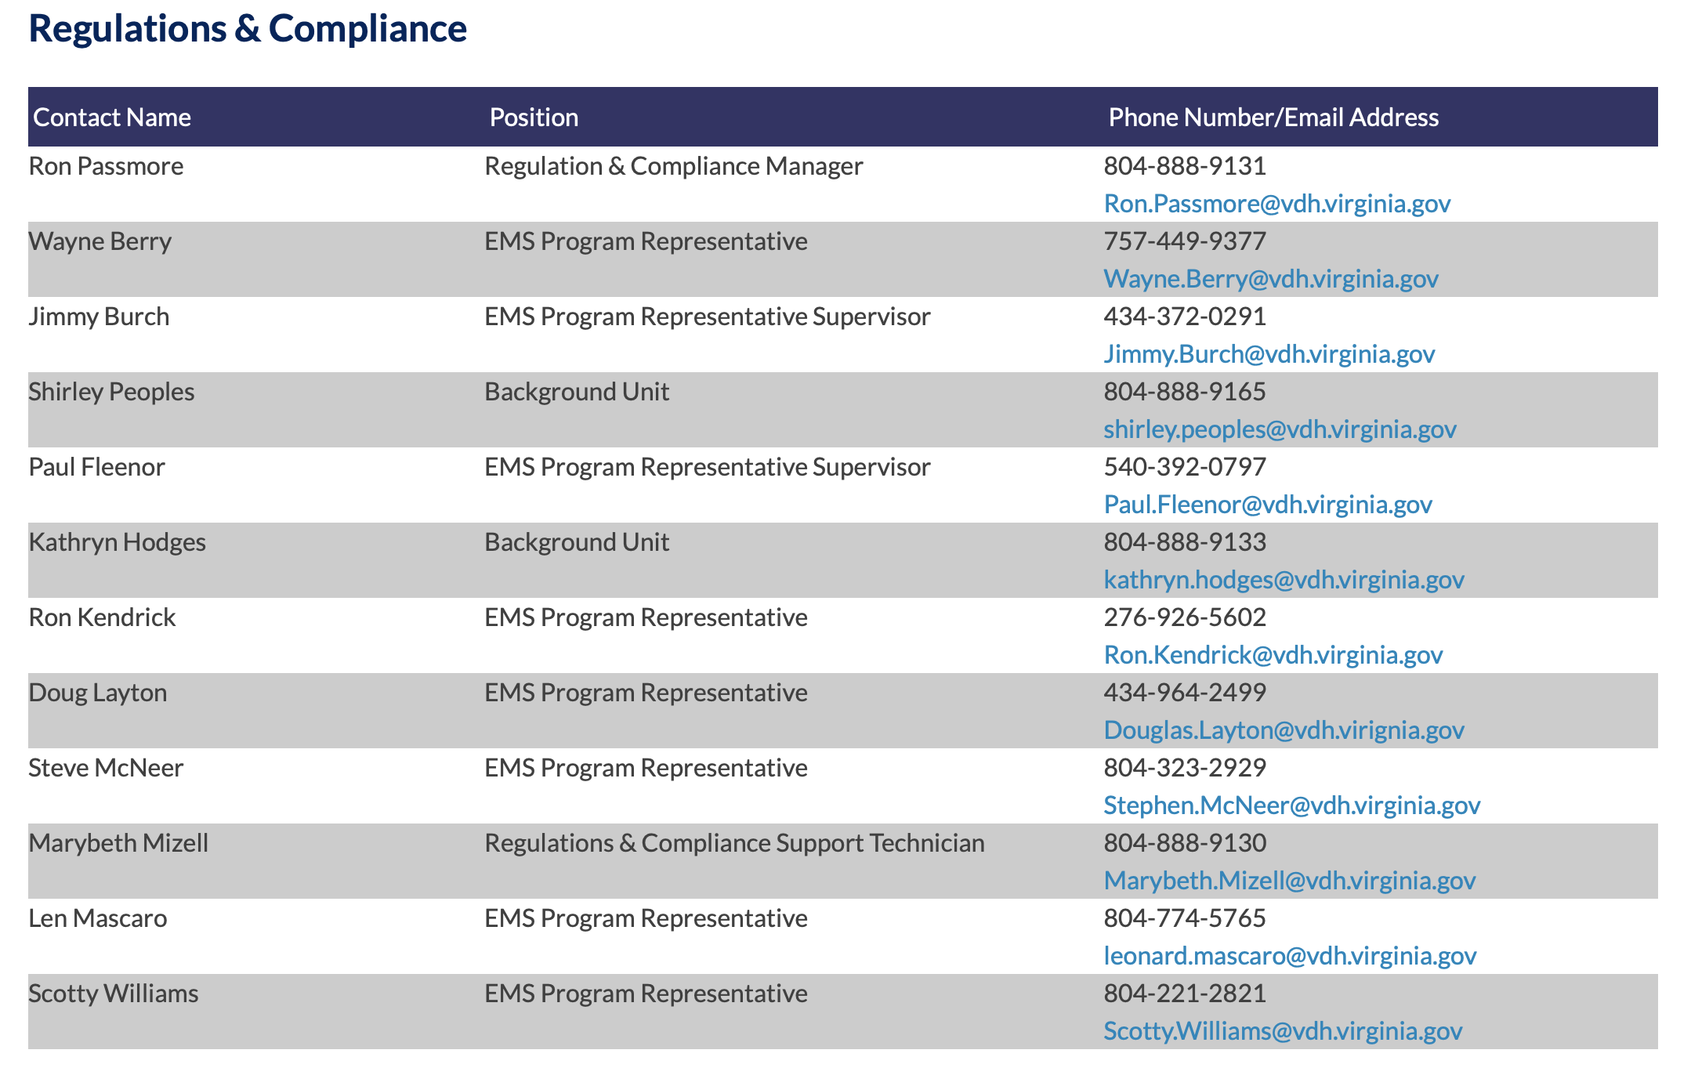

Slide 107
Regulation & Compliance Enforcement
EMS Physician (OMD/PCD) initial and re-endorsement (>200)
EMS agency initial and re-licensure (>600)
EMS vehicles permitting and renewal (>4,250)
EMS enforcement (12VAC5-31 & 12VAC5-66) current reg’s
EMS regulations development (12VAC5-32) proposed reg’s
EMS variances/exemption requests (provider/agency/entity)

Slide 108
Regulation & Compliance Enforcement
Investigate complaints of regulatory violations involving
Physicians, Providers, Agencies, Entities, EMS educational
Programs (VCCS & non-VCCS), educators, and students
Litigate IFFC appeal hearings regarding regulatory actions
(Correction Order, Verbal Warning, Citation, Suspension, Revocation, or Civil Penalty)
Background Investigations of EMS personnel (criminal history)
RASF Grant Compliance verification per cycle

Slide 109
Regulation & Compliance Enforcement
Investigate Drug Diversion complaints
Provide technical assistance & guidance to State EMS Advisory Board and all standing committees
Technical resource to state and local government entities, EMS agencies, and providers
National participation with EMS licensure & regulations
(National & State Provider Database Submissions)

Slide 110
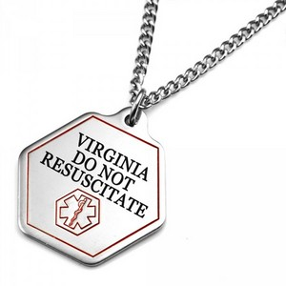
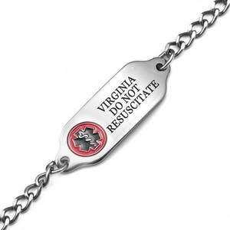
Are your providers “up to date” with DDNR regulation?
12VAC5-66 – DDNR Reg’s
Many EMS providers have an outdated understanding of DDNR regulations
Copies of DDNR are legal
  Even digital copies are acceptable
Official Virginia OEMS - DDNR Jewelry is legally the same as a copy of DDNR
  Most providers are unaware DDNR jewelry exists
  https://www.stickyj.com/category/dnr-jewelry-bracelets/virginia
Out of State DDNR is acceptable
  Excluding “ala carte” forms
Educational Update on these regulations are in need

Slide 111

Crystal Ball – What is on the Horizon?

Slide 112
Upcoming Challenges
* Develop OEMS resources to comply with coming DEA regulations for EMS Agencies drug box programs
* Develop EMS regulatory language defining Critical Care
* Monitor Legislative efforts for cost containment HEMS
* Development of CP/MIH programs within Virginia
* Develop a Return to Practice Pathway for the impaired provider
* EMS Physician Recruitment

Slide 113

Regulation & Compliance Enforcement
We welcome you to “spend a day” with one of the OEMS Program Representatives “in the field”.

Slide 114

Virginia Office of EMS
Division of
Community Health &
Technical Resources
(CHaTR)

Slide 115
What we do…
Mobile Integrated Healthcare/Community Paramedicine (MIH/CP)
Disease management and preventative healthcare services
Identification of underserved populations and gaps in access to healthcare
Fostering strategic partnerships and collaboration between EMS agencies, healthcare professionals, and communities to advance population-based initiatives that will improve health outcomes
Technical Assistance liaison and subject matter expert
EMS workforce development, recruitment and retention, EMS agency resiliency, and succession planning
EMS agency leadership and management.
Regional EMS Council Oversight
Virginia Statewide EMS Plan

Slide 116
A cohesive system…
It has been generally accepted that there are portions of not only Virginia, but the country, where there are identified underserved populations and gaps in access to healthcare.
EMS strives to be an active partner in helping to bridge those gaps.
Wellness checks
Mental health evaluations
Opioid screenings
Alternate destination considerations
Referral to other healthcare providers
Point of dispensing (POD) immunization clinics
Improving Population Health is key!

Slide 117
A cohesive system…
CHATR staffers continually seek to enhance partnerships with other entities within VDH.
Office of Health Equity
Population Health Action Team
Local Health Districts
Tasks to be addressed fall in line with both the OEMS and VDH Strategic Plans.

Slide 118
Technical Assistance
Local Governments
Stakeholders
EMS Agencies
Funding (Funding Your Future)
Agency resiliency (Standards of Excellence/Emergency Services Assistance Program)
Recruitment and retention (Keeping The Best!)
Leadership training (EMS Officer Series)
Succession Planning
Integration with other healthcare entities

Slide 119
Technical Assistance
EMS System Assessments
Virginia Department of Fire Programs
VDH Office of Rural Health(CAH studies)
Agency/locality request

Slide 120

Regional EMS Council Oversight
OEMS contracts with the eight Regional EMS Councils, which are non-profit organizations. The councils collectively receive $3.1 million dollars in contract funding annually.
The councils are responsible for the development of regional EMS plans and protocols, assist in administration of EMS certification examinations, and develop and maintain regional restocking agreements and medication exchange kit programs.

Slide 121
Virginia Statewide EMS Plan
§32.1-111.3 of the Code of Virginia requires the development of a comprehensive, coordinated, statewide emergency medical services plan by OEMS.
The Board of Health must review, update, and publish the plan triennially, making such revisions as may be necessary to improve the effectiveness and efficiency of the Commonwealth’s emergency care system. The objectives of the plan shall include, but not be limited to the nineteen (19) objectives outlined in §32.1-111.3.

Slide 122
Other current projects/programs
State Medevac System
State Rural Health Plan (resource to VDH-SORH)
State Telehealth Plan

Slide 123
CHaTR Staff
Tim Perkins, CHaTR Division Director
tim.perkins@vdh.virginia.gov
Chris Vernovai, EMS Systems Planner
chris.vernovai@vdh.virginia.gov
Hannah Lyons, Program Specialist
hannah.lyons@vdh.virginia.gov
https://www.vdh.virginia.gov/emergency-medical-services/chatr/

Slide 124
Virginia’s Regional EMS Councils
State EMS Advisory Board Orientation
Updated 2020

Slide 125
Role of Regional EMS Councils
Regional EMS Councils collaborate with the Virginia Office of EMS, local government officials, physicians, hospitals, EMS agencies, and other stakeholders to plan and coordinate EMS activities at the regional level to promote quality of care.

Slide 126
Background
The Code of Virginia (§ 32.1-111.11) establishes Regional EMS Councils and defines their function and purpose.
Each council is charged with the development and implementation of an efficient and effective regional emergency medical services delivery system.

Slide 127
Locations of Regional Councils
There are 11 regional EMS councils that are designated to serve specific geographic areas of the Commonwealth. Virginia’s regional EMS councils contract with the Virginia Office of EMS during their designation period and undergo designation reviews every 3 years.

Slide 128
Hybrid Regional Offices
Of the 11 regional EMS councils, there are 3 that are Regional Offices of the Office of EMS. These are hybrid offices, with OEMS staff completing the work of OEMS and the Regional Council’s Board of Directors for their region. Central Shenandoah EMS Council was the first to become a hybrid office followed by Blue Ridge EMS Council and Rappahannock EMS Council.

Slide 129
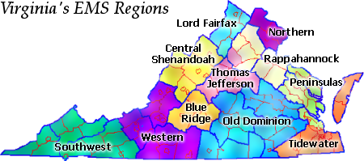
Map of Virginia EMS Regions

Slide 130
Regional Council Services
While services provided by regional EMS councils can vary, generally services can be broken into two distinct categories:
  Services required under contract with the OEMS
  Services necessary for the region but not required under OEMS contract

Slide 131
Contract Services
  Regional Infrastructure
    Assistance and Referral
    Continuity Planning
    State Committees
    Local VDH Collaboration
  Regional Medical Direction
    Regional Medical Direction
    Patient Care Protocols
    Medication Kit Exchange

Slide 132
Contract Services (cont.)
  Regional Planning
    Strategic EMS Plan
    Stroke Triage Plan
    Infectious Disease Planning
    Hospital Diversion Planning
  Regional Coordination
    Information and Referral
    Performance Improvement
    Trauma Triage Plan

Slide 133
Contract Services (cont.)
  Regional Coordination (cont.)
    RSAF Program
    CISM Program
    Regional EMS Awards
    Regional Instructor Network
    BLS Testing Coordination

Slide 134
Non-Contract Services
Councils may provide other services that are needed in their region but are not required under their OEMS contract including:
    EMS Training Programs (various)
    Medical Reserve Corps/Hospital and Healthcare Preparedness
    Emergency Planning/Preparedness
    Communications Systems
    Specialty Response Teams
    Local/Regional projects

Slide 135
Point of Contact
Virginia’s Regional EMS Councils provide a point of contact and support for all stakeholders in the regional EMS system. They will assist in resolving issues whenever possible, and they will make appropriate referrals to the state office on specific matters.

Slide 136
Virginia’s Regional EMS Councils
We appreciate the opportunity to talk with you. For more information, please visit www.vaems.org. From this website you can obtain contact information for each regional EMS council.
Questions or suggestions should be directed to:
Greg Woods, Chair
Virginia’s Regional EMS Councils
gwoods@vaems.org

Slide 137




Regional Hybrid EMS Offices
Notes:
Model developed by MOA in 2018
Formally launched in October 2019 with CSEMS.
May 2020, BREMS initiated transition
June 2020, REMS initiated transition
Similar functions of the regional EMS Councils, but directly managed by OEMS staff.

Slide 138

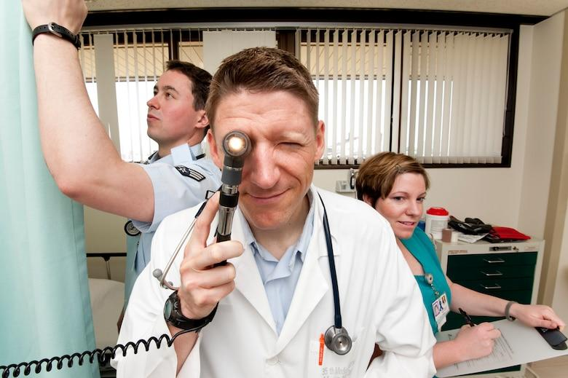
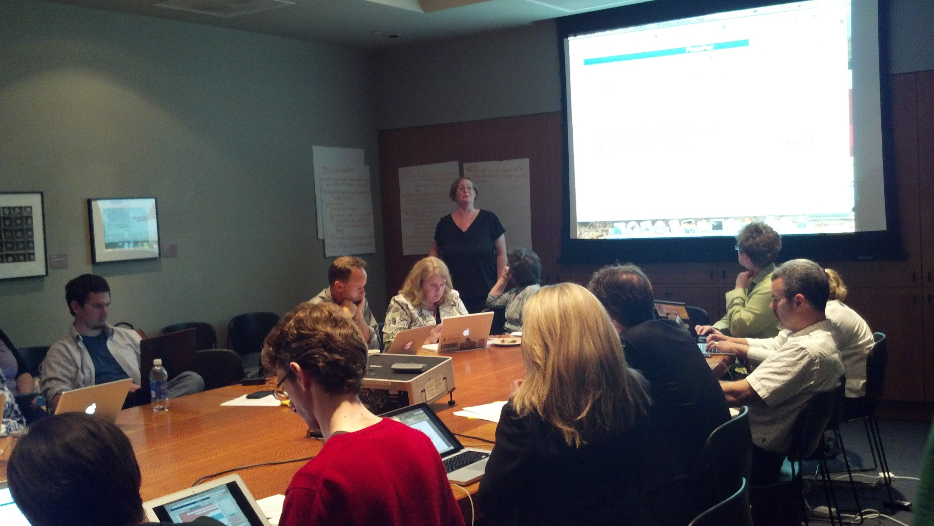
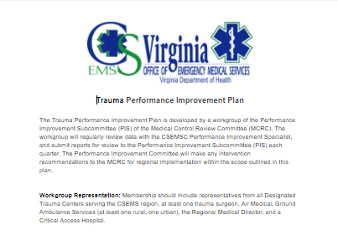
What we do...
Regional Infrastructure
Regional Medical Direction
Regional Planning
Regional Coordination
Notes:
Regional Infrastructure - Maintain local office/access point, continuity of operations, support staff
Regional Medical Direction - Regional medical director, protocols, medication and supply exchange programs
Regional Planning - Hospital diversions, MCI/WMD/EID, Patient Triage
Regional Coordination - Performance Improvement, RSAF grant support and review, CISM/Peer support for provider mental health, regional awards, Instructor network, Consolidated testing

Slide 139


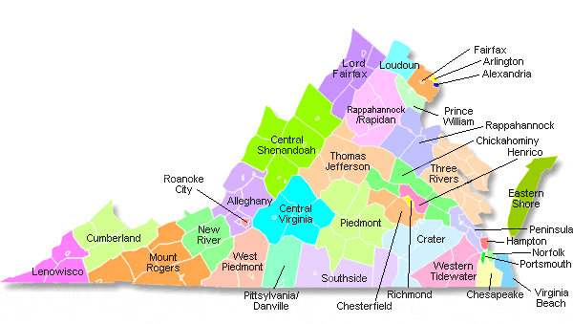
Located in Staunton, VA
Counties of Augusta, Bath, Highland, Rockbridge, and Rockingham
Cities of Buena Vista, Harrisonburg, Lexington, Staunton and Waynesboro.
Notes:
CSEMS covers 10 localities in the Central Shenandoah Valley, the intersection of I-81, and I64, and a population of nearly 300,000, served by approximately 1,700 EMS providers in 57 agencies, 3 accredited education programs, and 51 education coordinators.
Small cities ranging from 25k - 50k, and Virginia’s least populous county in rural, mountainous territory. Served by two community hospitals and two critical access hospitals.
No trauma centers within the region, so planning for patient triage is critical to support positive patient outcomes.

Slide 140


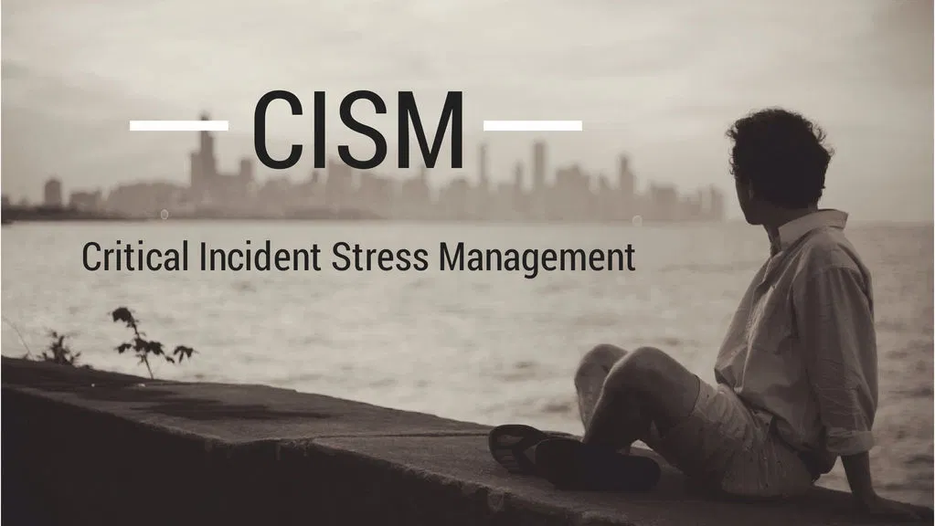
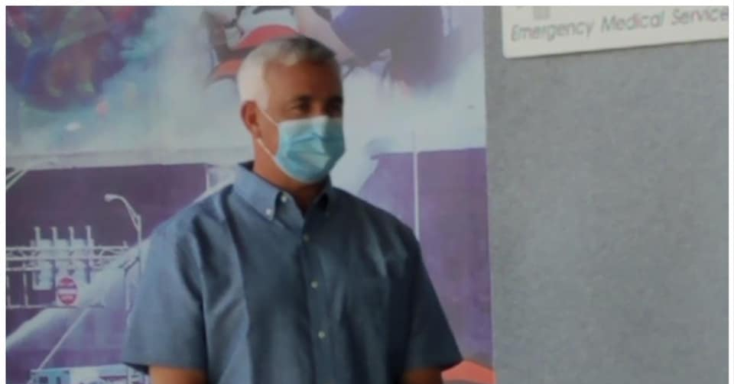
Unique to CSEMS
American Heart Association Training Center
National Association of EMTs Training Center
Regional CISM Team
Medical Control Review Committee
Notes:
Key unique features to the region
One of Virginia’s largest AHA Community Training Centers, providing nearly 10,000 certifications per year.
Recent approval as NAEMT Training Center
Volunteer CISM team, currently discussing a pilot program to improve mental health services for EMS by partnering with mental health professionals.
Medical Control Review Committee drives most of the clinical work in the region, made up of medical directors and EMS providers, chaired by Regional Medical Director

Slide 141
Staffing Model
Regional Director
Technical Resource Specialist
Administrative Coordinator
Performance Improvement Specialist

Slide 142


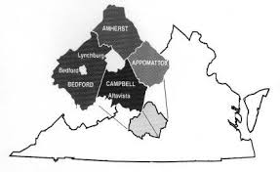
Located in Lynchburg, VA
Counties: Amherst, Appomattox, Bedford, and Campbell
Cities/Towns: Lynchburg City and Town of Bedford
Notes:
BREMS covers Planning District 11- which covers 5 counties (Amherst, Appomattox, Bedford, and Campbell) and the Town of Bedford and the City of Lynchburg. Regionally population around 260,000 and it can increase during the time the 4 area colleges are in full session. We have around 975 EMS providers total and 39 EMS agencies. We work with Central Virginia Community College (CVCC) to provide quality EMS programs in the region. We currently have approximately 25 Education Coordinators.
We are a combination of rural and urban with mountainous terrain in many of the rural counties. We have the Blue Ridge Parkway, James River, and Smith Mountain Lake, which all provide for unique EMS opportunities.
We are served by Centra Health Hospital System. Lynchburg General Hospital is Lynchburg and we work very closely with Centra Bedford Memorial Hospital (Bedford County), Centra Grenta Medical Facility (Pittsylvania County), and we work closely with Centra Southside Hospital in Farmville.

Slide 143
Unique to BREMS
Continuous Quality Improvement Program
Medical Direction Review Committee
Provider Workgroup
Advanced Paramedic Program
Notes:
Key Points:
The CQI committee- responsible for assuring and improving the quality of prehospital care within EMS systems that are served by the Blue Ridge Emergency Medical Services Council (BREMS).
Medical Direction Review Committee- Reviews of the CQI process by the regional MDC committee, to include review of benchmarks and outcomes.
Provider Workgroup- Provider Workgroup is a small subcommittee of the REgional MDC committee. This workgroup is determined through an application process. Committee members work with the MDC committee and the CQI committee directly, and help assist in protocol revisions and data analysis.
Advanced Paramedic Program- A group of around 35 in the BREMS region; the providers in this group fall under the Paramedic protocols but they have had specialized training under the RMD for additional skills, thus patient care involving APP Protocols, which are a small group of directives involving care limited to the APP group, will have additional review and case discussion to ensure high quality care, and encourage growth of critical thinking skills. The APP group is specifically overseen by the RMD, and as such the RMD will guide and oversee additional CQI projects related to this group.

Slide 144
OEMS/VDH
BREMS Board of Directors
BREMS Regional Director
Regional Medical Director
Field Coordinator
Administrative Assistant
Training Coordinator
Notes:
The BREMS Regional Director and RMD are currently state employees. We are in the process of recruitment for the Performance Improvement Specialist Position and hope to have this person hired after the first of the year.

Slide 145
OEMS/VDH
REMS Board of Directors
REMS Program Director
Regional System
Coordinator
Regional Field
Coordinator
Office Manager
Regional Education Coordinator
Notes:
Rappahannock is the newest Regional Office of EMS. We are still in the process of transitioning over, so at this point only the regional director is part of OEMS staff. The balance of the council remains as a traditional office. There were 7 positions originally. One position is now under OEMS, two were frozen due to budget a few years back, and four are still employed by the REMS Council.

Slide 146
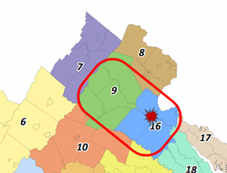
Rappahannock Regional EMS Office
Located in Fredericksburg, VA
Geography includes Planning District 9 and Planning District 16
City of Fredericksburg as well as the Counties of Caroline, Culpeper, Fauquier, King George, Orange, Rappahannock, Spotsylvania, Stafford, and Westmoreland - Colonial Beach.
Notes:
The region has a diverse civilian and military industry covering 2,700 square miles ranging from very rural to urban. The EMS system serves major transportation arteries of Interstate-95, Interstate-66, US Route 301, US Route 29,US Route 17, and US Route 1 with a regional population greater than 500,000. The highly integrated regional EMS system includes 46 EMS agencies with more than 3,200 EMS providers and they respond to more than 50,000 calls for service annually. In order to provide appropriate care the EMS system utilizes five acute-care hospitals, one free-standing ED, one Level II Trauma Center, and three stroke centers to provide healthcare to the ill and injured patients.

Slide 147
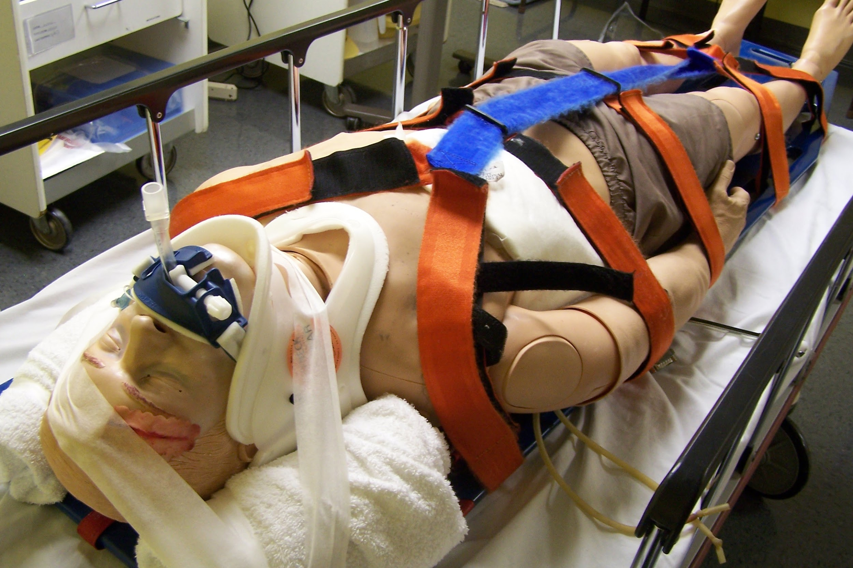
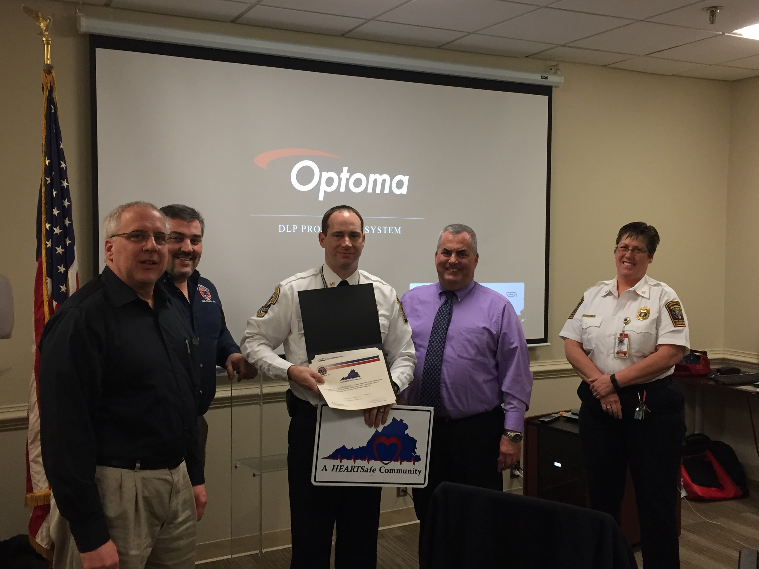
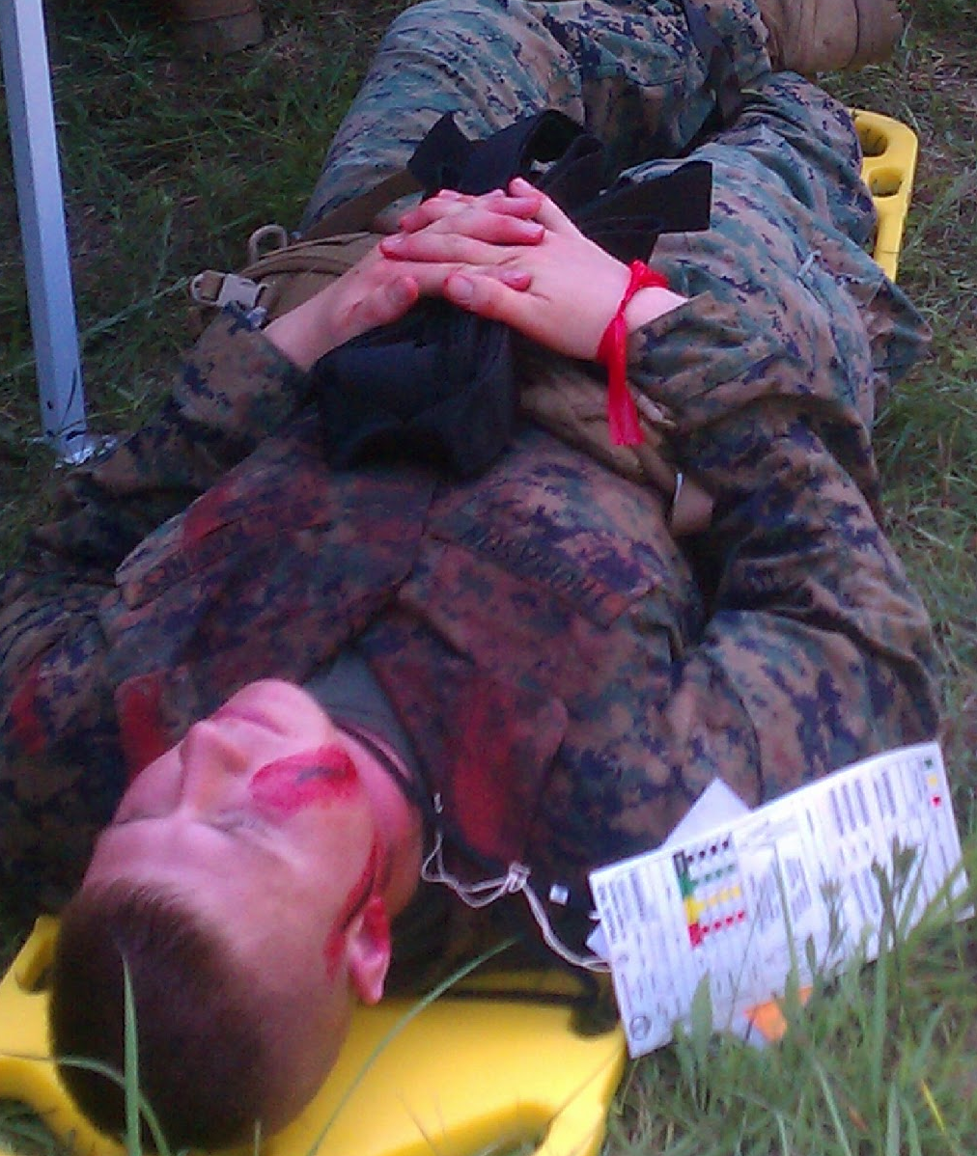
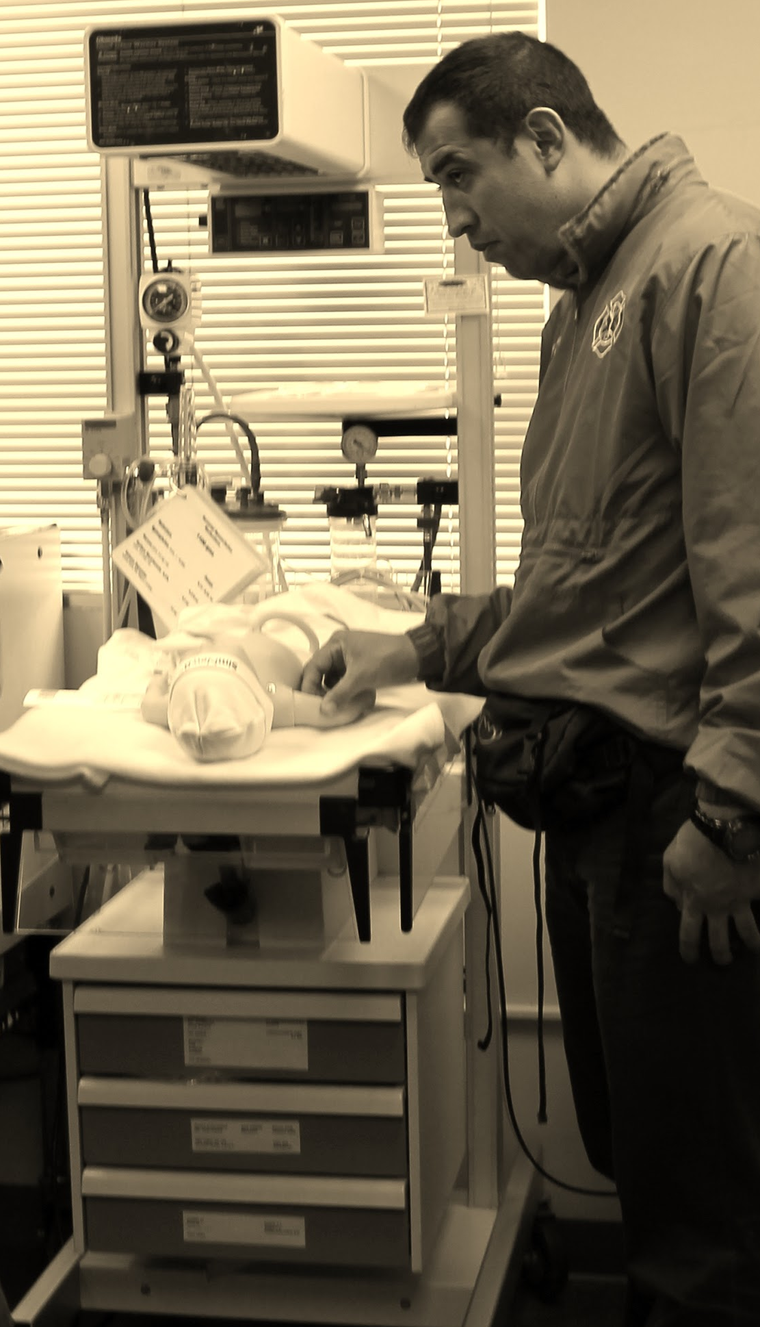
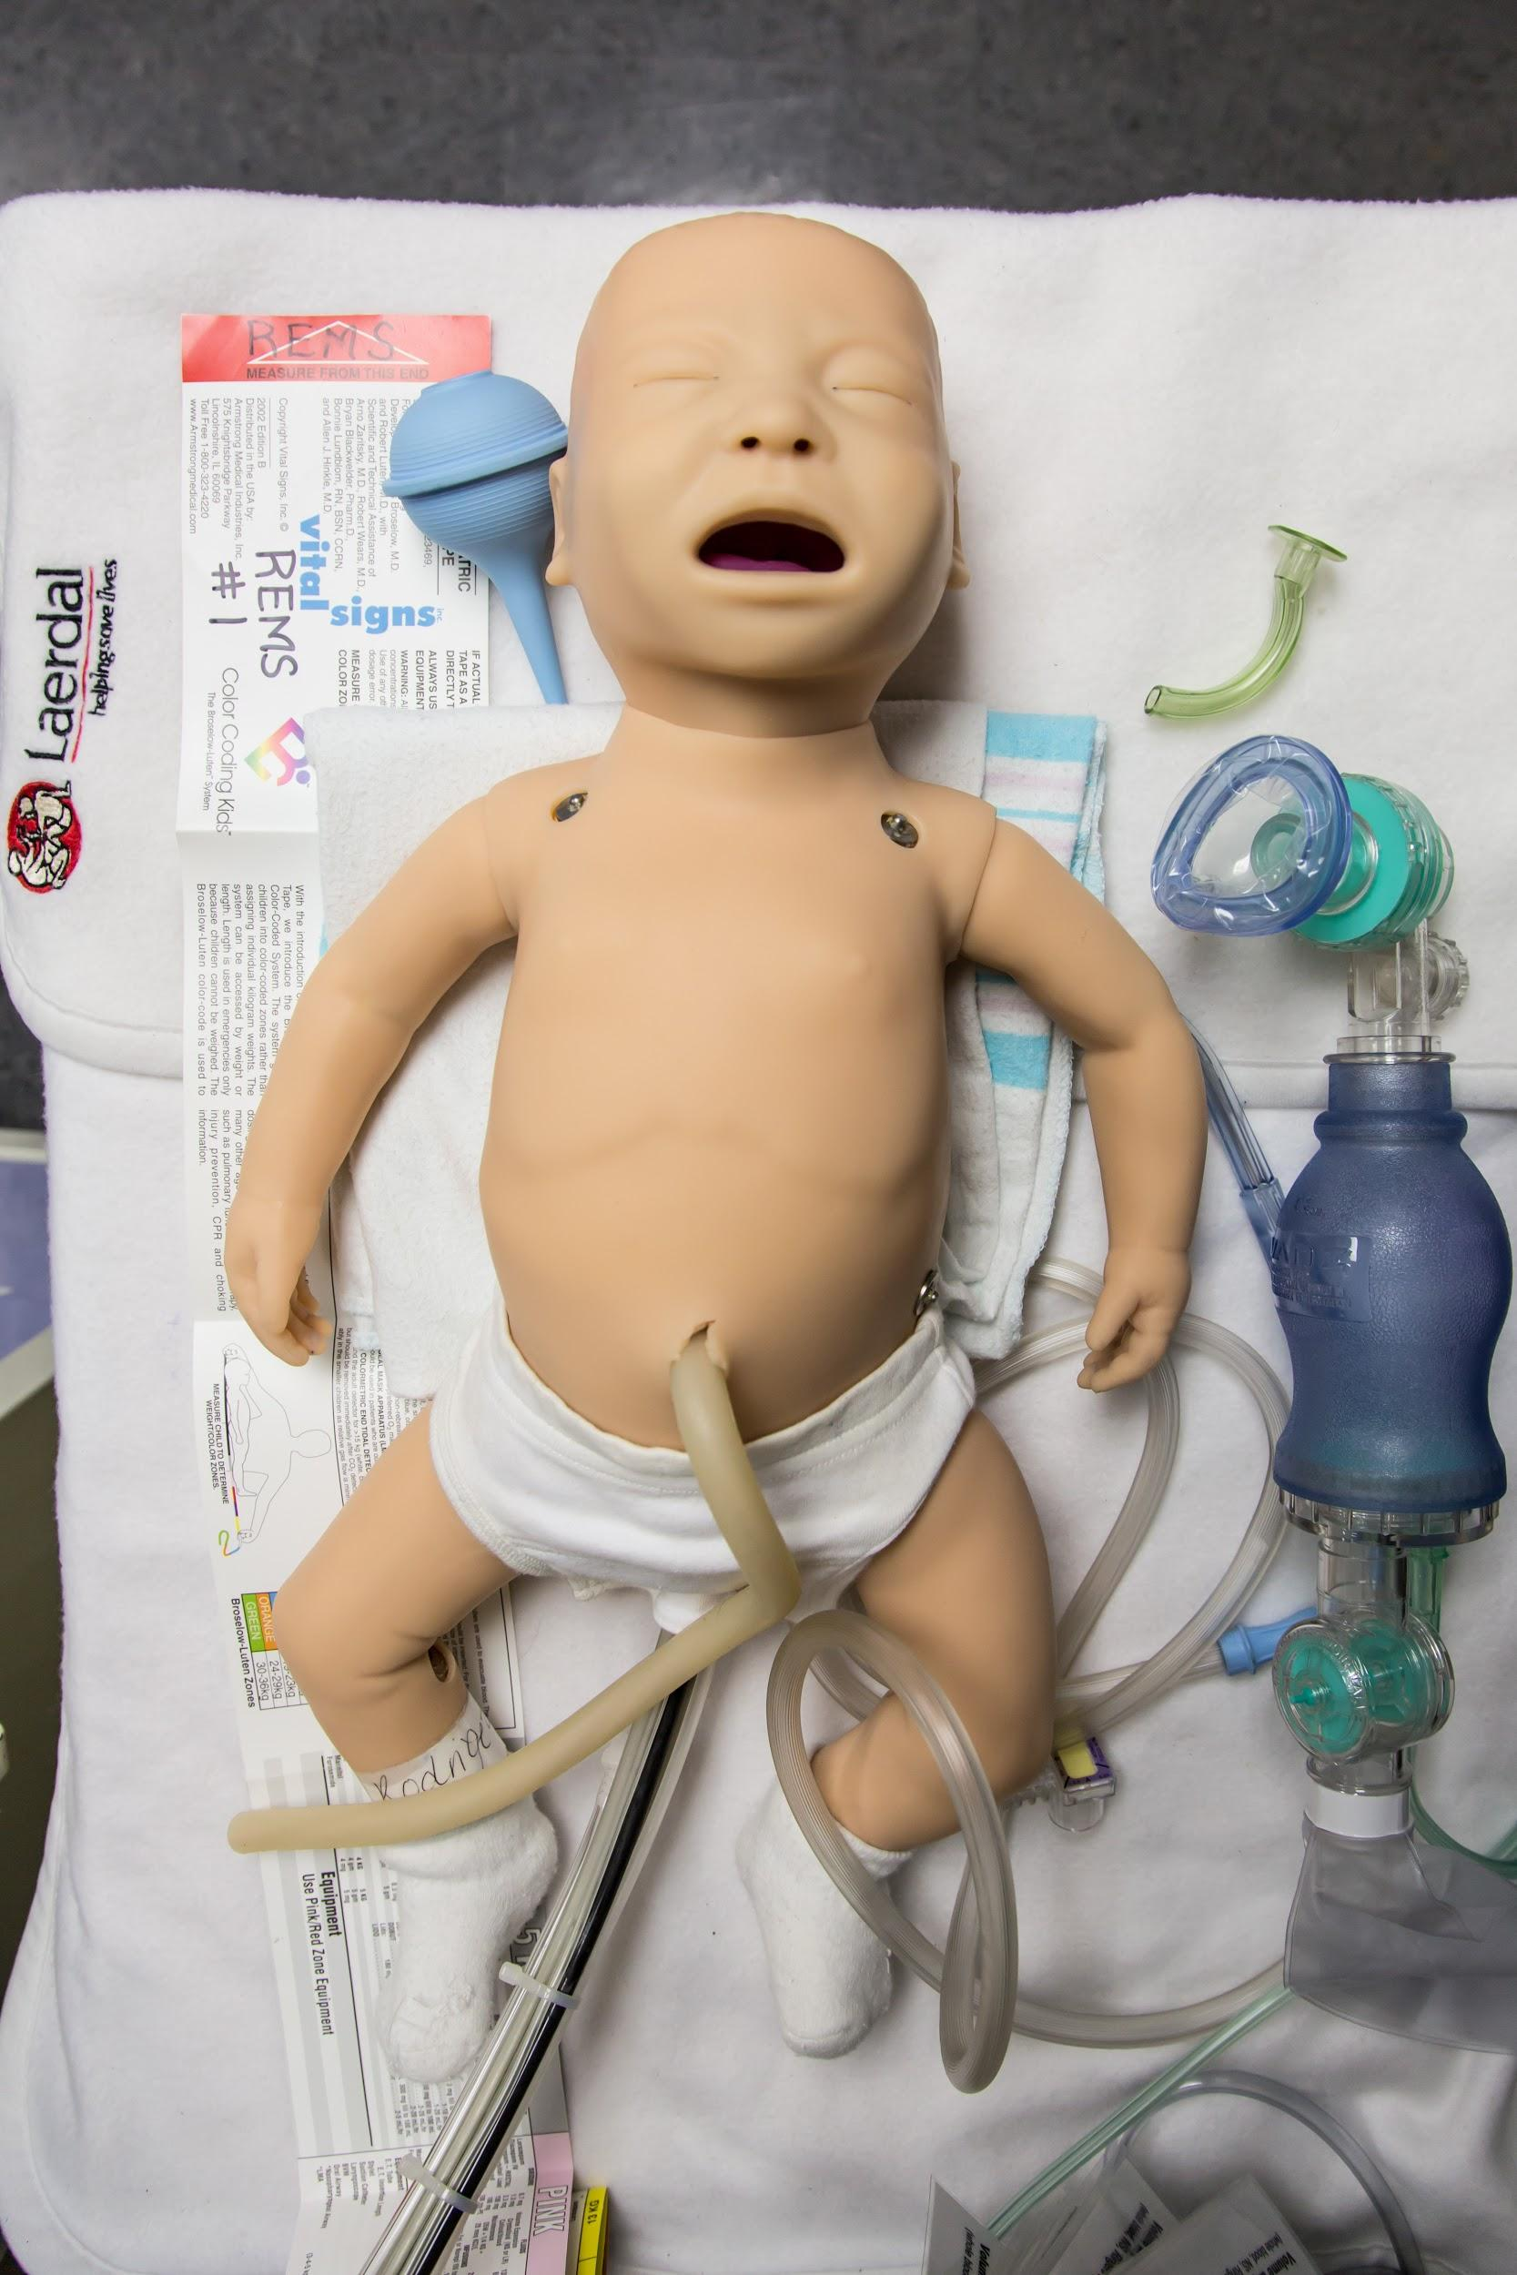
Unique to REMS
Established in 1976 - 44 years of service
International EMS Exchange Program
National Registry of EMT Advanced Psychomotor Testing Site
Regional Training and Simulation Center
Mass Casualty Incident Support
State-accredited/National Response CISM Team and Stress First Aid
Public Access Health and Safety - Stop the Bleed, 9-1-1 for Kids, etc.
Mobile Integrated Healthcare and Community Paramedicine
Notes:
The REMS Council was established in 1976 and has provided 44 years of service to the citizens of Virginia in support of the regional EMS system. The Council currently facilitates 15 regional committees with a total of more than 200 members. Membership consists of area EMS providers, citizens, physicians, hospital staff, and representation from various other health organization. These committees, guided by the region’s Strategic EMS Plan, help integrate the operations of various agencies in our service area, and steer the development of regional plans and policies. The REMS Board of Directors has oversight over all committees. The council provides all of the traditional and OEMS contract-mandated services, but there are a few things that are unique to this operation ….
The region hosts an annual exchange program with EMS Providers in Germany. There is a group that goes to Europe and then a group that comes here on a rotating basis. This program has been very well received and provides great interaction between quite a variety of EMS operations. We have also hosted several other exchange programs including EMS providers from Rwanda and Columbia who spend time learning about US EMS operations.
National Registry of EMT Advanced Psychomotor Testing Site - The council coordinates the testing of EMS provider for initial certification at both the basic and advanced life support levels. The REMS Council has conducted more than 50 NREMT sites for ALS providers who are advancing their certifications. We receive and provide testing for providers from across Virginia as well as many other states (Alaska is our furthest participant thus far).
The REMS Council manages and maintains a high-fidelity Regional Training and Simulation Center with a full complement of simulation equipment ranging from human patient simulators to advanced training labs with A-V capabilities, complete EMS training equipment, and an actual ambulance box imbedded into one of the training labs.
The REMS Council is active in providing Mass Casualty Incident Support for various regional drills and exercises. We provide evaluators, equipment, moulage technicians, and technical support for any requests across the region. The most recent drill, in 2019, involved more than 75 patients and replicated the improvised explosive device attack from Boston. The drill was held during an actual 5K run, utilizing the 100+ participants to add realism and logistic complications for the responding EMS personnel.
REMS operates a State-accredited CISM Team which also responds to National service requests as needed. The regional CISM Team is composed of more than 50 mental health and peer public safety personnel that provide defusings, debriefings, and other services at the request of the EMS system and ancillary personnel (hospital requests, VDOT fatality response, law enforcement, etc). In FY2019 there were 44 calls for service where 393 individuals were contacted. The region also provides Stress First Aid training and encourages a variety of peer-support and mental health services throughout the region.
The Council provides an avenue for public access to Health and Safety information in order to have a better prepared community. We offer programs such as Hands-only CPR, Stop the Bleed, and 9-1-1 for Kids. The council is the statewide reviewer for HeartSafe Community applications and has created other recognition programs such as HeartSafe Business and HeartSafe Schools to promote community awareness for cardiovasular disease and to create a trained public to respond to emergencies and render aid until EMS arrives.
The REMS Council has a multi-disciplinary task force that reviews and provides services for Mobile Integrated Healthcare and Community Paramedicine. Previously we have administered a small program in a single jurisdiction and we are currently working to develop a comprehensive multi-jurisdictional process to ensure health and wellness for the citizens that identifies and fills gaps in the healthcare system.

