Slide 1
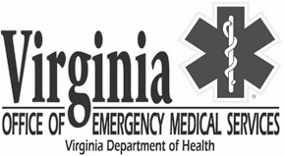
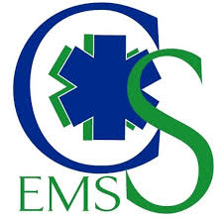
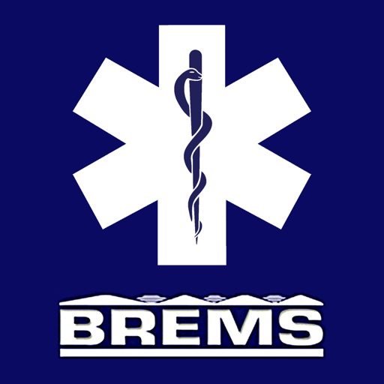
Regional Hybrid EMS Offices
Notes:
Model developed by MOA in 2018
Formally launched in October 2019 with CSEMS.
May 2020, BREMS initiated transition
June 2020, REMS initiated transition
Similar functions of the regional EMS Councils, but directly managed by OEMS staff.

Slide 2
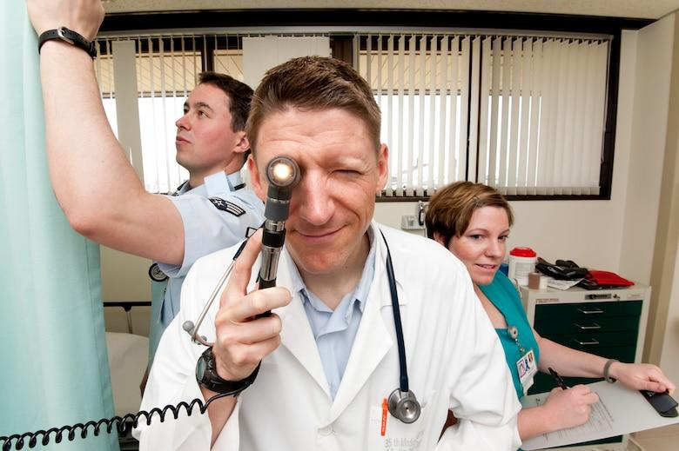
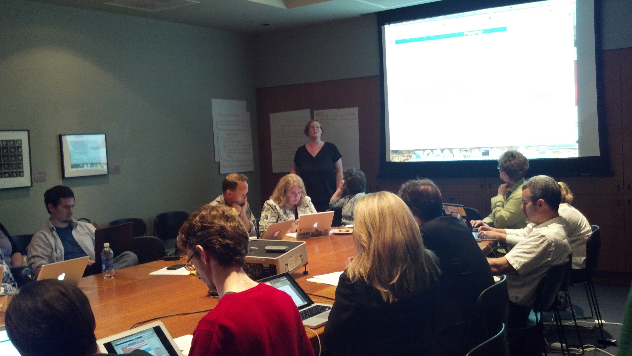
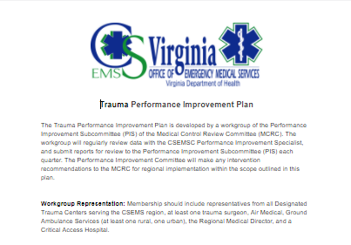
What we do...
Regional Infrastructure
Regional Medical Direction
Regional Planning
Regional Coordination
Notes:
Regional Infrastructure - Maintain local office/access point, continuity of operations, support staff
Regional Medical Direction - Regional medical director, protocols, medication and supply exchange programs
Regional Planning - Hospital diversions, MCI/WMD/EID, Patient Triage
Regional Coordination - Performance Improvement, RSAF grant support and review, CISM/Peer support for provider mental health, regional awards, Instructor network, Consolidated testing

Slide 3
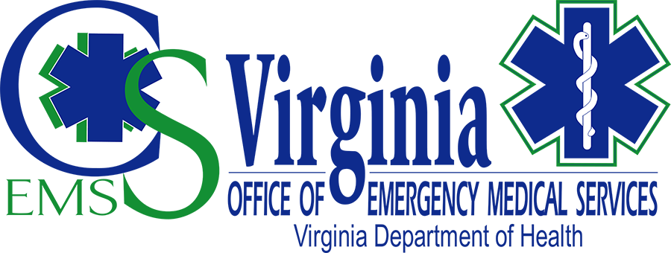
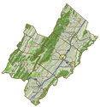
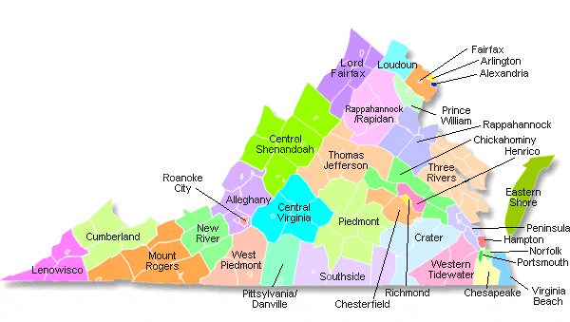
Located in Staunton, VA
Counties of Augusta, Bath, Highland, Rockbridge, and Rockingham
Cities of Buena Vista, Harrisonburg, Lexington, Staunton and Waynesboro.
Notes:
CSEMS covers 10 localities in the Central Shenandoah Valley, the intersection of I-81, and I64, and a population of nearly 300,000, served by approximately 1,700 EMS providers in 57 agencies, 3 accredited education programs, and 51 education coordinators.
Small cities ranging from 25k - 50k, and Virginia’s least populous county in rural, mountainous territory. Served by two community hospitals and two critical access hospitals.
No trauma centers within the region, so planning for patient triage is critical to support positive patient outcomes.

Slide 4
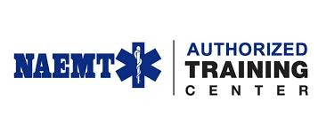
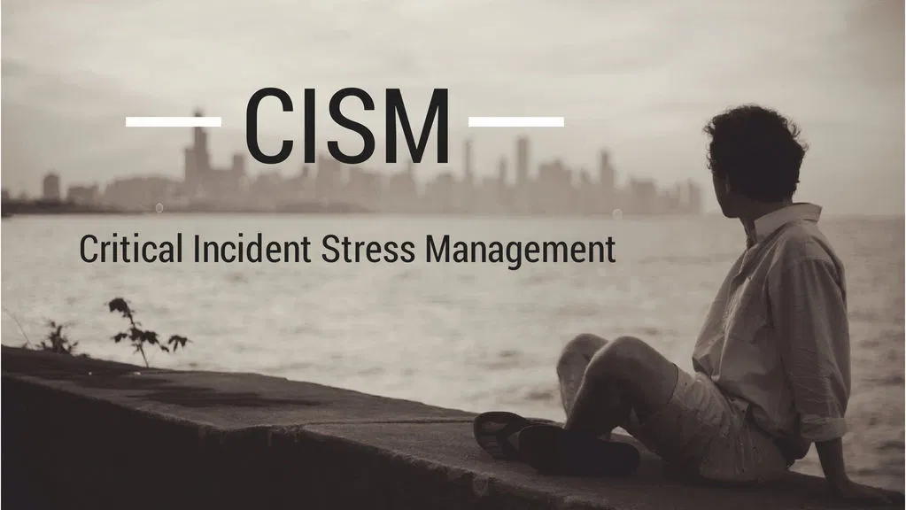
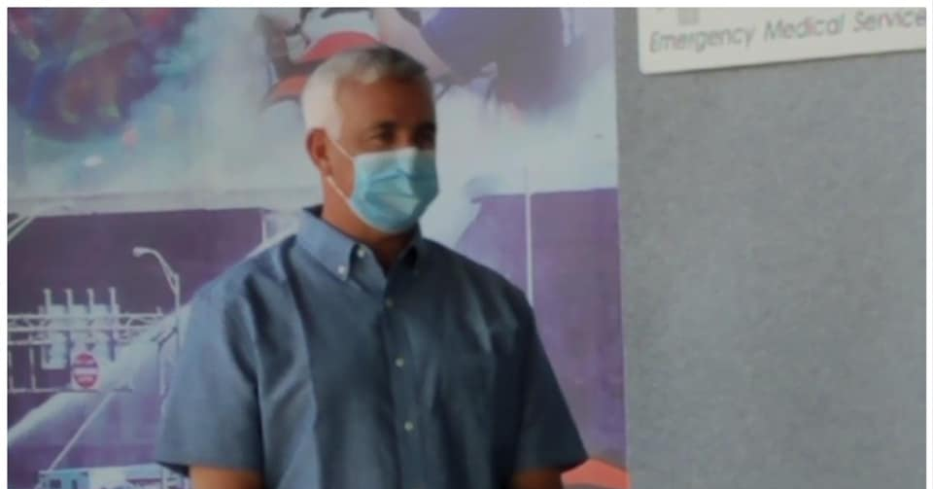
Unique to CSEMS
American Heart Association Training Center
National Association of EMTs Training Center
Regional CISM Team
Medical Control Review Committee
Notes:
Key unique features to the region
One of Virginia’s largest AHA Community Training Centers, providing nearly 10,000 certifications per year.
Recent approval as NAEMT Training Center
Volunteer CISM team, currently discussing a pilot program to improve mental health services for EMS by partnering with mental health professionals.
Medical Control Review Committee drives most of the clinical work in the region, made up of medical directors and EMS providers, chaired by Regional Medical Director

Slide 5
Staffing Model
Regional Director
Technical Resource Specialist
Administrative Coordinator
Performance Improvement Specialist

Slide 6
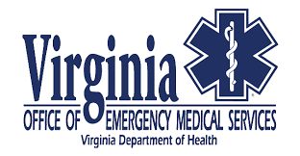
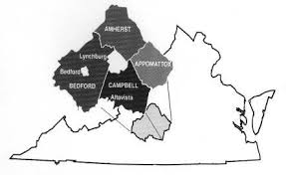
Located in Lynchburg, VA
Counties: Amherst, Appomattox, Bedford, and Campbell Cities/Towns: Lynchburg City and Town of Bedford
Notes:
BREMS covers Planning District 11- which covers 5 counties (Amherst, Appomattox, Bedford, and Campbell) and the Town of Bedford and the City of Lynchburg. Regionally population around 260,000 and it can increase during the time the 4 area colleges are in full session. We have around 975 EMS providers total and 39 EMS agencies. We work with Central Virginia Community College (CVCC) to provide quality EMS programs in the region. We currently have approximately 25 Education Coordinators.
We are a combination of rural and urban with mountainous terrain in many of the rural counties. We have the Blue Ridge Parkway, James River, and Smith Mountain Lake, which all provide for unique EMS opportunities.
We are served by Centra Health Hospital System. Lynchburg General Hospital is Lynchburg and we work very closely with Centra Bedford Memorial Hospital (Bedford County), Centra Grenta Medical Facility (Pittsylvania County), and we work closely with Centra Southside Hospital in Farmville.

Slide 7
Unique to BREMS
Continuous Quality Improvement Program
Medical Direction Review Committee
Provider Workgroup
Advanced Paramedic Program
Notes:
Key Points:
The CQI committee- responsible for assuring and improving the quality of prehospital care within EMS systems that are served by the Blue Ridge Emergency Medical Services Council (BREMS).
Medical Direction Review Committee- Reviews of the CQI process by the regional MDC committee, to include review of benchmarks and outcomes.
Provider Workgroup- Provider Workgroup is a small subcommittee of the REgional MDC committee. This workgroup is determined through an application process. Committee members work with the MDC committee and the CQI committee directly, and help assist in protocol revisions and data analysis.
Advanced Paramedic Program- A group of around 35 in the BREMS region; the providers in this group fall under the Paramedic protocols but they have had specialized training under the RMD for additional skills, thus patient care involving APP Protocols, which are a small group of directives involving care limited to the APP group, will have additional review and case discussion to ensure high quality care, and encourage growth of critical thinking skills. The APP group is specifically overseen by the RMD, and as such the RMD will guide and oversee additional CQI projects related to this group.

Slide 8
OEMS/VDH
BREMS Board of Directors
BREMS Regional Director
Regional Medical Director
Field Coordinator
Administrative Assistant
Training Coordinator
Notes:
The BREMS Regional Director and RMD are currently state employees. We are in the process of recruitment for the Performance Improvement Specialist Position and hope to have this person hired after the first of the year.

Slide 9
OEMS/VDH
REMS Board of Directors
REMS Program Director
Regional System
Coordinator
Regional Field
Coordinator
Office Manager
Regional Education Coordinator
Notes:
Rappahannock is the newest Regional Office of EMS. We are still in the process of transitioning over, so at this point only the regional director is part of OEMS staff. The balance of the council remains as a traditional office. There were 7 positions originally. One position is now under OEMS, two were frozen due to budget a few years back, and four are still employed by the REMS Council.

Slide 10
Rappahannock Regional EMS Office
Located in Fredericksburg, VA
Geography includes Planning District 9 and Planning District 16
City of Fredericksburg as well as the Counties of Caroline, Culpeper, Fauquier, King George, Orange, Rappahannock, Spotsylvania, Stafford, and Westmoreland - Colonial Beach.
Notes:
The region has a diverse civilian and military industry covering 2,700 square miles ranging from very rural to urban. The EMS system serves major transportation arteries of Interstate-95, Interstate-66, US Route 301, US Route 29,US Route 17, and US Route 1 with a regional population greater than 500,000. The highly integrated regional EMS system includes 46 EMS agencies with more than 3,200 EMS providers and they respond to more than 50,000 calls for service annually. In order to provide appropriate care the EMS system utilizes five acute-care hospitals, one free-standing ED, one Level II Trauma Center, and three stroke centers to provide healthcare to the ill and injured patients.

Slide 11
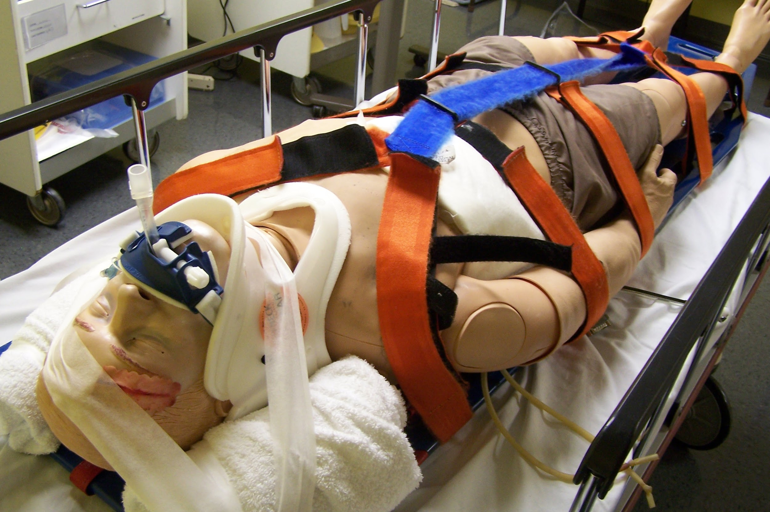
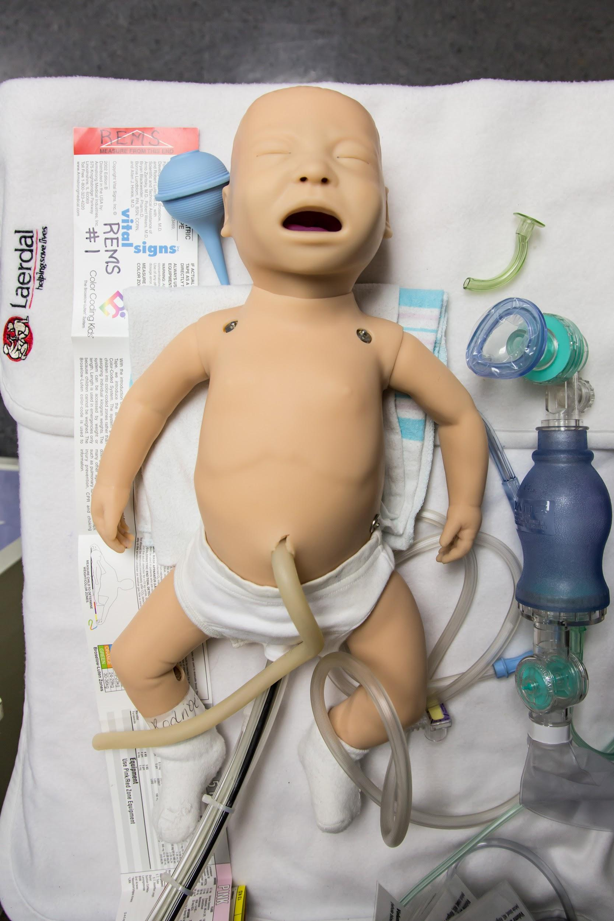
Unique to REMS
Established in 1976 - 44 years of service
International EMS Exchange Program
National Registry of EMT Advanced Psychomotor Testing Site
Regional Training and Simulation Center
Mass Casualty Incident Support
State-accredited/National Response CISM Team and Stress First Aid
Public Access Health and Safety - Stop the Bleed, 9-1-1 for Kids, etc.
Mobile Integrated Healthcare and Community Paramedicine
Notes:
The REMS Council was established in 1976 and has provided 44 years of service to the citizens of Virginia in support of the regional EMS system. The Council currently facilitates 15 regional committees with a total of more than 200 members. Membership consists of area EMS providers, citizens, physicians, hospital staff, and representation from various other health organization. These committees, guided by the region’s Strategic EMS Plan, help integrate the operations of various agencies in our service area, and steer the development of regional plans and policies. The REMS Board of Directors has oversight over all committees. The council provides all of the traditional and OEMS contract-mandated services, but there are a few things that are unique to this operation ….
The region hosts an annual exchange program with EMS Providers in Germany. There is a group that goes to Europe and then a group that comes here on a rotating basis. This program has been very well received and provides great interaction between quite a variety of EMS operations. We have also hosted several other exchange programs including EMS providers from Rwanda and Columbia who spend time learning about US EMS operations.
National Registry of EMT Advanced Psychomotor Testing Site - The council coordinates the testing of EMS provider for initial certification at both the basic and advanced life support levels. The REMS Council has conducted more than 50 NREMT sites for ALS providers who are advancing their certifications. We receive and provide testing for providers from across Virginia as well as many other states (Alaska is our furthest participant thus far).
The REMS Council manages and maintains a high-fidelity Regional Training and Simulation Center with a full complement of simulation equipment ranging from human patient simulators to advanced training labs with A-V capabilities, complete EMS training equipment, and an actual ambulance box imbedded into one of the training labs.
The REMS Council is active in providing Mass Casualty Incident Support for various regional drills and exercises. We provide evaluators, equipment, moulage technicians, and technical support for any requests across the region. The most recent drill, in 2019, involved more than 75 patients and replicated the improvised explosive device attack from Boston. The drill was held during an actual 5K run, utilizing the 100+ participants to add realism and logistic complications for the responding EMS personnel.
REMS operates a State-accredited CISM Team which also responds to National service requests as needed. The regional CISM Team is composed of more than 50 mental health and peer public safety personnel that provide defusings, debriefings, and other services at the request of the EMS system and ancillary personnel (hospital requests, VDOT fatality response, law enforcement, etc). In FY2019 there were 44 calls for service where 393 individuals were contacted. The region also provides Stress First Aid training and encourages a variety of peer-support and mental health services throughout the region.
The Council provides an avenue for public access to Health and Safety information in order to have a better prepared community. We offer programs such as Hands-only CPR, Stop the Bleed, and 9-1-1 for Kids. The council is the statewide reviewer for HeartSafe Community applications and has created other recognition programs such as HeartSafe Business and HeartSafe Schools to promote community awareness for cardiovasular disease and to create a trained public to respond to emergencies and render aid until EMS arrives.
The REMS Council has a multi-disciplinary task force that reviews and provides services for Mobile Integrated Healthcare and Community Paramedicine. Previously we have administered a small program in a single jurisdiction and we are currently working to develop a comprehensive multi-jurisdictional process to ensure health and wellness for the citizens that identifies and fills gaps in the healthcare system.

