Slide 1
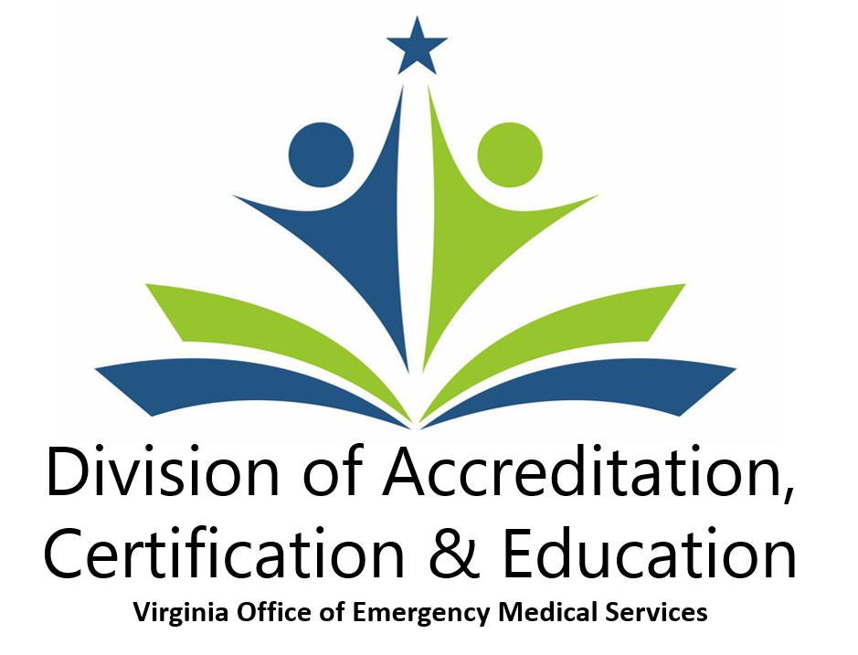
Notes:
Photo: Roanoke Fire-EMS (Western EMS Council)
Lead Presenter: Chad
Total Time: 60 minutes
Resources Needed:
A/V – Projector
Course Enrollment Forms
Goals:
Explaining EMS Scholarship and Grant process
Activity: (XX minutes)
XX

Slide 2
Division of Accreditation, Certification & Education
The ACE Division—as we are known—is the most publically facing division in the Office.
  60-70% of calls and e-mail messages coming into the Office are for the ACE Division staff. Our staff:
    interact with 36,000 + EMS providers and 10,000 + individuals in reentry,
    issue over 5,000 new provider level certifications per year,
    certify and oversee 650 + Education Coordinators and 75 + ALS Coordinators.
    approve on average 335 + initial certification courses and 1,070 continuing education programs.
Notes:
Presenter: Warren
Explain where our physical location for DED

Slide 3
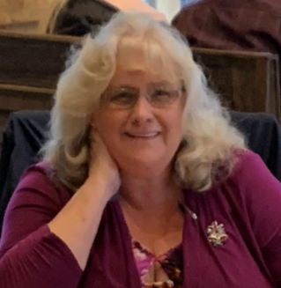


Division of Accreditation, Certification & Education
Debbie Akers
Director, Division of Accreditation, Certification & Education
Chad Blosser
Education Program Manager
Vacant
Accreditation Program Manager
Notes:
Presenter: Warren
13 seconds - Friends theme song to play when slide opens
Introduce the staff of OEMS
Each staff member will explain their sections following this slide

Slide 4

ACE Division Manager
Debbie Akers
Director, Division of Accreditation, Certification & Education
Continuing Education Certification
National Registry Liaison Medical Direction Committee
Toni Twyman
Certification Issues Testing Problems
Challenges/Reciprocity/Legal Recognition
Norma Howard
General Information CE Questions
Re-Entry Inquires CE Report Problems
Jackie Hunter
EMS Scholarship
Accreditation Site Visit Coordinator
Notes:
Presenter: Debbie
Introduction of role and support team

Slide 5

Education Program Manager
Chad Blosser
Education Program Manager
Education Coordinator Program
Virginia EMS Scholarship Virginia EMS Portal
Training and Certification Committee
Tracie Jones
Course Approvals Changes to Courses
Customized CE
Crystal Cuffley
OEMS Help Desk Technician
OEMS-AppSupport@vdh.virginia.gov
Notes:
Presenter: Billy
Introduction of role and support team

Slide 6
Accreditation
Accreditation is an effort to assess the quality of institutions, programs and services, measuring them against agreed-upon standards and thereby assuring that they meet those standards.
In the case of post-secondary education and training, there are two kinds of accreditation: institutional and programmatic (or specialized). Institutional accreditation helps to assure potential students that a school is a sound institution and has met certain minimum standards in terms of administration, resources, faculty and facilities.
Programmatic (or specialized) accreditation conducts an in-depth assessment of specialized or professional programs to ensure that education provided meets acceptable levels of quality.

Slide 7
Accreditation
The ACE Division administers accreditation for EMS educational programs across the Commonwealth.
  Develop, administer and oversee state accreditation of EMT and Advanced EMT programs.
  Liaise with the Committee on Accreditation of Educational Programs for the Emergency Medical Services Professions (CoAEMSP) which oversees accreditation of paramedic training programs in the United States.

Slide 9
Certification
ACE Division staff manage and administer the certification process for all EMS providers in the Commonwealth. The ACE staff work closely with National Registry (NREMT) to ensure certification meets or exceeds their requirements.
The process includes:
  oversight of certification programs,
  administration of psychomotor testing for all levels,
  monitoring certification data sharing with National Registry of EMT’s, and
  issuing state certification.

Slide 10
Certification (cont)
Basic Life Support (BLS) programs require the successful completion of:
    An approved initial certification program.
    A state administered psychomotor examination.
    A National Registry administered cognitive examination.
Advanced Life Support (ALS) programs require the successful completion of:
    An approved initial certification program.
    A National Registry administered psychomotor examination.
    A National Registry administered cognitive examination.

Slide 11
Certification (cont)
The ACE Division also oversees the awarding of certification for individuals coming into the Commonwealth from other states or territories:
  Reciprocity – recognition of a National Registry certification from someone who was not trained in Virginia.
  Legal Recognition – recognition of a certification from a provider in another state who does not have a National Registry certification.
  Challenge – recognition of a valid medical license held by a nurse, nurse practitioner, physicians assistant or a medical or osteopathic doctor allowing them to “challenge” the EMT exam without having to take an initial certification program.

Slide 14
Education
The ACE Division oversees all EMS educational programming—both initial certification and continuing education (CE)—conducted in the Commonwealth. This is accomplished through:
  a network of over 650 + certified Education Coordinators and 70 + ALS Coordinators across the state.
  working in concert with our constituent base through the Training & Certification Committee and the Medical Direction Committee—sub-committees of the EMS Advisory Board.

Slide 15
Education
  establishing minimum educational standards which must be taught through the adoption of the National EMS Education Standards
  publishing and maintaining an up-to-date Virginia Scope of Practice Procedures & Formulary.
  approval of all courses by the central office.
    monitoring of all student enrollments in initial programs, and
    receipt, processing and monitoring of all CE records submitted
  use of contracted staff by way of regionally-based EMS educators to conduct CAT 1 continuing education that meets the National Core Competency Requirements (NCCR).

