Slide 1
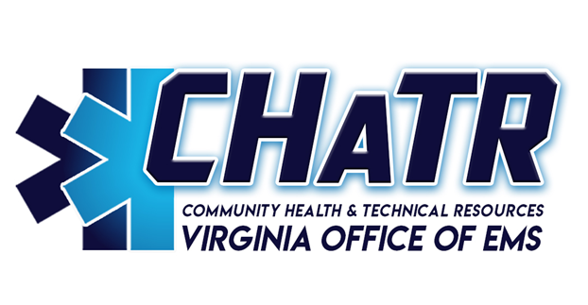
Virginia Office of EMS Division of Community Health & Technical Resources (CHaTR)

Slide 2
What we do…
Mobile Integrated Healthcare/Community Paramedicine (MIH/CP)
Disease management and preventative healthcare services
Identification of underserved populations and gaps in access to healthcare
Fostering strategic partnerships and collaboration between EMS agencies, healthcare professionals, and communities to advance population-based initiatives that will improve health outcomes
Technical Assistance liaison and subject matter expert
EMS workforce development, recruitment and retention, EMS agency resiliency, and succession planning
EMS agency leadership and management.
Regional EMS Council Oversight
Virginia Statewide EMS Plan

Slide 3
A cohesive system…
It has been generally accepted that there are portions of not only Virginia, but the country, where there are identified underserved populations and gaps in access to healthcare.
EMS strives to be an active partner in helping to bridge those gaps.
Wellness checks
Mental health evaluations
Opioid screenings
Alternate destination considerations
Referral to other healthcare providers
Point of dispensing (POD) immunization clinics
Improving Population Health is key!

Slide 4
A cohesive system…
CHATR staffers continually seek to enhance partnerships with other entities within VDH.
Office of Health Equity
Population Health Action Team
Local Health Districts
Tasks to be addressed fall in line with both the OEMS and VDH Strategic Plans.

Slide 5
Technical Assistance
Local Governments
Stakeholders
EMS Agencies
Funding (Funding Your Future)
Agency resiliency (Standards of Excellence/Emergency Services Assistance Program)
Recruitment and retention (Keeping The Best!)
Leadership training (EMS Officer Series)
Succession Planning
Integration with other healthcare entities

Slide 6
Technical Assistance
EMS System Assessments
Virginia Department of Fire Programs
VDH Office of Rural Health(CAH studies)
Agency/locality request

Slide 7
Regional EMS Council Oversight
OEMS contracts with the eight Regional EMS Councils, which are non-profit organizations. The councils collectively receive $3.1 million dollars in contract funding annually.
The councils are responsible for the development of regional EMS plans and protocols, assist in administration of EMS certification examinations, and develop and maintain regional restocking agreements and medication exchange kit programs.

Slide 8
Virginia Statewide EMS Plan
§32.1-111.3 of the Code of Virginia requires the development of a comprehensive, coordinated, statewide emergency medical services plan by OEMS.
The Board of Health must review, update, and publish the plan triennially, making such revisions as may be necessary to improve the effectiveness and efficiency of the Commonwealth’s emergency care system. The objectives of the plan shall include, but not be limited to the nineteen (19) objectives outlined in §32.1-111.3.

Slide 9
Other current projects/programs
State Medevac System
State Rural Health Plan (resource to VDH-SORH)
State Telehealth Plan

Slide 10
CHaTR Staff
Tim Perkins, CHaTR Division Director
tim.perkins@vdh.virginia.gov
Chris Vernovai, EMS Systems Planner
chris.vernovai@vdh.virginia.gov
Hannah Lyons, Program Specialist
hannah.lyons@vdh.virginia.gov
https://www.vdh.virginia.gov/emergency-medical-services/chatr/

