Slide 1
Public Information and Education

Slide 2
Public Information and Outreach
Our goal is to increase awareness of OEMS through the distribution of public information, and to provide clear and concise messages about its programs to key stakeholder groups.
EMS agencies and providers
Local governments
EMS organizations (VAGEMSA, VAVRS, etc.)
Regional EMS Councils
Fire services (Department of Fire Programs, VSFA, etc.)
Governor’s EMS Advisory Board
Trauma centers, ERs, emergency nurses and physicians

Slide 3
VDH Office of Risk Communication and Education
The OEMS Public Relations (PR) Coordinator is part of the VDH Office of Communications (COMO)
The OEMS PR Coordinator holds a dual role, representing the OEMS and COMO team.
The COMO team, comprised of seven Public Information Officers (PIOs), works together to provide updates in each of the PIOs respective health regions/offices, pertaining to upcoming events, projects, etc. We regularly collaborate on VDH projects and team assignments, including the commissioner’s email, social media, VDH in the News, Media Alerts, Clinician Letters, etc.
In times of crisis we all work together, on behalf of VDH, to respond to public health emergencies (i.e. H1N1, COVID-19) and to provide PR support at the Virginia Department of Emergency Management’s Joint Information Center (JIC).
The OEMS Public Relations Assistant’s primary job duties fall within the OEMS. However, this role also assists with COMO on Clinician Letters, Media Alerts and FOIA.

Slide 4
OEMS Program Support
The Public Relations team supports OEMS programs by:
Identifying divisions that need promotional assistance and designing program fliers, handouts, brochures, etc.
Creating a strategic marketing plan based upon identified priorities from the State EMS Plan.
Implementing a plan through a variety of outreach methods and researching new ways of reaching our target market.
Working with key stakeholder groups to promote joint programs and projects.
Managing the OEMS general email box and responding to program-related inquiries from the public.
Assisting with the coordination of program surveys via Survey Monkey.
Scheduling attendance at local conferences (i.e. VAVRS, Virginia Fire Chiefs, etc. ) to help promote OEMS.
Providing giveaway items to local organizations seeking EMS-related fliers or promotional materials.

Slide 5
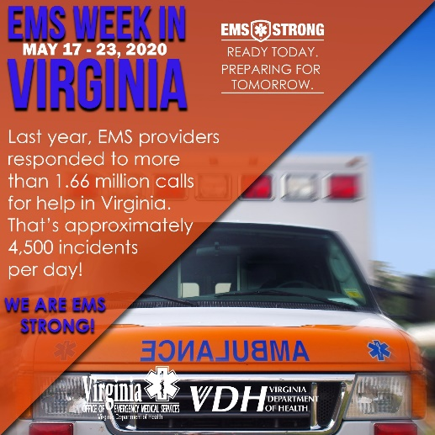
Outreach Methods
Work closely with the division managers to support and promote events and programs to our key stakeholder groups. We do this by utilizing several methods:
OEMS website
Social media (Facebook 8,200+ likes, Twitter, 5,200+ followers, YouTube)
Virginia EMS Blog
Listserv emails (apx. 32,000 contacts)
Regional EMS Councils
Media relations
Promotional mailings
Event promotion
Submitting articles to EMS/Fire Trade Publications
Designing and producing printed promotional items
Submitting stories to Commissioner’s weekly email and Governor’s weekly report

Slide 6
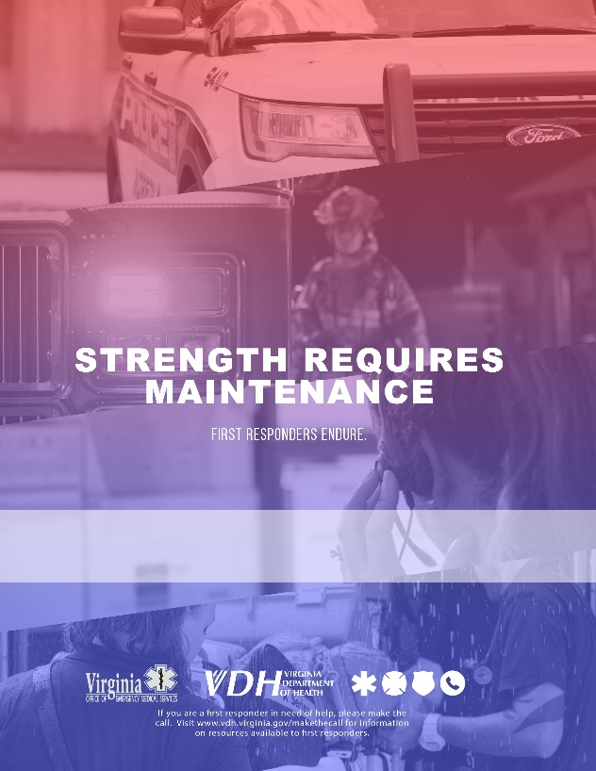
Marketing Campaigns
The Public Relations team creates, implements and manages new campaigns for the office. We do this by creating and disseminating promotional materials with a clear, concise and unified message. Past campaigns include:
#MaketheCall Mental Health Awareness
Campaign to promote Regional and Governor’s EMS Awards
Christopher Reeve recruitment campaign
Future campaigns might include:
Division of Edu. Certificate Program
Social Media campaign promoting EMS in Virginia
Public education campaign on illness and injury prevention
EMS education campaign (the EMS System or proper uses for 911)
Recruitment and retention

Slide 7
EMS Events
Work closely with OEMS program managers to promote OEMS events, in addition to the Symposium.
Work to promote national EMS events and days of recognition
EMS Week in Virginia/National EMS Week
National EMS for Children Day
Fire and EMS Memorial Week
Public Service Week
National Public Health Week
National EMS Memorial Service
National EMS Memorial Bike Ride
National Volunteer Week
National Trauma Month (Head Injury Prevention Month)

Slide 8
Virginia EMS Symposium
Provide management support and event coordination to Symposium committees.
Promote the Symposium to the EMS community through social media, e-blasts, advertising, local partners, stakeholders, etc.
Provide event planning functions:
Coordinate sponsor promotion/solicitation via sponsorship packet
Produce printed materials (catalog, on-site guide, promotional mailer, fliers, banners, signage, etc.)
Coordinate event advertising
Create event press release
Field event-related media inquiries
Manage Symposium website
Create and update Symposium App
Coordinate event giveaways and promotional items
Manage onsite signage
Organize registration packets and name badges
Manage on-site events: Flu shot clinic, Governor’s EMS Awards, nightly activities

Slide 9
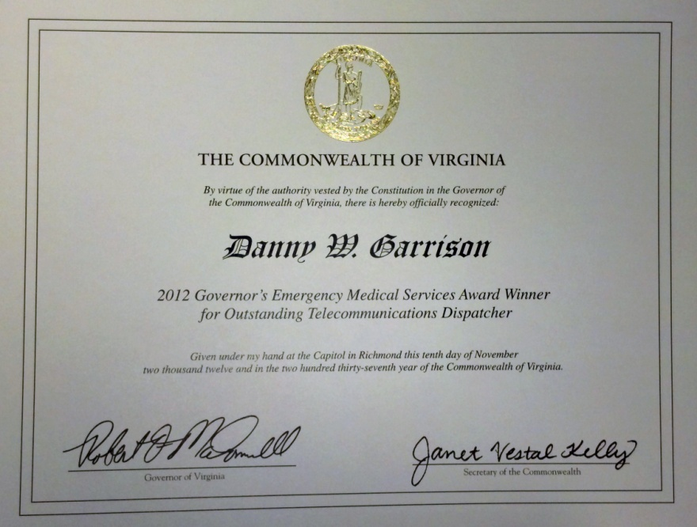
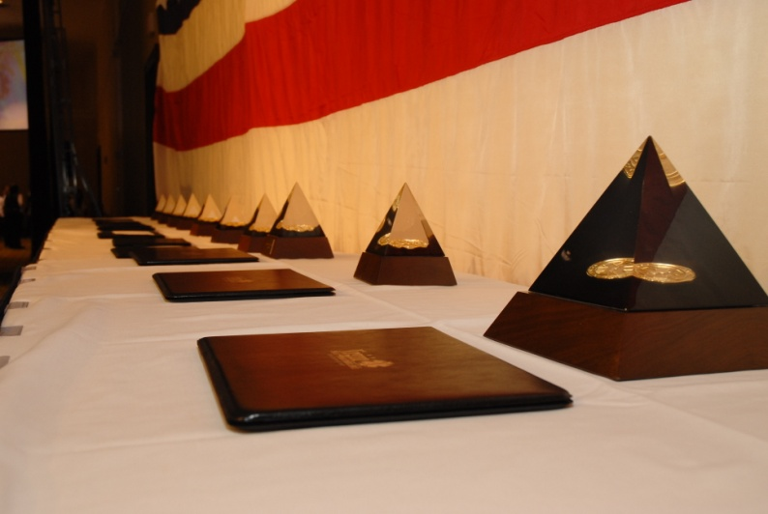
Governor’s EMS Awards
Manage all aspects of the Governor’s EMS Awards program.
Assist with the marketing and promotion of the Regional EMS Council Awards.
Work closely with the Regional EMS Councils to ensure that the best nominees are presented to the selection committee.
Organize Governor’s EMS Awards nomination committee meetings.
Work with the Governor's Office to formally recognize the winners with a signed certificate from the Governor and an engraved award.
Promote regional and state level winners to local media through press releases.

Slide 10
Internal and External Communications
Work with executive management and division managers to provide assistance with internal and external communications.
Review and edit documents (as requested) to meet the VDH communications standards.
Provide access to preapproved templates, PowerPoints, logos, etc. that have been approved by VDH. Note: Anytime OEMS logo is used, VDH logo must be used.
Assist with review and/or preparation of event and media notifications, constituent call sheets, legislative contact sheets.
Submit media alerts via Media Alert Generator (MAG) on behalf of staff who are interviewed by media. The MAG site is: www.vdh.virginia.gov/mag/
Important documents and policies* to familiarize yourself with: VDH Branding Guidance, VDH Correspondence Handbook, Guidance for Preparing Studies and Reports to the General Assembly, Social Media Guidance, Freedom of Information Act. *Documents can be found on L:drive> Division of Executive Management> Public Information Education. You can also find other helpful info and policies on the VDH intranet at: http://vdhweb/

Slide 11
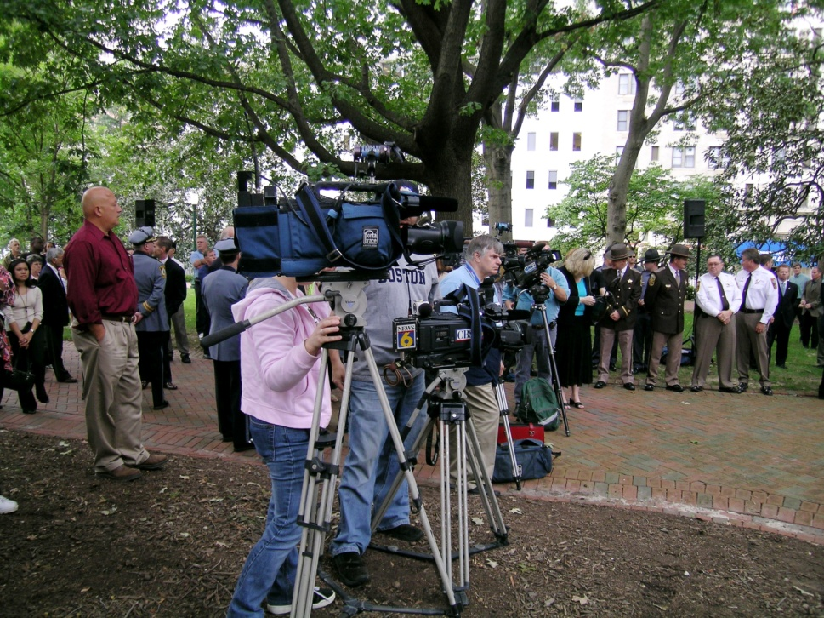
Media Relations
Manage all aspects of media relations
Outreach to media to promote programs, events, public health emergencies, etc.
Field and facilitate media calls related to EMS/VDH issues.
Work as a VDH representative in the Joint Information Center during crisis response or disaster situations.
Track media mentions of OEMS/EMS-related topics and submit to VDH in the News.
Submit Media Alerts when OEMS staff has been quoted or worked with the media.
Work with COMO team to create media training segments to be posted on TRAIN Virginia website.

Slide 12
Meet the PR Team
Marian Hunter Public Relations Coordinator Marian.Hunter@vdh.virginia.gov 804-888-9116
Tristen Graves Public Relations Assistant Tristen.Graves@vdh.virginia.gov 804-888-9115

